Slide 1
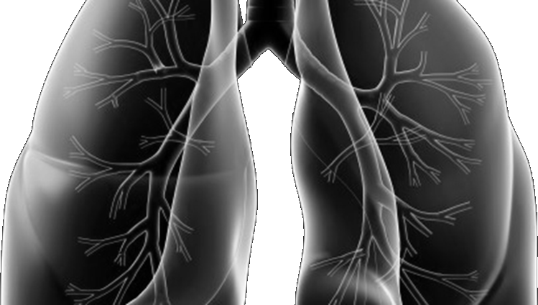




Lung-MAP Update
& S1900E Training Webinar
Welcome by
Roy Herbst, MD, Lung-MAP Chair
on Behalf of The Lung-MAP Team
October 26, 2020

Slide 2
Agenda
Study Updates
  Saiama Waqar, MD, LUNGMAP Co-Chair
S1900E Training
  Sukhmani Padda, MD, S1900E Chair
  David Gerber, MD, S1900E Co-Chair
S1900E Q & A – All attendees
Lung-MAP Logistics Refresher
  Louise Highleyman, Lung-MAP Data Coordinator
  Leah Everhart, Lung-MAP Data Coordinator
Site Coordinators Committee Tips
  Jessica O’Donovan, Lung-MAP Site Coordinators Committee Chair
Overview of Publications
  Mary Redman, PhD, Lead Biostatistician
Translational Medicine Overview
  David Kozono, MD, PhD, Lung-MAP Translational Medicine Chair
General Q & A – All attendees
There will be a Q & A session at the end of the S1900E training and at the end of the webinar.

Slide 3



Study
Updates
SWOG
ECOG-ACRIN
NRG
Alliance
Lung-MAP Master Protocol
SaiamA Waqar, MD
LungMAP Co-Chair

Slide 4
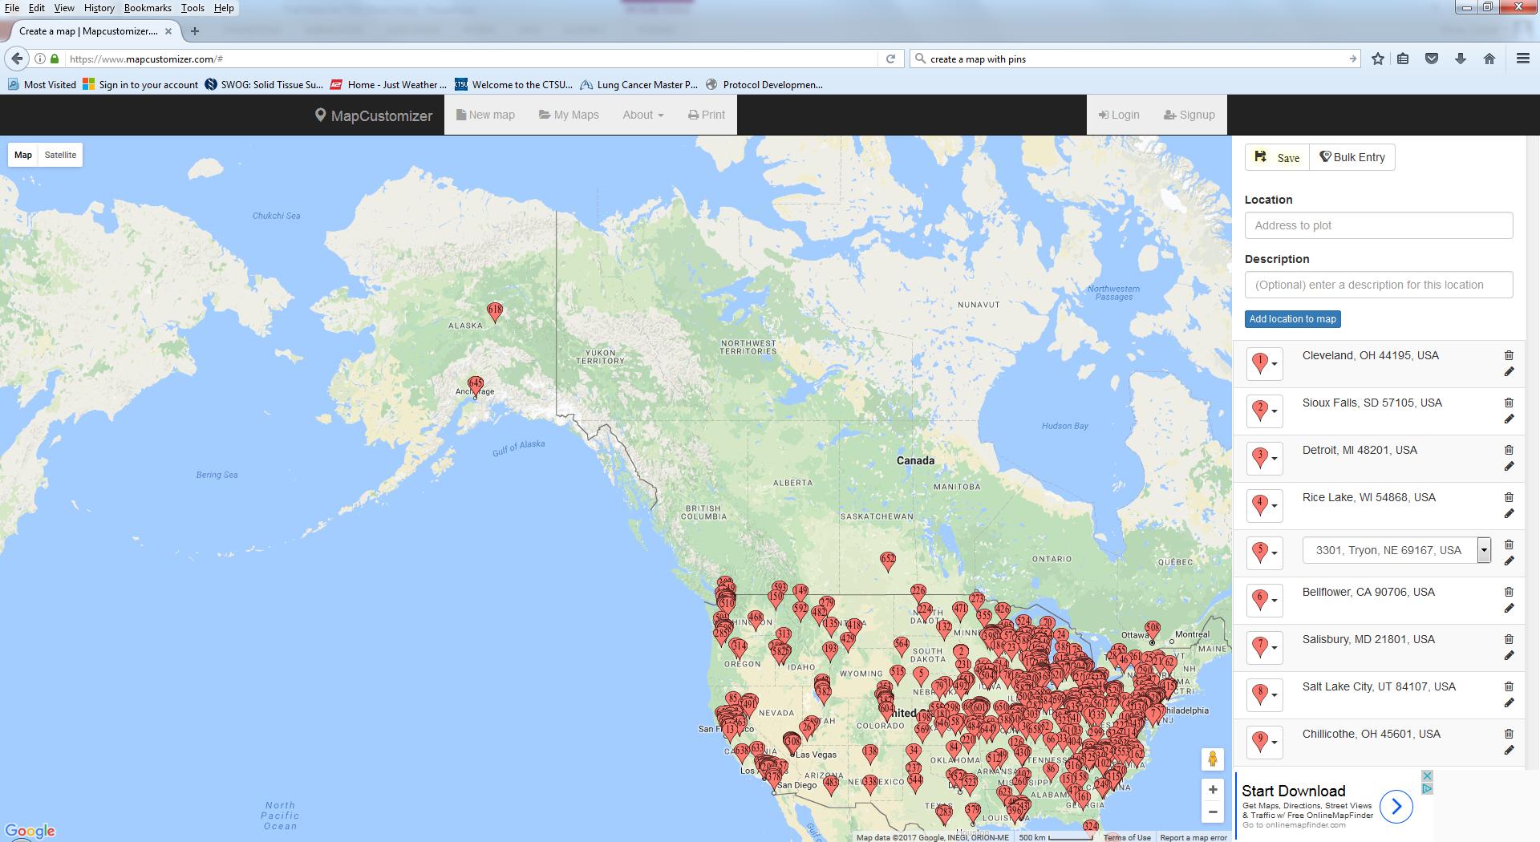
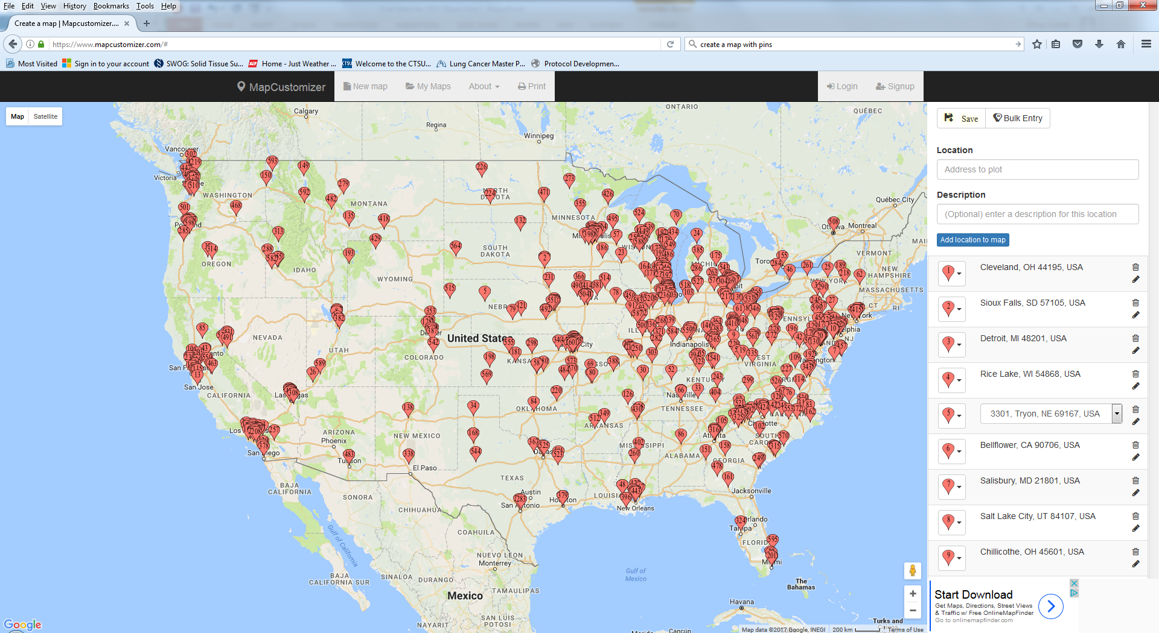
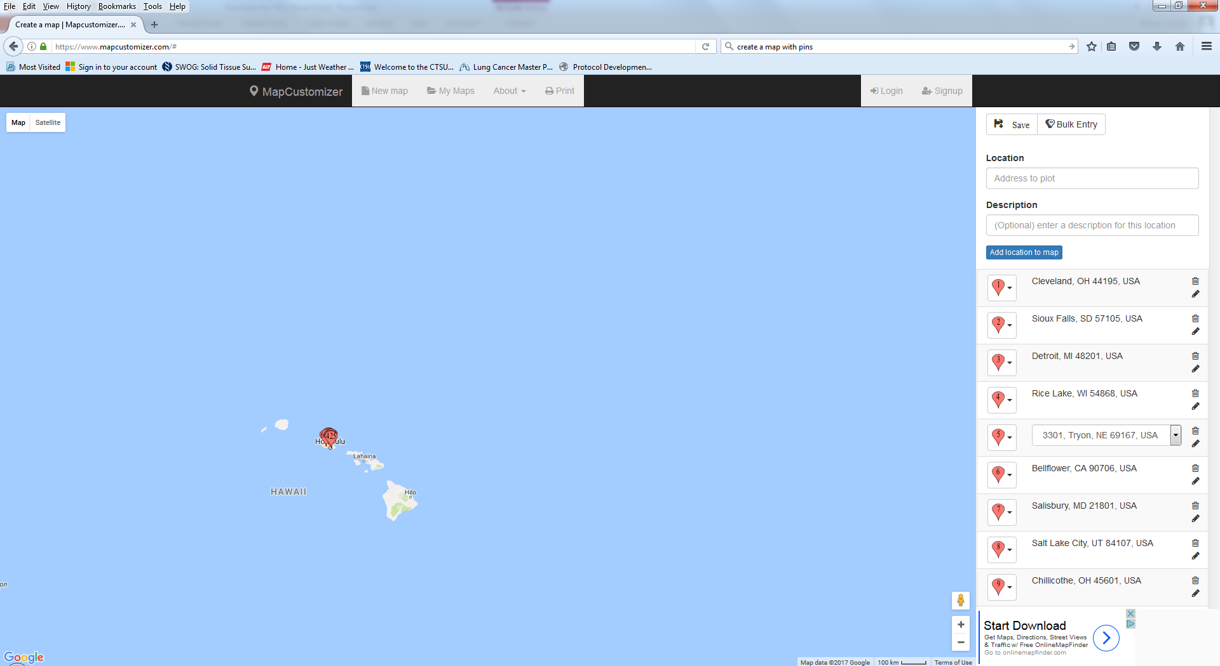
Where are we now?
Accrual as of 10/23/20
  S1400 Screening Protocol - Opened 6/16/14. Closed 1/28/19 to expand to all histologies of NSCLC with the new LUNGMAP protocol.
  1864 patients registered
  LUNGMAP Screening Protocol - Opened 1/28/19
  760 sites with LUNGMAP CIRB approval
  1681 patients registered
  962 pre-screening
  719 screening
  1144 non-squamous
  495 squamous
  42 mixed histology
  869 patients assigned to a sub-study
  247 patients have registered to sub-studies

Slide 5
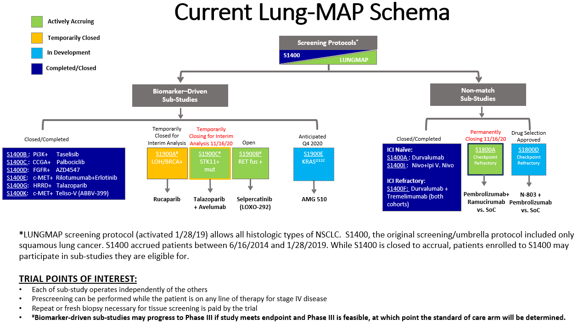

Slide 6
Current Open Sub-Study Status
Accrual as of 10/23/20
Biomarker-Driven
  S1900A (rucaparib – LOH+ and/or deleterious BRCA1/2 mutation)
  Opened 1/28/19. Temporarily closed for interim analysis.
  64 patients enrolled (27 squamous, 37 non-squamous or mixed)
  Accrual goal: 44 patients per cohort
  S1900C (talazoparib + avelumab – STK11)
  Opened 1/16/20. Temporarily closing for interim analysis 11/16/20.
  37 patients enrolled
  Accrual goal: 44 patients
  S1900B (LOXO-292 – RET Fusion +)
  Opened 2/10/20
  3 patients enrolled
  Accrual goal: 124 patients
  *Exploring potential redesign due to FDA approval of LOXO-292
Non-Match
  S1800A (ramucirumab + pembrolizumab v SOC)
  Opened 5/17/19. Permanently closing 11/16/20.
  151 patients enrolled
  Accrual goal: 144 patients
  *Plan to accrue past 144 patients to achieve 130 patients eligible

Slide 7
Anticipated Future Studies
Sub-Study Protocols in Development
S1900E (AMG-510)
Biomarker-Driven, non-squamous NSCLC
KRAS^{G12C} & co-mutations in TP53, STK11, and others
Currently under CIRB review
Anticipated activation mid-December 2020
*Overview and training will be presented next
Sub-Study Concepts in Development
S1800D (N-803 + pembrolizumab v SOC)
Non-match
Checkpoint refractory

Slide 8



S1900E Training
A Phase II Study of AMG 510 in Participants with Previously Treated Stage IV or Recurrent KRAS G12C Mutated Non-Squamous Non-Small Cell Lung Cancer
(ECOG-ACRIN Lung-MAP Sub-Study)
Anticipated Activation
mid-December
Sukhmani K. Padda, MD, Study Chair, Stanford University
David E. Gerber, MD, Study Co-ChaiR, UT Southwestern

Slide 9
S1900E Site Training Agenda
Review Drug and Disease
  AMG 510/Sotorasib
  KRAS Mutated NSCLC and Co-Occurring Mutations (TP53, STK11, KEAP1/NFE2L2/CUL3)
Review the S1900E Protocol
  S1900E Schema
  Objectives
  Eligibility
  Treatment Plan
  Treatment Discontinuation Criteria
  Snapshot of Study Calendar
  Statistics/Accrual Goals

Slide 10
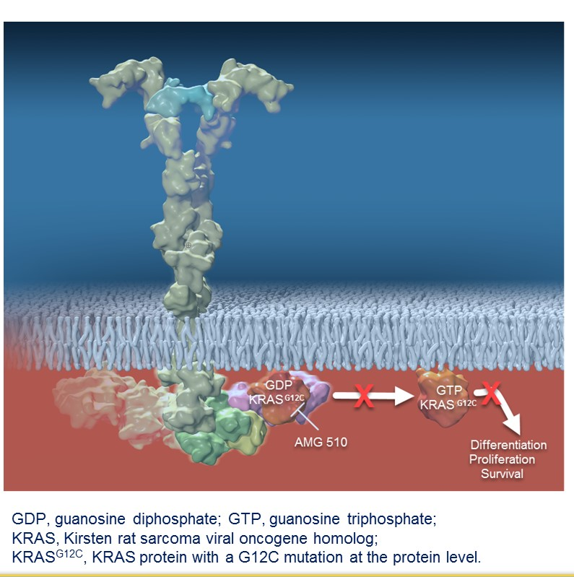
AMG 510 (Sotorasib) is a First in Class KRAS G12C Inhibitor
KRAS G12C mutation found in ~13% of lung cancer; 3% of colorectal cancer and appendix cancer; 1-3% of other solid tumors
AMG 510 is a novel, first in class, small molecule that specifically and irreversibly inhibits KRAS G12C by locking it in an inactive GDP-bound state
Fakih M et al. ASCO Annual Meeting 2019. Biernacka A et al. Cancer Genetic. 2016;209:195-198. Neumann J et al. Pathol Res Pract. 2009, 205:858-862. Zhou L et al. Med Oncol 2016;33:32.

Slide 11
AMG 510 (Sotorasib) in KRAS G12C NSCLC
N=59 NSCLC, median follow-up time 11.7 months
  ORR 32.2% (95% CI 20.6-45.6; n=19 PR)
  DCR 88.1% (95% CI, 77.1-95.1; n=19 PR/33 SD)
  mDOR: 10.9 months (1.1+-13.6); 10/19 ongoing
N=34 NSCLC at 960 mg dose
  ORR 35.3% (n=12 PR)
  DCR 91.2% (n=31 PR/SD)
Hong DS. N Engl J Med. 2020 Sep 24;383(13):1207-1217.

Slide 12
AMG 510 (Sotorasib) in KRAS G12C NSCLC
Hong DS. N Engl J Med. 2020 Sep 24;383(13):1207-1217.

Slide 13
Sotorasib Toxicity
No dose-limiting toxicities.
No treatment-related adverse events resulted in death.
LFT abnormalities observed
  AST increase: 13.2% any grade; 2.3% >= grade 3
  ALT increase: 11.6% any grade; 4.7% >=grade 3
*across dose levels and tumor types; only those >=15% any grade listed
Hong DS. N Engl J Med. 2020 Sep 24;383(13):1207-1217.

Slide 14
Co-mutations are arising as potentially predictive markers in KRAS mutated NSCLC
Most common TP53, STK11, KEAP1
Preclinical– differences in signaling, immune features, metabolic programming
Prognostic
Potentially predictive with treatment (e.g. immunotherapy)
Author | TP53 | STK11 | KEAP1
Arbour et al N=330 | 42% | 29% | 24%
Scheffler et al (n=1078) | 39% | 20% (n=101 subset) | 13% (n=101 subset)
Aredo et al (Stanford) KRAS G12C subtype | 31% | 27% | N/A
Arbour KC et al. Clin Cancer Res, 2018. 24(2): p. 334-340. Scheffler M et al. J Thorac Oncol, 2019. 14(4): p. 606-616. Aredo JV et al Lung Cancer, 2019. 133: p. 144-150. Chen Z et al. Nature. 2012 Mar 18;483(7391):613-7. Skoulidis F et al. Cancer Discovery. 2015 Aug 1;5(8):860-77. Galan-Cobo et al. Cancer Res. 2019 Jul 1;79(13):3251-3267. Skoulidis F et al. Cancer Discov 2018.

Slide 15
S1900E Schema
KRAS^{G12C}/TP53^{MUT}
Target N=40
AMG 510
960 mg QD
S1900E Sub-study
Recurrent or metastatic KRAS^{G12C} mutated non-squamous NSCLC
Received at least one prior systemic therapy
No uncontrolled brain metastasis
KRAS^{G12C}/STK11^{MUT}
Target N=25
AMG 510
960 mg QD
End of Treatment
Enrollment
KRAS^{G12C}/Other ª
Target N=40
AMG 510
960 mg QD
Primary Endpoint
Objective response rate
Secondary Endpoints
Duration of response
Progression free survival
Overall survival
Safety
Treatment Period
until disease progression, intolerance, or consent withdrawal
Clinic visits/labs every 3 weeks
Imaging every 6 weeks
If Progression
Liquid biopsy to determine resistance mechanism
ªother co-mutations (e.g., KEAP1, NFE2L2, CUL3), double or triple co-mutations (e.g., STK11/TP53, STK11/TP53/KEAP1), or no co-mutations

Slide 16
Primary Objective
To evaluate the response rate (confirmed, complete or partial) of AMG 510 in participants with KRAS^{G12C} mutated Stage IV or recurrent non-squamous non-small cell lung cancer (NSCLC).
  The response rates will be evaluated separately with cohorts defined as:
  Cohort 1 (co-mutation with TP53): Presence of TP53 mutations AND Wild Type STK11, KEAP1, NFE2L2, AND CUL3.
  Cohort 2 (co-mutation with STK11): Presence of STK11 co-mutations AND Wild Type TP53, KEAP1, NFE2L2, AND CUL3.
  Cohort 3 (all others): All participants not eligible for Cohorts 1 and 2 will be included in Cohort 3. Note that this includes participants with dual co-mutations in STK11 and TP53; co-mutations in KEAP1, NFE2L2, CUL3, or others; or lack of any co-mutations.

Slide 17
Secondary Objectives
To evaluate investigator assessed progression-free survival (IA-PFS) within each cohort.
To evaluate overall survival (OS) within each cohort.
To evaluate duration of response (DOR) among responders within each cohort.
To evaluate the frequency and severity of toxicities within the full study population (all cohorts combined).

Slide 18
Eligibility – Disease-related
Biomarker eligibility for S1900E is based on the identification of a KRAS^{G12C} mutation (LUNGMAP FoundationOne Assay).
Confirmed Stage IV or recurrent non-squamous non-small cell lung cancer (NSCLC).
  Mixed histology NSCLC with less than 50% squamous component is allowed.
Zubrod performance status 0-1.
Measurable disease by RECIST 1.1 documented by CT or MRI within 28 days.

Slide 19
Eligibility – Prior/Concurrent Therapy
Received at least one line of systemic treatment for Stage IV or recurrent NSCLC (including approved targeted therapy for EGFR, ALK, ROS1, BRAFV600E as applicable).
Progression following the most recent line of systemic therapy for NSCLC.
Recovered (≤ Grade 1) from side effects of prior therapy.
  Exception: if a side effect is known to be permanent without expected further recovery or resolution (i.e., endocrinopathy from immunotherapy or cisplatin neurotoxicity).
Therapy | Must not have received within [ ] days of sub-study registration
Systemic Therapy (chemo, IO) | 21 days
Radiation Therapy | 14 days
Major surgery | 14 days

Slide 20
Eligibility – Disease-related (CNS focused)
Brain imaging CT or brain MRI within 42 days.
Spinal cord compression or brain metastases must have received local treatment and remained clinically controlled and asymptomatic (washout: 7 days stereotactic/ 14 day whole brain radiation).
  No residual neurological dysfunction, unless no further recovery is expected, and on stable or weaning doses of corticosteroids.
No leptomeningeal disease unless: (1) asymptomatic and (2) only detected on radiographic imaging (i.e., not present in cytology from cerebral spinal fluid [CSF] if CSF sampled).

Slide 21
Eligibility – Clinical/Laboratory
No prior or concurrent malignancy whose natural history or treatment has the potential to interfere with the safety or efficacy assessment of the investigational regimen.
If known HIV, must be receiving anti-retroviral therapy and have an undetectable viral load within 6 months.
No significant GI disorders, cardiac disease.
Not pregnant/nursing.
Adequate blood counts, renal function, liver function.

Slide 22
Treatment Regimen
AMG 510 960 mg oral daily dosing (120 mg tablets; 8 tablets/daily dose)
  AMG 510 should be taken once a day, as close to the same time each day as possible, within a 2-hour window of the scheduled time.
  AMG 510 dose should not be taken more than 2 hours earlier than the scheduled time.
  Skip the AMG 510 dose if 6 hours have passed from the scheduled time.
  May be taken with or without food
    Exception: If it is medically necessary for a participant to take a proton pump inhibitor, AMG 510 must be taken with food.
One cycle =21 days *regardless of dose delays
Participant Diary (date/dose taken/time/comments)

Slide 23
Treatment Regimen – Precautions
Avoid proton pump inhibitors (PPIs).
  PPIs decrease AMG 510 concentration.
H2 receptor antagonists (histamine blockers), if necessary, permitted.
  Take at least 10 hours before and/or 2 hours after AMG 510.
Avoid narrow therapeutic index medications that are sensitive CYP3A4 substrates and/or transport proteins p-glycoprotein (P-gp) substrates.
  AMG 510 causes in vitro inhibition of CYP3A and induction of CYP3A4.
Avoid strong CYP3A4 inducers.
Avoid grapefruit, grapefruit juice, or Seville oranges.

Slide 24
Treatment Regimen – Supportive Care
Supportive care (including anti-emetics, anti-diarrheas, antibiotics, diuretics or other medications) may be given as indicated.
Palliative radiotherapy for painful metastases (e.g., bone, subcutaneous) is permitted, provided that no target lesions are encompassed, and the participant does not have progression.

Slide 25
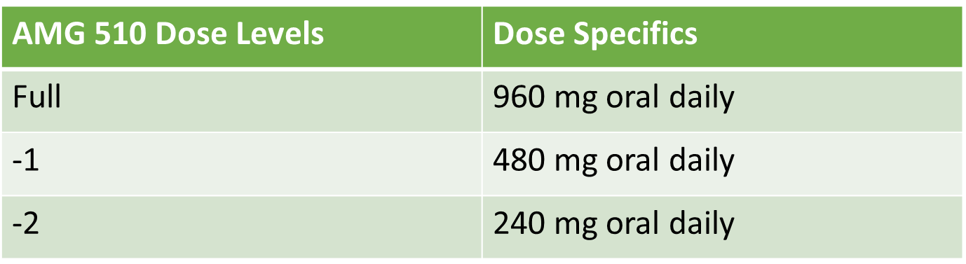
Dose Modifications
NCI CTCAE version 5 used for S1900E sub-study.
A maximum of two dose reductions are allowed.
If multiple treatment-related toxicities are experienced, dose modifications will be based on the toxicity requiring the most significant dose modification.

Slide 26
Criteria for Discontinuing Protocol Treatment
Progression of disease (PD) or symptomatic deterioration
EXCEPTION: Clinical benefit per treating investigator and the participant is not exposed to unreasonable risk, including:
  Absence of symptoms and signs indicating clinically significant progressive disease
  No decline in Zubrod performance status
  Absence of rapid disease progression or threat to vital organs or critical anatomical sites
Patient signs consent addendum if post-PD treatment. If second event of progression– discuss with study chairs.

Slide 27
Criteria for Discontinuing Protocol Treatment
Unacceptable toxicity.
Treatment delay for treatment-related toxicity > 28 days.
Treatment delay for unforeseen circumstance unrelated to treatment toxicity (i.e., other medical comorbidity, hospitalization unrelated to treatment) > 42 days.
Participants may withdraw from the protocol treatment at any time for any reason.

Slide 28
Study Calendar Overview
 | Pre-Reg (w/in 28 days prior to registration, unless otherwise noted) | Cycle Length = 21 days (+/- 3 days) |  |  |  |  | At Off Tx | Off Tx FU Prior to Prog | Off Tx FU After Prog ^{B}
REQUIRED STUDIES |  | Cycle 1 | Cycle 2 | Cycle 3 | Cycle 4 | Subsequent Cycles ^{A}
PHYSICAL
History & Physical Exam | X | X | X | X | X | X | X | X ^{C}
Weight & Performance Status | X | X | X | X | X | X | X | X ^{C}
Participant Diary ^{D} |  | X | X | X | X | X
Toxicity Notation |  | X | X | X | X | X | X | X ^{E} | X ^{E}
Smoking Status Assessment | X |  |  |  |  |  | X
LABORATORY
 | If labs obtained w/in 14 days prior to tx, tests need not be repeated on C1D1. |  | Results up to 48 hours prior to Day 1 tx
CBC / Diff / Platelets / Hgb | X | X | X | X | X | X | X | X ^{E} | X ^{E}
Chemistry Panel (non-fasting) ^{K} | X | X | X | X | X | X | X | X ^{E} | X ^{E}
Serum Pregnancy Test ^{F} | X
X-RAYS & SCANS
CT or MRI for Disease Assessment ^{G} | X |  |  | X |  | X |  | X
Brain CT or MRI ^{H} | X w/in 42 days |  |  |  | X | X |  | X
SPECIMEN SUBMISSION
ctDNA Whole Blood ^{I} |  | X | X | X |  |  | X (first progression)
Buffy Coat / Plasma for Banking ^{J} |  | X ^{J} | X ^{J} | X ^{J} | X ^{J} |  | X ^{J} (first progression)
TREATMENT (21-day cycle)
AMG 510 |  | X | X | X | X | X
Body disease assessment every 6 weeks for first year and then every 12 weeks thereafter (+/- 7 days)
History of brain metastases: brain imaging every 12 weeks (+/- 7 days)

Slide 29
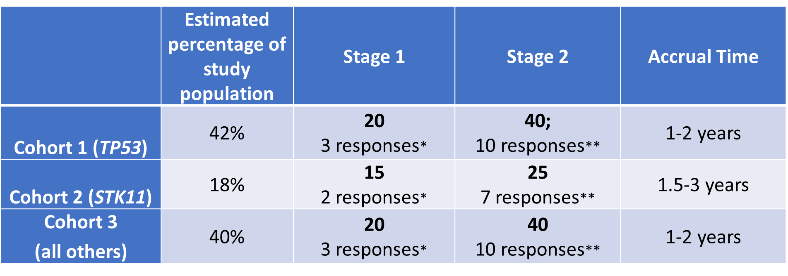
Statistics/Primary endpoint:
Objective response rate
*Responses required to proceed to stage 2.
**Cohort 1/3: 90% power to rule out 14% response rate at 5% 1 sided type 1 error if true response rate at least 34%
**Cohort 2: 90% power to rule out 14% response rate at 5% 1-sided type 1 error if true response rate at least 40%.
Biostatistics:
Mary Redman, Ph.D.
SWOG Statistic & Data Management Center

Slide 30
S1900E Lung-MAP Team
Suresh Ramalingam, ECOG-ACRIN Lung Committee Chair
LUNGMAP Leadership Chairs
Mary Redman, Lead Biostatistician
Katie Minichiello, Biostatistician
Judy Johnson, Patient Advocate
Louise Highleyman, Data Coordinator
Leah Everhart, Data Coordinator
Arthur Lee, Clinical Research Project Manager (CRAB)
Mariah Norman, Protocol Coordinator (SWOG)
Laura Gildner, Protocol Coordinator (SWOG)
Stacey Adam, Scientific Program Manager (FNIH)
Amrin Chowdhury, Project Manager (FNIH)
Chris Pustulka, Budget Analyst
Amgen Inc.
Foundation Medicine Inc.

Slide 31
Thank you for your kind attention!
Study Chairs:
Dr. Sukhmani K. Padda (Chair)
  Stanford University
Dr. David E. Gerber (Co-Chair)
  UT Southwestern
Questions:
Medical Questions for Study Chairs:
S1900EMedicalQuery@swog.org
Eligibility/Specimen/Data Submissions: LUNGMAPquestion@crab.org
General Protocol/Regulatory: lgildner@swog.org or mnorman@swog.org

Slide 32

S1900E Q & A Session
Please
“raise your hand” in WebEx or place questions in the chat box.
All Attendees

Slide 33
Lung-MAP
Logistics Refresher
Louise Highleyman
Leah Everhart
Lung-MAP Data Coordinators

Slide 34
LUNGMAP Screening
Step 0
Logistics and FAqs

Slide 35
Tissue and ctDNA Collection Procedures
Adequate archival tissue NOT available
Adequate archival tissue available
Step 0: Pre-Registration to obtain a patient ID
+/- 7 days
ctDNA specimen collected and shipped
Biopsy
Tissue processed and assessed for adequacy
Step 1: Registration
Step 1: Registration
Submit tissue
Submit tissue
Slide 35

Slide 36
FAQs: LUNGMAP Step 0
Q: What is LUNGMAP Step 0? Why does it exist?
A: Step 0 is an administrative registration step in OPEN used to obtain a SWOG patient ID number in order to label, log and ship the whole blood specimen for ctDNA assay required for patients undergoing a new biopsy. This whole blood specimen will likely need to be submitted before the tissue specimen has been evaluated for adequacy. Therefore, a SWOG patient ID number is needed before the patient is eligible to be registered to LUNGMAP Step 1.

Slide 37
FAQs: LUNGMAP Step 0
Q: When does a patient need to be registered to Step 0?
A: Any time a biopsy is being done to obtain tissue for the LUNGMAP study after the patient has consented to the study (and before they have been registered to Step 1). This is what we consider a “new” biopsy (in contrast to archival tissue).
Q: Is Step 0 required for all LUNGMAP patients?
A: No, patients with an adequate archival tissue specimen available should be registered directly to Step 1.

Slide 38
FAQs: LUNGMAP Step 0
Q: Are there any eligibility requirements for LUNGMAP Step 0?
A: No, as Step 0 is an administrative step only. The eligibility criteria in LUNGMAP protocol section 5 must be met prior to registration to LUNGMAP Step 1.
Q: Can I submit a tissue specimen under the Step 0 registration?
A: No, the patient must be registered to Step 1 before the tissue specimen can be logged and shipped. If the patient has only been registered to Step 0, the only available specimen in SWOG Specimen Tracking System (STS) will be the whole blood specimen.

Slide 39
FAQs: LUNGMAP Step 0
Q: If the patient will be registered to Step 1, is the same patient ID number used?
A: Yes, the SWOG patient ID number provided from the Step 0 registration will remain with the patient and must be used for the Step 1 registration and tissue submission.
Q: If a patient was registered directly to Step 1, but it is later determined a new biopsy is needed, does the Step 0 registration need to be done?
A: No, there is no need for Step 0 registration once the patient is registered to Step 1, as the patient will already have a SWOG patient ID number.

Slide 40
LUNGMAP
Tissue Requirements
A brief Refresher

Slide 41
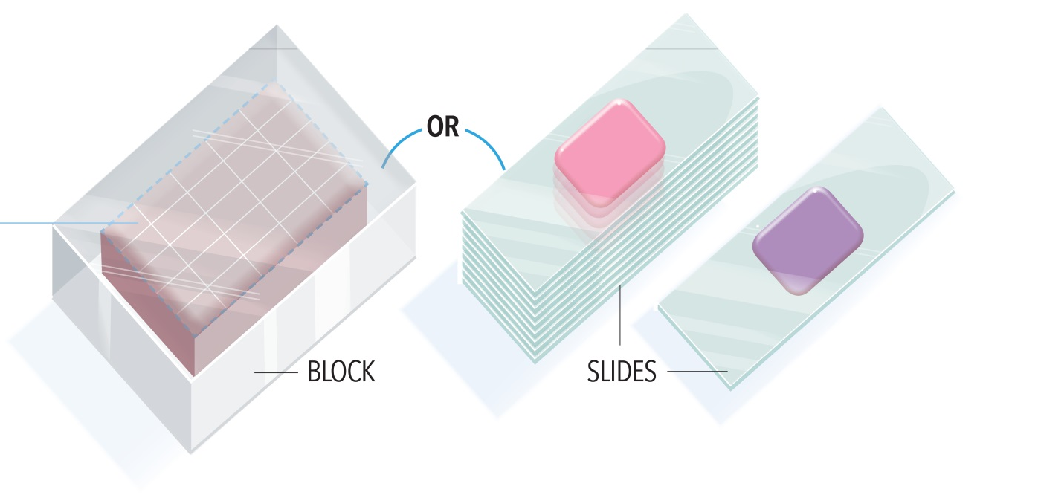
Tissue Requirements
Specimen Type
FFPE BLOCK or 12-20 SLIDES (+H&E SLIDE)
A tissue block is preferred.
  Tissue must be formalin-fixed and paraffin embedded.
  Fine needle aspirates with good cellularity are acceptable as long as cell blocks are established.
  Tissue can be from any site (primary or metastatic), except for bone.
If sending slides:
  A minimum of 12 unstained, charged, and unbaked 4-5 micron slides are required.
  20 slides are highly recommended.
  Slides should include an additional H&E stained slide (If unavailable, submit an extra unstained slide).

Slide 42
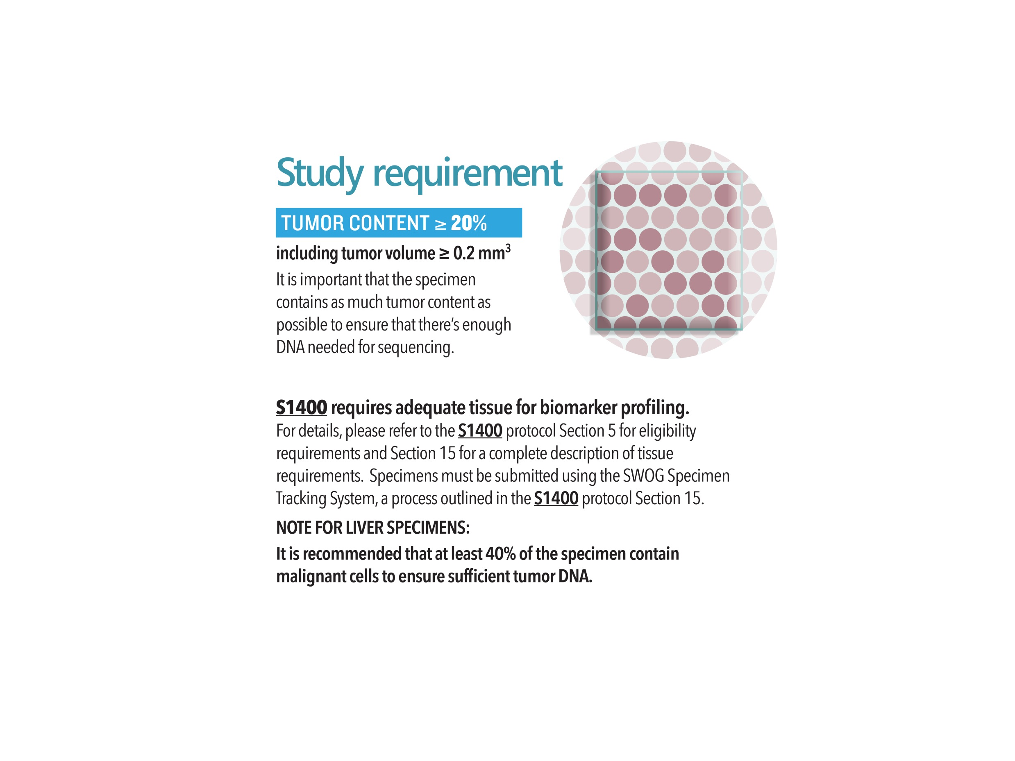
Tissue Requirements
Adequate Specimen
Tumor content > 20%
Tumor volume > 0.2 mm³
NOTE for LIVER SPECIMENS:
It is recommended that at least 40% of the specimen contain malignant cells to ensure sufficient tumor DNA.

Slide 43
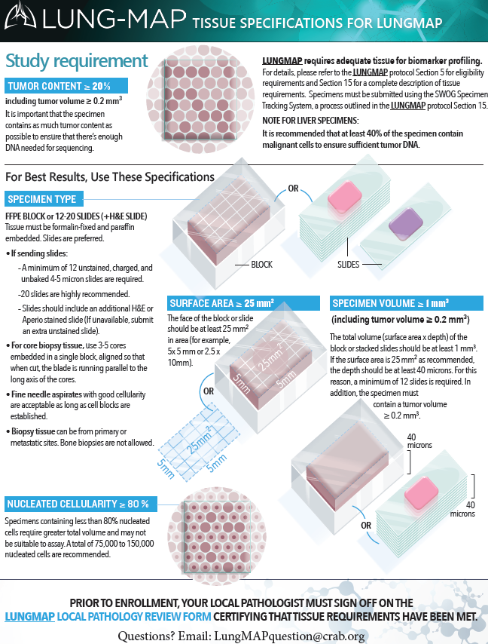
Tissue Specifications
Sheet
Lung-MAP Tissue Specifications resource provides additional tips for selecting an appropriate tissue specimen
This sheet can be provided to your pathology department as a reference when requesting tissue for the study
Available on the CTSU website (LUNGMAP Documents > Education & Promotion) or email LungMAPquestion@crab.org

Slide 44
Specimen Tracking System
Reminders and Tips

Slide 45

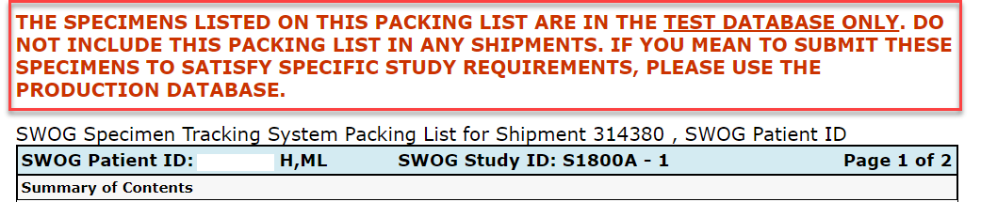
Logging Specimens
Production vs Test
  Watch for green block at top of page and warning above packing list
  Specimens logged in test aren’t actually recognized by our database

Slide 46
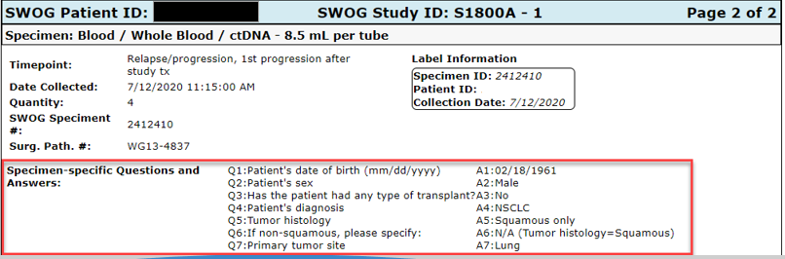
Logging Specimens
Importance of correctly answering specimen specific questions
  Avoid processing delays
  Entry errors corrected the same way as specimen entry errors
  Common errors include DOB, gender, & local specimen ID

Slide 47
Logging Specimens
Incorrect specimen is selected but has not been marked as “shipped”
  Delete the incorrect entry
  Log under correct specimen entry
Specimen marked as “shipped”
  Log under correct specimen entry and email technicalquestion@crab.org to have the extra entry deleted
  Include correct packing list in shipment
  If error is detected after specimen has been shipped, email LungMAPQuestion@crab.org or call (206) 652-2267 to make receiving lab aware

Slide 48
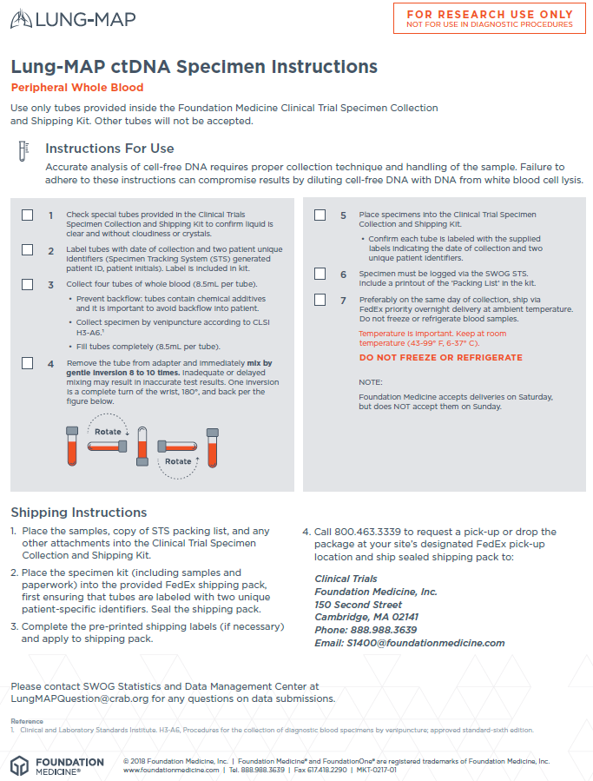
Preparing Specimens for Shipment
Whole blood ctDNA specimen
  Kit ordered from Foundation Medicine has label already affixed
  Avoid delays in processing by adding the requested identifiers to the affixed label before shipment
    Most common missed identifier is the specimen ID from STS
    Required identifiers are displayed on last page of packing list under “Label Information”
  Ensure the packing list is included in the shipment

Slide 49
Preparing Specimens for Shipment
Step 1 Tissue Submission
  Include the associated pathology report, Local Pathology Review form, and the STS packing list
  Ensure local specimen ID number matches across the pathology report, packing list, and specimen itself

Slide 50
Common Mistakes When Submitting Tissue
Stained slides
  We cannot accept stained slides
Multiple specimen submissions
  Foundation Medicine cannot combine specimens obtained from different biopsies to fulfill tissue requirements
  If there are multiple specimens that meet the requirements, please select the one with the highest tumor purity – avoid sending multiple specimens

Slide 51
Participating in Lung-MAP during the COVID-19 Pandemic
Jessica O’Donovan
Chair, Lung-MAP Site Coordinators Committee
VA Connecticut Healthcare System

Slide 52
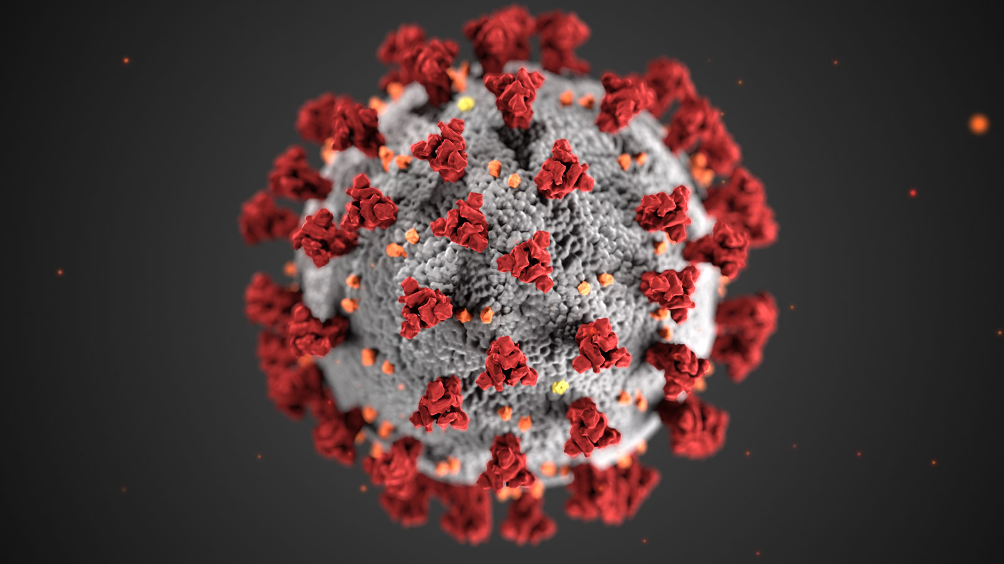
Research during the Pandemic
Reduced time in the office
Fewer team members available
  Being pulled to work on COVID
  Working from home full time
Deviations from standard protocol
Changes to conducting the Trial

Slide 53
What can we do?
Work together: Stay Connected
  Team meetings
ORGANIZE
  Calendar
  Checklists
  Deviations - tracking
Plan Accordingly
  Always know what is going on
  And what needs to be done
CHECK IN WITH THE PROTOCOL
Remote Consenting
  Who can remote consent?
  What are the rules for remote consenting?
Remote Auditing
  What to do
  What to Expect
Specimen Collection
  When is it okay to miss samples?

Slide 54

Meetings
Coordinators
  Meet to go over schedules
  What happened during the week
  What's happening next week
  Patient updates
Research Team
  Update everyone
  All the above information gets passed to PIs, nurses, pathology, pharmacy, etc.
  Keep team aware of events

Slide 55
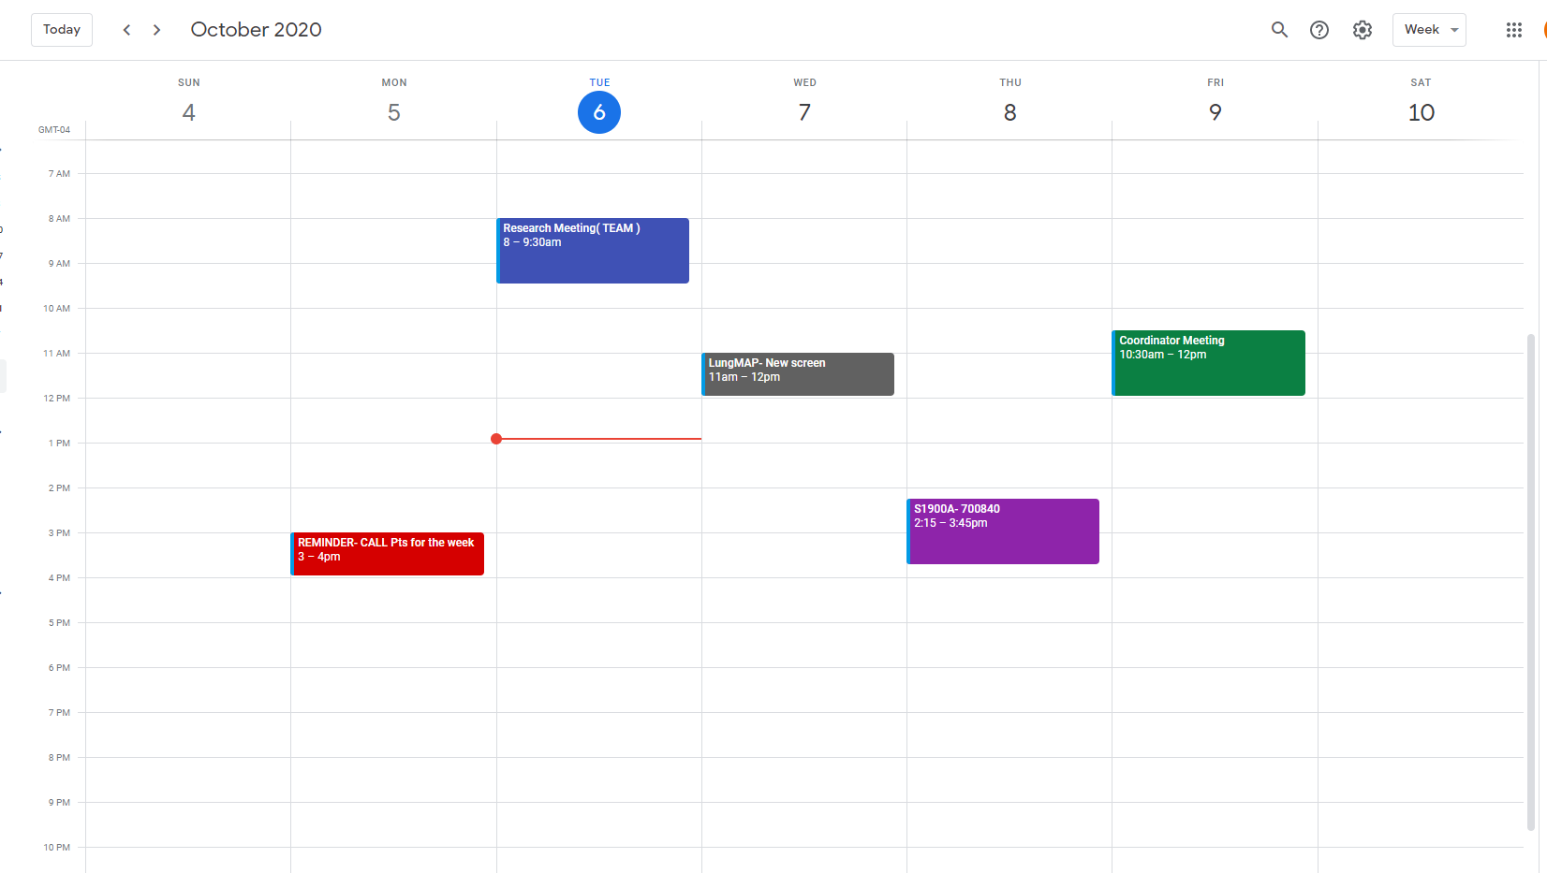
Shared Calendars

Slide 56
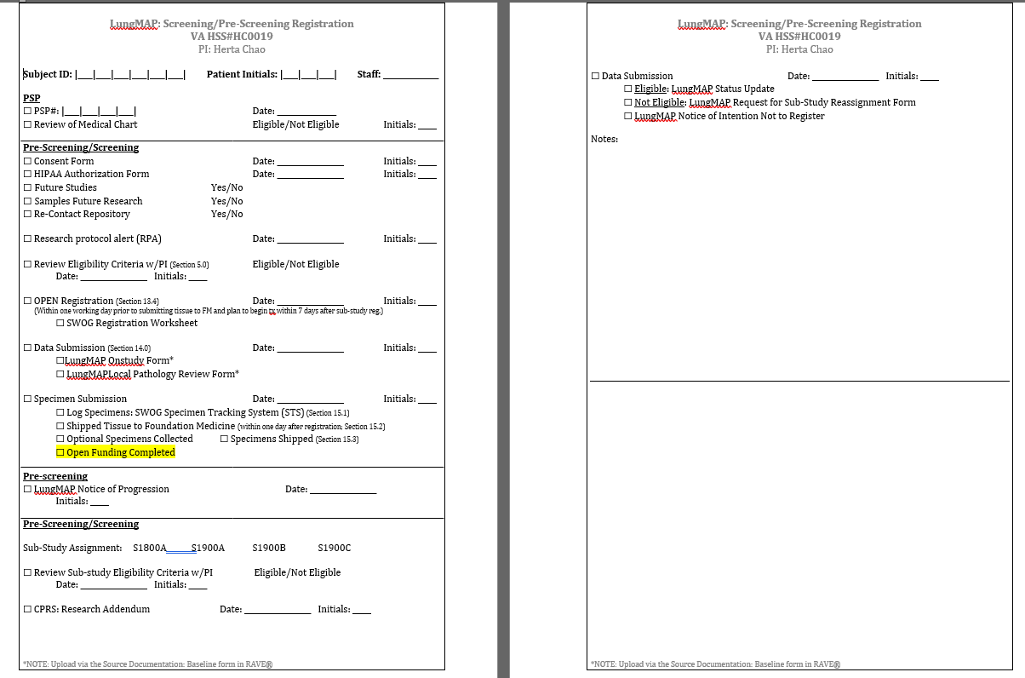
Creating Checklists - Screening

Slide 57
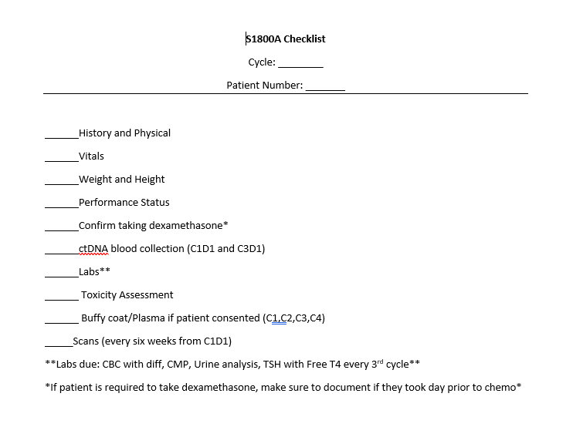
Creating Checklists – Sub-studies

Slide 58
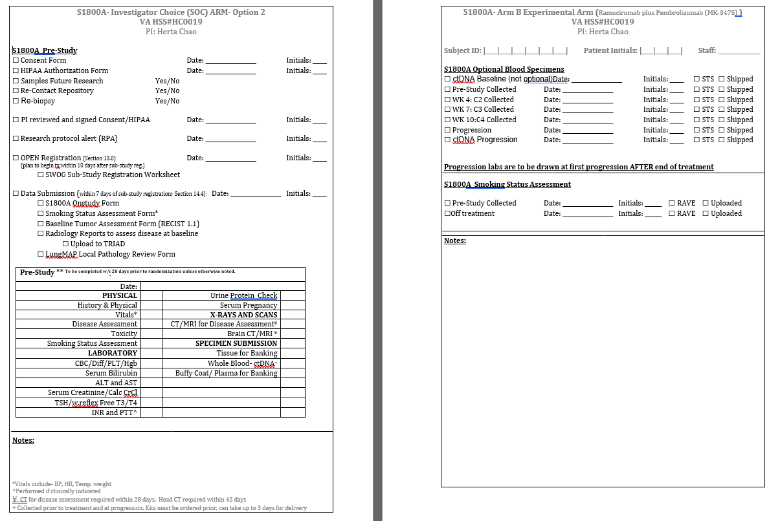
Creating Checklists – Sub-studies

Slide 59
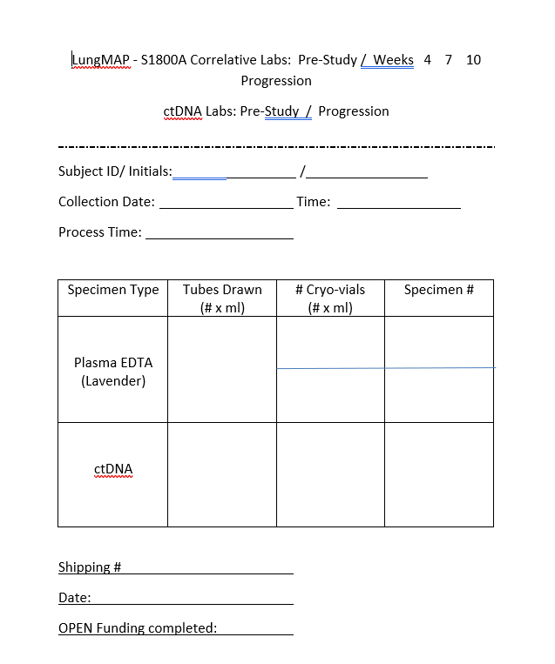
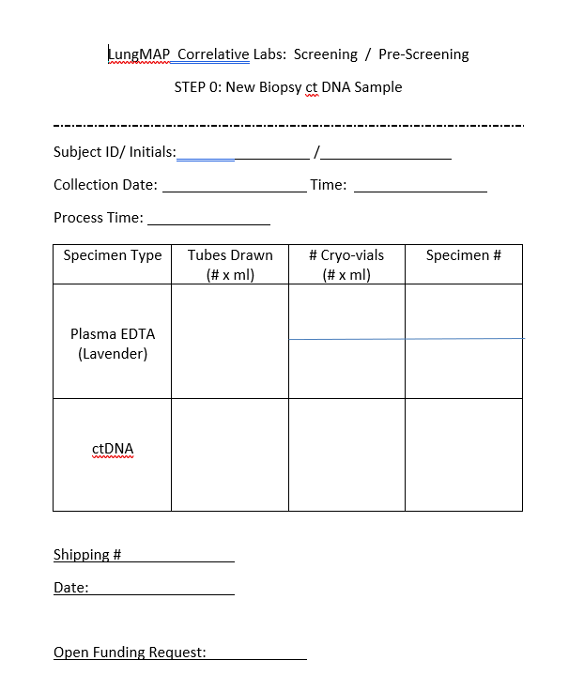
Lab Worksheets

Slide 60
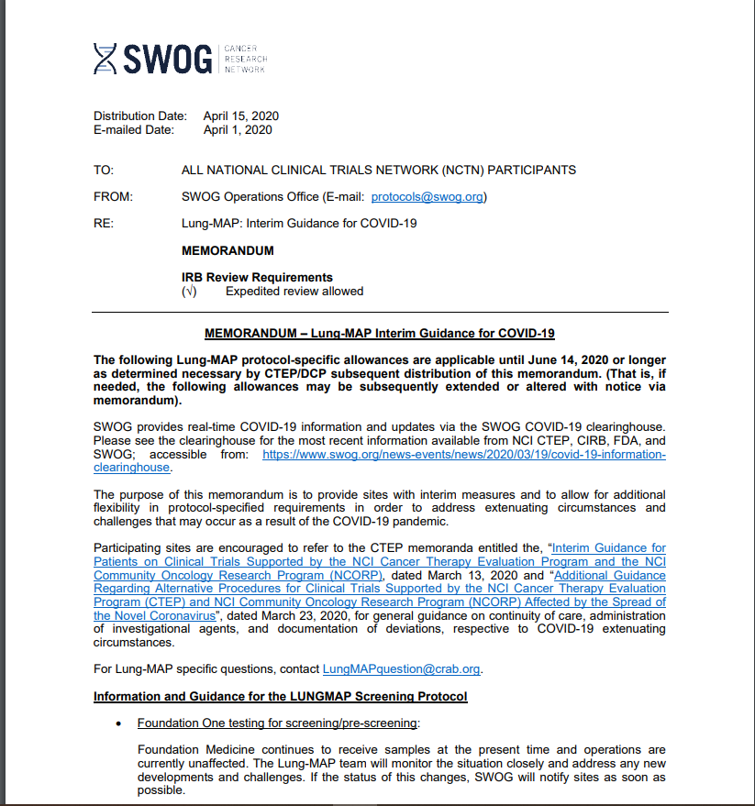
Check in with the Protocol/Local Institution
Verify what can be modified per the COVID guidelines
Verify what can be delayed due to COVID
Check what rules your hospital is instituting due to the Pandemic
  Regarding research in general
  Then specifics such as auditing

Slide 61
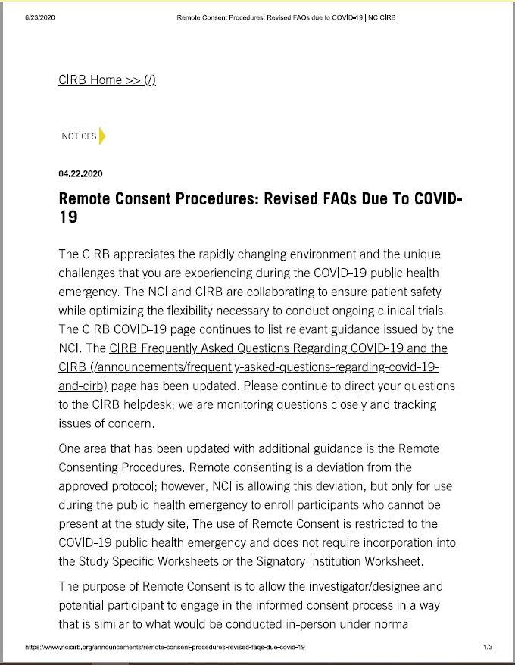
Remote Consenting
When is remote consent appropriate?
Who can consent remotely?
What needs to be done prior?
Who needs to be present for remote consent?

Slide 62
Remote Monitoring/Auditing
Sharing Regulatory Documents
Screen sharing
  Over the shoulder chart review
The Source Document Portal?
  What needs to be uploaded?
  How does this work?
Pharmacy Review
  What documents can be sent in advance?
Post review conference
What should you expect?

Slide 63
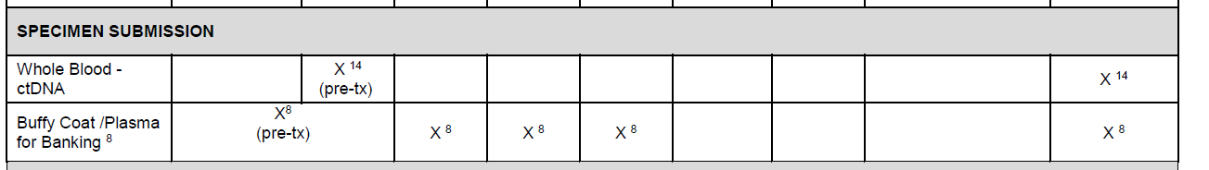
Sample Collection
When can samples be delayed?
When can samples be skipped?
How should deviations be tracked?
Should a patient be enrolled if there is a chance that you won't be able to get additional samples?

Slide 64
Overview of Publications
Mary Redman, PhD
Lung-MAP Lead Biostatistician

Slide 65
Publication Status for Completed Sub-Studies
Screening Protocol
S1400
S1400
S1400 Overview | Accepted Lancet Oncology 08/2020
Biomarker–Driven
Sub-Studies
Non-match
Sub-Studies
Study ID | Biomarker/Investigational Drug | Status
S1400B | Pi3K, Taselisib | Published JTO 10/2019
S1400C | Cell cycle gene alterations, palbociclib | Published JTO 10/2019
S1400D | FGFR, AZD4547 | Published JTO 10/2019
S1400G | Homologous recombinant repair deficiency, talazoparib | ASCO 2019 Accepted for publication, Clinical Lung Cancer 09/2020
S1400K | C-MET IHC, Teliso-V (ABBV-399) | ASCO 2019 Accepted for publication, Clinical Lung Cancer 09/2020
Study ID | Population/Investigational Drug | Status
S1400A | ICI naïve, 2nd line durvalumab | ASCO 2019 Accepted for publication, Clinical Lung Cancer 09/2020
S1400I | ICI naïve, 2nd line Nivolumab/Ipilimumab v Nivolumab | Submitted for Journal for publication October 2020.
S1400F | ICI relapsed/refractory, durvalumab + tremelimumab | Primary manuscript in development by study chair. Anticipated submission Q1 2021.

Slide 66
Publication Status for Translational Medicine Studies
S1400 Next Generation Sequencing
  Submitted to WCLC 2021
  Summarizes prevalence and prognostic role of gene alterations in the S1400 FoundationOne NGS data
  Lead author: David Kozono (Alliance)
NGS Biomarker analysis in Immunotherapy-treated Patients
  Submitted to WCLC 2021
  Evaluates prognostic association of NGS biomarker data with clinical outcomes in ICI naïve patients on S1400A (durvalumab) or S1400I (nivolumab +/- ipilimumab)
  Lead author: Fred Hirsch (SWOG)
ctDNA NGS versus tissue NGS on LUNGMAP
  Submitted to WCLC 2021
  Compares detection of driver mutations in tissue versus cfDNA among patients with a fresh tissue biopsy for LUNGMAP screening
  Lead author: Phil Mack (SWOG)

Slide 67
Translational Medicine/Scientific Leadership Committee
David Kozono, MD, PHD
Lung-MAP TM/Scientific Leadership Committee Chair

Slide 68
Purpose
Bring together expertise in translational medicine
Assist in biomarker selection and definitions and sample collection decisions for sub-studies under development
Review proposals for prospective and retrospective translational research
Assist in analysis and publication of sequencing and other correlative science data

Slide 69
Members/Attendees
Lung-MAP
  Hoss Borghaei, Jeff Bradley, Afshin Dowlati, Konstantin Dragnev, Marty Edelman, David Gandara, Roy Herbst, Fred Hirsch, Leora Horn, Karen Kelly, Phil Mack, Joel Neal, Jyoti Patel, James Rae, Suresh Ramalingam, Tom Stinchcombe, Saiama Waqar, Ignacio Wistuba
  Xing Hua, Katie Minichiello, Mary Redman, Mike Wu (Stats)
  Stacey Adam & Amrin Chowdhury (FNIH), Mariah Norman & Laura Gildner (SWOG)
  David Kozono (Chair, 2020-)
FMI: Lindsay Chan, Jennifer Mills, Lynn Sullivan, Khaled Tolba, Jeff Venstrom
Nationwide/Biobank: Erin Grundy, Yvonne Moyer, Nilsa Ramirez, Kae Tegtmeier

Slide 70
Areas of Expertise
Therapeutics
  Immuno-Oncology
  Targeted therapies
  DNA repair
  Anti-angiogenic therapy
Biospecimen banking and processing
Pathology
Clinical genomics

Slide 71
TM Goals and Ideas
To utilize patient specimens gathered on Lung-MAP clinical trials to identify biomarkers with the potential to improve patient outcomes by guiding treatment decisions based on specified laboratory criteria
TM ideas may be proposed by study chairs, companies or Lung-MAP collaborators (i.e., Foundation Medicine)

Slide 72
Keys for Successful TM
Be knowledgeable about the biology of the investigational agents
Be thoughtful about prospective biospecimen collection
  Specimen types
  Timepoints
  Quantity
  Processing, shipment and storage
Engage collaborators including biologists, biostatisticians and pathologists

Slide 73
Accomplishments
Review of TM proposal for S1900E AMG 510 for KRAS G12C
Three abstracts selected as mini-oral presentations at World Conference on Lung Cancer (WCLC) 2021
  Two abstracts feature analyses of the SWOG S1400 Next Generation Sequencing (NGS) data on 1672 tumors profiled using Foundation Medicine’s FoundationOne T5 research platform, which sequenced the exons and/or introns of 313 cancer-related genes
  The third abstract features a comparison of alterations detected in LUNGMAP tumor samples versus plasma circulating tumor (ct)DNA

Slide 74
Insights Gained from TM Studies
S1400 NGS: identification of mutated genes that are rarely found together (mutually exclusive) or commonly found together (co-occurring) can provide insights into the biology of lung cancer
S1400I/A (Hirsch F et al): NGS can be used to determine tumor mutational burden (TMB), and high TMB may predict improved survival outcomes in patients treated with immunotherapy
ctDNA vs tissue NGS (Mack P et al): high concordance between these would support the use of ctDNA (i.e., blood tests) for enrollment onto LUNGMAP sub-studies

Slide 75
General Q & A Session
Please
“raise your hand” in WebEx or place questions in the chat box.
All Attendees

Slide 76
Contact Us
Site Coordinators Committee
  LUNGMAPSCC@crab.org
General Protocol & Regulatory Questions
lgildner@swog.org or
  mnorman@swog.org
  Eligibility/Specimen/Data Submission Questions
  LUNGMAPQuestion@crab.org
  General Medical Questions
  LUNGMAP@swog.org
  Funding Questions
  Funding@swog.org
  Sub-Study Medical Questions
  S1400FMedicalQuery@swog.org
  S1900AMedicalQuery@swog.org
  S1800AMedicalQuery@swog.org
  S1900CMedicalQuery@swog.org
  S1900BMedicalQuery@swog.org
  S1900EMedicalQuery@swog.org
  Central Monitoring Questions
  centralmonitorquestion@crab.org
  QA Auditing Questions
  qamail@swog.org

Slide 77

Summary & Adjourn
Thank you for joining us!
The slides and recording will be available on the SWOG & CTSU websites.
Certificates are not provided; however, you can complete and save the verification form on the Lung-MAP Training Page to keep for your records https://www.swog.org/required-lung-map-training.

