Slide 1

Active Study Informational Webinar
Fall 2017 Update: December 7th, 2017
11am PT/1pm CT/2pm ET
A Biomarker-Driven Master Protocol for Previously Treated Squamous Cell Lung Cancer (LUNG-MAP)
Version Date: 7Dec2017 FINAL v2

Slide 2
Introduction to Lung-MAP and
Today’s Webinar
Roy Herbst, M.D., Ph.D.
S1400 Study Co-Chair

Slide 3
Webinar Agenda
Introduction
  Lung-MAP Partnership and Collaborators
  Current Trial Schema
Tissue Screening at PD vs
Pre-Screening
Summary of Open Sub-studies
  S1400F
  S1400G
  S1400I
    Immune-Related Adverse Events (irAEs)
  S1400VCP
Summary of Upcoming Sub-studies
  S1400K
  S1400GEN
Revision 9/10 Forms Changes
Quality Assurance and Monitoring
Study Protocol Structure and Revision Status

Slide 4




S1400 Master Protocol
Led by SWOG, with a unique private-public partnership
SWOG
ECOG-ACRIN
NRG
CCTG
Alliance
S1400 Master Protocol
Slide #: 4
Notes:
I think we need something on the intergroup collaboration and Canada

Slide 5
















Lung-MAP Partners and Collaborators

Slide 6
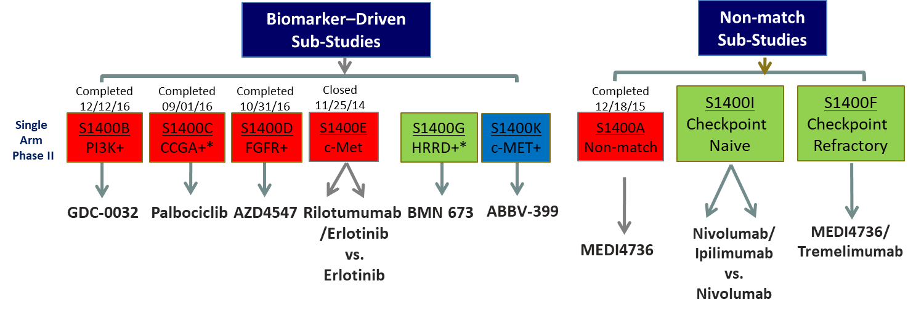
Current Lung-MAP Schema
OPENED
2/2017
Est. Activation
1/2018
OPENED
10/2017
OPENED
12/2015
S1400GEN – ancillary study for all participants
Estimated activation 01/2018

Slide 7
Tissue Screening:
Screening at PD vs Pre-Screening
Martin Edelman, M.D.
S1400C Study Chair
Lung-MAP Study Chair/Champion on behalf of NRG

Slide 8
Screening of Tissue
Patients can participate in screening in two ways:
Option 1: Screening at Progression on prior treatment
Option 2: Pre-screened prior to progression on current treatment
Pre-Screening criteria:
Current treatment must be for Stage IV or recurrent disease
Must have received at least one dose of the current regimen
Must have previously received or currently be receiving a platinum-based chemotherapy regimen or anti-PD-1/PD-L1 therapy (e.g. Nivolumab or Pembrolizumab)
NOTE: Each sub-study has its own eligibility criteria (related to labs, history, etc.).
Eligibility for Screening/Pre-Screening doesn’t imply eligibility for all sub-studies.

Slide 9
Advantages of Pre-Screening
Assures that specimen can be obtained and is adequate. Eliminates the lag time that results in patient anxiety.
Provides rapid assessment for trial eligibility at the time of progression (24 hours vs 2 weeks).
Example Scenario where Pre-Screening is best utilized:
Mr. Smith has stage IV NSCLC. He is receiving carboplatin/gemcitabine and is doing well after two cycles. He is consented and pre-screened. Tissue is retrieved from the archives, and evaluated for adequacy by a local pathologist. The patient is registered to S1400 pre-screening, tissue is submitted and Foundation analysis performed. After cycle 4 he is found to have progressive disease. The Notice of Progression form is submitted in Rave and the patient is able to be assigned to a trial the next day.

Slide 10
Summary of Open Sub-studies:
S1400F
Natasha Leighl, M.D.
S1400F Study Chair

Slide 11
S1400F – Single Arm Phase II
A “non-match” study for patients who have previously received and progressed on a PD-1 or PD-L1 inhibitor as a single agent treatment and are not eligible for other Lung-MAP sub-studies.
Seeks to evaluate the efficacy of MEDI4736 (durvalumab) + tremelimumab, potent PD-L1 and CTLA-4 inhibitors, in such patients.
MEDI4736 (durvalumab) + tremelimumab will be administered intravenously on 1 day for four 28-day cycles. MEDI4736 will be given alone for subsequent cycles.
Treatment will continue in consenting patients until disease progression or intolerable toxicity.

Slide 12
Summary of Open Sub-studies:
S1400G
Roy Herbst, M.D., Ph.D.
S1400 Study Co-Chair

Slide 13
S1400G – Single Arm Phase II
A PARP Inhibitor study for patients with homologous recombination DNA repair deficiency (HRRD) who may be particularly receptive to treatment with PARP inhibitors.
Seeks to evaluate the efficacy of talazoparib, a potent PARP inhibitor, in such patients.
Includes patients with alterations in BRCA1/2, ATM, CHEK1 and other HRRD genes.
Talazoparib will be administered orally once daily in 21-day cycles.
Treatment will continue in consenting patients until disease progression or intolerable toxicity.

Slide 14
Summary of Open Sub-studies:
S1400I
Lyudmila Bazhenova, M.D.
S1400I Study Co-Chair

Slide 15
S1400I – Randomized Phase III
A “non-match” study for patients whose molecular profile does not match a targeted therapy and who have not been treated previously with a checkpoint inhibitor.
Seeks to compare overall survival in patients randomized to nivolumab plus ipilimumab versus nivolumab.
Arm 1 – Nivolumab will be administered intravenously on Day 1 of every 14 day cycle. Ipilimumab will be administered intravenously on Day 1 of every third cycle (i.e. Cycle 1, Cycle 4, etc.).
Arm 2 – Nivolumab will be administered intravenously on Day 1 of every 14 day cycle.
Treatment will continue in consenting patients until disease progression or intolerable toxicity.

Slide 16
Management and Prevention of irAEs
Resources on irAE management:
  Dr. Bazhenova’s Presentation Slides
  https://swog.org/Visitors/S1400/UpdateSlides_0622.pdf
  Checkpoint Inhibitors: Common Immune-Related Adverse Events and Their Management (Paper in Clinical Journal of Oncology Nursing)
  https://cjon.ons.org/cjon/21/2-0/supplement/checkpoint-inhibitors-common-immune-related-adverse-events-and-their
  CTSU Video: “Harnessing the Power of the Human Immune System Against Cancer” video
  Click Immunotherapy (Checkpoint Inhibitors) Video – April 26, 2017 or sign into the CTSU members' website with your CTEP-IAM account, go to the Resources Tab > Educational Multimedia > Videos.
  NCCN immunotherapy teaching/monitoring tool for clinicians and patients: https://www.nccn.org/immunotherapytool/pdf/NCCN_Immunotherapy_Teaching_Monitoring_Tool.pdf
  This printable tool doesn’t discuss management, but lists the common toxicities associated with specific immunotherapeutic agents.

Slide 17
Summary of Open Sub-studies:
S1400VCP
Crystal Miwa
Lung-MAP Project Manager and Protocol Coordinator

Slide 18
S1400VCP – Version Control Protocol
Intent is to keep track of changes in the VCP and various component documents over the course of the study
An index will track revisions or updates made and list the version date of each component of Lung-MAP associated with that revision or update
The VCP will always include the updated version dates for all components in the index
Revisions can be made to a sub-study independently of the other sub-studies

Slide 19
Summary of Upcoming Sub-studies: S1400K and S1400GEN
Roy Herbst, M.D., Ph.D.
S1400 Study Co-Chair

Slide 20
S1400K – Single Arm Phase II
A biomarker study w/ eligibility defined as C-Met positive squamous cell as follows:
  IHC positive based on Ventana SP44 Assay (H score ≥150) – Flagship/ARUP
Seeks to evaluate the overall response rate (ORR) with telisotuzumab vedotin (ABBV-399) in all patients with c-Met-positive lung squamous cell carcinoma.
ABBV-399 will be administered intravenously on 1 day of 21-day cycles.
Treatment will continue in consenting patients until disease progression or intolerable toxicity.
Total accrual goal is 44 pts, prevalence 30%
Notes:
Single arm Phase II Biomarker Driven

Slide 21
S1400GEN - Ancillary Study
Title: Evaluating Patient and Physician Knowledge, Attitudes, and Preferences Related to Return of
Genomic Results in S1400
Conducted by: Fred Hutchinson Cancer Research Center
All U.S. English language speaking patients registered to the S1400 master protocol study will be eligible for participation in this ancillary study
The surveys will be conducted over the phone.
25-30 minutes or less to complete
Recruit and survey 30 study physicians that are providing care to patients enrolled in the S1400 ancillary study
Online survey
15-20 minutes or less to complete

Slide 22
Revision 9/10 Forms Changes
Louise Highleyman
Lung-MAP Data Coordinator

Slide 23
Revision 9/10 Forms Changes
S1400A
  MEDI4736 arm only
  Retrospective
  Onstudy: Prior Treatment
    One question added: “Number of prior systemic therapies for Stage IV disease”
  Adverse Events: Report
    Immune-related adverse events (Yes/No)
  Emails sent to relevant sites (~60 sites with 1-2 pts. each)

Slide 24
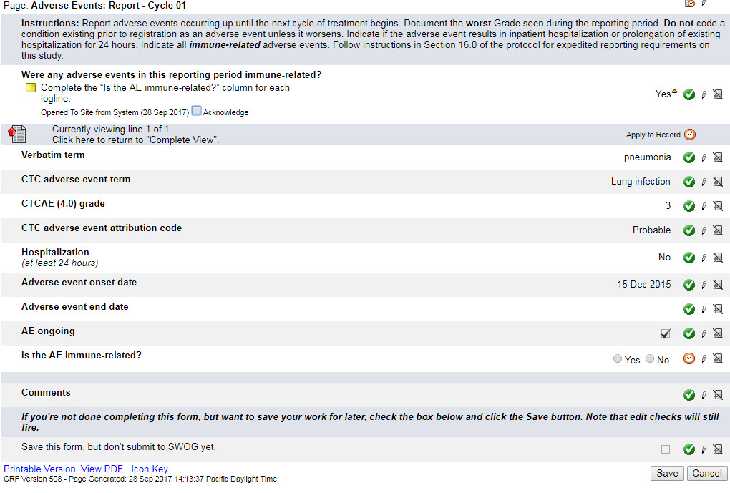
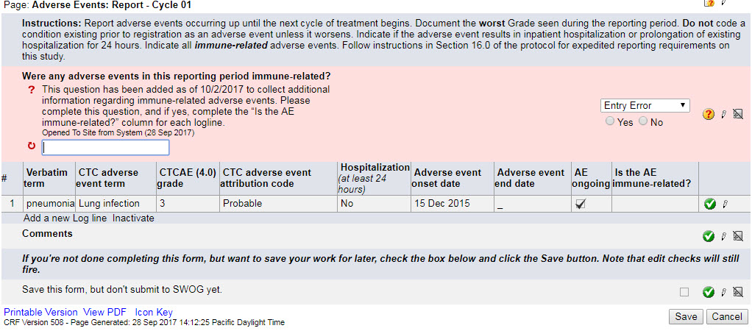
Revision 9/10 Forms Changes
Notes:
For patients who received MEDI4736 on S1400A, retrospective data collection regarding immune-related adverse events (irAEs) will be required starting with the release of Lung-MAP Revision #9/10 on 10/2/2017. On this form, please indicate if any immune-related AEs were seen during the cycle. If “Yes” is selected as the response to the question “Were any adverse events seen in this reporting period immune-related?”, for each adverse event listed in the cycle, please indicate “Yes” or “No” to the “Is the AE immune-related?” field that generates.

Slide 25
Revision 9/10 Forms Changes
S1400I
  Retrospective & prospective, both treatment arms
  “Adverse Events: Report”
    Immune-related adverse events (Yes/No)
    CTEP-AERS report ticket number (if applicable)
  If there are irAEs: “Immune-Related Adverse Event” form
    One form per event per cycle
    A few supplemental questions
    Note: Keep an eye out for similar data forms
    on S1400F and any future IO sub-studies.

Slide 26
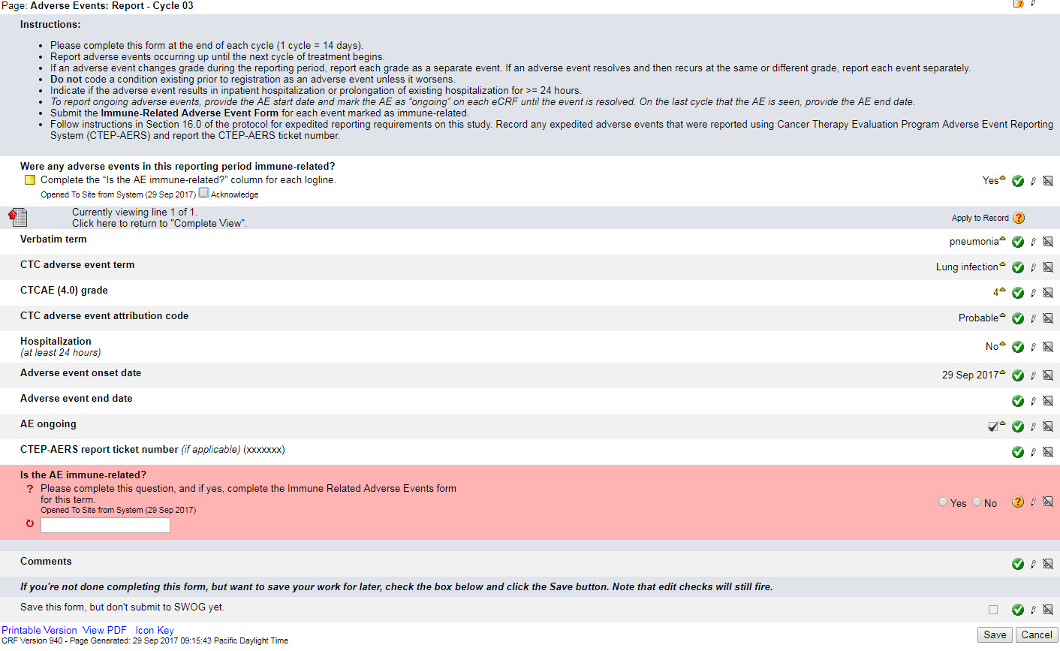
Revision 9/10 Forms Changes
If the adverse event warranted expedited reporting via the CTEP-AERS system, please enter the CTEP-AERS report ticket number here. The grade and attribution of the event should match the CTEP-AERS report.
If any AE’s in this reporting period were immune-related, this question must be answered for all loglines. A separate “Immune-Related Adverse Event” supplemental form will generate for each adverse event term where this question is answered “Yes”.
Notes:
On this form, please indicate if any irAEs were seen during the cycle. Please also note the addition of the “CTEP-AERS report ticket number” field for correlation with expedited SAE reporting, and the updated form instructions. If “Yes” is selected as the response to the question “Were any adverse events seen in this reporting period immune-related?”, for each adverse event listed in the cycle, please indicate “Yes” or “No” to the “Is the AE immune-related?” field that generates.

Slide 27
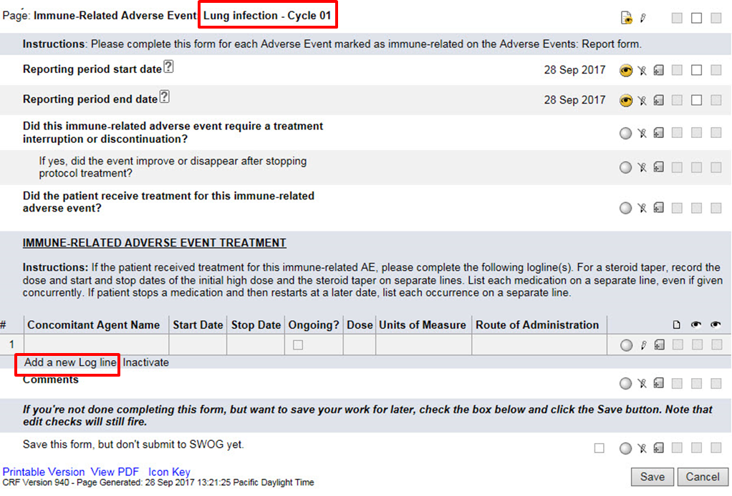
Revision 9/10 Forms Changes
Notes:
If “Yes” is selected as the response to the question “Is the AE immune-related?” for a specific adverse event, a supplemental “Immune-Related Adverse Event” form will be generated for each immune-related adverse event in the cycle. A separate form will need to be completed for each immune-related adverse event. Use “Add a new Log line” as needed to list multiple concomitant agents. For concomitant agents administered for the treatment of immune-related AEs, please only list a stop date within the corresponding cycle; if treatment was still ongoing at the end of the cycle, please mark the “Ongoing” checkbox instead.

Slide 28
Revision 9/10 Forms Changes
S1400I
  “Follow-up Tumor: Assessment”
    Added field: “Will the patient continue to receive protocol treatment?”
    Follow-up Tumor Assessment folders will continue to roll-out for patients who remain on treatment after progression
    Reflects change in protocol going forward, but retrospectively we are just hoping to get data (including tumor measurements) on any scans done at site’s discretion

Slide 29
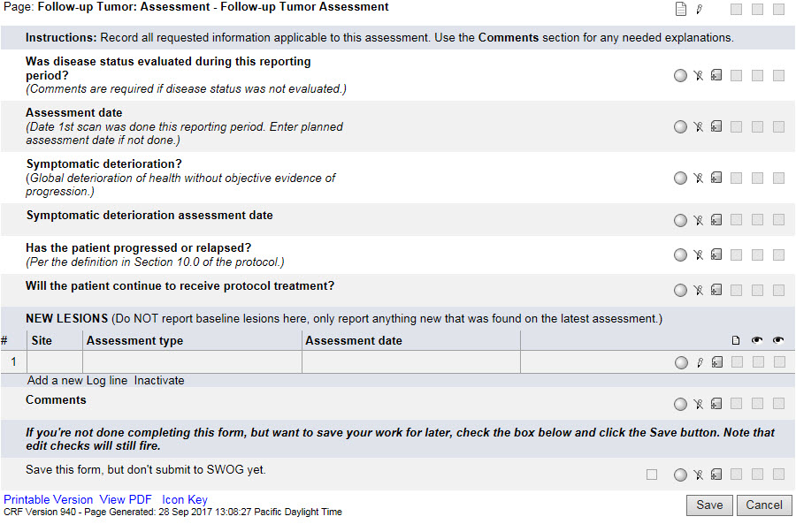
Revision 9/10 Forms Changes
For S1400I only
(added 10/2/17).

Slide 30
Quality Assurance and Monitoring
Rose Ermete, RN, BSN, OCN, CCRP
SWOG Quality Assurance Manager

Slide 31
QA/Monitoring: Common Problems
Regulatory: For sites using the CIRB:
  Consent forms deviate from the approved boilerplate language
  Unable to determine when consent versions were implemented
Boilerplate Document
  Protocol Specific
  Annual Signatory
DTL – New requirement

Slide 32
QA/Monitoring: Common Problems
Patient Case Review: Eligibility
  S1400: Failure to confirm ≥ 20% tumor cells by local pathologist
    Much better – we are seeing less of this
  S1400G: Must have achieved stable disease, a partial response, or a complete response at their first disease assessment after initiating first-line platinum-based chemotherapy
  S1400I: Must not have received systemic treatment with corticosteroids (> 10 mg daily prednisone or equivalent) or other immunosuppressive medications within 14 days prior to sub-study registration.

Slide 33

QA/Monitoring: Common Problems
Patient Case Review: Treatment
  Failure to dose reduce per protocol
  Failure to document compliance to oral drugs
Patient Case Review: Adverse Events
  Failure to report adverse events
  See CRF Guidelines page 27
  NEW: S1400 A & I - Collection of immune relationships of events (going forward & retrospective)

Slide 34
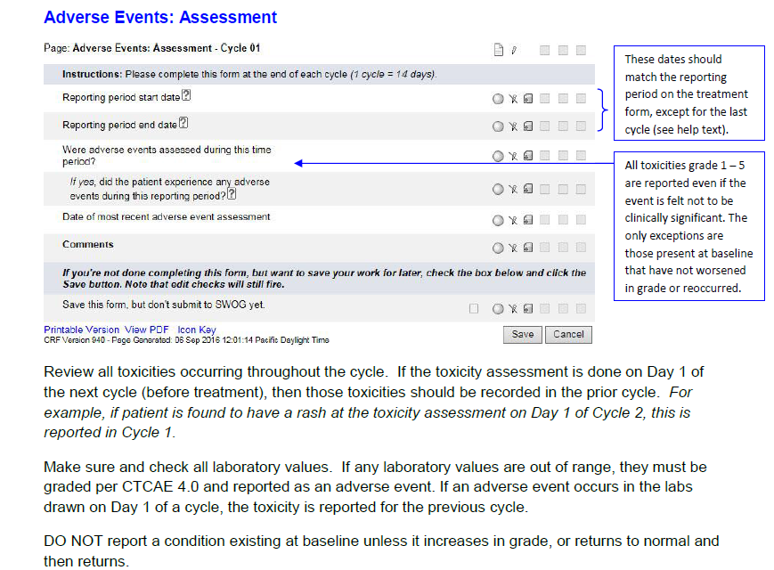

Slide 35
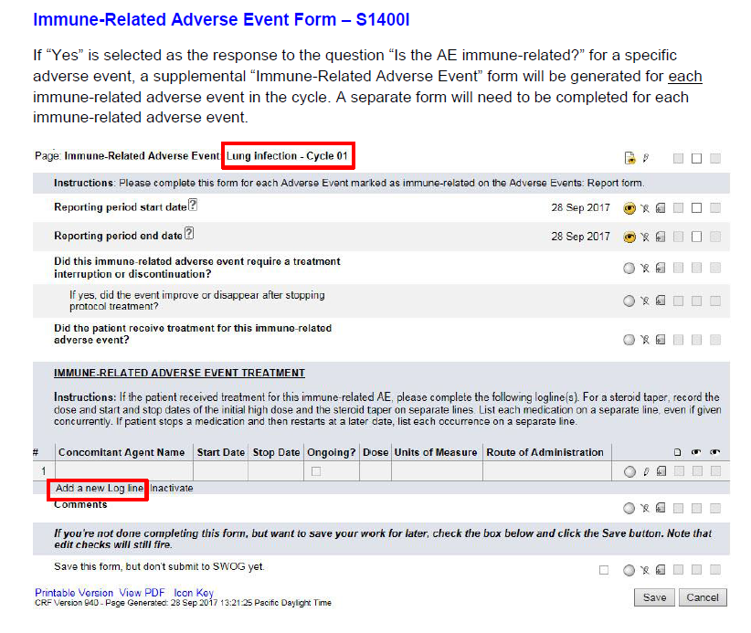

Slide 36
QA/Monitoring: Common Problems
Patient Case Review: Data Quality
  Data entry errors (CRF Guidelines on Abstract page and CRA Workbench)
    Current date of staging (Pg 3)
    TNM staging (Pg 3)
    # of prior systemic treatments for Stage IV (Pg 4)
    Date on uploaded reports (Pg 5)
    Measured Creatinine Clearance (Pg 15)
    RECIST (Pg 21 & 22)

Slide 37
QA/Monitoring: Disease Assessment
Target Lesions
  Choose up to 2 lesions per organ & 5 lesions total
  For lymph nodes, record the smallest (short axis) diameter (must be > 1.5 cm to be a measurable lesion).
  Nodules are generally not considered lymph nodes.

Slide 38
QA/Monitoring: Disease Assessment
Non-Target Lesions
  Measurable lesions that were not selected as target lesions. Since only two lesions per organ and five lesions in total can be selected as target lesions, any additional lesions should be followed as non-target disease.
  Small lesions (longest diameter < 1.0 cm or pathologic lymph nodes with ≥ 1.0 cm to <1.5 cm short axis). Note: Lymph nodes that have a short axis < 1.0 cm (10 mm) are considered non-pathological and should not be recorded or followed.
  Bone lesions, leptomeningeal disease, ascites, pleural/pericardial effusions, lymphangitis cutis/pulmonitis, inflammatory breast disease, and abdominal masses (not followed by CT or MRI).
  Previously radiated lesions that have not progressed.

Slide 39
QA/Monitoring: Data and Tissue Submission Requirements
All data is submitted electronically:
Medidata Rave® | TRIAD application | SWOG Specimen Tracking System
All case report forms & specified source documentation | Radiology images | All specimens
Protocol Section 14 for submission schedule | Protocol Section 14 for schedule Protocol Section 15 for details | Protocol Section 15 for details and schedule
Baseline forms due within 7 days of registration | Scan images to be uploaded within 7 days of the disease assessment | Specimens can be batched, but enter the date drawn in Specimen tracking
For Baseline Forms: > 30 days late is a lesser > 90 days late is a major | For Baseline Forms: > 30 days late is a lesser > 90 days late is a major
Timely submission of data is critical to trial success!

Slide 40
Study Protocol Structure and
Revision Status
Mary Redman, Ph.D.
S1400 Lead Biostatistician

Slide 41
Planned Expansion of the Study
Previously-treated Stage IV or Recurrent
Non-Small Cell Lung Cancer
All Histology
(Chemo or Immunotherapy Refractory Patients)
NEW
Centralized Biomarker Profiling
S1400F (squamous) and
S1800 Immunotherapy Combination
Platform (all NSCLC)
Biomarker Matched*
Sub-studies
Non-Matched (Immunotherapy)
Sub-studies
Biomarker 1
Positive
…Biomarker n Positive
IO Naïve
(Squamous only)
IO Relapsed/Refractory
Collect Tissue for Immuno Biomarker Profiling
Sub-study 1
Biomarker-driven
Targeted Therapy
…Sub-study n
Biomarker-driven
Targeted Therapy
R
Phase 2
Evaluate: Investigational therapy 1
Evaluate: Investigational therapy n
Nivolumab + Ipilimumab
v.
Nivolumab
IO Sub-study 1
IO Combo 1
…IO Sub-study m
IO Combo m
Phase 3
R
R
Study Activated 12/2015
Accrual is ongoing
Investigational therapy 1
vs
Standard of Care
Investigational therapy n
vs
Standard of Care
Currently, biomarkers are defined by NGS. Though, approaches such as c-MET IHC or Immunotherapy biomarkers may be used.

Slide 42
Status of Developing Sub-studies
Developing
  Biomarker-driven sub-studies:
  S1400L [Clovis]
    evaluating Rucaparib, genomic LOH-positive pts, all NSCLC
    Using a loss-of-heterozygosity signature developed by Foundation Medicine (FMI), ~ 16% of patients
    Est. ~ 4% of patients will be LOH+ and HRRD+
  Non-match sub-studies:
  S1800 – IO Combos (all NSCLC)
    Combination #1- Pembrolizumab + Ramuciramab
    Potential combination: Nivolumab + Rucaparib

Slide 43
Study Contact Information
Eligibility + Imaging + Data Submission
Data Operations, (206) 652-2267
S1400Question@crab.org
Protocol + Regulatory
SWOG Operations Office, (210) 614-8808 ext 1019
cmiwa@swog.org
Funding Questions
Group Chair’s Office, funding@swog.org
For additional information, see funding memos

Slide 44

S1400 Site Coordinator Committee
SITE COORDINATORS COMMITTEE
SCC Mission
To represent study site staff at the nursing, CRA, data management, and regulatory levels by providing feedback to and from the study leadership to enhance accrual and improve study management.
Jessica Jordan, VA Connecticut, Chair
Lavinia Dobrea, St Joe’s CA, Co-Chair
Feel free to send questions and suggestions to:
LungMapSCC@crab.org

Slide 45

Questions? …Please “raise your hand” in WebEx or use the chat feature
Thank You For Your Participation!

