Slide 1




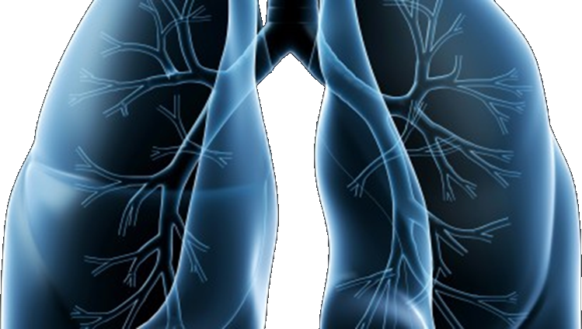

S1400
Revision #1
Training Slides
Phase II/III Biomarker-Driven Master Protocol for Second Line Therapy of Squamous Cell Lung Cancer. (LUNG-MAP)
This slide deck contains an overview of the study design, eligibility criteria, and updates to the design and eligibility for Revision #1 of S1400
Version date December 2015

Slide 2
S1400 Revision #1 version 12/1/2014
Phase II/III Biomarker-Driven Master Protocol for Second Line Therapy of Squamous Cell Lung Cancer. (LUNG-MAP)
Revision Summary of Changes
Schema
Study design/goals
Objectives
Eligibility Updates
Study Chairs

Slide 3
Revision #1 Summary of Changes
This revision was largely a clean up to provide clarity and consistency throughout the protocol
Disease related eligibility clarified to:
  Squamous cell carcinoma (SCCA) of the lung , only Stage IV, and no mixed histologies
Relaxed prior therapy criteria and expanded the time to register to a sub-study
Relaxed the timing to start treatment
Clarification on tissue submission logistics

Slide 4
Schema at Revision #1
Biomarker Profiling
S1400A
Non-match
S1400B
PI3K
S1400C
CCGA
S1400D
FGFR
S1400E
MET
Closed to Accrual
11/25/14
1:1
1:1
1:1
1:1
1:1
Rilotumumab + erlotinib
Erlotinib
MEDI4736
CT
GDC-0032
CT
Palbociclib
CT
AZD4547
CT
CT = Docetaxel

Slide 5
Study Design and Goals at Revision #1
Overall Study Goal:
Identify and quickly lead to approvals of immunotherapies as safe and effective regimens (monotherapy or combinations) based on matched predictive biomarker-targeted drug pairs.
Study Design
S1400A (non-match study): Seamless Randomized Phase II/III
S1400B, S1400C, S1400D, S1400E (biomarker-driven sub-studies):
Seamless Randomized Phase II/III

Slide 6
Study Objectives for All Sub-Studies at Revision #1
Primary Objectives:
Phase II Component: To evaluate if there is sufficient evidence to continue to the Phase III component of each sub-study by comparing progression-free survival (PFS) the investigational therapy versus standard therapy (SoC) in patients with advanced stage refractory squamous cell carcinoma (SCCA) of the lung.
Phase III Component:
To determine if there is both a statistically and clinically-meaningful difference in PFS among advanced stage refractory SCCA of the lung randomized to receive investigational therapy versus SoC.
To compare overall survival (OS) in patients with advanced stage refractory SCCA of the lung randomized to investigational therapy versus SoC.
Secondary Objectives:
Phase II and III Component:
  Compare response rates among patients with measurable disease randomized to receive investigational therapy versus SoC.
  Frequency and severity of toxicities with investigational therapy versus SoC.

Slide 7
Eligibility Overview
Original | Revised
Disease setting
Incurable stage IIIB or Stage IV | Only Stage IV
Mixed Histology ≥50% allowed | Mixed histology not allowed
Prior Treatment
No restrictions on prior radiation | Prior radiation within 28 days before S1400 registration not allowed
Exactly one platinum-containing chemotherapy regimen | Platinum-based chemotherapy required. Can be regimen for Stage I-IIIB 2nd for Stage IV allowed after progression of Stage I-IIIB
 | If initial chemo given for Stage IV, exactly one allowed
Other
Register to assigned sub-study within 28 days | Register to assigned sub-study within 42 days
SGOT/SGPT <= 2.5 | ALT/AST <= 2.0

Slide 8
Eligibility Overview
Patients must have progressed after receiving a platinum-based chemotherapy regimen
Patients who received platinum-based chemotherapy for Stage I-IIIB disease may have received at most one additional chemotherapy regimen for Stage IV disease and must have progressed after receiving this regimen for Stage IV disease
Patients who progressed after chemotherapy for Stage IV disease must not have received any additional chemotherapy

Slide 9
S1400 Sub-Study Chairs at Revision #1
S1400A–MEDI4736
  Vassiliki A. Papadimitrakopoulou, MD
  NCTN: SWOG
  Hossein Borghaei, DO
  NCTN: ECOG-ACRIN
S1400B–GDC-0032 (TASELISIB)
  Jeffrey A. Engelman, MD, PhD
  NCTN: ALLIANCE
  Corey J. Langer, MD
  NCTN: NRG
S1400C–PALBOCICLIB
  Martin J. Edelman, MD
  NCTN: NRG
  Kathy S. Albain, MD
  NCTN: SWOG
S1400D–AZD4547
  Charu Aggarwal, MD, MPH
  NCTN: ECOG-ACRIN
  Primo N. Lara, Jr., MD
  NCTN: SWOG
S1400E–Rilotumumab plus erlotinib
  Mark Socinski, MD
  NCTN: ALLIANCE

