Slide 1




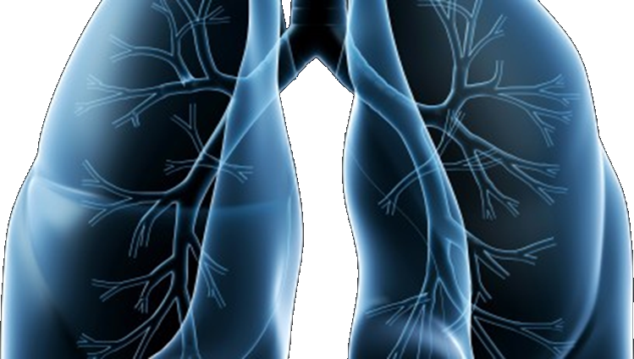

S1400
Revision #6/7
Training Slides
A Biomarker-Driven Master Protocol for Previously Treated Squamous Cell Lung Cancer. (LUNG-MAP)
This slide deck contains an overview of the study design, eligibility criteria, and updates to the design and eligibility for Revision #6/7 of S1400
Version date february 2017

Slide 2
S1400 Revision #6/7 version 8/29/2016 and 1/19/2017
A Biomarker-Driven Master Protocol for Previously Treated Squamous Cell Lung Cancer. (LUNG-MAP)
Revision Summary of Changes
Schema
Study design/goals
Objectives
Eligibility Overview
Study Chairs

Slide 3
Revision #6 and #7 Summary of Changes
  Revision #6
  NEW Sub-Study, S1400G: a biomarker-driven study including a PARP inhibitor
  This study will follow the Phase II design from Design #2: Seamless Phase II followed by Phase III among patients defined to be HRRD MDVN-positive.
  Talazoparib
Administrative Closure of S1400C, CDK4/6 – Palbociclib
  S1400C Permanently Closed on 9/1/2016
S1400D Permanently Closed on 10/31/2016
  Revision #7
  Rapid Request for Amendment (RRA) for ipilimumab and for nivolumab

Slide 4
Schema at Revision #6/#7
Biomarker Driven
Sub-Studies
Non-match
Sub-Study
S1400B§
PI3K
S1400D§
FGFR
S1400G
HRRD
S1400I
Checkpoint
Naive
Single Arm
Phase II
GDC-0032
AZD4547
Talazoparib
Randomized
Phase III
Nivolumab/
Ipilimumab
Nivolumab
GDC-0032
vs. TBD
AZD4547
vs. TBD
Talazoparib
vs. TBD
Biomarker-driven sub-studies will progress to Phase III if study meets endpoint and Phase III is feasible at which point the standard of care arm will be determined.
§S1400B and S1400D Closed prior to the activation of Revision #6/7

Slide 5
Study Design and Goals at Revision #6/#7
Overall Study Goal:
Identify and quickly lead to approvals of immunotherapies as safe and effective regimens (monotherapy or combinations) based on matched predictive biomarker-targeted drug pairs
Study Design:
S1400G: Single arm Phase II Design
S1400I: Randomized Phase III Design

Slide 6
Study Objectives at Revision #6/#7
Study Objectives for Phase II Biomarker-driven Sub-study: S1400G
Primary Objective:
To estimate the response rate among patients treated with the investigational therapy
Secondary Objectives:
To evaluate investigator-assessed progression-free survival and overall survival with the investigational therapy
To evaluate duration of response with the investigational therapy
To evaluate frequency and severity of toxicities associated with investigational therapy

Slide 7
Study Objectives at Revision #6/#7
Study Objectives for Phase III Non-Match Sub-study: S1400I
Primary Objective:
To compare overall survival in patients randomized to nivolumab plus ipilimumab vs. nivolumab
Secondary Objectives:
To compare investigator-assessed progression-free survival in patients randomized to nivolumab plus ipilimumab vs. nivolumab
To compare response rates among patients randomized to nivolumab plus ipilimumab vs. nivolumab
To evaluate frequency and severity of toxicities associated with nivolumab plus ipilimumab vs. nivolumab

Slide 8
S1400 Screening/Pre-screening Eligibility Overview
Patients must have Stage IV or recurrent squamous cell lung cancer
Patients are eligible for the S1400 Screening/Pre-Screening registration:
  upon progression on prior therapy (Screen at progression), or
  prior to progression on current treatment for Stage IV disease (Pre-Screen prior to progression)
Patients must have measurable disease
Patients must have a performance status of 0-1
Patients must have an adequate tissue specimen for biomarker profiling
  The local pathologist must sign off on the S1400 Local Pathology Review Form prior to enrollment certifying the tissue requirements have been met

Slide 9
S1400 Sub-Study Chairs Revision #6/#7
S1400A–MEDI4736
  Vassiliki A. Papadimitrakopoulou, MD
  NCTN: SWOG
  Hossein Borghaei, DO
  NCTN: ECOG-ACRIN
S1400B–GDC-0032 (TASELISIB)
  Corey J. Langer, MD
  NCTN: NRG
  James Wade III, MD
  NCTN: SWOG
S1400C–PALBOCICLIB
  Martin J. Edelman, MD
  NCTN: NRG
  Kathy S. Albain, MD
  NCTN: SWOG
S1400D–AZD4547
  Charu Aggarwal, MD, MPH
  NCTN: ECOG-ACRIN
  Primo N. Lara, Jr., MD
  NCTN: SWOG
S1400G–Talazoparib
  Taofeek K. Owonikoko, MD, PhD, MSCR
  NCTN: ECOG-ACRIN
  Lauren A. Byers, MD
  NCTN: SWOG
S1400I–Nivolumab plus Ipilimumab
  Scott N. Gettinger, MD
  NCTN: SWOG
  Lyudmila A. Bazhenova, MD
  NCTN: ALLIANCE

