Slide 1
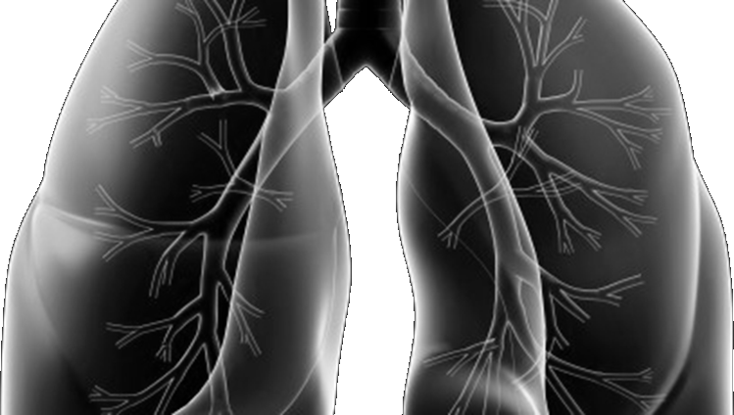







Lung-MAP Update Forum
SWOG Fall meeting
September 19, 2025

Slide 2
Agenda
There will be
two Q & A sessions during the Update Forum.
Welcome & Lung-MAP Accomplishments– Karen Reckamp, MD & Saiama Waqar, MD
Manuscript and Accrual Updates– Mary W. Redman, PhD
Accrual Enhancement Committee Updates & Lung-MAP Website Updates– Frank DeSanto
S1900G Update– Sarah Goldberg, MD
S1900J Update– Christian Rolfo, MD
S1900K Update– Paul K. Paik, MD
S1800E Update– Saiama Waqar, MD
Q&A– Karen Reckamp, MD
S1900N Update– Jonathan Riess, MD
How to Engage with Lung-MAP Through the Drug Selection Committee– Konstantin Dragnev, MD
How to Engage with Lung-MAP Through the Translational Medicine Committee– Joel Neal, MD
Q&A– Karen Reckamp, MD

Slide 3
Welcome
Karen Reckamp, MD, MS
Chair, Lung-MAP (SWOG)
Cedars-Sinai Medical Center Dept of Medicine
Saiama Waqar, MD, MSCI
Co-Chair, Lung-Map (NRG)
Washington University School of Medicine in St. Louis

Slide 4

Judy Johnson, Patient Advocate
Thank you for
10 years of dedicated service to Lung-MAP!

Slide 5
Lung-MAP Accomplishments
Karen Reckamp, MD, MS
Chair, Lung-MAP (SWOG)
Cedars-Sinai Medical Center Dept of Medicine
Saiama Waqar, MD, MSCI
Co-Chair, Lung-Map (NRG)
Washington University School of Medicine in St. Louis

Slide 6
Top-Accruing Sites Last 12 Months (8/24 – 7/25)
Palo Alto Medical Foundation-Sunnyvale – Sunnyvale, CA 18 patients enrolled
Edwards Comprehensive Cancer Center – Huntington, WV 15
Sutter Pacific Medical Foundation – Santa Rosa, CA 13
Harold Alfond Center for Cancer Care – Augusta, ME 10
Univ of Kansas Hospital-Westwood Cancer Ctr – Westwood, KS 8
Mercy Hospital South – Saint Louis, MO 7
Saint Mary’s Medical Center – Huntington, WV 7
University of New Mexico Cancer Center – Albuquerque, NM 7
UPMC Hillman Cancer Center – Monroeville – Monroeville, PA 7
Eastern Maine Medical Center Cancer Care – Brewer, ME 6
Palo Alto Medical Foundation Health Care – Palo Alto, CA 6
Ralph H Johnson VA Medical Center – Charleston, SC 6
Saint Vincent Hospital Cancer Ctr at Saint Mary's – Green Bay, WI 6

Slide 7
Top-Accruing Investigators Last 12 Months
Kim-Son Nguyen | Palo Alto Medical Foundation-Sunnyvale | 11
Zeyad Kanaan | Sutter Pacific Medical Foundation | 11
Chao Huang | U Kansas Hospital-Westwood Ca Ctr (8) and Kansas City VAMC (1) | 9
Toni Pacioles | Edwards Comprehensive Cancer Center | 8
Muhammad Omer Jamil | Edwards Comprehensive Cancer Center | 6
Oleksandra Lupak | Ralph H Johnson VA Medical Center | 6
Moises Harari-Turquie | University of New Mexico Cancer Center | 6
Gauri Kiefer | UPMC Cancer Centers - Arnold Palmer Pavilion | 4
Tianhong Li | Mather VA Medical Ctr (3) and UC Davis CCC (1) | 4
David Groteluschen | Saint Vincent Hospital Cancer Ctr at Saint Mary's | 4
Huy Nguyen | Palo Alto Medical Foundation-Sunnyvale | 4
Nishant Tageja | UPMC Hillman Cancer Center – Monroeville | 4

Slide 8
Sites Recently Enrolling Their First Patient(s)
These sites have enrolled their first patient to LUNGMAP within the last 4 months:
Baptist Cancer Center-Grenada (MS)
Baptist Memorial Hospital and Cancer Center-Collierville (TN)
Huntsman Cancer Institute/University of Utah (UT)
Kaiser Permanente-Caton Hill Medical Center (VA)
Mather Veteran Affairs Medical Center (CA) (enrolled 4!)
Memorial Hospital East (IL)
Memorial Sloan Kettering Basking Ridge (NJ)
Providence Portland Medical Center (OR)
Ridley-Tree Cancer Center (CA) (enrolled 2)
Saint Francis Medical Center (MO)
Siteman Cancer Center-South County (MO)
University of Virginia Cancer Center (VA)
VA Palo Alto Health Care System (CA)

Slide 9
Manuscript
& Accrual Updates
Mary W. Redman, PhD
Statistics Chair, Lung-MAP
Fred Hutchinson Cancer Center

Slide 10
Lung-MAP Accrual: January 2019 to Present
 | TOTAL | Registrations within the Last:
 | REGS.
 | since Jan. 2019 | 6 | 3 | 30 | 7
 |  | Months | Months | Days | Days
LUNGMAP Screening Protocol Registrations
Total | 3740 | 153 | 90 | 38 | 5
Screened at PD | 1317 | 66 | 45 | 20 | 1
Pre-Screened prior to PD | 2413 | 77 | 41 | 17 | 4
Treatment-naïve (for S1900K) | 10 | 10 | 4 | 1 | 0
Sub-Study Assignments
LUNGMAP Sub-Study Assignments | 1970 | 215 | 67 | 30 | 4
Sub-Study Registrations
LUNGMAP Sub-Study Registrations | 532 | 37 | 25 | 13 | 1

Slide 11
Lung-MAP Publications October 2024 to Present
Sub-study Publications since 10/2024:
  S1900E ASCO Oral Abstract Presentation:
    ECOG-ACRIN LUNG-MAP S1900E substudy: A phase II study of sotorasib in participants (Pts) with previously treated stage IV or recurrent KRAS G12C mutant non-squamous (Non-sq) non-small cell lung cancer (NSCLC).
    Authors: Sukhmani Padda, Mary Redman, David Gerber, Tom Stinchcombe, Saiama Waqar, Ticiana Leal, Katherine Minichiello, Karen Reckamp, Roy Herbst, Hossein Borghaei, Julie Brahmer, Jhanelle Gray, Karen Kelly, Suresh Ramalingam, and Joel Neal
    Lung-MAP Chairs: Roy Herbst and Jyoti Patel (2019-2022); Hoss Borghaei and Karen Reckamp (2022-2024); Karen Reckamp and Saiama Waqar (2024-Present)

Slide 12
Lung-MAP Publications October 2024 to Present
Translational Medicine Publications since 10/2024:
  Lung-MAP Next-Generation Sequencing Analysis of Advanced Squamous Cell Lung Cancers (SWOG S1400).
  Kozono D, Hua X, Wu MC, Tolba KA, Waqar SN, Dragnev KH, Cheng H, Hirsch FR, Mack PC, Gray JE, Kelly K, Borghaei H, Herbst RS, Gandara DR, Redman MW.
  J. Thorac Oncol. 2024 Dec;19(12):1618-1629. doi: 10.1016/j.jtho.2024.07.024. Epub 2024 Aug 5.PMID: 39111731
  Lung-MAP Chairs: Vali Papadimitrakopoulou and Roy Herbst (2014-2019); TM Chair David Kozono (2019-2024)
  Elevated ctDNA Tumor Fraction Is Associated with Improved Mutation Detection but Worse Overall Survival in Advanced Non-Small Cell Lung Cancer: A Lung-MAP Study.
    Mack PC, Redman MW, Tukachinsky H, Kozono DE, Minichiello K, Dragnev KH, Tolba KA, Neal JW, Madison RW, Waqar SN, Aggarwal C, Hirsch FR, Patel JD, Herbst RS, Chiang AC, Reckamp KL, Kelly K, Borghaei H, Gray JE, Gandara DR.
    Clin Cancer Res. 2025 Aug 14;31(16):3550-3561. doi: 10.1158/1078-0432.CCR-24-3658.PMID: 40465842
  Lung-MAP Chairs: Vali Papadimitrakopoulou and Roy Herbst (2014-2019); TM Chair David Kozono (2019-2024)

Slide 13
Lung-MAP Publications in Progress
Sub-study Primary Manuscripts :
  S1900A: A phase II study of rucaparib in participants with genomic LOH High and/or deleterious BRCA1/2 Mutation Stage IV or Recurrent Non-Small Cell Lung Cancer.
  Study Chairs: J Riess and P Wheatley-Price; Statisticians: M Redman and K Minichiello; Study Champion: D Gandara
  Lung-MAP Chairs: Vali Papadimitrokopoulou and Roy Herbst (2014-2019)
  Status: Presented ASCO 2021. Study team responding to reviewer comments from Nature Communications
  S1900C: A phase II study of talazoparib plus avelumab in patients with stage IV or recurrent nonsquamous non–small cell lung cancer bearing pathogenic STK11 genomic alterations
  Study Chairs: M Suga and F Skoulidis; Statisticians: M Redman and K Minichiello; Study Champion: D Gandara
  Status: Presented ASCO 2021. Study team finalizing draft for final reviews prior to submission
  Lung-MAP Chairs: Vali Papadimitrokopoulou and Roy Herbst (2014-2019)
  S1900E: A phase II study of sotorasib in participants (Pts) with previously treated stage IV or recurrent KRAS G12C mutant non-squamous (Non-sq) non-small cell lung cancer (NSCLC).
  Study Chairs: S Padda and D Gerber; Statisticians: M Redman and K Minichiello; Study Champion: J Neal
  Lung-MAP Chairs: Roy Herbst and Jyoti Patel (2019-2022)
  Status: Presented ASCO 2025. Study chair nearly finalized with initial draft
  S1800D: A phase II/III study of N-803 (ALT-803) plus pembrolizumab versus standard of care in participants with stage IV or recurrent non-small cell lung cancer (NSCLC) previously treated with anti-PD-1 or anti-PD-L1 therapy.
  Study Chairs: J Wrangle and H Husain; Statisticians: M Redman and K Minichiello; Study Champion: R Herbst
  Lung-MAP Chairs: Roy Herbst and Jyoti Patel (2019-2022)
  Status: Presented ASCO 2024. Manuscript draft with statistics team for updates.

Slide 14
Lung-MAP Publications in Progress
Ancillary Projects :
  Acquired and primary resistance to immune checkpoint inhibitor treatment in clinical trials:
  a perspective from Lung MAP investigators
  Project Leads: Deborah Doroshow, Ticiana Leal, Saiama Waqar, Mary Redman, and Karen Reckamp
  Status: Submitted to J Clin Oncol, Comments and Controversies
  S1800A: analysis of ctDNA at baseline, C3D1, and PD
  Project Leads: Konstantin Dragnev and Karen Reckamp; Statisticians: Sarah Samorodnitsky, Mike Wu, and Mary Redman
  Status: Analyses completed. Study team working on manuscript.
  Association between grade of irAEs and outcomes in patients treated with immunotherapy in Lung-MAP sub-studies
  Project Lead: Diane Tseng; Mentor: Chris Baik; Statisticians: Mary Redman and Jim Moon
  Status: Initial analyses completed. Bi-monthly working group call being arranged.
  Docetaxel Pre- and Post-Immunotherapy
  Project Lead: Christine Auberle, Mentor: Saiama Waqar; Statisticians: Mary Redman and Yuzheng Zhang
  Status: Meeting to initiate project being scheduled
  KRAS and smoking and other factors in LUNGMAP
  Project Lead: Bruna Pellini, Mentor: TBD; Statisticians: Yingqi Zhao and Yuzheng Zhang
  Status: Meeting to continue project being scheduled
  Plasma proteomic profiling by PROphet (OncoHost) in S1800A
  Project Lead: Surbhi Singhal, Mentor: David Gandara; Statisticians: Mary Redman and Yuzheng Zhang
  Status: Call scheduled to arrange transfer of data and then analyses will be initiated

Slide 15
Accrual Enhancement Committee & Lung-MAP Website Updates
Frank DeSanto
Communications Manager
SWOG Cancer Research Network

Slide 16
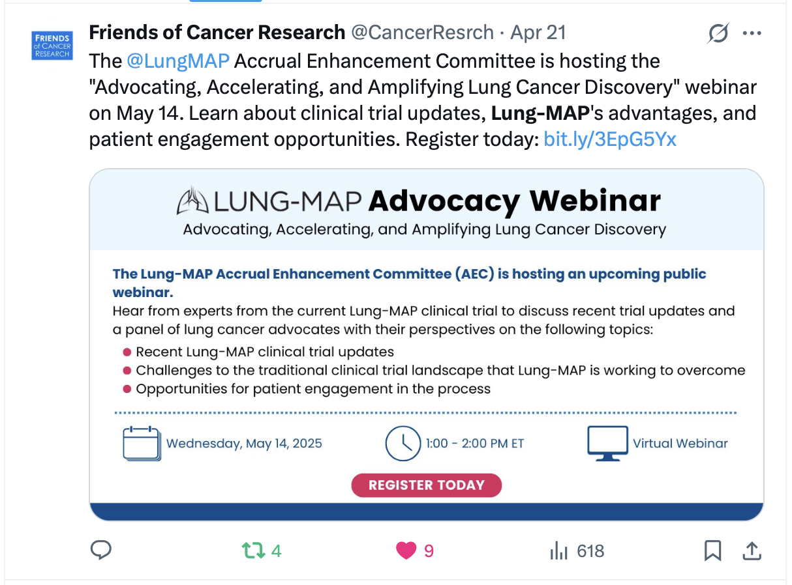
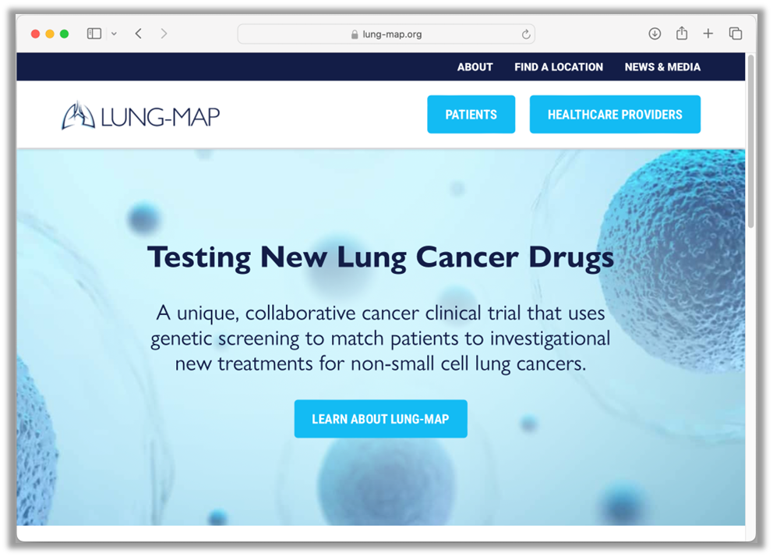
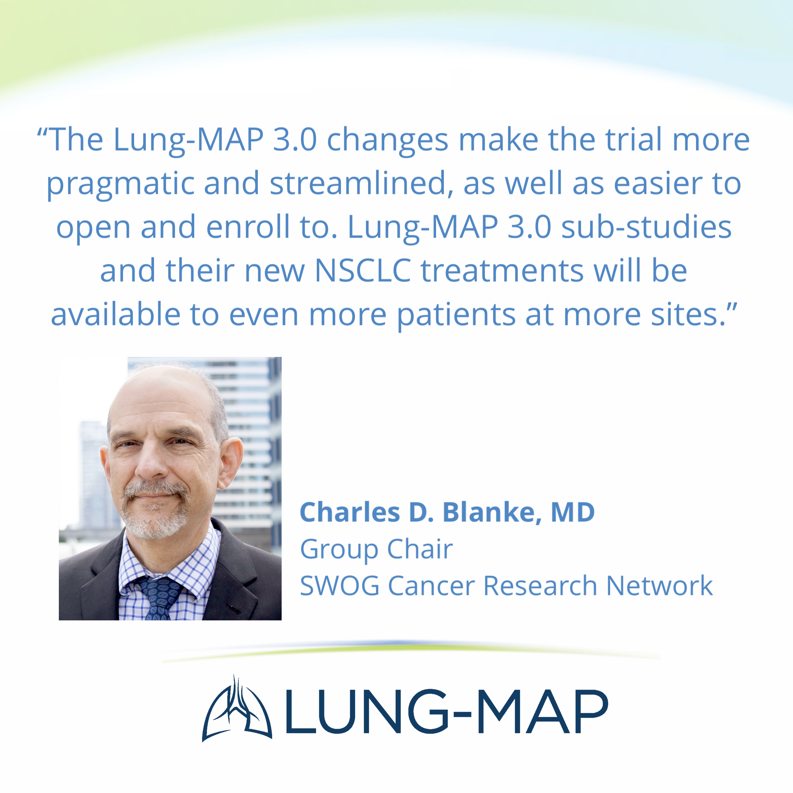
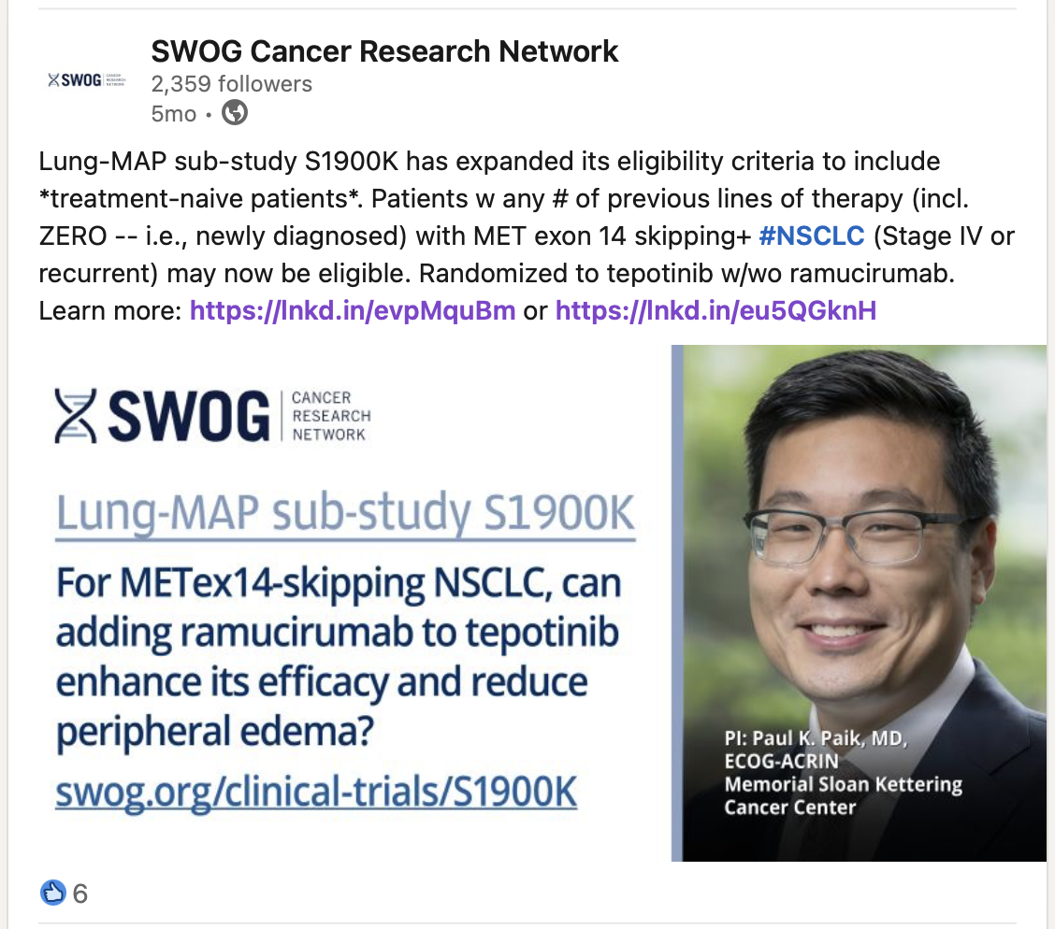
Lung-MAP 3.0: Spreading the Word
Spreading the word about expanded NGS testing options with Lung-MAP relaunch
Slide set introducing changes
Press release
Front Line post and plenary
Social media push
Advocate outreach
Newsletters
Website enhancements

Slide 17
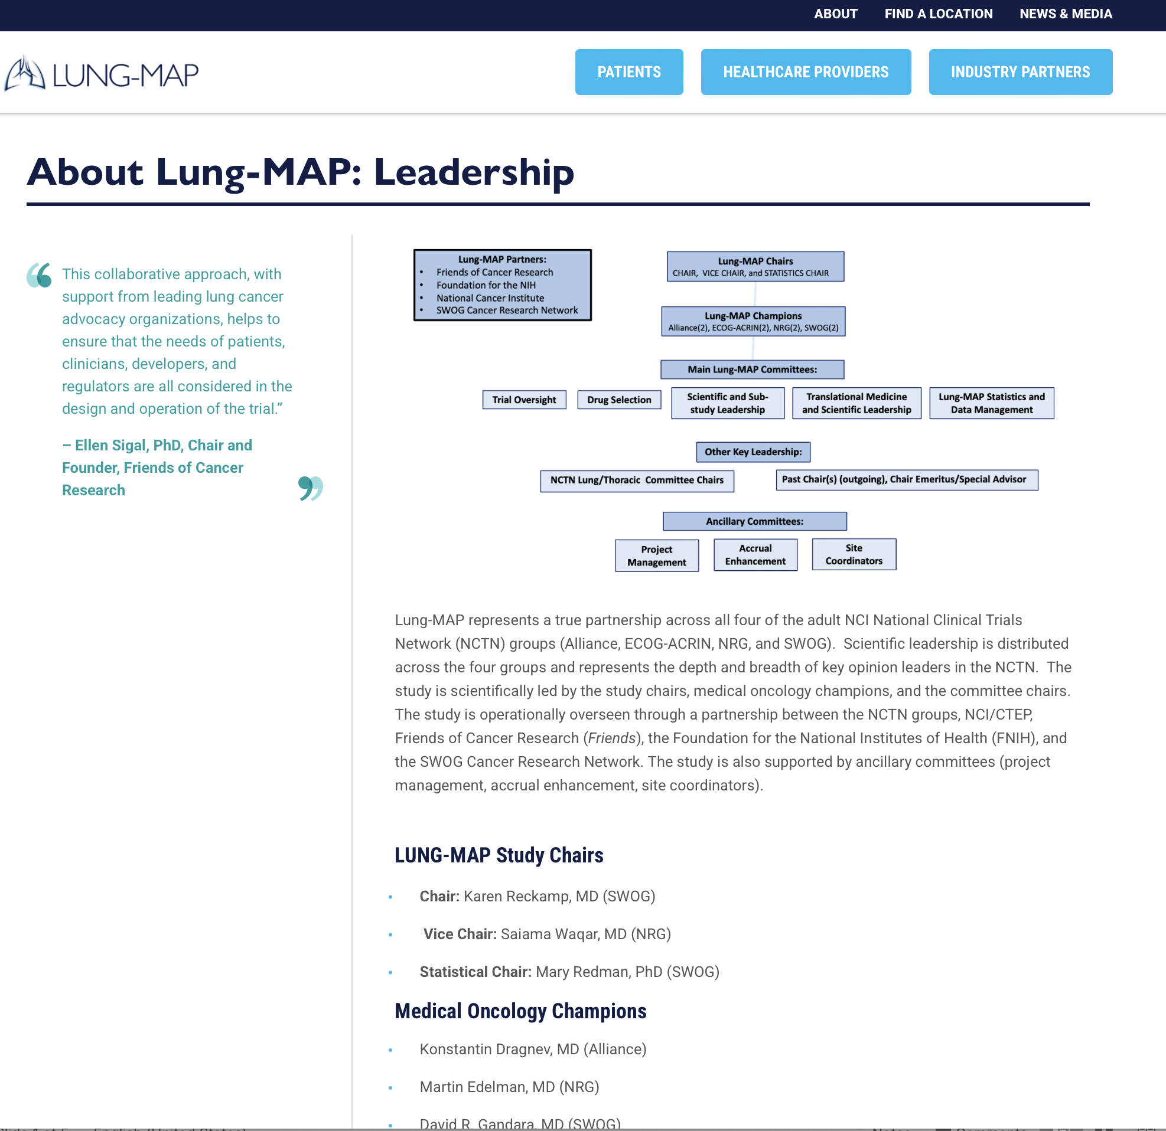
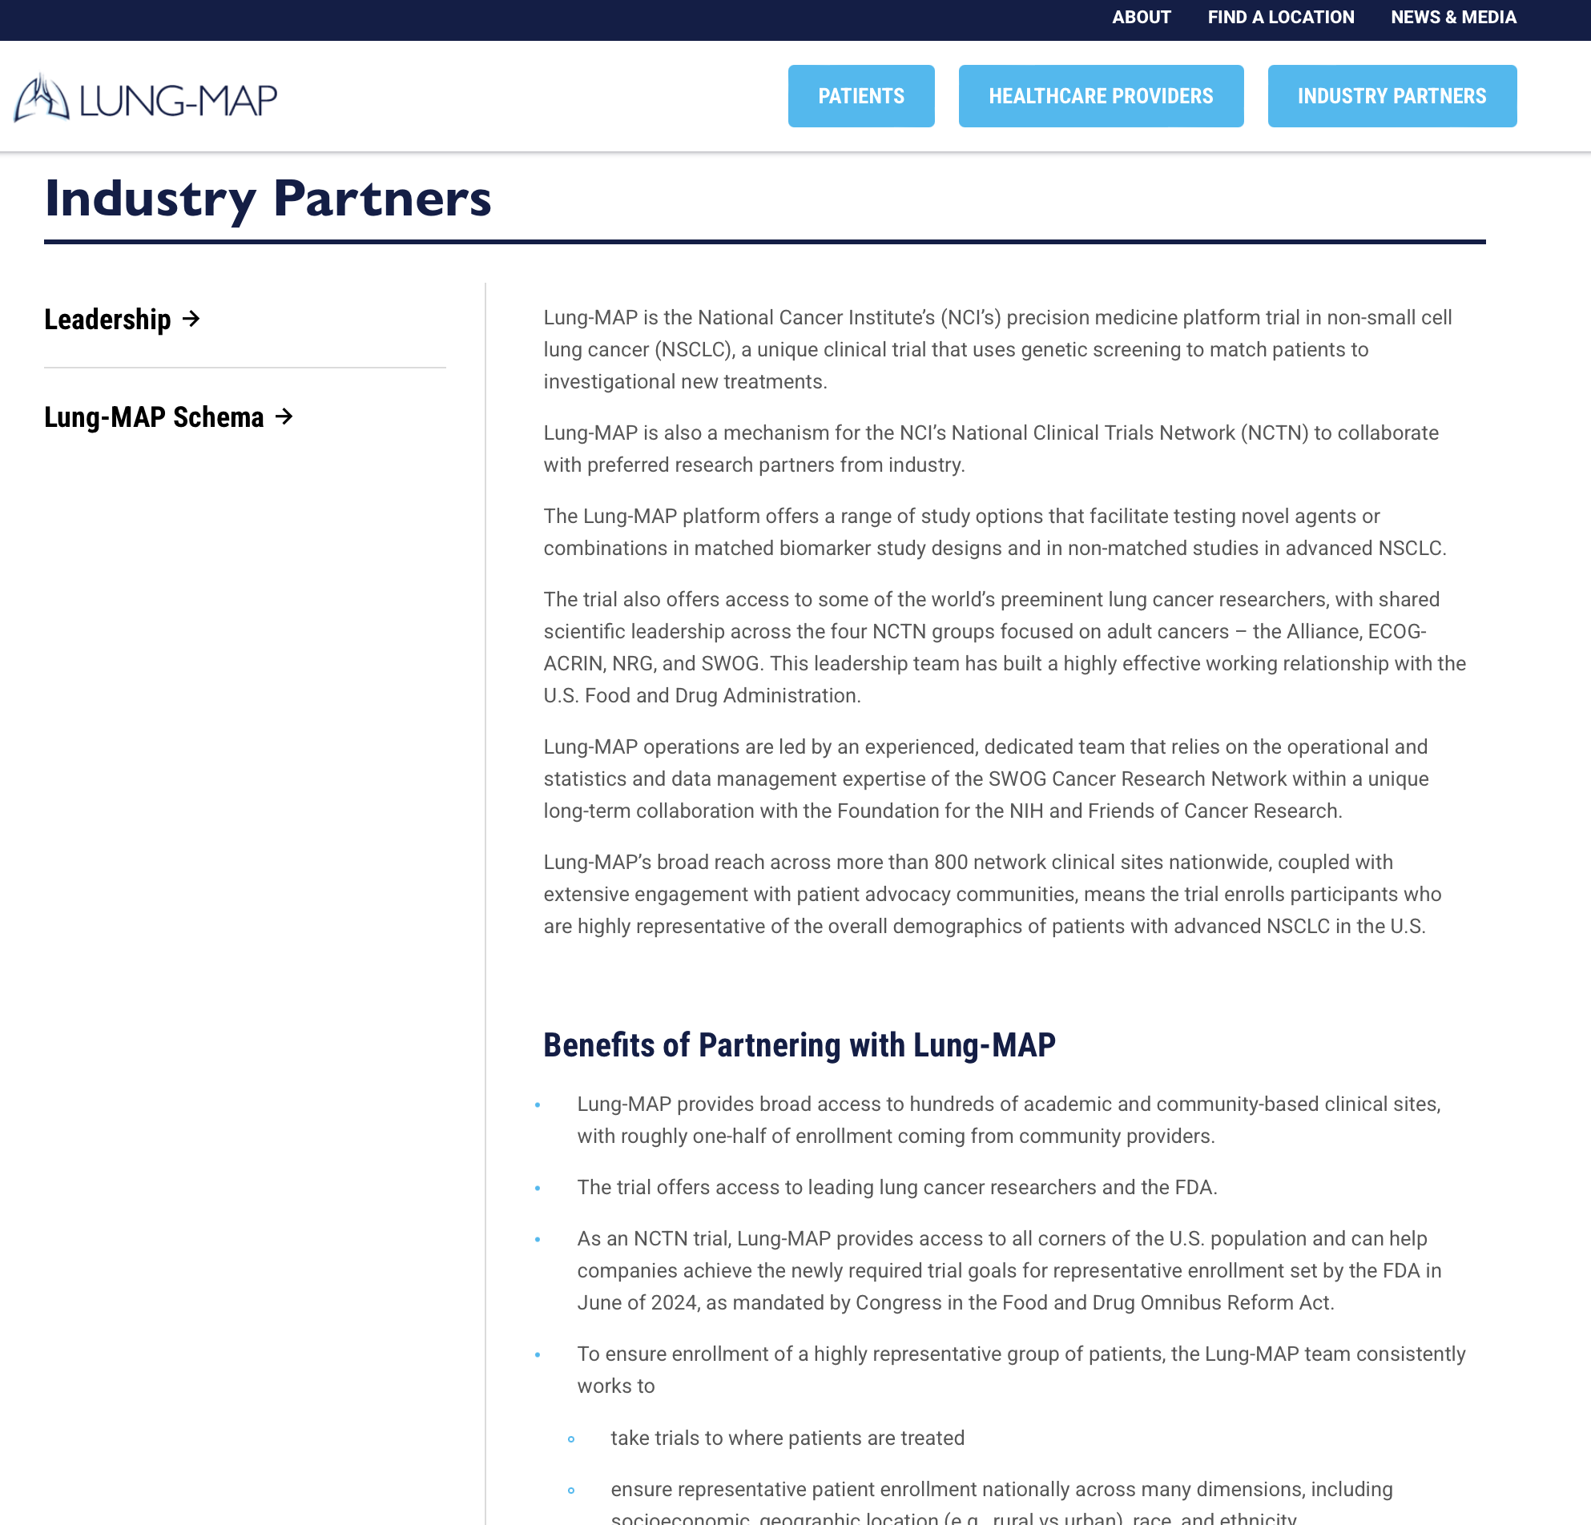
Website Enhancements & Updates
Added Lung-MAP 3.0 messaging
New presentation of Lung-MAP leadership structure
Updated patient content
Added Mission and Vision
Added section with messaging for potential industry partners
  How Lung-MAP works
  Roles of collaborating groups
  Benefits of partnering
Updated site language per White House directives

Slide 18
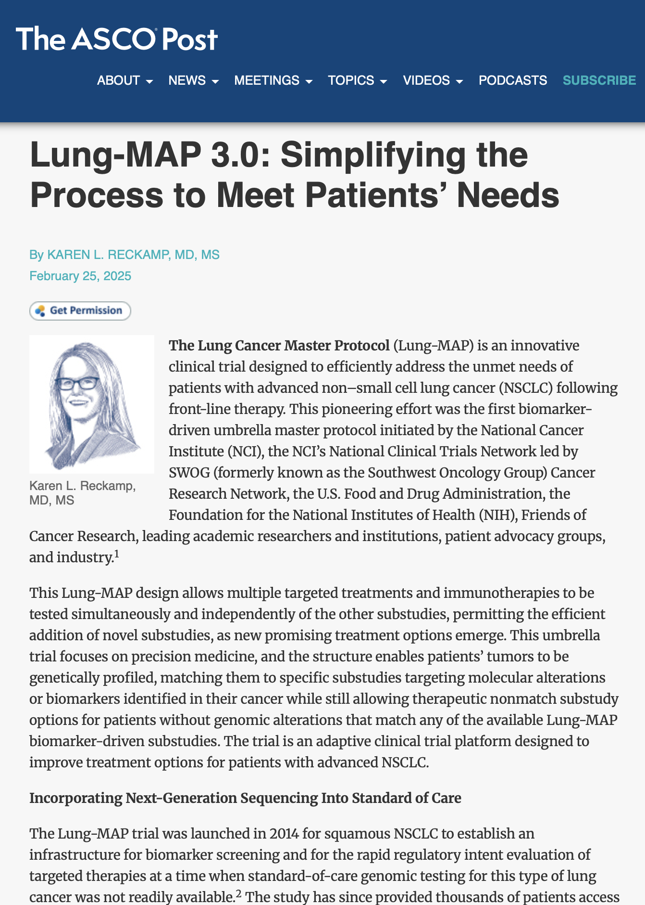
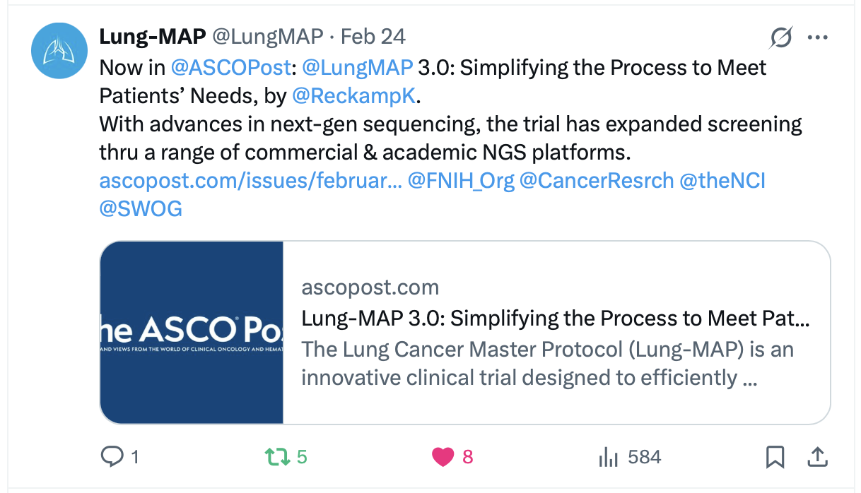
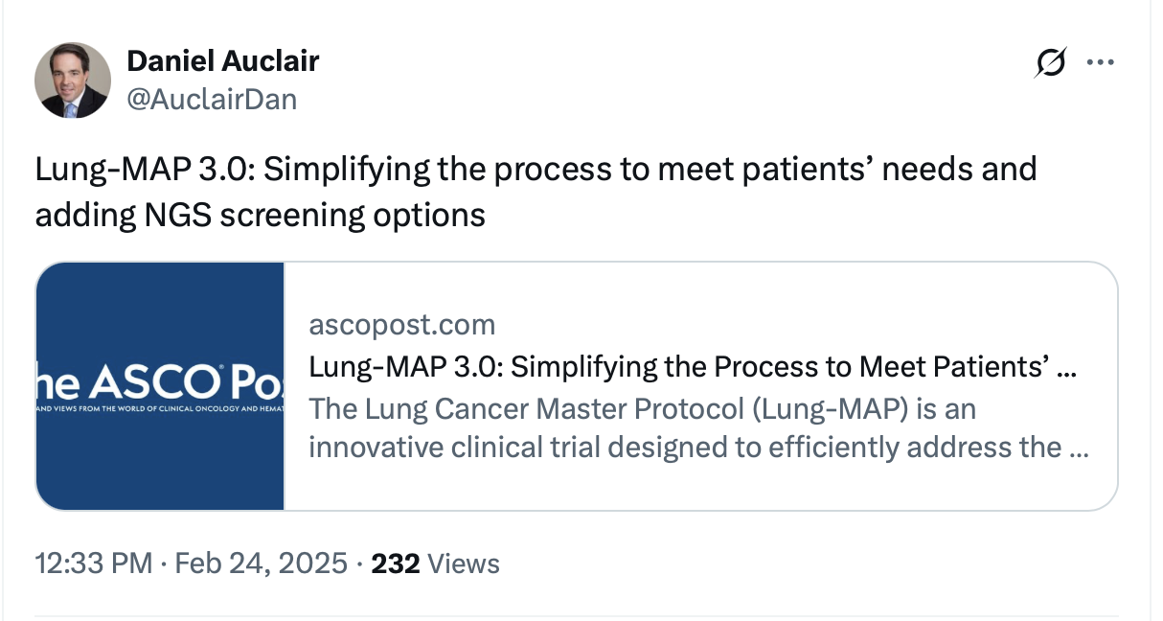
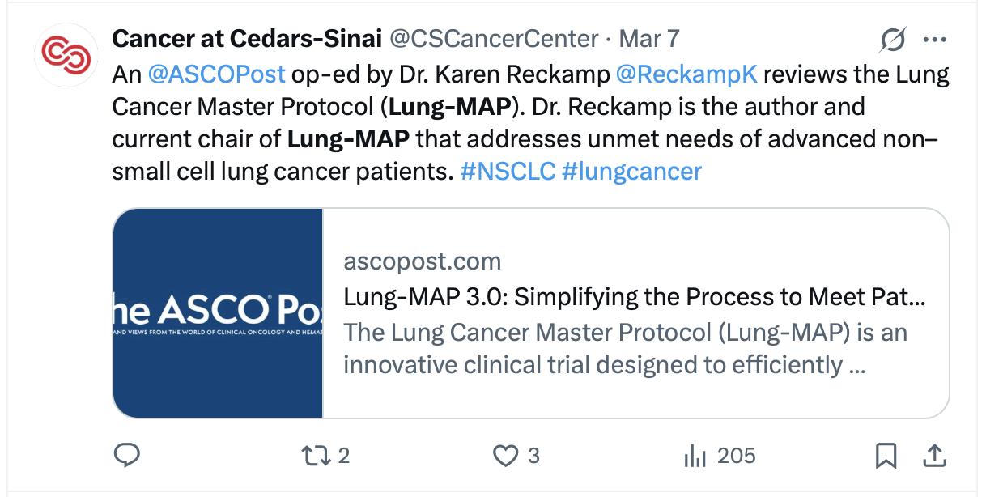
LM 3.0 Editorial
Worked with
Dr. Karen Reckamp
to pitch Lung-MAP 3.0
editorial to ASCO Post
Published Feb. 25, 2025

Slide 19
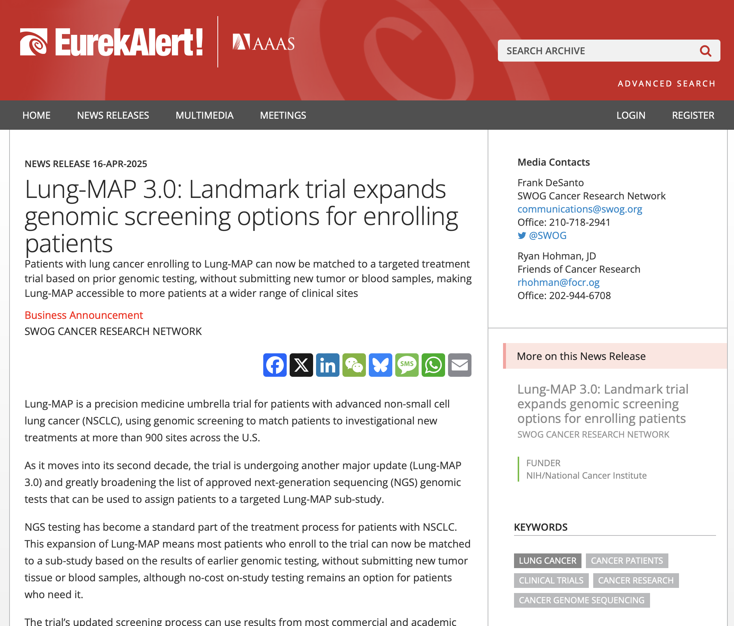
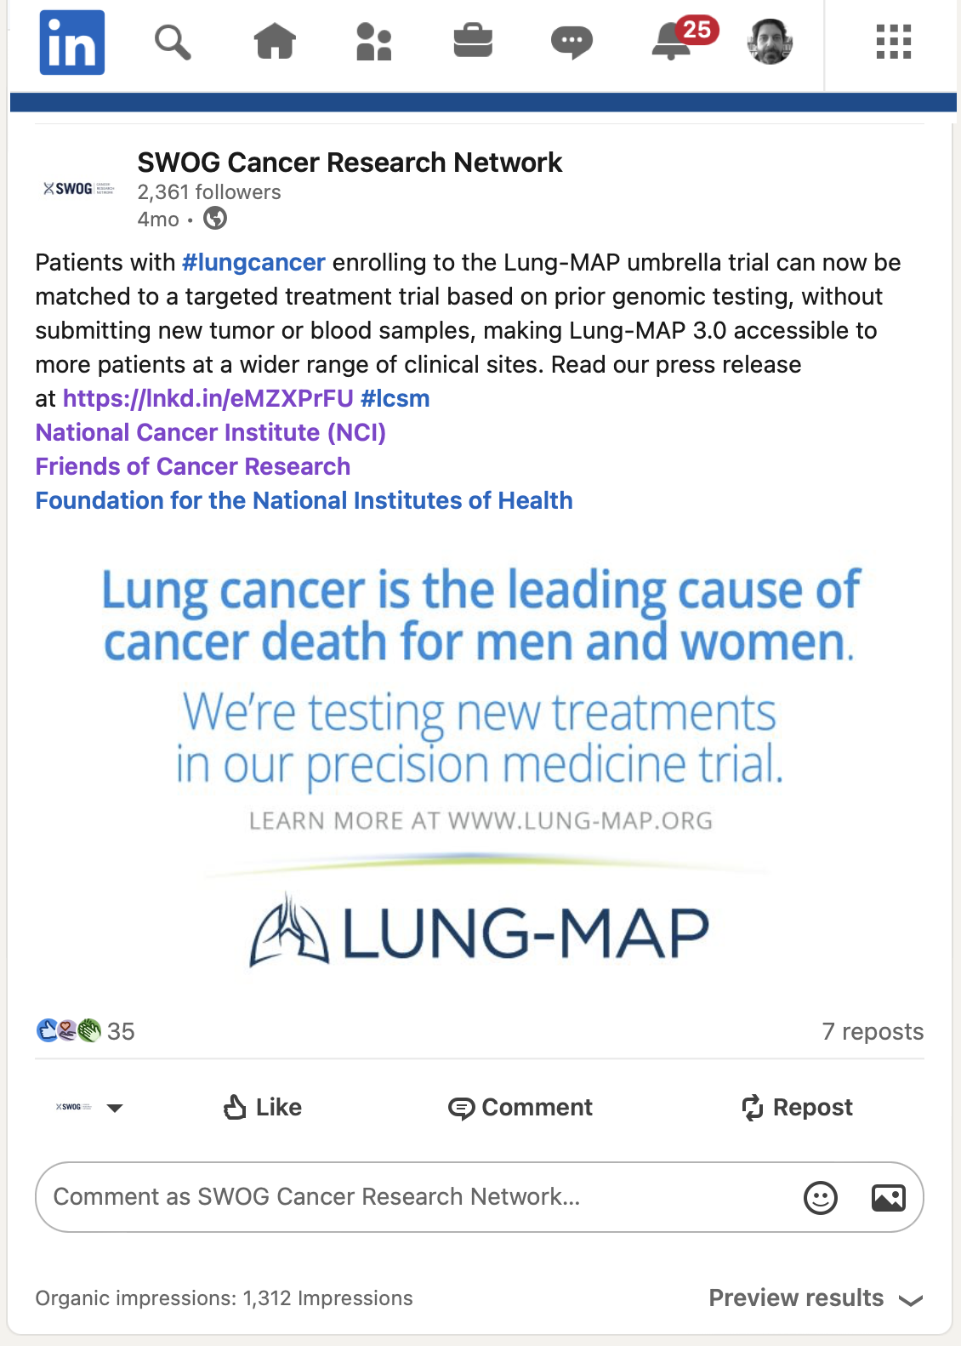
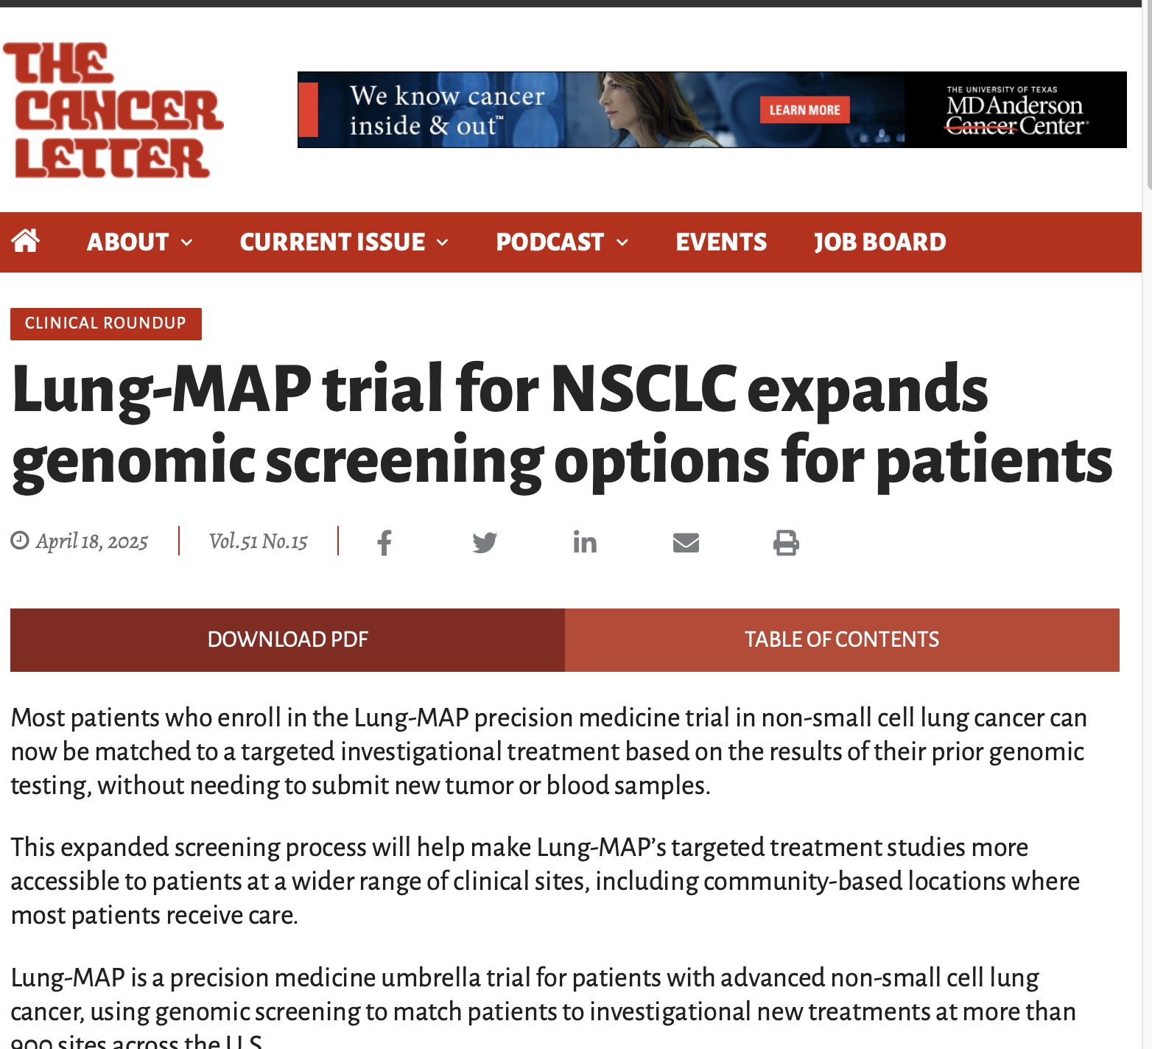
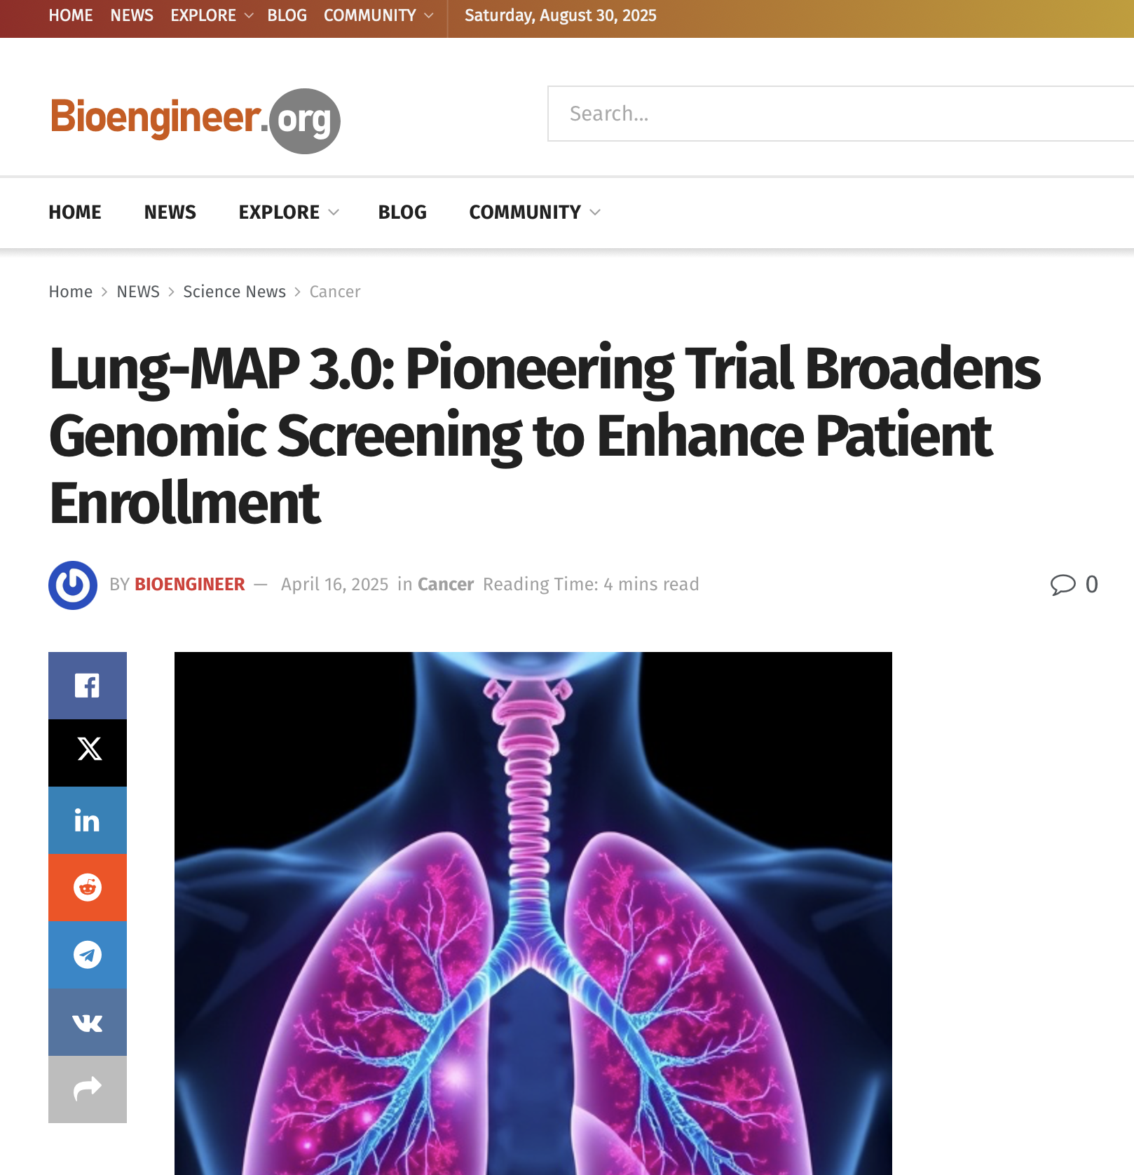
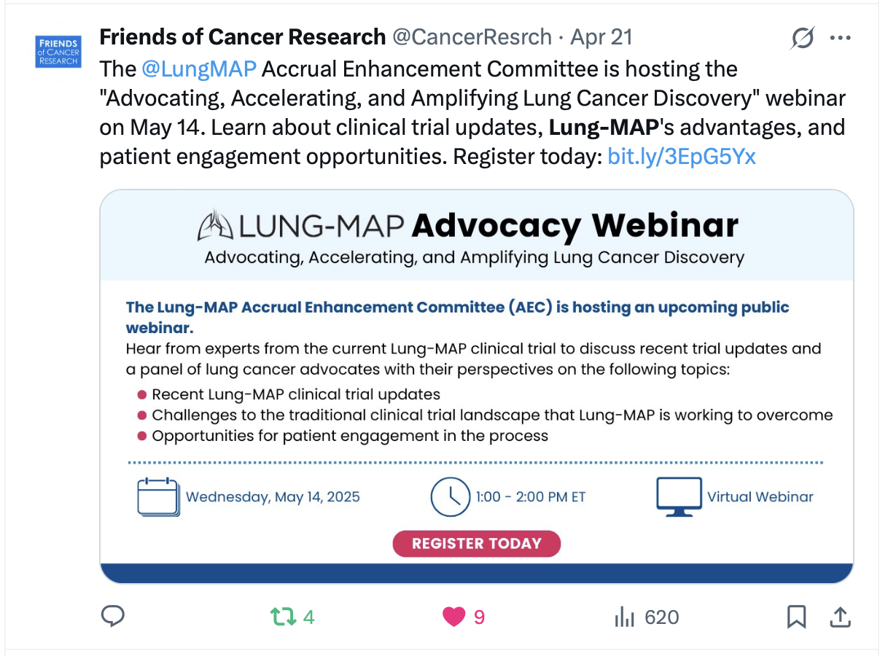
Press Release
Distributed mid-April
With advisory about
May advocacy webinar

Slide 20
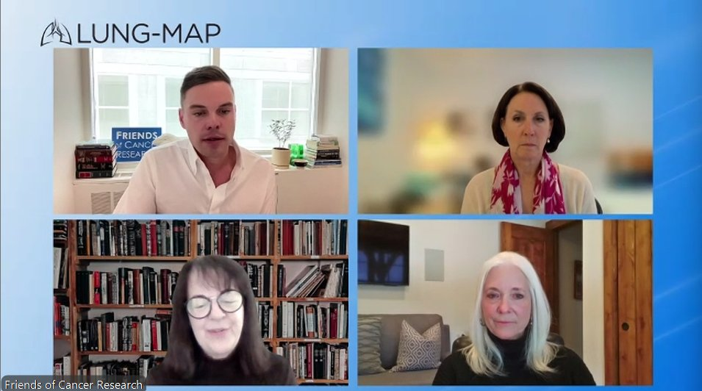
Partnering with Advocacy Groups
May 2025 Lung-MAP Advocacy Webinar
Third such event since 2022
Featured Lung-MAP leaders and advocacy organization leaders
Updated the advocate community on Lung-MAP's current evolution
Engaged advocate partners, to learn more about current and emerging patient needs
Attendance: 300+

Slide 21
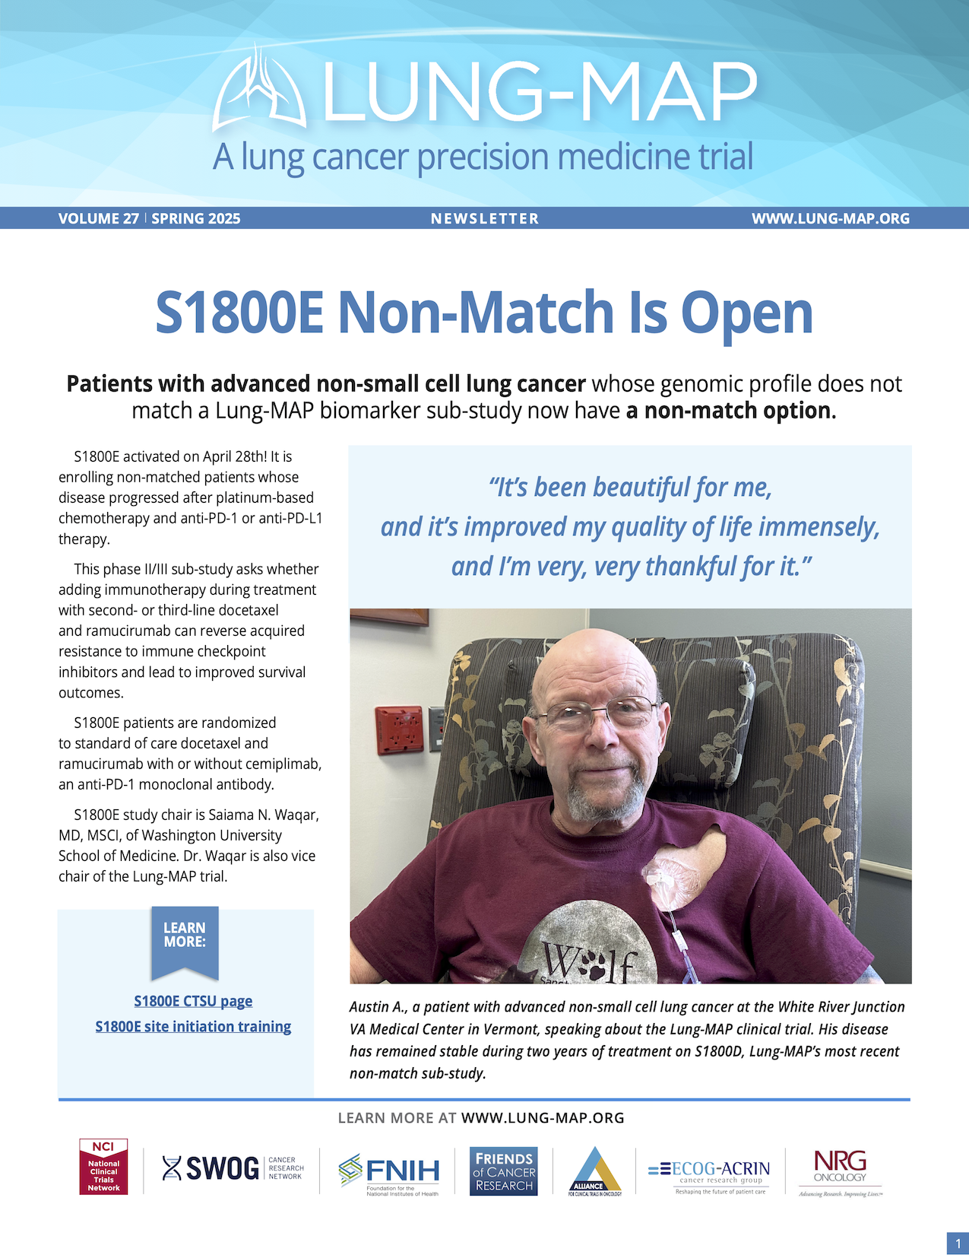
Outreach to Sites
Lung-MAP Newsletter to active site PIs and
primary contacts
Recent content has included
  Lung-MAP 3.0 benefits
  key details of new sub-studies
  revisions to ongoing sub-studies
  patient testimonials
  upcoming educational webinars on sub-studies
Updated site initiation training webinar
in CTSU’s CLASS learning management system
LM 3.0 presented on monthly NCORP admin webinar
  October 2024
  Presenting again next week (Sept 24, 2025)
Dedicated slide set for introducing LM 3.0

Slide 22
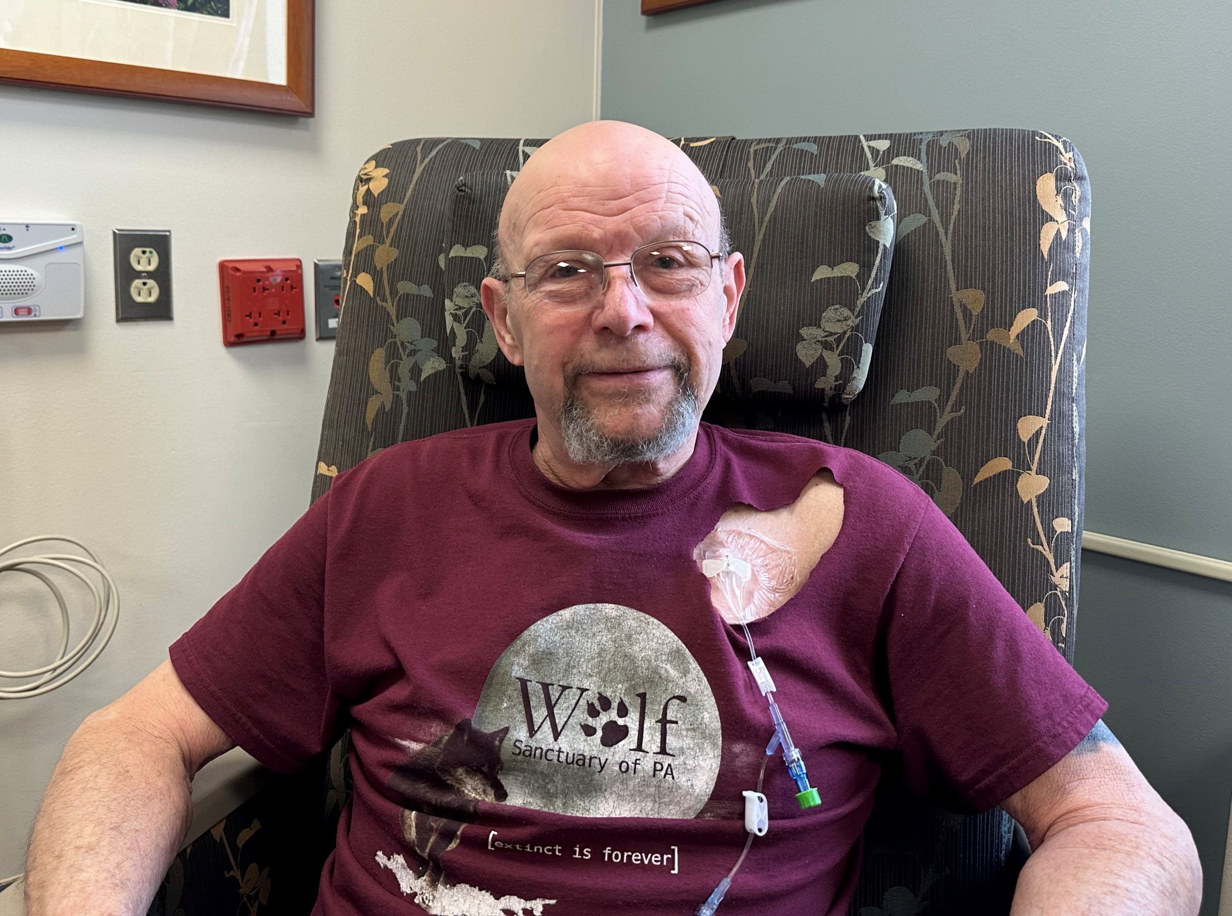
Patient Profiles, Quotes, Photos
“I wake up every morning and I say ‘thank you, here I am.’ And it’s not just because of the man above–
it’s because of science.”
– Austin A., whose disease has not progressed during two years of treatment on Lung-MAP S1800D

Slide 23
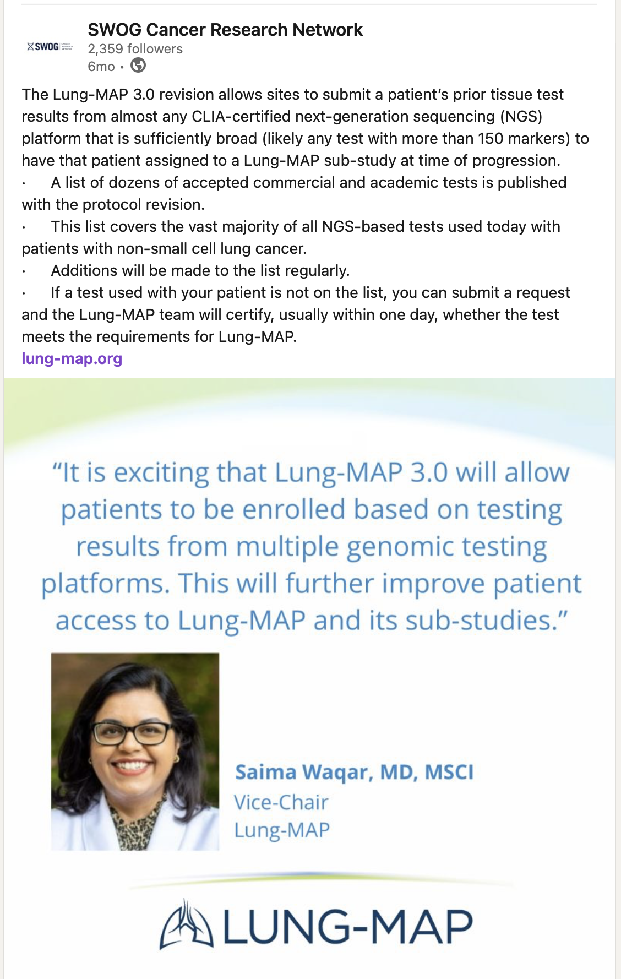
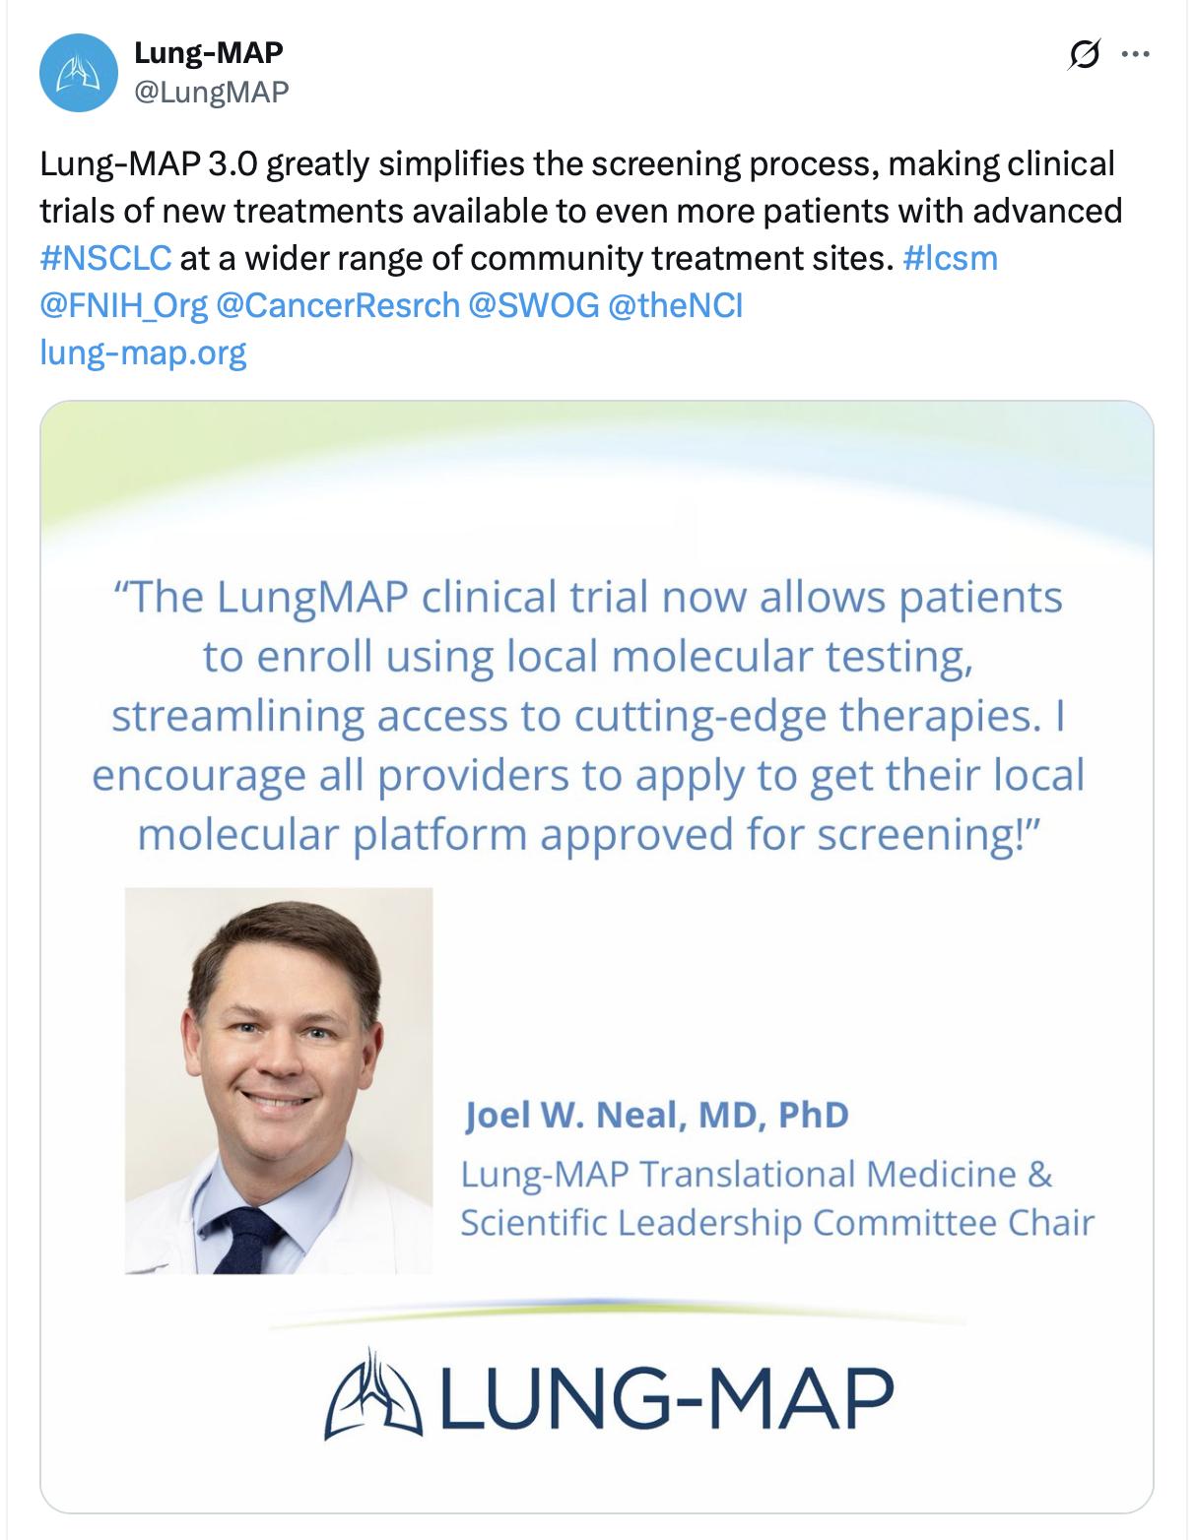
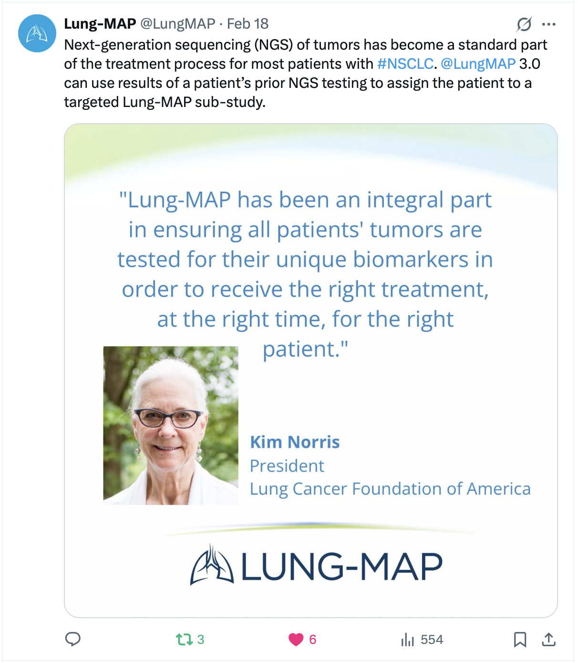
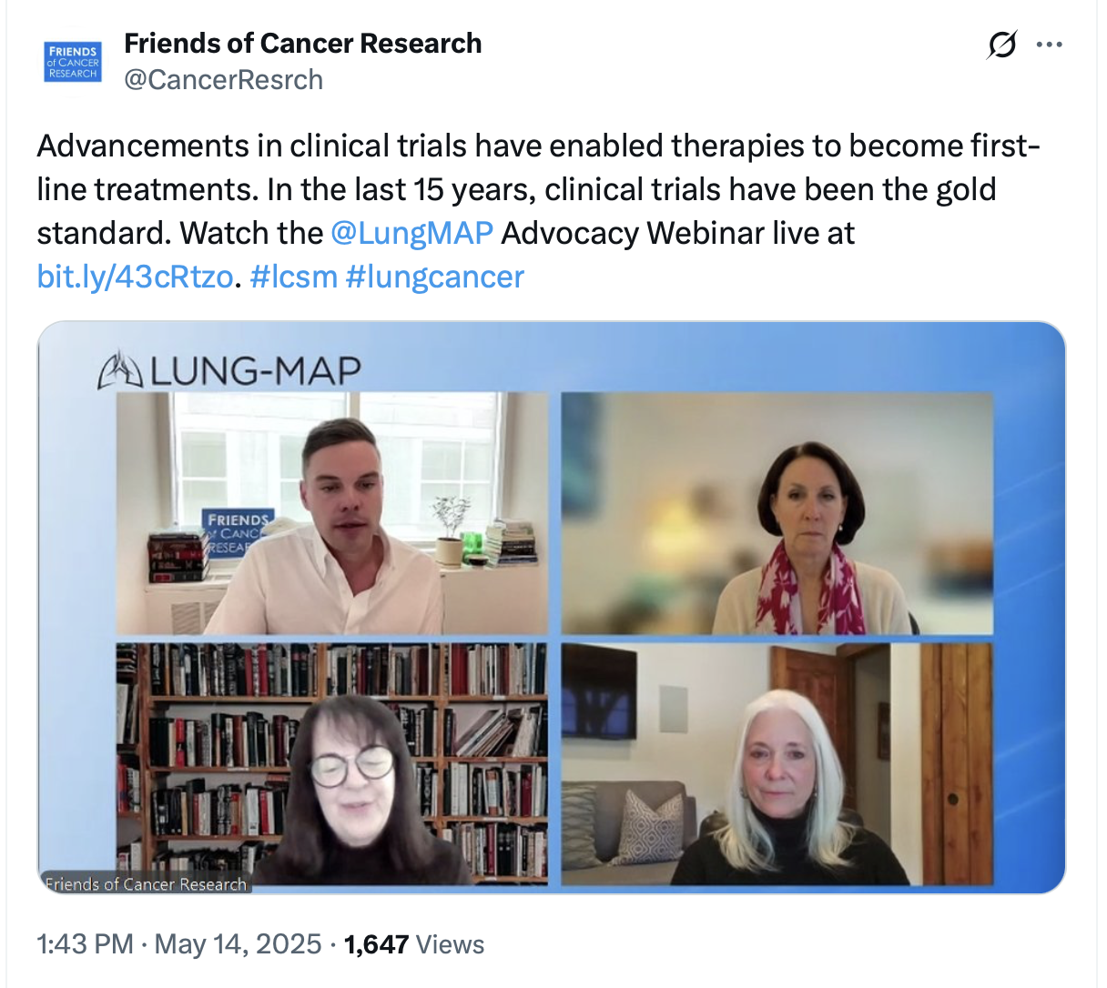
Lung-MAP 3.0 Social Media
Lung-MAP 3.0 messaging
Statements of support by leaders in lung cancer research & advocacy
@LungMAP Twitter/X
  SWOG’s LinkedIn and Facebook
  Partner org accounts: Friends, FNIH

Slide 24
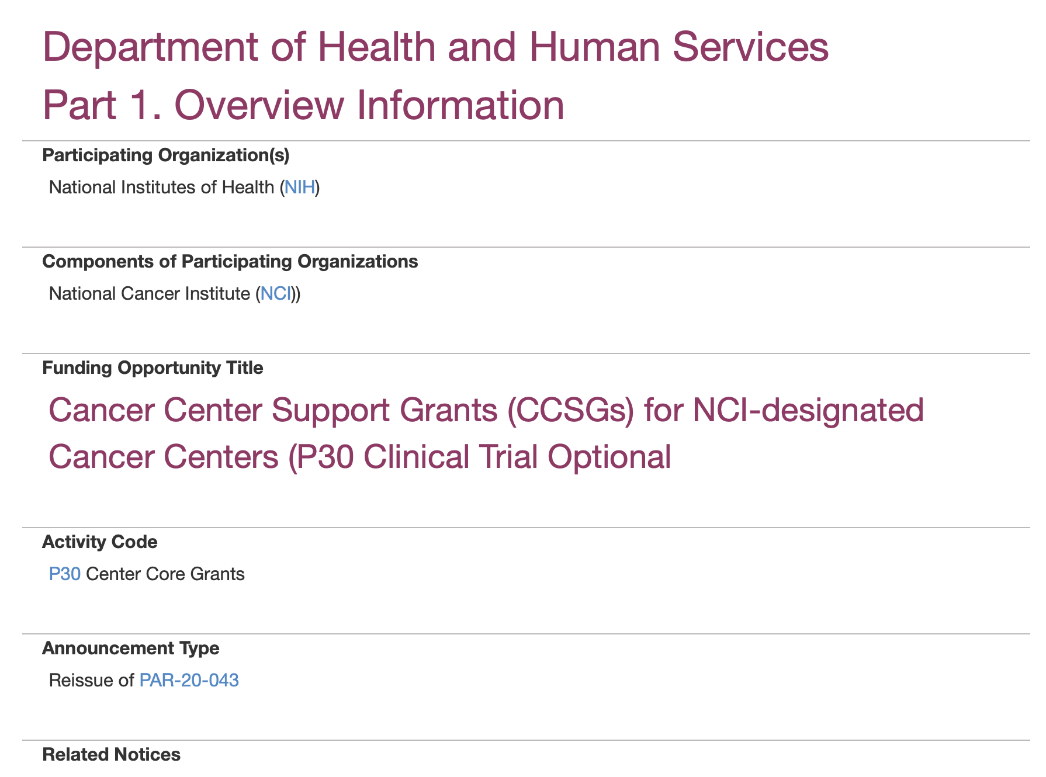
Cancer Centers: Targeted Messaging
Problem: Cancer centers not opening sub-studies they expect to accrue poorly and/or closing sub-studies early for poor accrual
Worked with leadership from other NCI master
protocols – primarily myeloMATCH – on draft message
Message from NCI DCTD leaders to research
leadership at cancer centers:
  Grant FOA exceptions for trials studying rare tumors or
  molecular subtypes
  Guidance in FOA(s) for reporting master protocol accrual
  collectively vs by sub-study
    Sites are not penalized for low accrual to individual sub-studies
Will consider follow-up messaging to these cancer
centers when timing is right

Slide 25
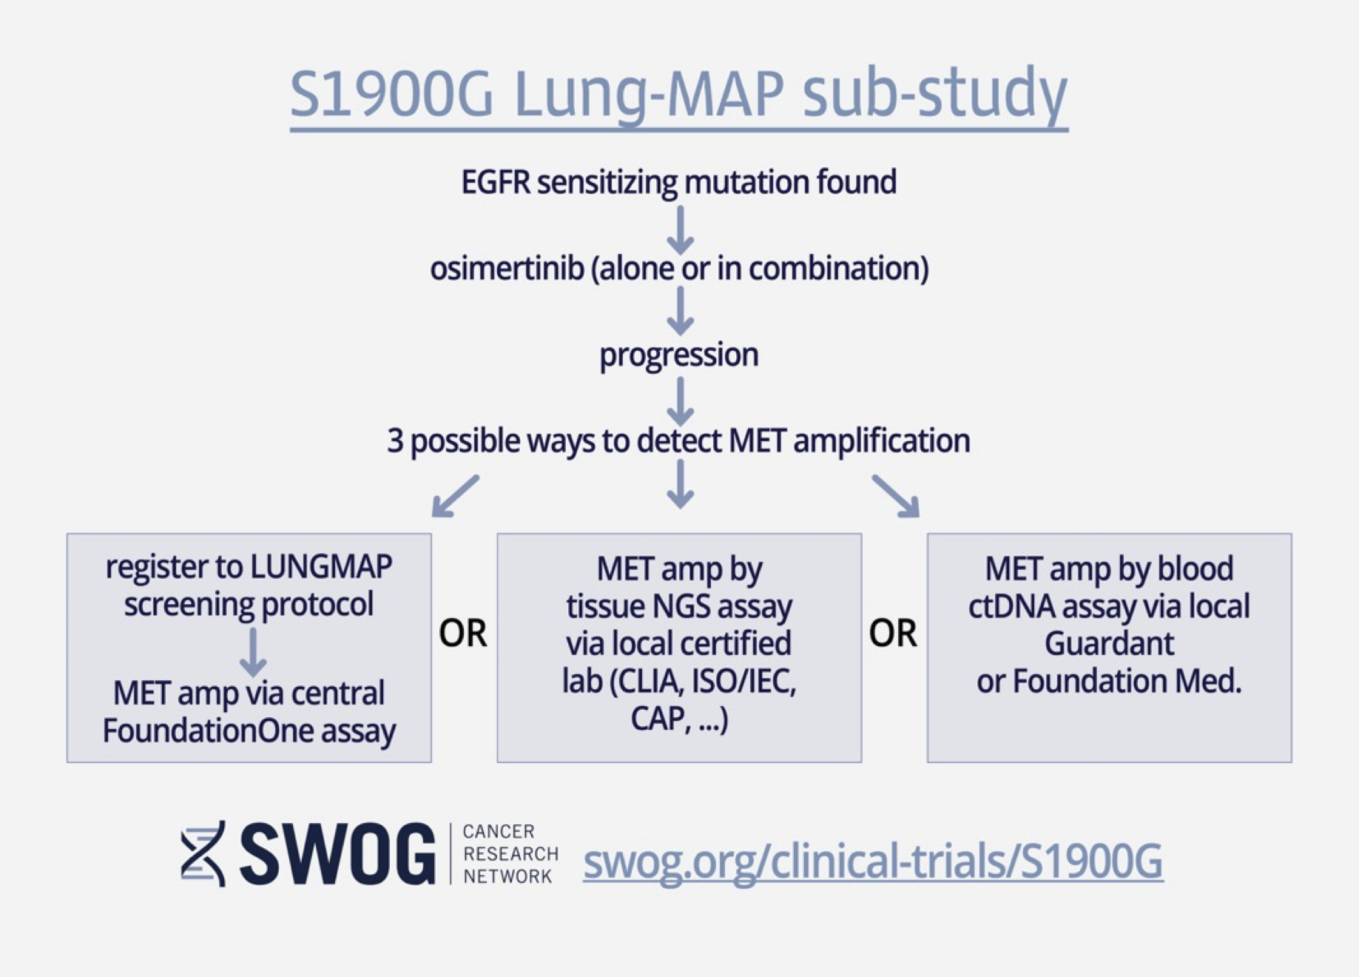
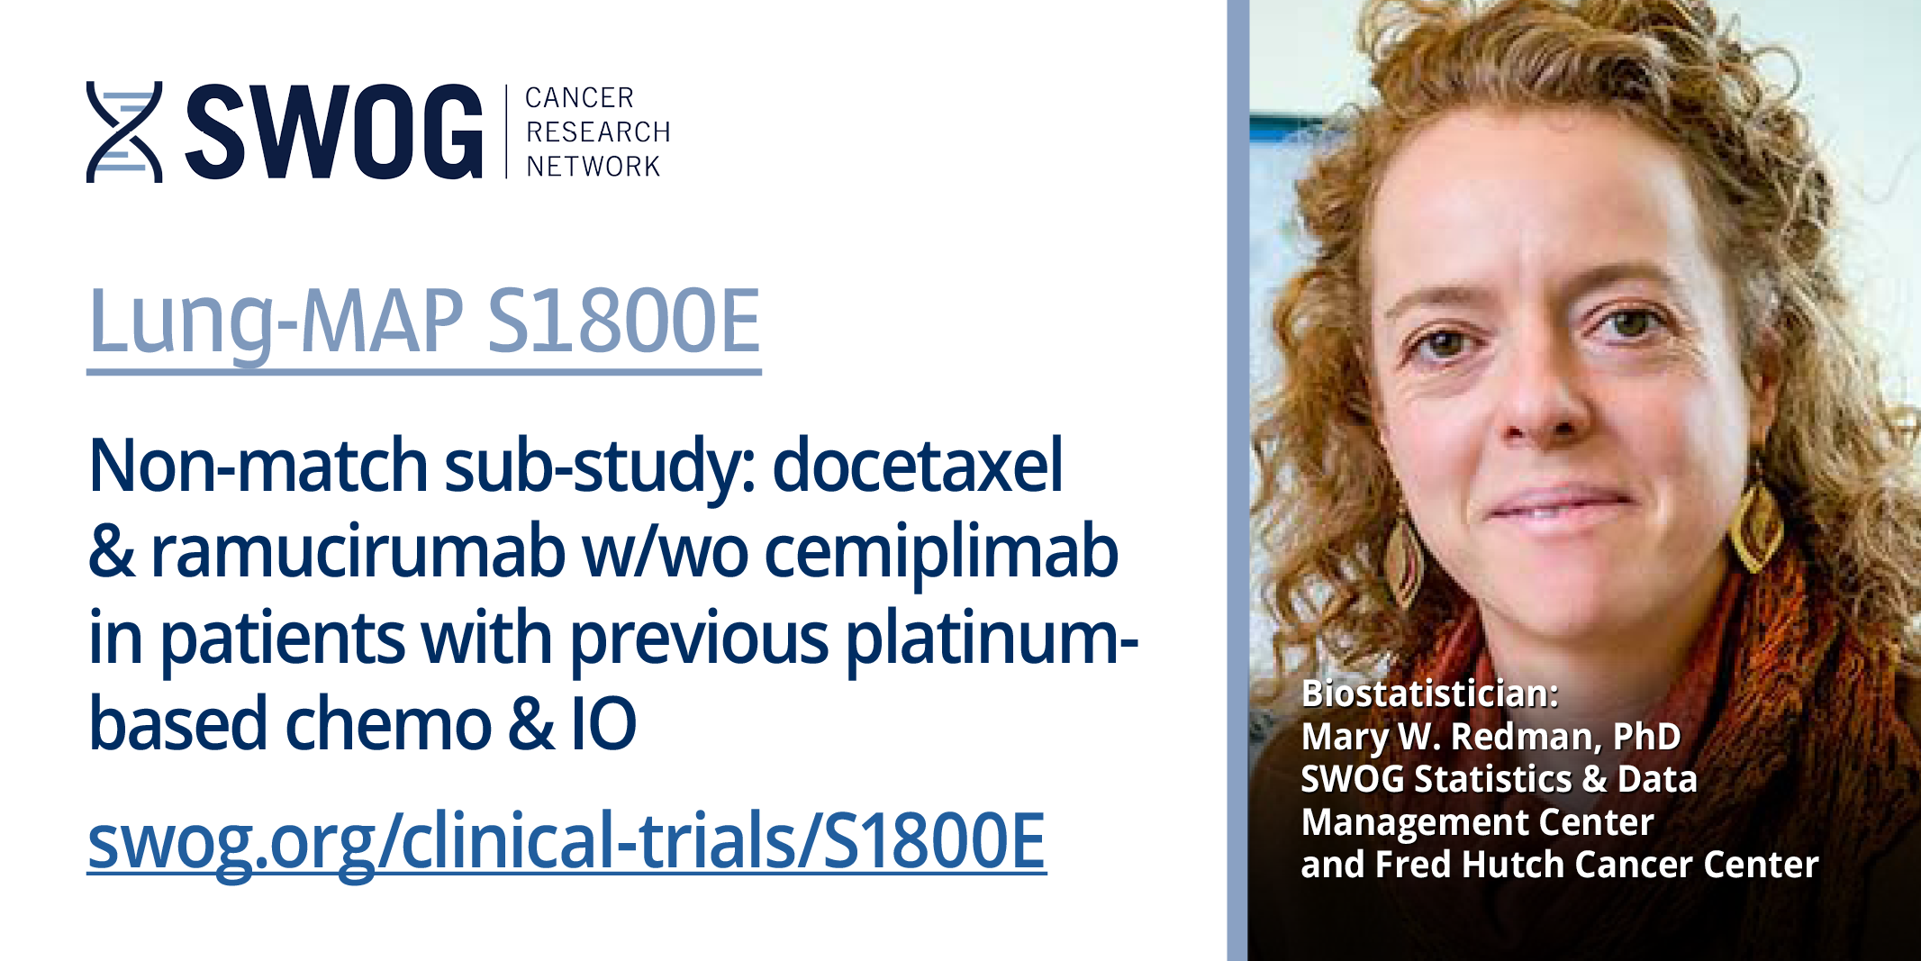
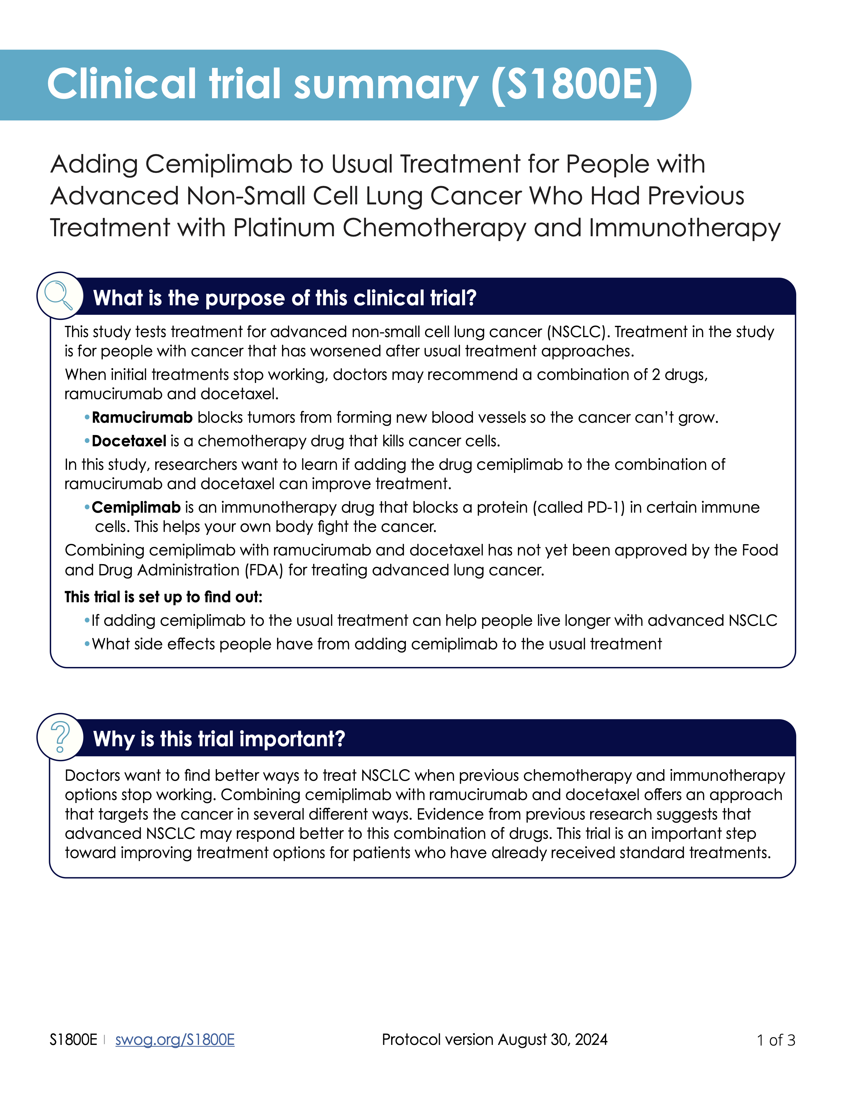

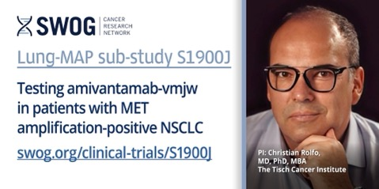
Resources: All Sub-Studies
e.g., swog.org/S1900G

Slide 26

Lung-MAP.org
Website Report
May 1, 2023 – May 1, 2025
Notes:
Since our last Lung-MAP Update Forum, Fall 2024

Slide 27
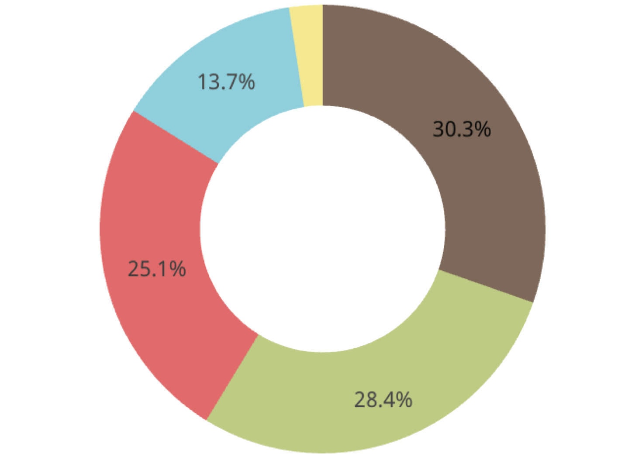
Website Traffic and Performance
May 2023 – May 2025
Sessions
Session Start
Page View
First Visit
User Engagement
Scroll
53,037 Views
  12,694 May 2023 – 2024
  40,397 May 2024 – 2025
12,784 Sessions
11,625 New Users
7.16 Events Per Session
  4.43 May 2023 – 2024
  10.69 May 2024 – 2025
7.97 Event Count Per User
  5.3 May 2023 – 2024
  11.49 May 2024 – 2025
33% Engagement Rate
  29% May 2023 – 2024
  37% May 2024 – 2025
67% Bounce Rate
  71% May 2023 – 2024
  63% May 2024 – 2025
77 Seconds Average Engagement Time Per
Active User

Slide 28
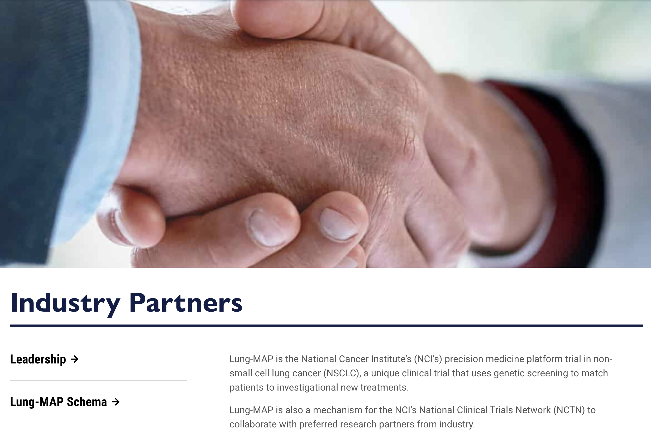
Top-Performing Pages
Homepage – 10K Views (20%)
About – 2.1K Views (4%)
Healthcare Providers– 1.5K Views (3%)
Find a Location– 1.2K Views (2.5%)
Patients– 928 Views (1.75%)
Leadership– 829 Views (1.5%)

Slide 29
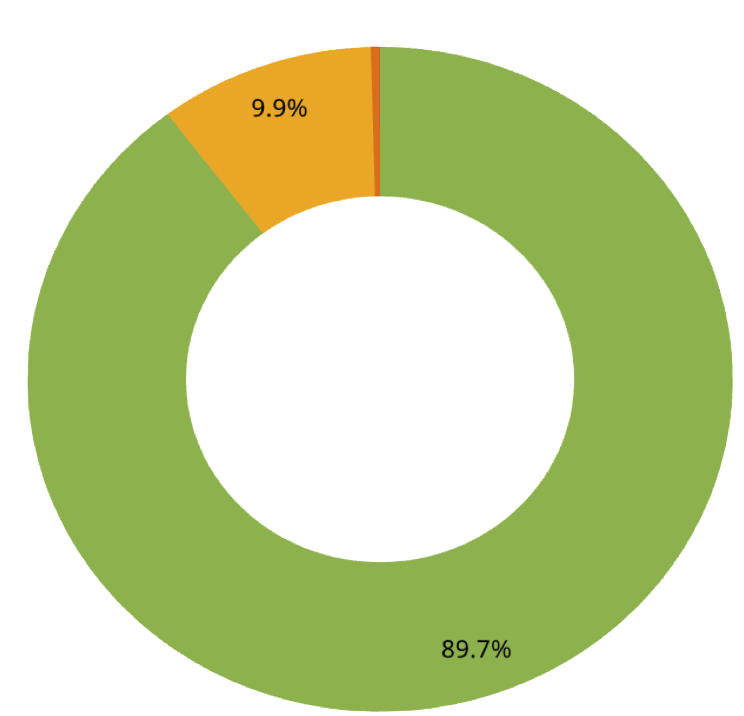
Traffic
User Language Breakdown
1. English - 10,390
2. Chinese - 366
3. Spanish - 143
4. Korean - 134
5. German - 88
6. French - 82
7. Portuguese - 71
8. Japanese - 50
9. Turkish - 48
10. Italian - 43
Traffic by Device Type
Desktop
  10,472
Mobile
  1,149
Tablet
  48
Smart TV
  1

Slide 30

Traffic by Location
1. Americas
  7,894 New Users
  7,800 Active Users
2. Europe
  2,091 New Users
  2,069 Active Users
3. Asia
  1,371 New Users
  1,282 Active Users
4. Africa
  163 New Users
  129 Active Users

Slide 31
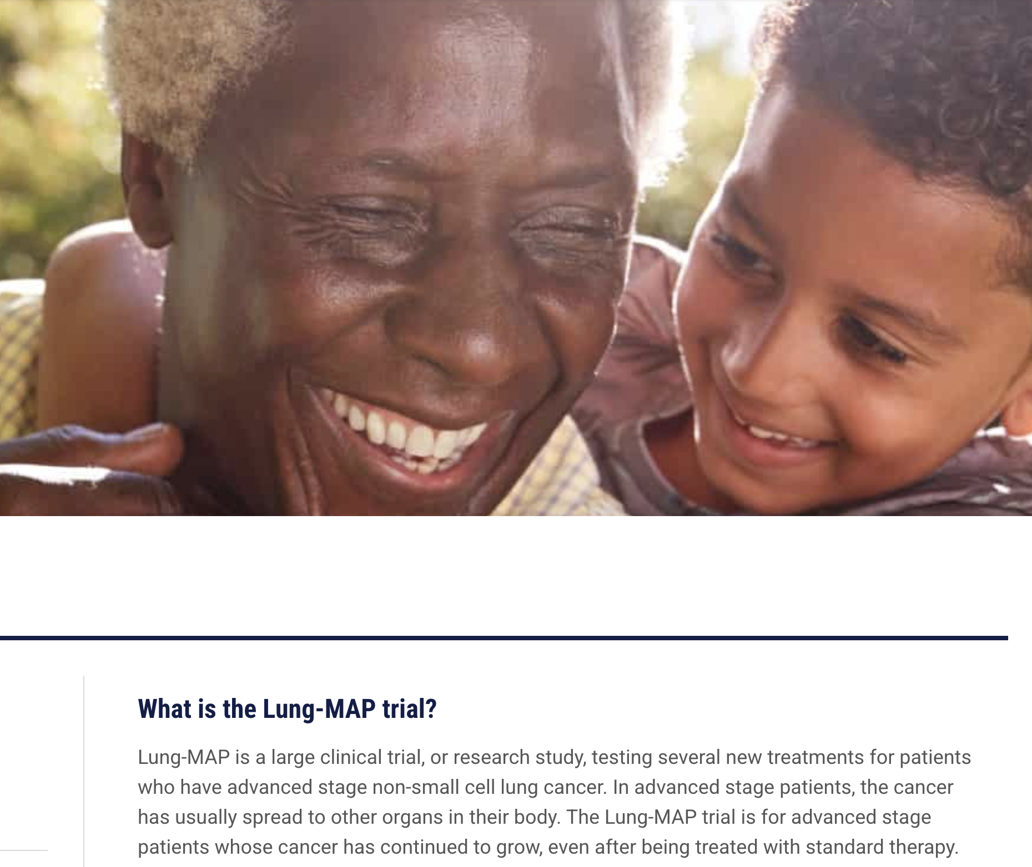
Website Revamp – January 2025
In January 2025 lung-map.org underwent a site wide revamp with updated language added to several key pages.
  lung-map.org/patients/
  lung-map.org/healthcare-providers/
  lung-map.org/industry-partners/
  lung-map.org/about/leadership/
  lung-map.org/about/lung-map-partners/

Slide 32
Site Recommendations
Increase amplification and awareness of lung-map.org products
  Newsletters, events, enrollment announcements, media
Encourage and provide resources for enrolling sites and project partners to add lung-map.org to materials
Increase session duration (set 120 second benchmark goal)
  Promote “Find a location” page (currently 44-second session duration)
Consider pop-ups on the lung-map.org homepage to drive traffic to other pages
Promote lung-map.org pages in SWOG, Friends of Cancer Research, and FNIH social media and email
Desktop users are majority of traffic: continue to create content designed for desktop use

Slide 33
Questions, insights, suggestions?

Slide 34
S1900G
A Randomized Phase II Study of Capmatinib plus Osimertinib with or without Ramucirumab in Participants with EGFR-Mutant, MET-Amplified Stage IV or Recurrent Non-Small Cell Lung Cancer (Lung-MAP Sub-Study)
Sarah Goldberg, MD, MPH
Study Chair (SWOG)
Ross Camidge, MD, PhD
Study Co-Chair (SWOG)
Mary W. Redman, PhD
Statistics Chair (SWOG)
Helen J. Ross, MD
LUNGMAP Study Champion Lead (Alliance)

Slide 35


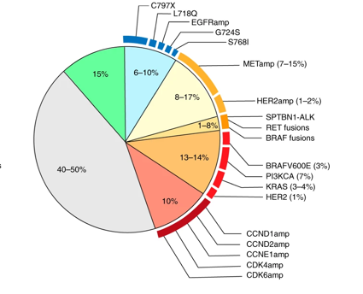
Treatment paradigm for EGFR-mutant lung cancer
Treatment-naïve EGFR-mutant NSCLC
EGFR inhibitor-resistant disease
Treated
EGFR inhibitor (such as osimertinib), alone or in combination
Ongoing EGFR inhibitor treatment
Blood (ctDNA)
Tumor biopsy
Mechanisms of resistance to osimertinib

Slide 36
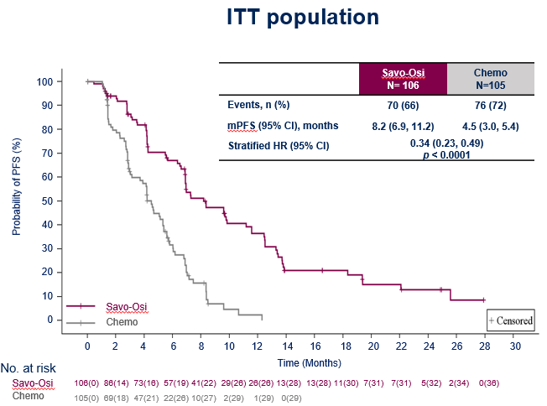
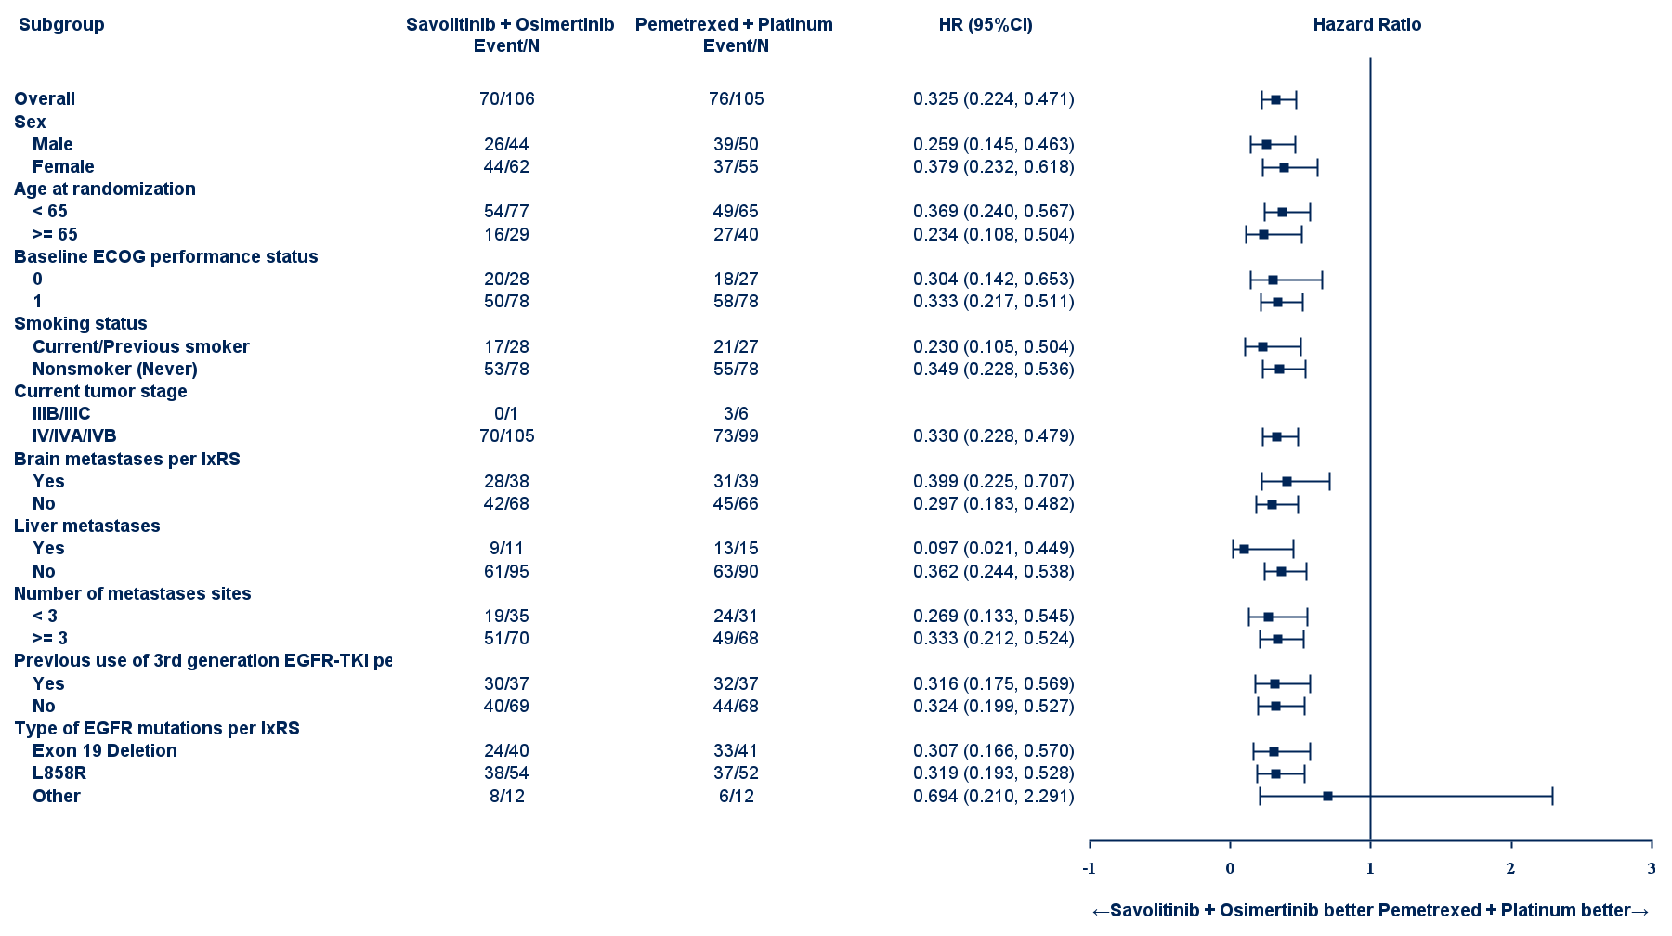
MET inhibitors in EGFR-mutant, MET-amplified NSCLC
Savolitinib/osimertinib vs platinum/pemetrexed
 | Savo-Osi N=106 | Chemo N=105 | Stratified OR (95% CI)
ORR, % (95% CI) | 58 (49-68) | 34 (25-44) | 2.74 (1.50-4.98) p=0.0004
DCR, % (95% CI) | 89 (81-94) | 67 (57-76) | 3.98 (1.81-8.82) p=0.0001
Median DoR, month (95% CI) | 8.4 (5.9-11.1) | 3.2 (2.8-4.2) | -
Shun Lu, MD, PhD
chemo, chemotherapy; CI, confidence interval; ECOG, Eastern Cooperative Oncology Group; EGFR, epidermal growth factor receptor; HR: hazard ratio; IRC, independent review committee; PFS, progression-free survival; TKI, tyrosine kinase inhibitor.

Slide 37
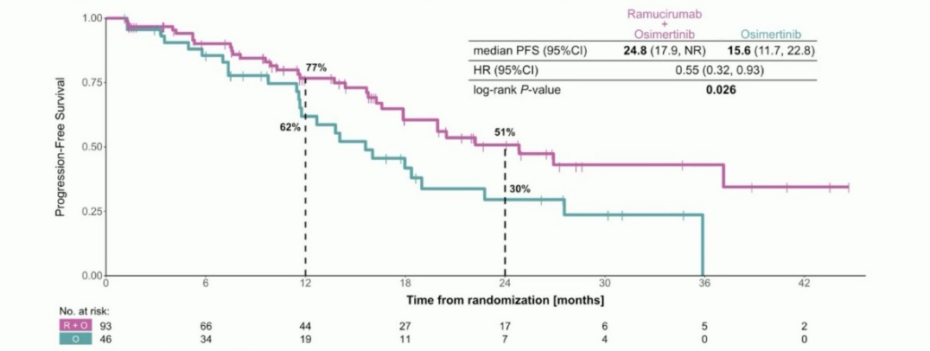
VEGF inhibition might improve both efficacy AND toxicity
The addition of a VEGF or VEGFR2 inhibitor can increase the progression-free survival when added to an EGFR TKI in EGFR-mutant lung cancer
Preclinical data demonstrates the crosstalk between VEGF and MET signaling
Dual inhibition of VEGFR and MET may be able to delay or overcome resistance to EGFR TKIs
The addition of a VEGF pathway inhibitor may improve toxicity associated with MET inhibition by decreasing peripheral edema
Osimertinib with or without ramucirumab (RAMOSE)
Le X, ESMO 2023

Slide 38
S1900G Schema
Study Chairs: Goldberg, Camidge
Statisticians: Redman, Minichiello
Data Coordinator: Highleyman
Protocol Project Manager: Chadwell
Study Champion: Ross
Lung-MAP Chairs: Herbst, Patel (2019-2022)
Borghaei, Reckamp (2022-2024)
Reckamp, Waqar (2024-Present)
KEY ELIGIBILITY
Advanced EGFR-mutant NSCLC
At least 1 prior EGFR TKI, including osimertinib as the most recent prior treatment
Osimertinib may be given alone or in combination with other agents
MET amplification*
Chemotherapy +/- immunotherapy is allowed but not required
No prior MET tyrosine kinase inhibitor (prior amivantamab allowed)
Prior VEGF pathway inhibitors allowed
Untreated, asymptomatic brain metastases allowed
Capmatinib at 400 mg BID** plus osimertinib 80mg QD plus ramucirumab 10mg/kg Q2w
Primary Endpoints:
Progression-free survival
Randomize
Secondary Endpoints:
Toxicity by CTCAE
Response
Duration of response
Overall survival
Edema
Changes in weight
Capmatinib at 400 mg BID** plus osimertinib 80mg QD
N = 40 eligible (44 total)
Stratification factors: Brain metastases and 2L vs 3+L prior lines of therapy
* MET amplification as determined by tissue-based or blood-based (ctDNA) NGS assay obtained after progression on osimertinib. Testing for MET amplification can be done locally using a tissue or blood-based NGS test; testing through the LUNGMAP screening protocol is also available.
** The study will include a safety run-in on the 1st 10 participants in each arm; if too toxic, regimen will include capmatinib at 200mg BID

Slide 39
Biomarker identification on S1900G
EGFR mutation must have been detected at baseline
MET amplification must be detected after radiographic or clinical progression on osimertinib
Any level of MET amplification is allowed
There are several possible ways to demonstrate MET amplification:
  In ctDNA from blood OR in a tumor tissue biopsy
  Testing can be done centrally OR locally (using acceptable assays including Foundation, Guardant, Caris, and Tempus)

Slide 40
S1900G Accrual and Updates
S1900G Revision 4
Released to Sites
9/15/25
Accrual goal: 66 (60 eligible)
Monthly accrual goal: 2 patients
  Opened 4/3/23
  21 patients registered
  Revision 4 Updates
    Lowers accrual goal from 60 to 40 eligible patients
    Extends accrual duration to the end of 2026
    Relaxes eligibility criteria around blood pressure
    Adds secondary objectives regarding edema and change in weight

Slide 41
S1900G Contacts
Study Chairs:
Sarah Goldberg, M.D.
  Yale Cancer Center
  Sarah.Goldberg@yale.edu
Ross Camidge, M.D., Ph.D.
  University of Colorado Cancer Center
  ross.camidge@cuanschutz.edu
Questions:
Medical Questions for Study Chairs:
S1900GMedicalQuery@swog.org
Eligibility/Specimen/Data Submissions: LUNGMAPquestion@crab.org
General Protocol/Regulatory: gchadwell@swog.org

Slide 42
S1900J
A Phase II Study of Amivantamab Hyaluronidase in Participants with MET Amplification-Positive Stage IV or Recurrent Non-Small Cell Lung Cancer (Lung-MAP Sub-Study)
Christian Rolfo, MD
Study Chair (SWOG)
Shirish Gadgeel, MD
Study Co-Chair (SWOG)
Mary W. Redman, PhD
Statistics Chair (SWOG)
David Gandara, MD
LUNGMAP Study Champion (SWOG)

Slide 43
S1900J Schema
Study Chairs: Rolfo, Gadgeel
Statisticians: Redman, Minichiello
Data Coordinator: Ahmadzai
Protocol Project Manager: Beeler
Study Champion: Gandara
Lung-MAP Chairs: Borghaei, Reckamp (2022-2024)
Reckamp, Waqar (2024-Present)
LUNGMAP Registration
(Screening) Study
MET Amplification
Primary Endpoint:
Response by RECIST
Registration to S1900J
Non-Squamous Cohort
N=44 (40 Eligible)
Squamous Cohort
N=44 (40 Eligible)
Amivantamab Hyaluronidase
1600 mg (if < 80kg) or 2240 mg (if ≥ 80kg) ª
q weekly for 4 weeks, then q 2 weeks thereafter ^{b, c}
ª The dosage will be based on the participant’s body weight at screening.
^{b} Cycle 1: Days 1, 8, 15 and 22. Cycles 2+: Days 1 and 15. See protocol Section 7.2
^{c} Continue treatment until one of the criteria in Protocol Section 7.5 is met.

Slide 44
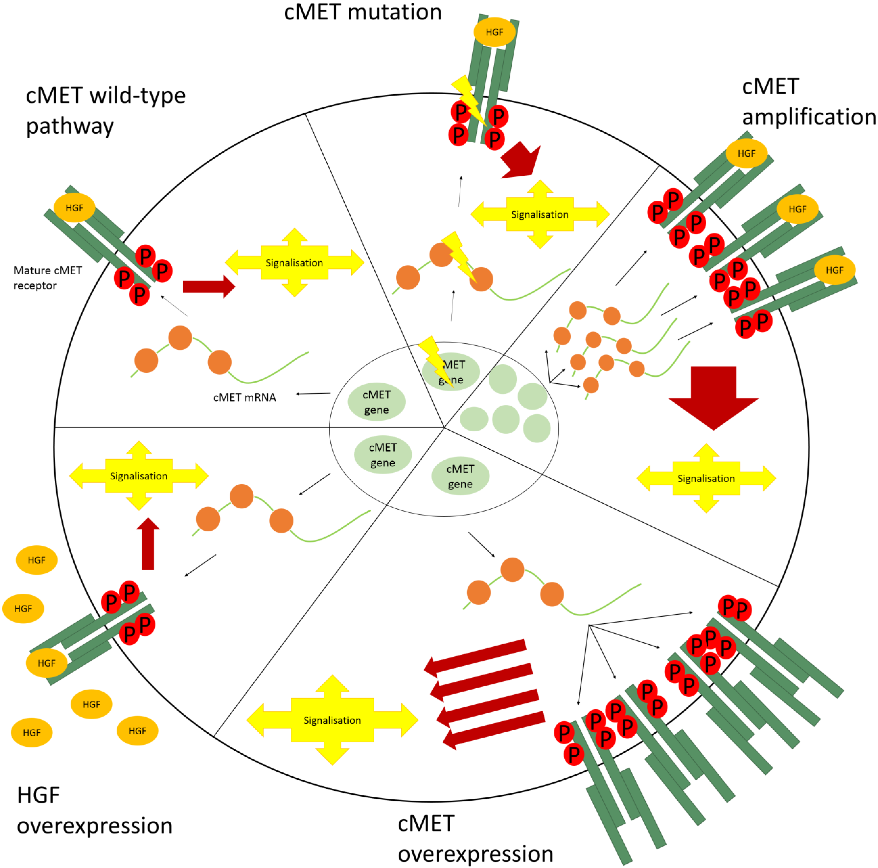
Background/Overview
The MET gene represents one of the drivers of tumorigenesis due to genetic aberrations, including germline or somatic point mutations, splice-site mutations leading to the skipping of exon 14 (MET exon 14 skipping) or gene amplification
Amplification of the cMET gene is a rare potentially actionable, primary oncogenic driver in patients with NSCLC. For primary amplification, the median percentages in literature vary around 3% to 4%
The majority of the data are collected in non-squamous, but recently, new data on squamous cell carcinoma are available
It is also necessary to make a distinction between its role as an acquired resistance pathway to tyrosine kinase inhibitors (TKIs) in NSCLC or as a concurrent alteration within patients with MET exon 14 with NSCLC.
The amplification itself can be targeted with multikinase or MET-specific inhibitors to improve the outcome (Table 1) with a median ORR of 30%, PFS 4 months and OS of approximately 9 months.
Van der Steen N et al, (Rolfo) Cancers 2015, 7(2), 556-573

Slide 45
Key Eligibility Criteria
NSCLC with MET amplification determined by FMI tissue-based NGS assay.
Measurable disease documented by CT or MRI.
  Pleural effusions, ascites and laboratory parameters are not acceptable as the only evidence of disease.
CT or MRI scan of the brain to evaluate for CNS disease within 42 days prior to S1900J registration.
Participants with asymptomatic CNS metastasis (brain metastases or leptomeningeal disease) must be clinically stable and asymptomatic for at least 14 days prior to sub-study registration.
  Participants can be on a low-dose corticosteroid treatment (≤10 mg prednisone or equivalent) for at least 14 days prior to study treatment.
No other known actionable oncogenic alterations, such as (but not limited to) EGFR sensitizing mutations, EGFR T790M mutation, MET Exon-14 skipping mutant NSCLC, ALK gene fusion, ROS1 gene rearrangement, RET gene rearrangement, NTRK rearrangement, HER2 mutation, KRAS activating mutations, and BRAF V600E mutation.
Must have received at least one line of systemic treatment for Stage IV or recurrent NSCLC and participants must have progressed (in the opinion of the treating physician) following the most recent line of therapy.
No prior treatment with MET TKIs, such as: tepotinib, capmatinib, and crizotinib.
No prior systemic therapy (systemic chemotherapy, immunotherapy or investigational drug) within 21 days prior to S1900J registration.
Zubrod PS 0-2 within 28 days prior to registration.

Slide 46
S1900J Amivantamab Hyaluronidase Administration
Amivantamab hyaluronidase will be delivered by means of a manual injection at alternating locations on the abdomen in the periumbilical area. Dosage will be based on the participant’s body weight at screening.
Cycle 1: Administer amivantamab hyaluronidase weekly for 4 weeks.
Cycle 2+: Administer amivantamab hyaluronidase every 2 weeks until any criteria in S1900J Protocol Section 7.5 is met.
  Amivantamab Hyaluronidase Administration Schedule
  Table for Dosing
Cycle (one cycle = 28 days) | Schedule
Cycle 1 | Days 1, 8, 15, and 22
Cycle 2 and onwards | Days 1 and 15
Body Weight at Baseline ª | Total Amivantamab/Hyaluronidase Planned Dose (mg/units) | Volume of Amivantamab Hyaluronidase (mL)
<80 kg | 1,600 mg amivantamab/ 20,000 units hyaluronidase | 10
>= 80 kg | 2,240 mg amivantamab/ 28,000 units hyaluronidase | 14
ª Dose adjustment not required for subsequent body weight changes.

Slide 47
S1900J Study Updates
Revision 1

Slide 48
Revision 1 Updates
S1900J Revision 1
Released to Sites
9/15/25
Expansion of NGS Testing Platforms
S1900J will allow NGS testing platform beyond FMI (approved NGS) tissue and liquid biopsy
Participants who provided documentation of MET amplification in LUNGMAP from a previously completed non-FMI test must agree to submit archival tissue (if available) for retrospective FMI testing (results will not be required for registration to S1900J).
Eligibility Expansion
No other known actionable oncogenic alterations, such as (but not limited to) EGFR sensitizing mutations, EGFR T790M mutation, MET Exon-14 skipping mutant NSCLC, ALK gene fusion, ROS1 gene rearrangement, RET gene rearrangement, NTRK rearrangement, HER2 mutation, KRAS G12C, and BRAF V600E mutation.
  Revision specifies that participants with KRAS G12C mutation are not allowed.
  Participants with other KRAS activating mutations will be allowed.

Slide 49
Study Updates
S1900J opened 9/27/24
2 participants enrolled
S1900J Revision 1 to allow for additional NGS testing was released to sites 9/15/25

Slide 50
S1900J Contacts
Study Chairs:
Christian Rolfo, MD, PhD, MBA, Dr.hc.
The James CCC
The Ohio State University
508 Biomedical Research Tower
460 W 12th Ave , Columbus, OH 43210
Phone: 614/366-2336
E-mail: christian.rolfo@osumc.edu
Shirish Gadgeel, M.D.
Henry Ford Cancer Institute
2800 West Grand Boulevard, E3011, Detroit, MI 48202
Phone: 313/556-8820
E-mail: sgadgee1@hfhs.org
Questions:
Medical Questions for Study Chairs:
S1900JMedicalQuery@swog.org
Eligibility/Specimen/Data Submissions: LUNGMAPquestion@crab.org
General Protocol/Regulatory: jbeeler@swog.org

Slide 51
S1900K
A Randomized Phase II Study of Tepotinib With Or Without Ramucirumab In Participants With MET Exon 14 Skipping Positive Stage IV Or Recurrent Non-Small Cell Lung Cancer (Lung-MAP Sub-Study)
PAUL K. PAIK, MD
Study Chair (ECOG-ACRIN)
Xiuning Le, MD
Study Co-Chair (SWOG)
Mary W. Redman, PhD
Statistics Chair (SWOG)
Hossein Borghaei, DO
LUNGMAP Study Champion Lead (ECOG-ACRIN)

Slide 52
MET inhibition relieves VEGFR2 degradation, engenders compensatory switch to VEGFR2 signaling
MET induced VEGF via PI3K, folded in ER with VEGFR2 -> ubiquitination and degradation
MET inhibition shuts off VEGF induction, prevents VEGFR2 degradation, potentiates VEGFR2 signaling
Chen et al. EBioMedicine 2015

Slide 53
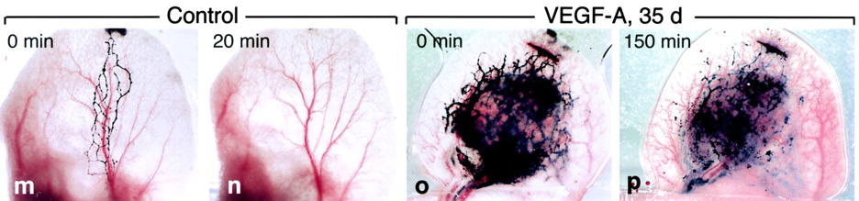
VEGF-A implicated in lymphangiogenesis
VEGF-A induces a strong lymphangiogenesis response
New lymphatics are abnormal
  Very large
  Incompetent valves
  Sluggish flow
  Delayed lymph clearance
Murine ear lymphatics after intravital infusion of colloidal carbon, injected w/ Ad-VEGF-A.
Kinetics of lymphatics clearance in Control (m,n) and Ad-VEGF-A (o,p) mice. Clearance occurs within 20 minutes in control mice but persists for at least 150 min. in Ad-VEGF-A mice.

Slide 54
Hypothesis: dual VEGFR2 and MET inhibition will increase efficacy while decreasing toxicity
MET inhibition leads to an inducible increase in VEGF/VEGFR2 dependence as bypass pathway, also causing changes in the microvasculature that instigate many of the MET inh class-associated side effects
Administration of ramucirumab with tepotinib will effectively abrogate the inducible intratumoral switch to VEGFR2 signaling as a bypass pathway while also blunting the effect of VEGF/VEGFR2 interaction in the periphery, decreasing the frequency and magnitude of peripheral edema, effusions, and hypoalbuminemia caused by tepotinib

Slide 55
S1900K Schema
Study Chairs: Paik, Le
Statisticians: Redman, Minichiello
Data Coordinator: Moralda
Protocol Project Manager: Beeler
Study Champion: Borghaei
Lung-MAP Chairs: Herbst, Patel (2019-2022)
Borghaei, Reckamp (2022-2024)
Reckamp, Waqar (2024-Present)
Key Eligibility
Stage IV or recurrent NSCLC with a MET exon 14 skipping mutation
Participants may have received any number of prior lines of therapy for Stage IV or recurrent NSCLC (including zero)
No other known actionable alterations
If CNS metastases, eligibility is still a possible in some circumstances
No prior MET inhibitor or angiogenesis inhibitor therapies.
Treatment
Endpoints
Primary:
ORR
Secondary:
PFS
Frequency of all grade edema
Lymphoscintigraphy scan changes (now optional)
Tepotinib 450mg po qd
+
Ramucirumab 10mg/kg q3wk
(21-day cycles)
Tepotinib 450mg po qd
(21-day cycles)
Based on the VISION trial (Thomas et al., WCLC 2022), the estimated response rate with tepotinib alone is 45% (n=149).
With 50 eligible participants, this study has 90% power to rule detect a difference in response rates of 34% at the 1-sided 10% level. The estimated minimal detectable difference in response rates is 18%. The power of this comparison using a continuity correction is 83%.
The projected accrual duration to this study is 38 months based on an accrual rate of 1-2 patients per month.

Slide 56
Study Objectives
Primary Objective:
The primary objective is to compare the response rate (confirmed or unconfirmed, complete or partial) between participants with MET exon 14 skipping positive NSCLC randomized to tepotinib with or without ramucirumab.
Secondary Objectives:
To compare the frequency of all-grade treatment- related peripheral edema as defined by CTCAE between the arms.
To evaluate the frequency and severity of toxicities within each arm.
To compare progression-free survival between the arms.
To compare overall survival between the arms.
To estimate the duration of response (DoR) among responders within each arm.

Slide 57
Key Eligibility –
Disease and Prior/Concurrent Therapy Criteria
Stage IV or recurrent NSCLC
  MET exon 14 skipping+ by any commercial assay
Participants may have received any number of prior lines of therapy for Stage IV or recurrent NSCLC (including zero).
  Participants who have received at least one line of therapy for Stage IV or recurrent NSCLC must have progressed (in opinion of treating physician) after the most recent line of therapy.
No radiation therapy within 7 days prior to randomization with exception of:
  Stereotactic radiation for CNS metastases (must be completed at least 3 days prior to randomization) and
  Palliative radiotherapy to bone metastases must be completed at least 1 day prior to randomization.

Slide 58
Treatment Administration: Tepotinib and Ramucirumab
Agent | Dose: | Route: | Day | Schedule | Administration | Pre-medication | Prohibited Concomitant Medications *
Tepotinib | 450mg | Oral * Pt. Handout + Medication Diary | D1-D21 | Daily (21-day cycle) | Patient takes tepotinib at home On infusion day: Tepotinib must be taken at least 1 hr. after ramucirumab infusion is finished | None | CYP3A inhibitors, P-gp inhibitors
Ramucirumab | 10mg/kg | IV over 30-60 minutes | D1 | q 21 days (21-day cycle) | First infusion: Administered over 60 mins. If tolerated, subsequent infusions may be administered over 30 mins. | Per local institutional guidelines. Recommended: Pre-med with an intravenous histamine H1 antagonist (e.g., diphenhydramine hydrochloride (or equivalent). | CYP3A inhibitors, P-gp inhibitors
* Refer to S1900K Protocol Section 7.1 for online drug and herbal supplement interaction resources.

Slide 59
Accrual status (September 19, 2025)
Arm | N | Target N
Tepotinib | 5 | 25
Tepotinib + ramucirumab | 9 | 25
*10 patients randomized to treatment following line agnostic amendment (6 months)

Slide 60
S1900K Contacts
Study Chairs:
Paul K. Paik, M.D.
  Memorial Sloan Kettering Cancer Center
  paikp@mskcc.org
Xiuning Le, M.D., Ph.D.
  MD Anderson Cancer Center
  xle1@mdanderson.org
Questions:
Medical Questions for Study Chairs:
S1900KMedicalQuery@swog.org
Eligibility/Specimen/Data Submissions: LUNGMAPquestion@crab.org
General Protocol/Regulatory: jbeeler@swog.org

Slide 61
S1800E
A Randomized Phase II/III Study of Docetaxel and Ramucirumab with or without Cemiplimab for Participants Previously Treated with Platinum-based Chemotherapy and Immunotherapy for Stage IV or Recurrent Non-Small Cell Lung Cancer (Lung-MAP Non-Matched Sub-Study)
SAIAMA N. WAQAR, MD
Study Chair (NRG)
Tina Li, MD
Study Co-Chair (SWOG)
Mary W. Redman, PhD
Statistics Chair (SWOG)
David Gandara, MD
Study Champion (SWOG)

Slide 62
Disclosures
Advisory Board: Astra Zeneca, Pfizer, Amgen, Daiichi Sankyo, Boehringer Ingelheim, Gilead, Janssen, Adcendo
Research Grant Support: SWOG Clinical trial partnership, Astra Zeneca, Genentech, Gilead, Abbvie, Advenchen, Daiichi Sankyo, Nuvalent, Elevation Oncology, Ribon, Janssen

Slide 63
S1800E Background/Overview
PD-1/PD-L1 inhibitors, either alone or in combination with platinum-based chemotherapy doublets, have became the standard of care (SOC) for patients with newly diagnosed, unresectable NSCLC.
However, the majority of patients experience disease progression.
Docetaxel, alone or with anti-angiogenesis inhibitor ramucirumab, remains the current SOC 2nd line therapy.
In the recently completed pragmatic S2302 (Pragmatica-Lung) trial, the addition of ramucirumab to pembrolizumab had similar OS compared to the investigator choice of chemotherapy alone in patients with acquired resistance to first line chemoimmunotherapy (10.1 vs 9.3 mos; HR 0.99, p=0.46) (June 2025).
Both the chemotherapy docetaxel and the VEGFR2 inhibitor ramucirumab may play important roles in overcoming acquired resistance to PD(L)1 inhibitor-containing first-line systemic therapy in mNSCLC.
  Ivonescimab data strengthens the idea that combining PD‑1 inhibition with VEGF pathway blockade can provide benefit over PD‑1 inhibition alone in the first‑line mNSCLC.
We hypothesize that the addition of cemiplimab to docetaxel and ramucirumab will improve OS compared to docetaxel and ramucirumab alone in the patient population studied in the Pragmatica-Lung trial.
  S1800E is a non-match study for patients with stage IV or recurrent NSCLC, previously treated with platinum doublet and anti-PD(L)-1 therapy with disease progression ≥ 84 days after start of anti-PD(L)1 therapy
  No clinical data available on the triplet combination of cemiplimab, ramucirumab and docetaxel. So, 10 patient safety lead-in.
Sezer A et al. Lancet 2021; Gogishvili M et al. Nature Med 2022; Garon EB et al. Lancet 2014; Reckamp K et al. J Clin Oncol 2022
Notes:
1. For participants who received neoadjuvant, adjuvant, and/or consolidation anti-PD-1 or anti-PD-L1 therapy for Stage I-III disease:
If they experienced disease progression within (≤) 365 days from initiation (Cycle 1 Day 1) or anti-PD-1 or anti-PD-L1 therapy, this counts as the single allowed anti-PD-1 or anti-PD-L1 therapy for advanced disease.
If they experienced disease progression more than (>) 365 days from initiation (Cycle 1 Day 1) or anti-PD-1 or anti-PD-L1 therapy, this is not considered anti-PD-1 or anti-PD-L1 therapy for advance disease. These participants must have received anti-PD-1 or anti-PD-L1 therapy for Stage IV or recurrent disease
2. If known sensitizing molecular alteration for which a FDA-approved targeted therapy for NSCLC exists (e.g., EGFR, ALK, ROS1, BRAF, RET, NTRK, KRAS, HER2, and MET sensitizing mutations), participants must have previously received at least one of the approved therapy(s).
Administration: Ram then docetaxel then cemiplimab

Slide 64
S1800E: A Randomized Phase II/III Study of Docetaxel and Ramucirumab with or Without Cemiplimab (REGN2810) for Participants Previously Treated with Platinum-Based Chemotherapy and Immunotherapy for Stage IV or Recurrent Non-Small Cell Lung Cancer (Lung-MAP Non-Matched Sub-Study)
Status:
Study activation: 4/28/2025
First participant registered: 5/22/2025
Sites with S1800E open as of 9/19/2025: 316
Accrual as of 9/19/2025: 24 patients (12 each arm)
Study Chairs: Waqar , Li
Statisticians: Redman, Minichiello
Data Coordinators: Highleyman, Ahmadzai
Protocol Project Manager: Beeler
Study Champion: Gandara
Lung-MAP Chairs: Borghaei, Reckamp (2022-2024)
Reckamp, Waqar (2024-Present)
Previous platinum
1 prior anti-PD(L)-1 agent
for advanced NSCLC
with SD/PR/CR>84 days
Ramucirumab, IO
eligible
ARM A
Standard of care
Docetaxel +Ramucirumab
N=378
for 340 Eligible
Participants
Randomization
1:1
ARM B
Cemiplimab +
Docetaxel + Ramucirumab
Stratification factors: histology and PS
Primary Objective: OS
Secondary Objective(s): PFS, investigator-assessed ORR, DCR, DoR, toxicities,
PFS and OS by stratification factors and PD-L1 status
TM Objectives: ctDNA baseline, C3D1 and progression, tissue/blood repository
10 Participant
Safety run-in for Arm B
Notes:
1. For participants who received neoadjuvant, adjuvant, and/or consolidation anti-PD-1 or anti-PD-L1 therapy for Stage I-III disease:
If they experienced disease progression within (≤) 365 days from initiation (Cycle 1 Day 1) or anti-PD-1 or anti-PD-L1 therapy, this counts as the single allowed anti-PD-1 or anti-PD-L1 therapy for advanced disease.
If they experienced disease progression more than (>) 365 days from initiation (Cycle 1 Day 1) or anti-PD-1 or anti-PD-L1 therapy, this is not considered anti-PD-1 or anti-PD-L1 therapy for advance disease. These participants must have received anti-PD-1 or anti-PD-L1 therapy for Stage IV or recurrent disease
2. If known sensitizing molecular alteration for which a FDA-approved targeted therapy for NSCLC exists (e.g., EGFR, ALK, ROS1, BRAF, RET, NTRK, KRAS, HER2, and MET sensitizing mutations), participants must have previously received at
least one of the approved therapy(s).
Administration: Ram then docetaxel then cemiplimab

Slide 65
Status Update
CTEP Full Approval: 4/24/2025
Activation Date: 4/28/2025
First Patient Registered: 5/22/2025
Sites with S1800E open as of 9/19/2025: 316
Accrual as of 9/19/2025: 24 patients

Slide 66
S1800E Contacts
Study Chairs:
Saiama Waqar, M.D.
  Siteman Cancer Center/Washington University School of Medicine
Tianhong (Tina) Li, M.D., Ph.D.
  University of California Davis Comprehensive Cancer Center
Questions:
Medical Questions for Study Chairs:
S1800EMedicalQuery@swog.org
Eligibility/Specimen/Data Submissions: LUNGMAPquestion@crab.org
General Protocol/Regulatory: jbeeler@swog.org

Slide 67
Q & A Session
Virtual attendees–
Place your questions in the chat box and a team member will read it out loud for the Lung-MAP team to answer.
Karen Reckamp, MD,MS, chair, Lung-MAP (SWOG)
All Attendees

Slide 68
S1900N
A Randomized Phase II Study of TROP-2 ADC alone, PD1-VEGF bispecific alone, or combination TROP-2 ADC and PD1-VEGF bispecific in Participants with Previously-Treated Actionable Genomic Alteration Positive Stage IV or Recurrent Non-Small Cell Lung Cancer (Lung-MAP Sub-Study)
Susan Scott, MD
Study Chair (ECOG-ACRIN)
Jonathan Riess, MD
Study Co-chair (SWOG)
Mary W. Redman, PhD
Statistical Chair (SWOG)
John Wrangle, MD
Study Champion (SWOG)

Slide 69
Disclosures
Research Funding (to institution):
Pfizer, Boehringer Ingelheim, Revolution Medicines, ArriVent, Nuvalent, Kinnate, IO Biotech, AstraZeneca, Summit, Merck, Novartis.
Consulting/Advisory Board:
BMS, Jannsen, Roche/Genentech, Regeneron, Oncohost, Merck, Pfizer, GSK, Bicycle Therapeutics, Daiichi Sankyo, Replimmune, AstraZeneca

Slide 70
Study Chairs: Scott, Riess
Statisticians: Redman, Minichiello
Data Coordinator: Moralda
Protocol Project Manager: Chadwell
Study Champion: Wrangle
Lung-MAP Chairs: Borghaei, Reckamp (2022-2024)
Reckamp, Waqar (2024-Present)
Metastatic NSCLC
Tumor must harbor an actionable genomic alteration (EGFR, ALK, ROS1, MET, RET, HER2, NTRK)
Progression on or after platinum-based chemo and approved targeted therapy
No prior anti-PD-(L)1 therapy
No prior TROP2 ADC
No limit on prior lines of treatment (no more than 3 lines of prior cytotoxic chemotherapy)
Stable, treated or untreated brain metastases are allowed
Arm 1*
TROP2 ADC
+ PD1-VEGF bispecific antibody
Randomization
Primary Endpoint(s):
PFS and Response
Secondary Endpoints: DOR, toxicity, OS, CNS PFS
Exploratory objectives: PFS by PD-L1 status, ctDNA clearance, PFS by PROphet blood-based assay, TROP2 IHC
Arm 2
TROP2 ADC
Arm 3
PD1-VEGF bispecific antibody
N: 117 total (105 eligible)
*Safety run-in on 1st 10 patients in arm 1. Primary endpoint: DLT = grade 3+ non-heme/grade 4 heme. Neutropenia only DLT if G4 febrile neutropenia. Acceptable DLT rate 30%.
Stratification factors:
Any EGFR mutation (yes/no)
Brain metastasis (yes/no)
Target Activation Q4 2025/Q1 2026
Anticipated study duration: ~30 months (4-5 pts per month)

Slide 71
How to Engage with
Lung-MAP Through the
Drug Selection Committee
Konstantin Dragnev, MD
Chair, Drug Selection Committee (Alliance)
Dartmouth Cancer Center
Amie Franklin, PhD, &
Jamie Struthers, PharmD
CCS Associates

Slide 72
Disclosures
  Research Support to institution for clinical trials (site PI): Merck, Lilly/Loxo, Roche/Genentech, Daiichi Sankyo, Amgen, Astra Zeneca, Molecular Templates, Conjupro, 7 Hills Pharma

Slide 73
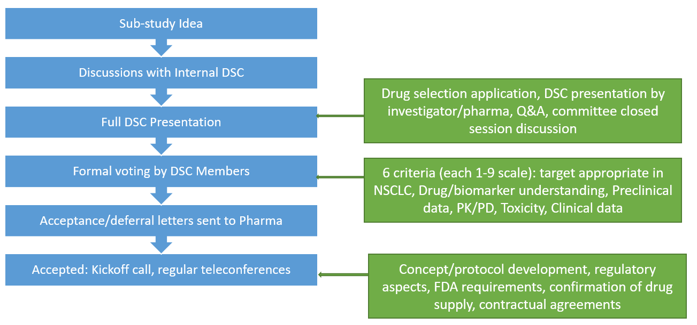
DSC Sub-study Process Review

Slide 74
DSC Sub-study Process Review

Slide 75
Sub-Study Idea Presentation
Investigational agent
Company and contact information – have there been any written or verbal commitments
Background on agent: Pre-clinical data, clinically relevant phase I/II/III results, dosing, schedule, toxicity profile
Target population – if biomarker specific; incidence of biomarker, type of assay
Eligibility criteria
Study schema: phase, specific cohorts
Primary and secondary endpoints
Preliminary statistical considerations

Slide 76
Benefits of Lung-MAP
(https://lung-map.org/)
Lung-MAP Screening Protocol
  Open at >800 US sites
  Community sites contribute to ~50% of enrollment
  Molecular testing expanded to other platforms e.g., FMI (original), Tempus, Caris, Guardent, etc.
  Patients in a Lung-MAP sub-study can be re-assigned to another sub-study upon progression.
Sub-Study Protocol
  Single contract and point of contact for NCTN infrastructure (SWOG) including sites.
  Budget covers: trial infrastructure/operations/management, regulatory submissions, statistics & data management, specimens including NGS and ctDNA testing & analysis, drug management/distribution, and auditing if registrational intent.

Slide 77
DSC Activities
Year | Monthly DSC meetings | Company/concept meetings | Admin Meetings (½ h) | Total
2022 | 6 | 3 | - | 9
2023 | 11 | 17 | - | 28
2024 | 9 | 22 | 22 | 53
2025 | 6 | 14 | 26 | 46 (to 8/25)

Slide 78
Developing Studies
In Protocol Development
S1900N TROP2 ADC and bispecific antibody targeting PD-1 and VEGF for patients with previously-treated NSCLC with actionable genomic alterations | DSC approved 7/15/24 Updated protocol resubmitted to CTEP 9/9/25 Target activation Q4 2025/Q1 2026
S1900P mTORC1/2 + PI3Kα inhibitor plus paclitaxel versus standard of care chemotherapy in participants with NFE2L2, KEAP1 or PI3K pathway-positive squamous cell lung cancer | DSC approved 6/6/25 Budget estimates are currently being reviewed
S1800G Anti-IL-27 with or without anti-PD-1 antibody in participants with previously treated squamous cell lung cancer | DSC approved 12/11/24 CTEP submission of official concept 9/18/25.
In Concept Development
S1900X HER2 TKI for previously treated NSCLC with HER2 dysregulation
S1800X Combination of PCSK9 inhibitor with anti-PD1 antibody for previously treated NSCLC
S1900X Next-Gen PARPi in HRD previously treated NSCLC

Slide 79
How to Engage with
Lung-MAP Through the TM Committee
Joel Neal, MD, PhD
Chair, Translational Medicine Committee (ECOG-ACRIN)
Stanford Cancer Institute

Slide 80
Lung-MAP TM strategic priorities
Make discoveries, not just descriptive analyses, utilizing Lung-MAP data and biospecimens from exceptional responders but also from negative trials/ones without differential outcomes
Maximize utilization of the expertise in Lung-MAP, including pathology, immunology
Promote clarity and awareness of how to perform TM research in Lung-MAP
Garner support for TM research, including outreach to advocacy groups
Inform the next generation of Lung-MAP study concepts

Slide 81
Roadmap: Translational science concepts using Lung-MAP samples and data
Submit idea for Lung-MAP TM Committee review
Assess availability of data and specimens
Draft TM Proposal
Draft Budget
Stat Center Review
Lung-Map Leadership and SWOG Exec Review (loose review)
Obtain SWOG and Lung-Map Letter of Support
Submit Proposal
Funded proposals: get CTEP/NCI approval

Slide 82
Initial Steps
Submit idea for Lung-MAP TM Committee review
  Present idea to (this) committee – monthly meetings, currently 3rd Thursday at 4 p.m. Eastern (1 p.m. Pacific)
  Assess the viability and priority of proposed use of data and specimens
  Ensure no overlap with prior or current work
  Typically 6 months prior to grant deadline
Assess availability of data and specimens
  Make sure that the data and specimens exist
  Work with Stats (who will work with SWOG Bank)
  Make sure that the study timeline works with the proposal timeline!

Slide 83
Drafting Proposals and Budgets
Draft TM Proposal
  Formally put together Objectives, Scientific Plan, and Statistical Analysis plan (ask for template)
  Clear definition of which samples and time points, as well as primary clinical endpoints
Draft Budget
  For SWOG Bank and for SWOG Stats
  Cost for obtaining and processing samples
  Costs for SWOG Statistical Support

Slide 84
Reviews
Stat Center Review
  Full review of TM proposal
  Assess whether budget for statistical support is sufficient
Lung-MAP Leadership and SWOG Exec Review (high level feasibility review)
  High level feasibility review of grant objectives
  May do full review of TM proposal

Slide 85
Grant Proposal
Obtain SWOG and Lung-MAP Letter of Support
  Approved proposals will receive LOS from SWOG supporting concept and allow specimens to be reserved
  Usually allow for up to 2 years to get the funding
Submit Proposal
  Subcontracts to Fred Hutch and SWOG Bank
  Work with Stats and Bank to draft appropriate sections of the proposal
Funded proposals
  Final approval from NCI is necessary to use specimens – for phase 2 this should be “fast and easy,” phase 3 or registrational review is more rigorous
  Specific science in protocol and amendments to protocol are strongly discouraged – protocol work must be completed before other translational concepts can be pursued!

Slide 86
Considerations
Grants and funding
  Necessary for processing of Lung-MAP Specimens
  Necessary for collection of additional specimens (Much more complicated)
  We acknowledge the Catch-22: Funding needed if you want access to specimens, but need specimens to get funding
There may be some variation in process depending on specifics
  E.g., adding additional specimen or data collection
  E.g., requesting clinical data for release (Clinical data are typically NOT released outside of SWOG Statistics and Data Management Center)
Approach TM Committee Leadership, and Stats early

Slide 87
Lung-MAP blood sample collection plan
 |  |  |  |  | EDTA (0.5 ml froz plasma aliquots)/buffy coat |  |  |  |  | RNA samples |  |  | cfDNA samples (two 8.5 ml Roche tubes)
Study | Biomarker | Drug | Accrual | Goal | Baseline | Wk/Cycl | Wk/Cycl | Wk/Cycl | 1st progr | Baseline | Wk/Cycl | Wk/Cycl | Baseline | Cycle | Cycle | Cycle | 1st prog
S1400 | Screening |  | 1864 | closed | X
S1400A | Non-match | durvalumab vs. docetaxel | 116 | closed | X | W3-4 | W7 | W9-10 | X | X | W13 | W25
S1400B | PI3K | taselisib | 39 | closed | X | W4 | W7 | W10 | X
S1400C | Cell cycle gene alterations | palbociclib vs. docetaxel | 53 | closed | X | W4-5 | W7 | W9-10 | X
S1400D | FGFR | AZD4547 | 43 | closed | X | W4 | W7 | W10 | X
S1400E | c-Met | erlotinib ± rilotumumab | 9 | closed | X | W4 | W7 | W10 | X
S1400F | Non-match | durvalumab + tremelimumab | 67 | closed | X | W5 | W9 | W13 | X
S1400G | HR repair deficiency | talazoparib | 51 | closed | X | W4 | W7 | W10 | X
S1400I | Non-match | nivolumab ± ipilimumab | 275 | closed | X | W3 | W7 | W9 | X
S1400K | c-Met | ABBV-399 | 28 | closed | X | W4 | W7 | W10 | X
LUNGMAP | Screening |  | 3714 | 6000 | X |  |  |  |  |  |  |  | n = 166
S1800A | previously IO treated | ramucirumab/pembrolizumab vs. SOC | 166 | closed | X | C2 | C3 | C4 | X |  |  |  | X |  |  |  | X
S1800D | previously IO treated | N-803/pembrolizumab vs. SOC | 82 | closed | X | C2 | C3 | C5 | X | X | C2 | 1st prog | X | C2 | C3 | C5 | X
S1800E | previously IO treated | docetaxel/ramucirumab ± cemiplimab | 12 | 378 | X | C2 | C3 | C4 | X |  |  |  | X |  | C3 |  | X
S1900A | gLOH high or BRCA1/2 | rucaparib | 64 | closed | X | C2 | C3 | C4 | X |  |  |  | X
S1900B | RET fusion | selpercatinib | 6 | closed | X | C2 | C3 | C4 | X |  |  |  | X |  |  |  | X
S1900C | STK11, nonsquamous | talazoparib + avelumab | 47 | closed | X | C2 | C3 | C4 | X |  |  |  | X |  | C3 |  | X
S1900E | KRAS G12C, nonsquamous | sotorasib | 118 | closed | X | C2 | C3 | C4 | X |  |  |  | X | C2 | C3 |  | X
S1900F | RET fusion, nonsquamous | carboplatin/pemetrexed ± selpercatinib | 0 | closed | X | C2 | C3 | C4 | X |  |  |  | X |  |  |  | X
S1900G | EGFR mut, MET amplified | capmatinib/osimertinib ± ramucirumab | 21 | 66 | X | C2 | C3 | C4 | X |  |  |  | X | C1D15 | C3 |  | X
S1900J | MET amplification | amivantamab sc | 2 | 88 | X | C2 | C3 | C4 | X |  |  |  | X |  | C3 |  | X
S1900K | MET exon 14 skipping | tepotinib ± ramucirumab | 12 | 56 | X | C2 | C3 | C4 | X

Slide 88
Lung-MAP blood samples collected
S1400 | Specimen Type | Eligible Participants | Eligible Units
Baseline | Blood Buffy Coat Frozen | 633 | 1116
Baseline | DNA | 43 | 53
Baseline | Paraffin Block Metastatic | 303 | 322
Baseline | Paraffin Block Primary | 635 | 696
Baseline | Paraffin Stained Metastatic | 178 | 207
Baseline | Paraffin Stained Primary | 396 | 527
Baseline | Paraffin Unstained Metastatic | 223 | 1626
Baseline | Paraffin Unstained Primary | 476 | 3255
Baseline | Plasma Frozen | 673 | 3987
Baseline | RNA | 67 | 109
LUNGMAP | Specimen Type | Eligible Participants | Eligible Units
Baseline | Blood Buffy Coat Frozen | 1413 | 2823
Baseline | Paraffin Block Metastatic | 759 | 803
Baseline | Paraffin Block Primary | 952 | 1021
Baseline | Paraffin Stained Metastatic | 187 | 217
Baseline | Paraffin Stained Primary | 239 | 268
Baseline | Paraffin Unstained Metastatic | 215 | 1934
Baseline | Paraffin Unstained Primary | 288 | 2465
Baseline | Plasma Frozen | 1438 | 8005
S1800A | Specimen Type | Arm 1 Eligible Participants | Arm 1 Eligible Units | Arm 2 Eligible Participants | Arm 2 Eligible Units
Baseline | Blood Buffy Coat Frozen | 38 | 73 | 41 | 76
Baseline | Plasma Frozen | 40 | 230 | 42 | 239
Week 4 | Blood Buffy Coat Frozen | 41 | 78 | 52 | 106
Week 4 | Plasma Frozen | 43 | 293 | 54 | 318
Week 7 | Blood Buffy Coat Frozen | 35 | 66 | 44 | 84
Week 7 | Plasma Frozen | 38 | 240 | 46 | 255
Week 10 | Blood Buffy Coat Frozen | 31 | 57 | 36 | 65
Week 10 | Plasma Frozen | 34 | 204 | 38 | 193
Progression | Blood Buffy Coat Frozen | 29 | 58 | 31 | 55
Progression | Plasma Frozen | 29 | 168 | 32 | 170

Slide 89
Thank You
Email: Joel Neal jwneal@stanford.edu
lungmapngs@swog.org

Slide 90
Q & A Session
Virtual attendees–
Place your questions in the chat box and a team member will read it out loud for the Lung-MAP team to answer.
Karen Reckamp, MD,MS, chair, Lung-MAP (SWOG)
All Attendees

Slide 91

Contact Us
Site Coordinators Committee
  LUNGMAPSCC@crab.org
Protocol & Regulatory Questions
jbeeler@swog.org and gchadwell@swog.org
  Eligibility & Data Submission Questions
  LUNGMAPQuestion@crab.org
  Funding Questions
  Funding@swog.org
Accrual Enhancement Committee
lungmapAEC@swog.org
  General Medical Questions
  LUNGMAP@swog.org
  S1900G Medical Questions
  S1900GMedicalQuery@swog.org
  S1900J Medical Questions
  S1900JMedicalQuery@swog.org
  S1900K Medical Questions
  S1900KMedicalQuery@swog.org
  S1800E Medical Questions
  S1800EMedicalQuery@swog.org

Slide 92
Acknowledgements
Thank you for supporting the Lung-MAP Trial!
Patients and Sites
Lung-MAP Site Coordinators Committee
Patient Advocate
Participant Engagement Coordinator
Accrual Enhancement Committee
Trial Oversight Committee
Study Chairs
Statistical Team
Pharmaceutical Collaborators
Data Coordinators & Protocol Project Managers
Applications Development Team
Quality Assurance Team
Funding & Contracts Team
NCI, CTEP, CIRB, CTSU
Foundation for the National Institutes of Health
Friends of Cancer Research
CCS Associates Inc.

Slide 93

Thank you for joining us!
The slides will be available on the SWOG & CTSU websites.

