Slide 1
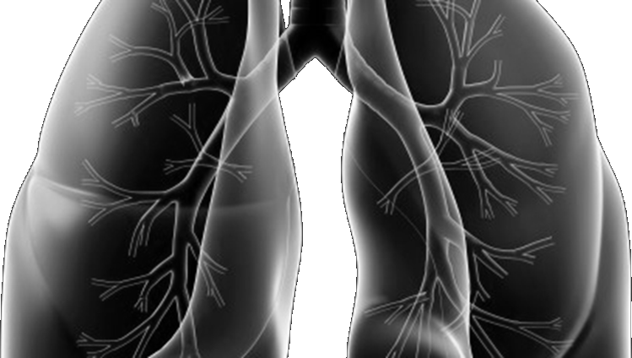







Lung-MAP Update Meeting
SWOG FAll meeting
October 13, 2023

Slide 2
Agenda
There will be a Q & A session at the end of the presentation.
Welcome– Hossein Borghaei, DO, MS
Lung-MAP Accomplishments– Hossein Borghaei, DO, MS & Karen Reckamp, MD, MS
Manuscript Updates– Mary Redman, PhD
Accrual Update– Karen Reckamp, MD, MS
Accrual Enhancement Committee Update– Frank DeSanto
S1900E Update– Karen Reckamp, MD, MS
S1900G Update– Sarah Goldberg, MD, MPH
S1900K Update– Paul K. Paik, MD
S1900J Update– Christian Rolfo, MD, PhD
The Future of Lung-MAP– Hossein Borghaei, DO, MS & Karen Reckamp, MD, MS
Translational Medicine Committee Updates– David Kozono, MD, PhD
Drug Selection Committee Updates– Saiama Waqar, MD

Slide 3
Welcome
Hossein Borghaei, Do, MS
LungMAP Chair (ECOG-ACRIN)
Chief of Thoracic Medical Oncology, Professor
Fox Chase Cancer Center

Slide 4
Lung-MAP Accomplishments
Hossein Borghaei, Do, MS, LungMAP Chair (ECOG-ACRIN)
Karen Reckamp, MD, MS, LUNGMAP vice chair (SWOG)

Slide 5
Publications Updates
MarY W. Redman, phd
Statistical Chair, Lung-MAP
Professor, Fred Hutchinson Cancer Center

Slide 6
Publications in 2023
Unger JM, Qian L, Redman MW, et al. Quality-of-life outcomes and risk prediction for patients randomized to nivolumab plus ipilimumab vs nivolumab on LungMAP-S1400I. J Natl Cancer Inst. 2023 Apr 11;115(4):437-446. doi: 10.1093/jnci/djad003. PMID: 36625510; PMCID: PMC10086628.
Lee SM, Fan W, Wang A, et al. Novel Approaches for Dynamic Visualization of Adverse Event Data in Oncology Clinical Trials: A Case Study Using Immunotherapy Trial S1400-I (SWOG). JCO Clin Cancer Inform. 2023 Apr;7:e2200165. doi: 10.1200/CCI.22.00165. PMID: 37084329; PMCID: PMC10281446.
Vaidya R, Unger JM, Qian L, et al. Representativeness of Patients Enrolled in the Lung Cancer Master Protocol Lung-MAP JCO Precis Oncol. 2023 Sep;7:e2300218. doi: 10.1200/PO.23.00218.PMID: 37677122
Parra E, Zhang J, Duose DY, et. al. Multi-omics analysis reveals immune features associated with immunotherapy benefit in squamous cell lung cancer patients from Phase III Lung-MAP S1400I trial. In Press Clinical Cancer Research.

Slide 7
Manuscripts in Progress: Primary Results of Sub-studies
S1900A: A Phase II study of rucaparib in patients with previously-treated stage IV or recurrent LOH+ or BRCA+ NSCLC
  Study Chairs: J Reiss and P Wheatley-Price
  Presented at ASCO 2021
  Aim to be submitted by end of 2023
S1900C: A Phase II study of talazoparib and avelumab in patients with stage IV or recurrent NSCLC bearing pathogenic STK11 genomic alterations
  Study Chairs: N Skoulidis and J(M) Suga
  Presented at ASCO 2022
  Aim to be submitted by Q1 or Q2 of 2024
S1800D: A Phase III study of N-803 and pembrolizumab versus SoC in patients with stage IV or recurrent NSCLC previously treated with immunotherapy and platinum-based chemotherapy
  Study Chairs: J Wrangle and
  Primary analysis pending additional information. Expected late 2023/early 2024.
  Likely submit to ASCO for 2024 meeting.

Slide 8
Manuscripts in Progress:
Translational Medicine or Ancillary Projects
S1800A ctDNA
  Project Lead(s): Konstantin Dragnev and Karen Reckamp
  Protocol being updated to have approval to do analyses
Lung-MAP Accrual
  Project Lead(s): Mary Redman
  Manuscript in progression
S1400 NGS
  Project Lead(s): David Kozono and Michael Wu
  Manuscript to be submitted soon
LUNGMAP ctDNA/tissue NGS comparison
  Project Lead(s): Charu Aggarwal and Phil Mack
  Presented at WCLC 2020 and ASCO 2023
  Aim to be submitted Q1 2024
S1400 IO biomarkers
  Project Lead(s): Fred Hirsch
  Presented at WCLC 2020
  Aim to be submitted by Q2 2024

Slide 9
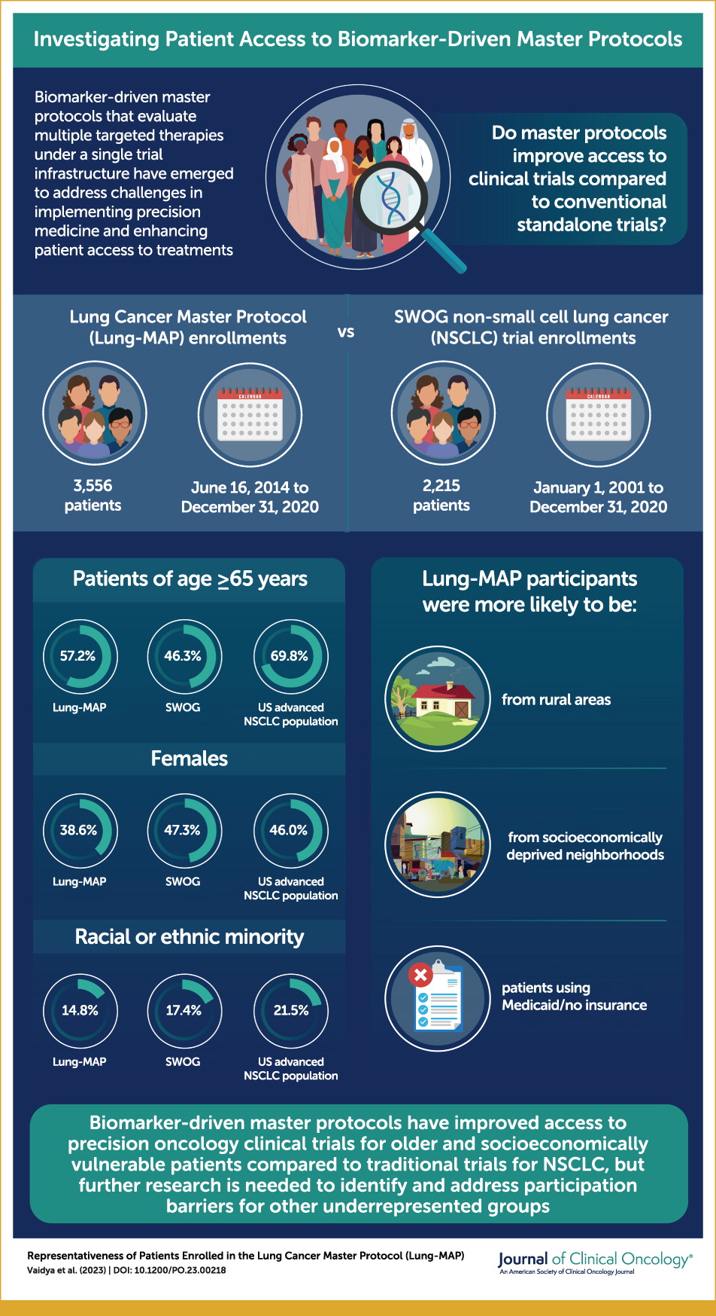

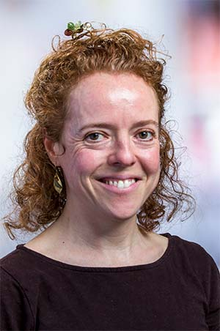
Representativeness of patients enrolled in Lung-MAP
Riha Vaidya, PhD
Mary Redman, PhD

Slide 10
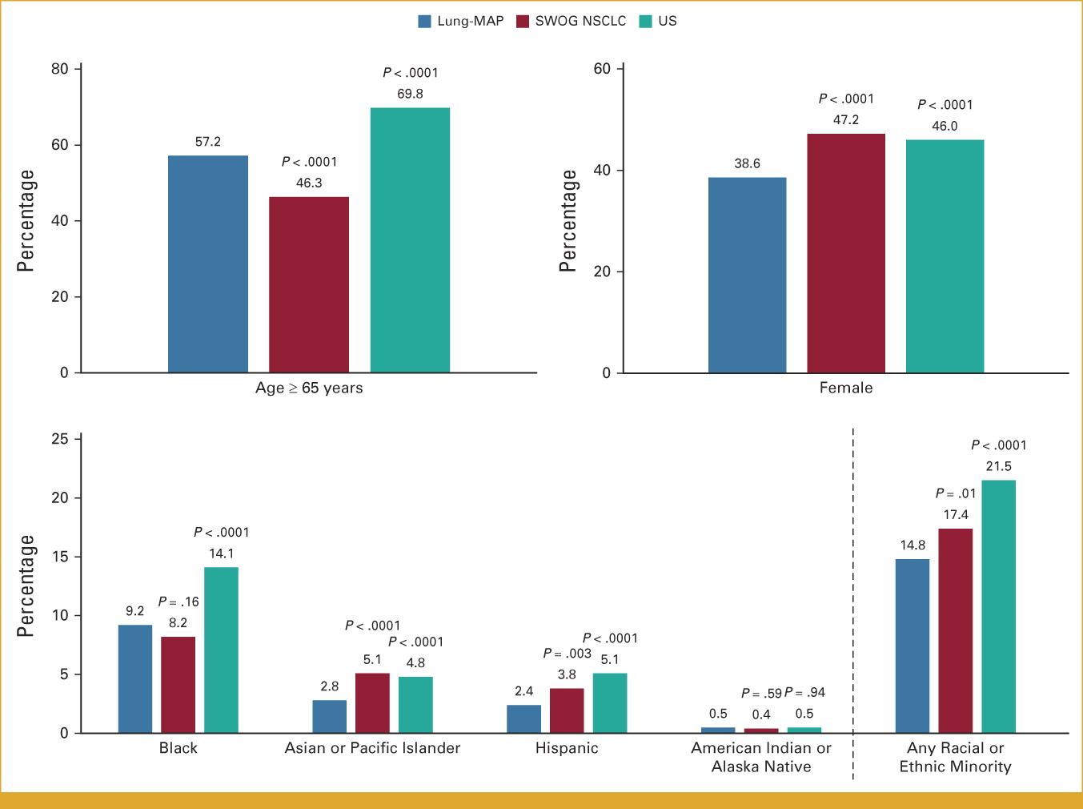
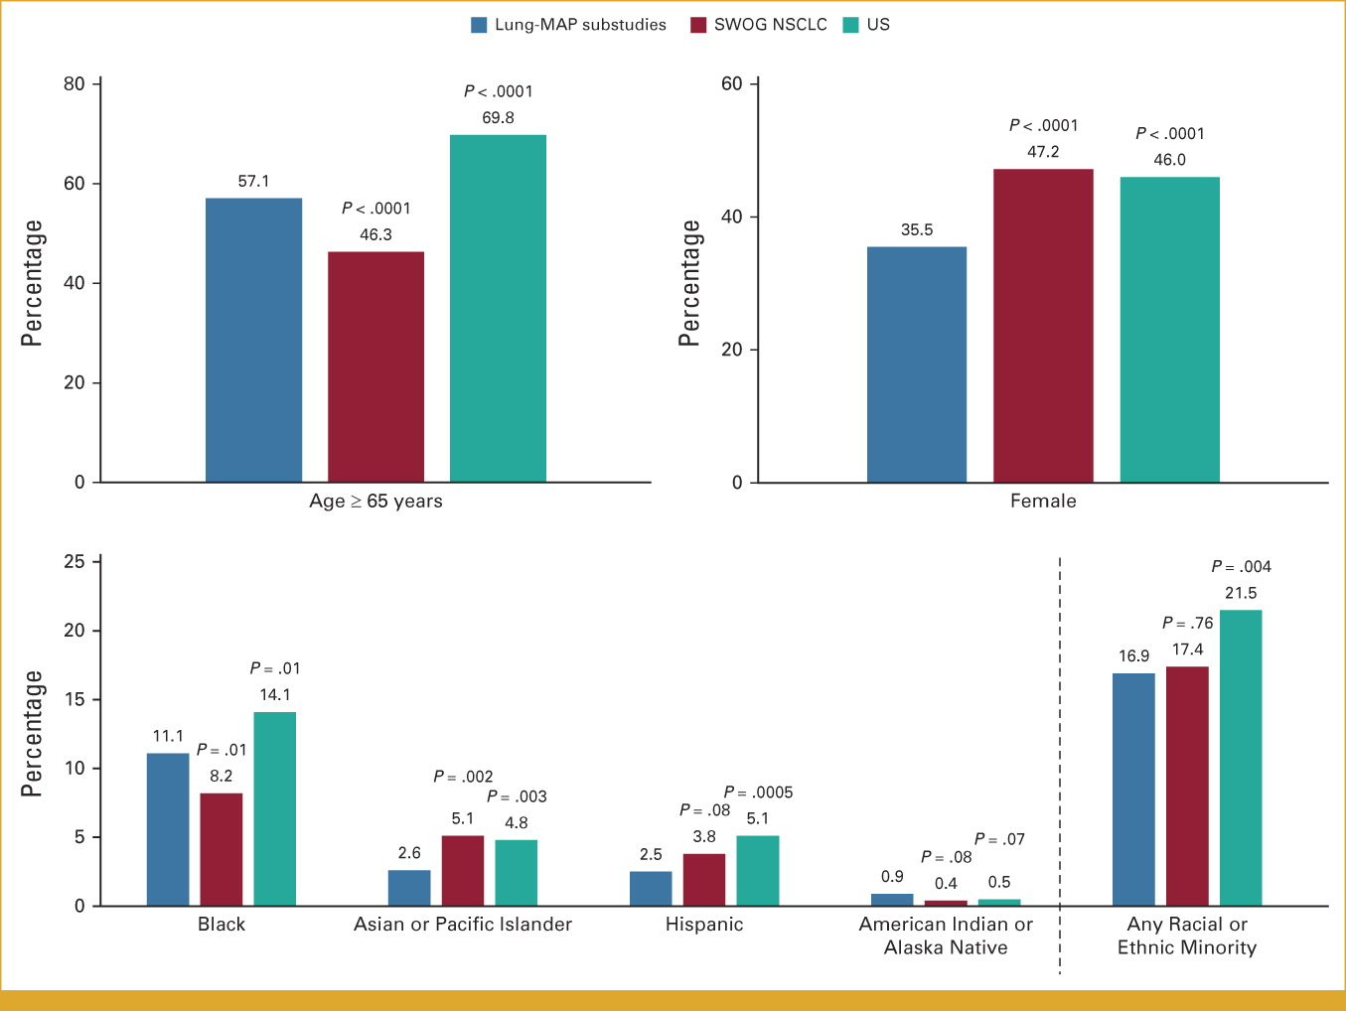
Representativeness of patients enrolled in Lung-MAP
LUNGMAP Screening
Lung-MAP Sub-studies

Slide 11
Accrual Update
Karen Reckamp, MD, MS
LUNGMAP Vice Chair (SWOG)
Division Director, Medical Oncology
Cedars-Sinai

Slide 12
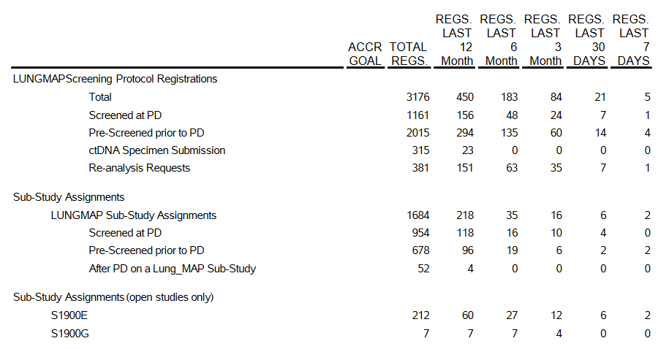
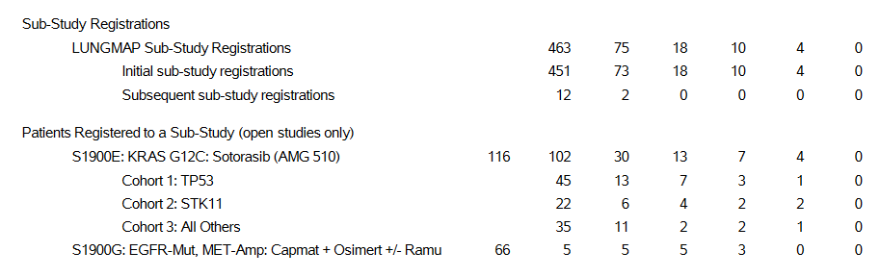
Lung-MAP Accrual (as of October 2023)

Slide 13
Accrual Enhancement Committee Update
Frank Desanto
SWOG Cancer Research Network

Slide 14
Advocate Webinar
Presentations on sub-studies
Dr. Jay Nayak: making Lung-MAP work at a community site
Panel with 3 advocate leaders
Valuable advice on how to present Lung-MAP
Value proposition: something for everyone, based on the molecular profile of your tumor
What patients need when considering trials
Key questions and information align well with patient summaries
100+ tuned in during the event; ~400 views since
Recording linked from swog.org and ctsu.org as well

Slide 15


Slide 16
Lessons Learned
Diversity of research team important for diversifying trial participants
Highlight diversity of Lung-MAP team
Highlight diversity of enrollment thus far
Vaidya et al paper on representativeness of Lung-MAP enrollment
Editorial accompanying paper: “A Bend in the Arc Toward Justice”
“Vaidya et al demonstrate a way forward”
Diversity of enrollment to “non-match” stand-in: S2302 Pragmatica-Lung

Slide 17
Lessons Learned
Desire for "executive summary" for patients
Create, post, and advertise patient-friendly summary for each new sub-study
Revisit form of overall Lung-MAP summary
Spanish versions of all sub-study summaries for patients

Slide 18
Lessons Learned
Opportunity to present Lung-MAP to the wider community
Use webinar recording modularly so we can add to it as sub-studies open
  Make it a “continual” event
Bring targeted advocates into trial development in the earliest stages, before protocol development begins

Slide 19
AEC: Next Steps
Involve targeted advocates early in study concept development
Message: Lung-MAP is accessible
  Prepare for outreach when NGS testing options are expanded

Slide 20
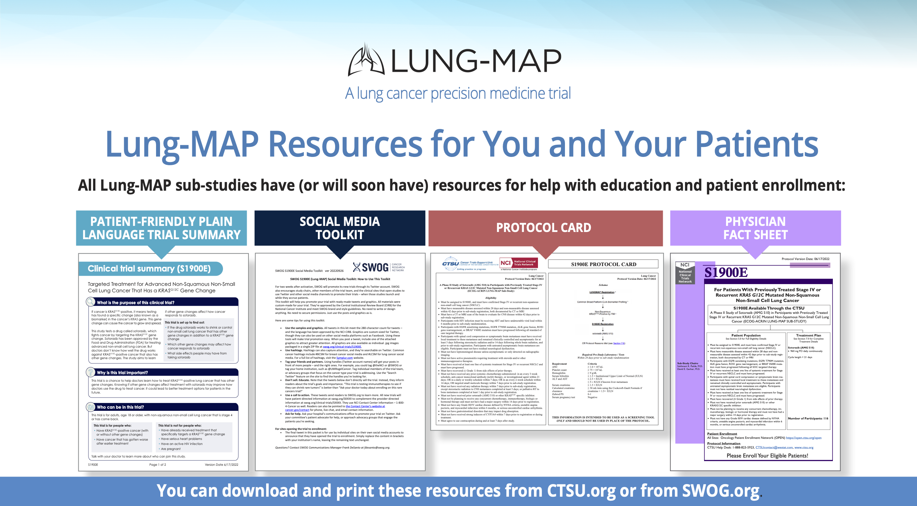

Slide 21
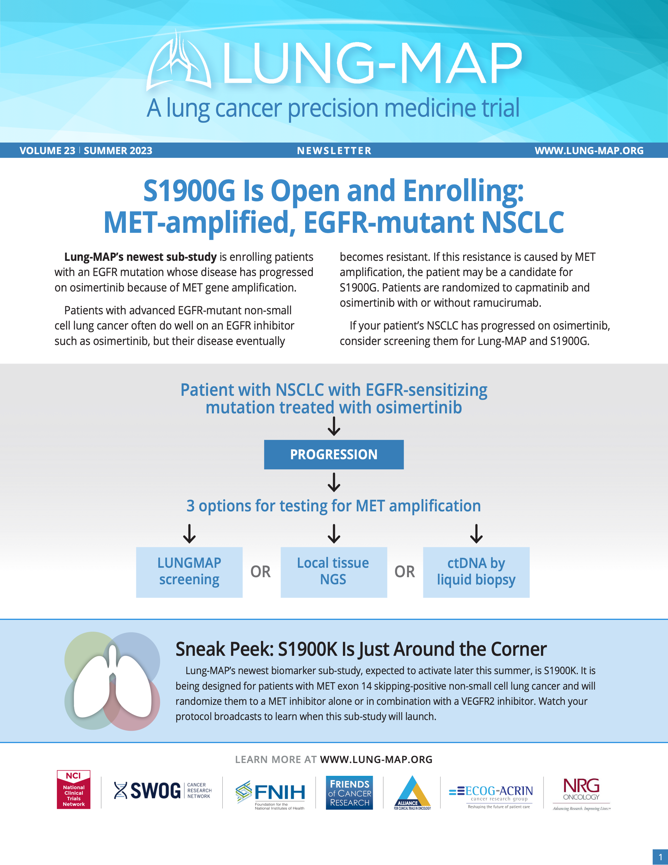

Slide 22
S1900E
A Phase II Study Of Sotorasib (AMG 510) In Participants With Previously Treated Stage IV Or Recurrent KRAS G12C Mutated Non-squamous Non-small Cell Lung Cancer (ECOG-ACRIN Lung-MAP Sub-study)
Sukhmani K. Padda, MD
Study Chair (ECOG-ACRIN)
David Gerber, MD
Study Co-chair (ECOG-ACRIN)
Julie R. Brahmer, MD
Lung Committee Chair
(ECOG-ACRIN)
Joel Neal, MD, PhD
LUNGMAP Study Champion Lead
(ECOG-ACRIN)
Mary Redman, PhD
Lead Statistician
(SWOG)

Slide 23
S1900E Schema
KRAS^{G12C}/TP53^{MUT}
Target N=40
AMG 510/Sotorasib
960 mg QD
S1900E Substudy
Recurrent or metastatic KRAS^{G12C} mutated non-squamous NSCLC
Received at least one prior systemic therapy
No uncontrolled brain metastasis
KRAS^{G12C}/STK11^{MUT}
Target N=25
AMG 510/Sotorasib
960 mg QD
End of Treatment
Enrollment
KRAS^{G12C}/Other ª
Target N=40
AMG 510/Sotorasib
960 mg QD
Primary Endpoint
Objective response rate
Secondary Endpoints
Duration of response
Progression free survival
Overall survival
Safety
Treatment Period
until disease progression, intolerance, or consent withdrawal
Clinic visits/labs every 3 weeks
Imaging every 6 weeks
If Progression
Liquid biopsy to determine resistance mechanism
ªother co-mutations (e.g., KEAP1, NFE2L2, CUL3), double or triple co-mutations (e.g., STK11/TP53, STK11/TP53/KEAP1), or no co-mutations
Notes:
Cohort 1 (co-mutation with TP53): Presence of TP53 mutations AND Wild Type STK11, Wild Type KEAP1, Wild Type NFE2L2, AND Wild Type CUL3.
Cohort 2 (co-mutation with STK11): Presence of STK11 co-mutations AND Wild Type TP53, Wild Type KEAP1, Wild Type NFE2L2, AND Wild Type CUL3.
Cohort 3 (all others): All participants not eligible for Cohorts 1 and 2 will be included in Cohort 3. Note that this includes participants with dual co-mutations in STK11 and TP53; co-mutations in KEAP1, NFE2L2, CUL3, or others; or lack of any co-mutations.
Statistics:
†Cohort 1/3: 90% power to rule out 14% response rate at 5% 1 sided type 1 error if true response rate at least 34%
‡Cohort 2: 90% power to rule out 14% response rate at 5% 1-sided type 1 error if true response rate at least 40%.

Slide 24
Lung-Map S1900E Status Update
101/116 (87%) participants enrolled (44 TP53, 22 STK11, 35 Others) since 4/2/2021 activation
    4 in last 30 days; 2 in last 7 days as of 9/19/2023
    Meeting conservative accrual goals (TP53 15-25 pts/year, STK11 6-11 pts/year, Other 14-24 pts/year)
    At 70 participants Race/Ethnicity: 87% (61) White, 10% (7) Black, 1% (1) Asian; 99% non-Hispanic and 1% Not Reported
Notes:
Accrual Timelines:
TP53: Accrual 15-25 pts/year
STK11: 6-11 pts/year
All others: 14-24 pts/year
Interim at 20 pt mark in cohort 1/3 and 15 in cohort 2 – removed
Amendment 3
Allows pts with untreated asymptomatic brain mets
Shorter washouts for prior anti-cancer systemic treatments & radiation
Shorter washout & clarification of DDI
Eligibility lab thresholds liberalized (e.g., ANC, Cr)
Removal of interim analysis
Prior to Revision 3, the average accrual rate was 4-5 patients/month. Since April, the average rate has been 2-3 patients/month.
Rationale
Doubles Amgen CodeBreaK100 sample size
Rigorous upfront co-mutation biomarker definitions - accounts for co-occurring mutations
Expected 95% CI narrower around point estimates of ORR
Enhanced diversity

Slide 25
Lung-Map S1900E Status Update
Available Slots
    Still need 2 evaluable for TP53 cohort per stats and multiple slots available STK11 and Others
      (at least 6 & 9 depending on evaluability)
Increasing awareness & next steps
    Directed communication from chair to investigators when patients assigned & registered
    TM Proposal incorporated as protocol amendment, allowing ctDNA analysis C1D1, C2D1, C3D1, and at progression
Notes:
Accrual Timelines:
TP53: Accrual 15-25 pts/year
STK11: 6-11 pts/year
All others: 14-24 pts/year
Interim at 20 pt mark in cohort 1/3 and 15 in cohort 2 – removed
Amendment 3
Allows pts with untreated asymptomatic brain mets
Shorter washouts for prior anti-cancer systemic treatments & radiation
Shorter washout & clarification of DDI
Eligibility lab thresholds liberalized (e.g., ANC, Cr)
Removal of interim analysis
Prior to Revision 3, the average accrual rate was 4-5 patients/month. Since April, the average rate has been 2-3 patients/month.
Rationale
Doubles Amgen CodeBreaK100 sample size
Rigorous upfront co-mutation biomarker definitions - accounts for co-occurring mutations
Expected 95% CI narrower around point estimates of ORR
Enhanced diversity

Slide 26
S1900E Contacts
Study Chairs:
Dr. Sukhmani K. Padda (ECOG-ACRIN)
  Temple Health and Fox Chase Cancer Center
Dr. David E. Gerber (ECOG-ACRIN)
  UT Southwestern Medical Center
Questions:
Medical Questions for Study Chairs:
S1900EMedicalQuery@swog.org
Eligibility/Specimen/Data Submissions: LUNGMAPquestion@crab.org
General Protocol/Regulatory: jbeeler@swog.org

Slide 27
S1900G
A Randomized Phase II Study of Capmatinib plus Osimertinib with or without Ramucirumab in Participants with EGFR-Mutant, MET-Amplified Stage IV or Recurrent Non-Small Cell Lung Cancer (Lung-MAP Sub-Study)
Sarah Goldberg, MD, MPH
Study Chair (SWOG)
Ross Camidge, MD, PhD
Study Co-chair (SWOG)
Jhanelle E. Gray, MD
Lung Committee Chair
(SWOG)
Jyoti D. Patel, MD
LUNGMAP Study Champion Lead
(Alliance)
Mary Redman, PhD
Lead Statistician
(SWOG)
Confidentiality Disclosure: Information provided in this presentation is confidential and provided solely for the purposes of site consideration of activation and initiation activities.

Slide 28
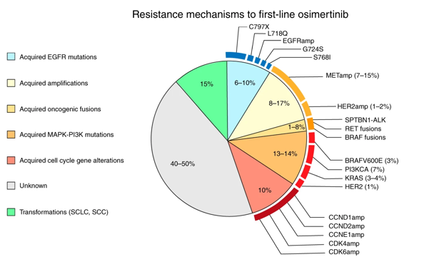
Background/Overview
Participants with advanced EGFR-mutant NSCLC often respond well to EGFR inhibitors but resistance eventually develops
One mechanism of resistance to EGFR inhibitors is MET amplification
Combining a MET inhibitor with an EGFR inhibitor can overcome resistance to EGFR TKIs driven by MET amplification
The addition of a VEGF or VEGFR2 inhibitor can increase the progression-free survival when added to an EGFR TKI in EGFR-mutant lung cancer
Preclinical data demonstrates the crosstalk between VEGF and MET signaling, and the dual inhibition of VEGFR and MET may be able to delay or overcome resistance to EGFR TKIs

Slide 29
S1900G Schema
KEY ELIGIBILITY
Advanced EGFR-mutant NSCLC
MET amplification*
At least 1 prior EGFR TKI, including osimertinib as the most recent prior treatment (alone or in combination with other agents)
Chemotherapy +/- immunotherapy is allowed but not required
No prior MET or VEGF-pathway inhibitor
Untreated, asymptomatic brain metastases allowed
Primary Endpoints:
Progression-free survival
Capmatinib at 400 mg BID** plus osimertinib 80mg QD plus ramucirumab 10mg/kg Q2w
Secondary Endpoints:
Toxicity by CTCAE
Response
Duration of response
Overall survival
Randomize
1:1
Capmatinib at 400 mg BID** plus osimertinib 80mg QD
N = 60 eligible (66 total)
Stratification factors: Brain metastases and 2L vs 3+L prior lines of therapy
* MET amplification as determined by tissue-based or blood-based (ctDNA) NGS assay obtained at the time of progression on osimertinib. Tissue testing may be done by FMI through the LUNGMAP screening protocol or using testing results completed outside of the study.
** The study will include a safety run-in on the 1st 10 participants in each arm; if too toxic, regimen will include capmatinib at 200mg BID
Lead Group: SWOG

Slide 30
Key Eligibility (1)
Documentation of NSCLC with a sensitizing EGFR mutation and have radiologically or clinically progressed (in the opinion of the treating physician) on osimertinib, alone or in combination with other agent(s), as their most recent line of therapy. Any number of prior lines of therapy is allowed.
MET amplification determined by tissue-based or blood-based (circulating tumor DNA [ctDNA]) NGS assay. MET amplifications may have been determined based on tissue submitted for testing by FMI through the LUNGMAP screening protocol or using test results completed outside of the study. Tissue or blood must be obtained after disease progression on osimertinib. The testing must be done within a laboratory with CLIA, ISO/IEC, CAP, or similar certification.
Participants must have either measurable disease or non-measurable disease documented by CT or MRI.
Participants with symptomatic CNS metastasis (brain metastases or leptomeningeal disease) must be neurologically stable and have a stable or decreasing corticosteroid requirement for at least 5 days before sub-study randomization.

Slide 31
Key Eligibility (2)
Participants must not have received an anti-VEGF or VEGFR inhibitor or MET inhibitor.
Zubrod performance status must be 0-1.
ECG performed, with a QTcF ≤ 470 msec.
Participant must have a urinary protein ≤1+ on dipstick or routine urinalysis (UA).
Participants must have adequate cardiac function.
Participants must not have received strong inducers of CYP3A4 (including herbal supplements such as St. John’s Wort); CYP3A4 inhibitors; CYP1A2 substrates; P-gp and BCRP substrates; sensitive substrates of MATE1 and MATE2K; or drugs that are known to prolong QT interval within 7 days prior to sub-study registration and must not be planning to use any of these throughout protocol treatment.
Participants must not have uncontrolled blood pressure and hypertension.

Slide 32
Biomarker detection
Timing:
  EGFR mutation must have been detected at baseline
  MET amplification must be detected after radiographic or clinical progression on osimertinib
MET amplification detection occurs during LUNGMAP screening prior to sub-study assignment to S1900G

Slide 33
Identification of MET amplification
Several possible ways to demonstrate MET amplification:
  Tissue-based testing through standard LUNGMAP procedure:
  If repeat molecular testing at progression not yet performed → submit new biopsy material for biomarker profiling on LUNGMAP
  MET amplification detected at the time of progression using commercial FoundationOne CDx tissue-based (not liquid) tumor testing
  Local testing (outside of FoundationOne CDx):
  3. MET amplification using local tissue-based assay:
    Acceptable tissue assays: any assay performed in a laboratory with CLIA, ISO/IEC, CAP or similar certification
  4. MET amplification using local blood-based assay
      Acceptable blood-based assays: Foundation Medicine or Guardant 360 cfDNA assays only
      Submit request for reanalysis of commercial FoundationOne CDx results
      Additional submission of tissue is not needed
      Indicate this during LUNGMAP registration and then submit results in LUNGMAP Rave EDC
      Submit tissue if available (not required)

Slide 34
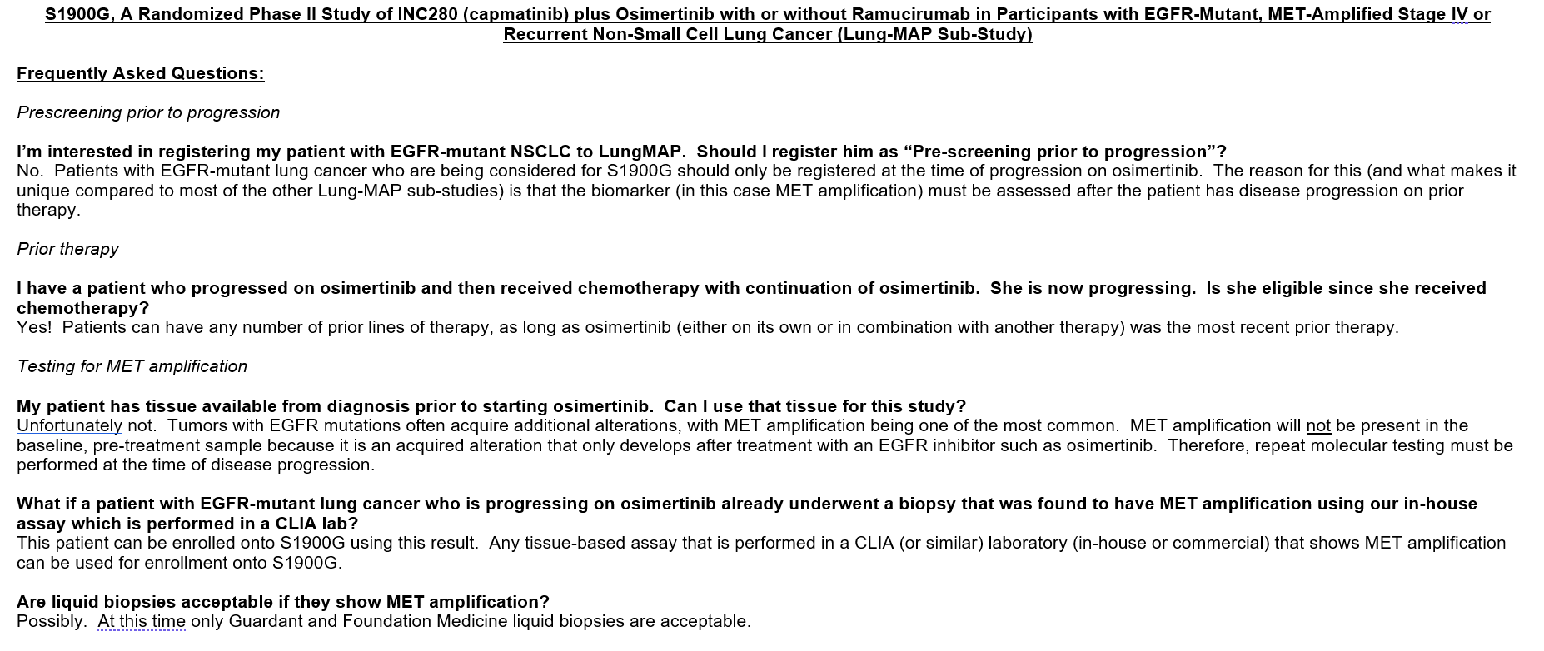
Updates
2 patients accrued
FAQ document

Slide 35
S1900G Contacts
Study Chairs:
Dr. Sarah Goldberg (SWOG)
  Yale Cancer Center
Dr. Ross Camidge (SWOG)
  University of Colorado Cancer Center
Questions:
Medical Questions for Study Chairs:
S1900GMedicalQuery@swog.org
Eligibility/Specimen/Data Submissions: LUNGMAPquestion@crab.org
General Protocol/Regulatory: Lsmith@swog.org

Slide 36
S1900K
A Randomized Phase II Study of Tepotinib With Or Without Ramucirumab In Participants With MET Exon 14 Skipping Positive Stage IV Or Recurrent Non-Small Cell Lung Cancer (Lung-MAP Sub-Study)
PAUL K. PAIK, MD
Study Chair (ECOG-ACRIN)
Xiuning Le, MD
Study Co-chair (SWOG)
Jhanelle E. Gray, MD
Lung Committee Chair
(SWOG)
Jyoti D. Patel, MD
LUNGMAP Study Champion Lead
(Alliance)
Mary Redman, PhD
Lead Statistician
(SWOG)

Slide 37
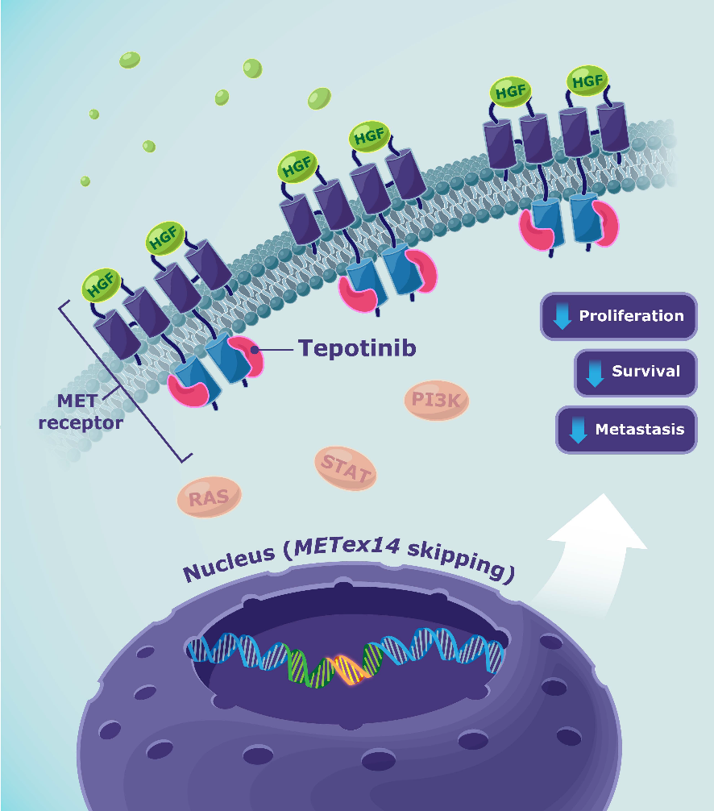
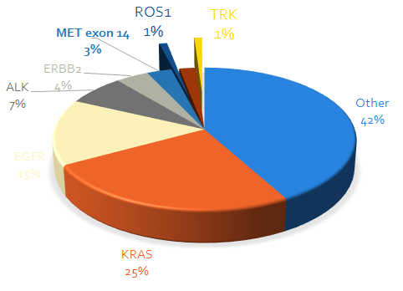
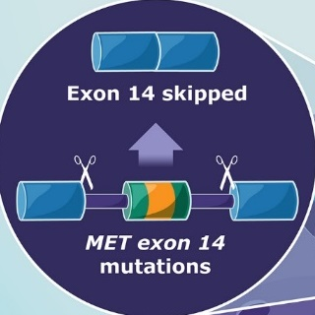
MET alterations in NSCLC: exon 14 skipping
MET exon 14 skipping

Slide 38
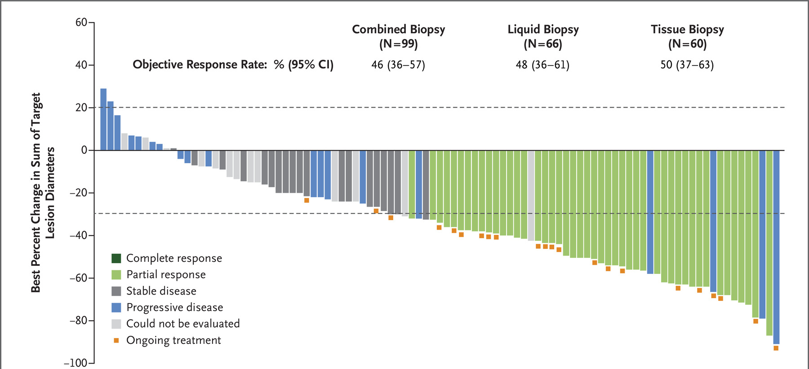
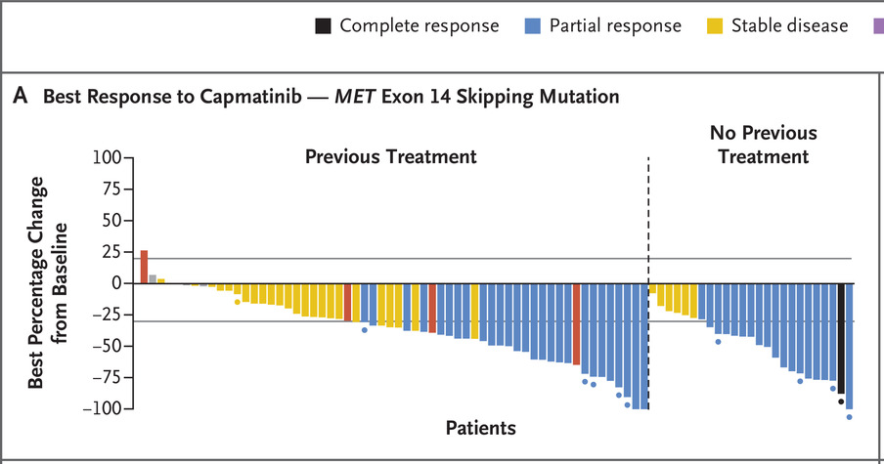
MET exon 14 skipping is actionable
Tepotinib ORR ~ 46%, all lines
  Tepotinib median PFS ~ 9 months
Capmatinib ORR 41% 2nd line+, 68% 1st line
  Capmatinib median PFS 2nd line + = 5.4 months
  Capmatinib median PFS 1st line = 12 months
Paik and Le et al. NEJM 2020
Wolf et al. NEJM 2020

Slide 39
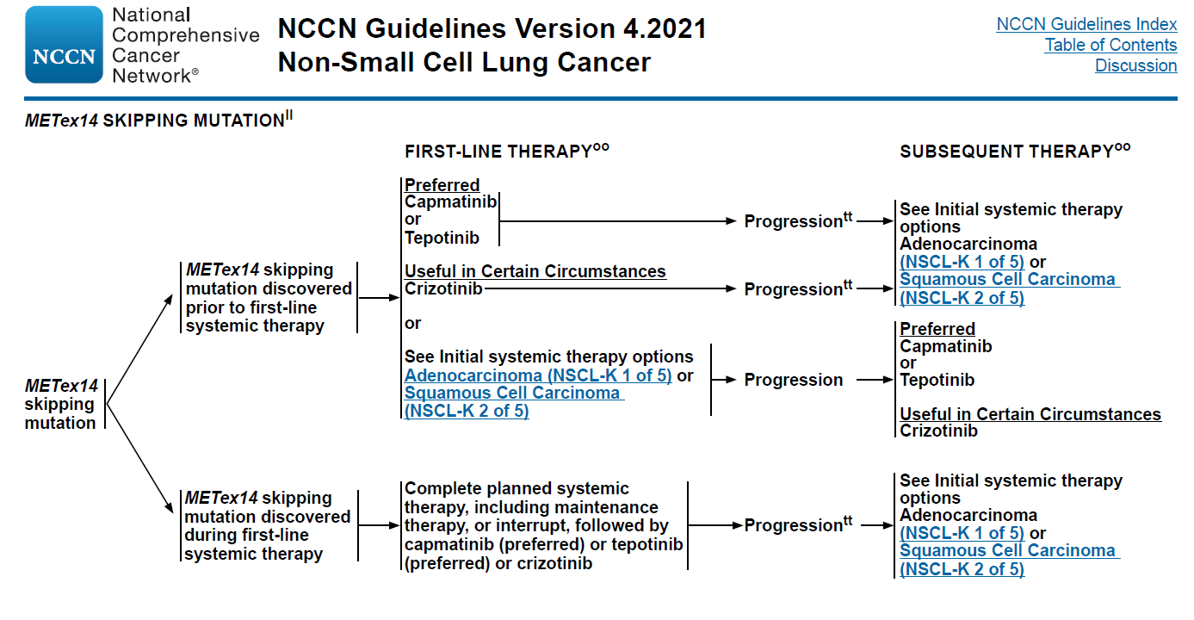
Testing for and treating MET exon 14 skipping now standard of care
NCCN NSCL-28

Slide 40
MET inhibitor efficacy: room for improvement
Osimertinib: EGFR
Alectinib: ALK
Crizotinib: ROS1
Repotrectinib: ROS1
Tepotinib: MET exon 14
Shaw et al. NEJM 2015
Soria et al. NEJM 2018
Drilon et al. NEJM 2019
Paik et al. NEJM 2020

Slide 41
MET inhibitor AEs as a window into biology: edema, effusions, hypoalbuminemia
Paik et al. WCLC 2020

Slide 42
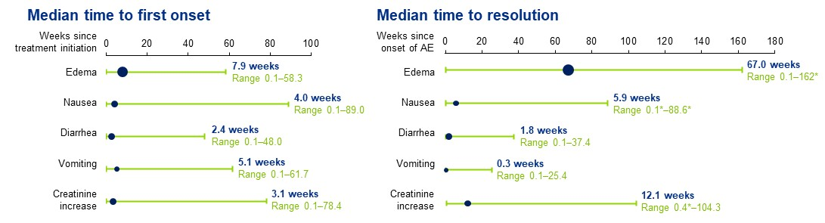
Tepotinib AE kinetics as a window into biology: edema as a unique toxicity
Veillon et al. WCLC 2020

Slide 43
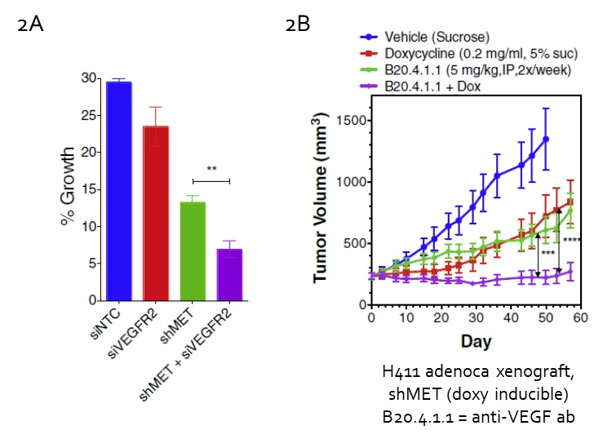
S1900K A Randomized Phase II Study of Tepotinib with or without Ramucirumab in Participants with MET Exon 14 Skipping Stage IV or Recurrent Non-Small Cell Lung Cancer
Rationale/Background:
Synergistic anti-tumor effect on anti-MET and anti-VEGFR dual inhibition
VEGF-A/VEGFR signaling increased after MET TKI use, which leads to structural changes marked by endothelial cell permeability and lymphangiogenesis.
Hypothesis:
The primary mechanism of resistance to MET inhibition and the causal factor for peripheral edema are the result of an upregulation of VEGF/VEGFR2 signaling induced by MET inhibition.
Coupling ramucirumab to tepotinib will increase anti-tumor efficacy in patients with METex14 NSCLC while blunting the development of peripheral edema and its related adverse events, improving tolerability for our patients.

Slide 44
S1900K schema
Treatment
Tepotinib 450mg po qd
+
Ramucirumab 10mg/kg q3wk
(21 day cycles)
Key Eligibility
Stage IIIB/IV/recurrent NSCLC
MET exon 14 skipping + (LungMAP screening, tumor or liquid, consider local testing by FDA approved assay)
CNS mets allowed if not active/symptomatic, <1cm
No contraindications to angiogenesis inhibition
MET inhibitor naïve
Received prior first-line therapy
No prior angiogenesis inhibition
Endpoints
Primary:
ORR
Secondary:
PFS
Frequency of all grade edema
Lymphoscintigraphy scan changes
N=25
Treatment
Tepotinib 450mg po qd
(21 day cycles)
Based on the VISION trial (Thomas et al., WCLC 2022), the estimated response rate with tepotinib alone is 45% (n=149).
With 50 eligible participants, this study has 90% power to rule detect a difference in response rates of 34% at the 1-sided 10% level. The estimated minimal detectable difference in response rates is 18% (or 64%). The power of this comparison using a continuity correction is 83%. The projected accrual duration to this study is 38 months based on an accrual rate of 1-2 patients per month.
N=25

Slide 45
Statistical considerations
The primary objective is to compare ORR between participants with METex14 NSCLC randomized to receive tepotinib with ramu vs. tepotinib monotherapy. The estimated response rate with tepotinib alone is 45% (n=149).
The accrual goal to the study is 50 eligible participants (~25/arm).
With 50 eligible participants, this study has 90% power to detect a difference in response rates of 34% at the 1-sided 10% level. The estimated minimal detectable difference in response rates is 18%. The power of this comparison using a continuity correction is 83%. Assuming 10% of participants do not meet the eligibility criteria, the total accrual goal is 56 participants.
The projected accrual duration to this study is 38 months based on an accrual rate of 1-2 patients per month.

Slide 46
S1900K contacts
Study Chairs– Paul K. Paik, MD (Chair) & Xiuning Le (Co-chair)
Lead Group/Committee Chair– SWOG/Jhanelle E. Gray, MD
Study Champion Lead– Jyoti Patel, MD
Lead Statistician– Mary Redman, PhD
Data Coordinator– Louise Highleyman
Protocol Project Manager– Jennifer Beeler, MA

Slide 47
S1900J
A Phase II of Amivantamab-vmjw in Participants with Stage IV or Recurrent Non-Small Cell Lung Cancer Previously Treated with high MET amplification (Lung-MAP Sub-Study)
Christian Rolfo, MD
Study Chair (SWOG)
Shirish Gadgeel, MD
Study Co-chair (SWOG)
Jhanelle E. Gray, MD
Lung Committee Chair
(SWOG)
David Gandara, MD
LUNGMAP Study Champion Lead
(SWOG)
Mary Redman, PhD
Lead Statistician
(SWOG)

Slide 48
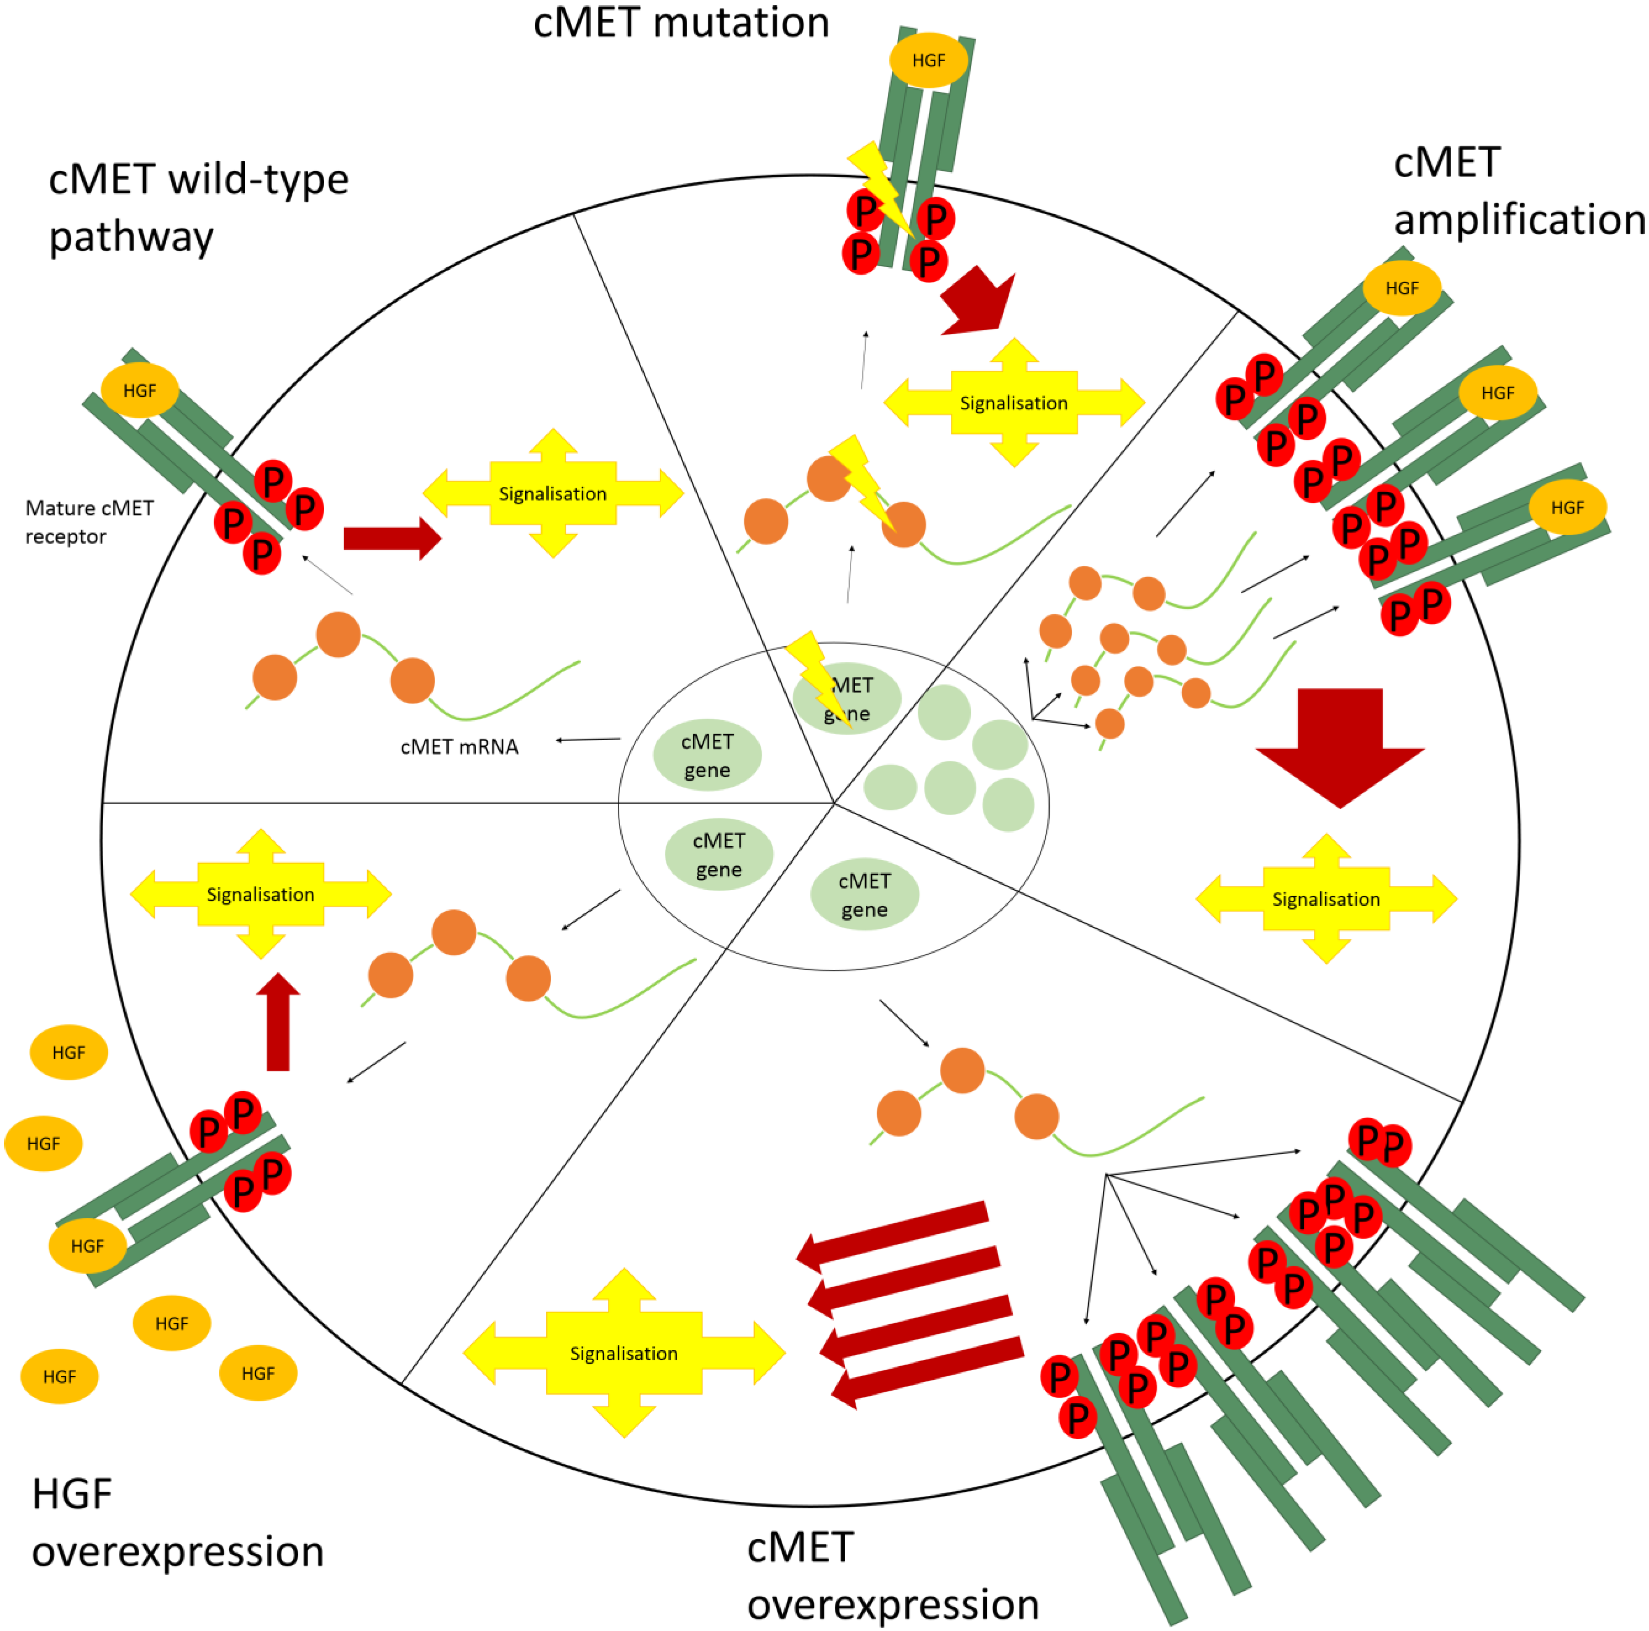
cMET in NSCLC: Can We Cut off the Head of the Hydra?
MET gene represents one of the drivers of tumorigenesis due to genetic aberrations, including germline or somatic point mutations, splice-site mutations leading to the skipping of exon 14 (MET exon 14 skipping) or gene amplification
Prevalence as primary target 3% to 4% on NSCLC
Present also in Squamous Cell lung Cancer
Amplification itself can be targeted with multikinase or MET-specific inhibitors to improve the outcome with a median ORR of 30%, PFS 4 months and OS of 9 months circa
Van Der Steen et al, (Rolfo), Cancers 2015, 7(2), 556-573

Slide 49
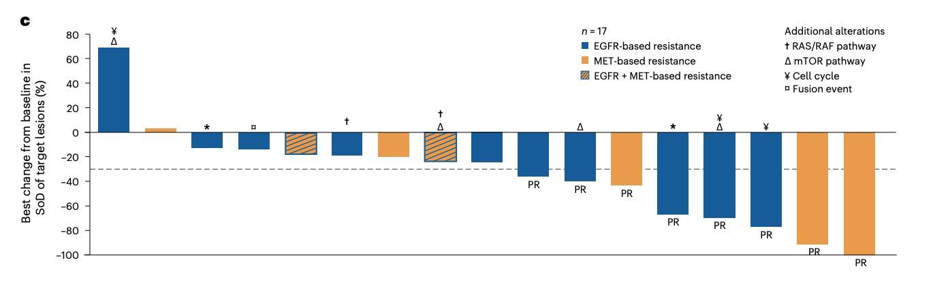
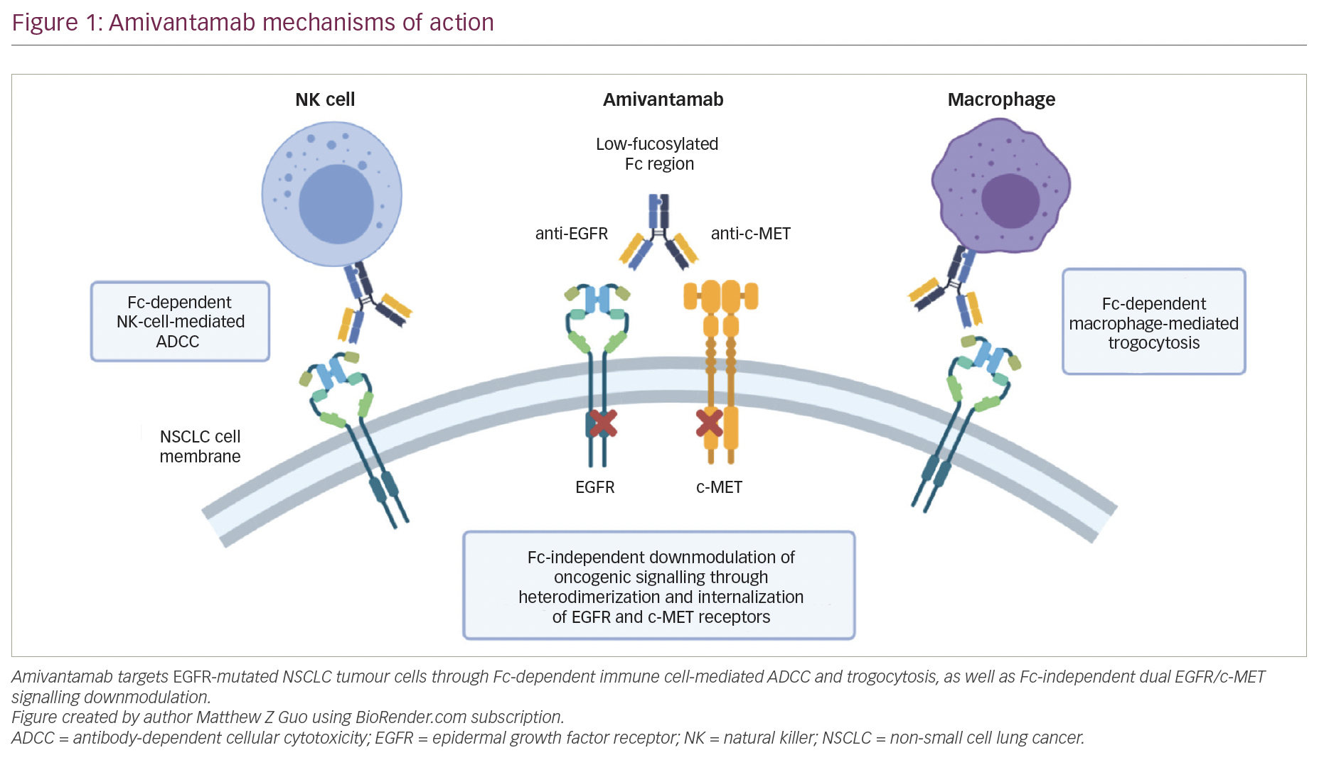
Amivantamab-vmjw
A fully human immunoglobulin G1 (IgG1)-based bispecific antibody (Ab) that targets epidermal growth factor receptor (EGFR) and mesenchymal-epithelial transition (MET).
Amivantamab plus lazertinib in osimertinib-relapsed EGFR-mutant advanced non-small cell lung cancer demonstrated activity in MET aberrations as a mechanism of resistance
Amivantamab in MET exon 14 skipping (CHRYSALIS study) Overall response rate was 33% (50% [3/6] in treatment-naïve pts, 46% [5/11] in pts with no prior MET inhibitor, and 21% [4/19] in pts with prior MET inhibitor therapy).
Guo et al, Touch Reviews 2021
Cho et al, Nature Medicine 2023, Krebs et al ASCO 2022

Slide 50
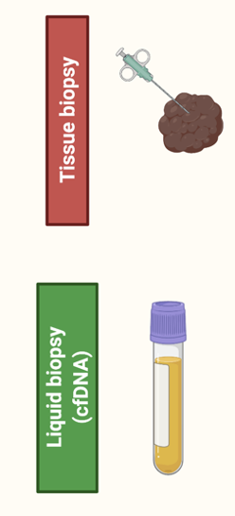
S1900J A Phase II of Amivantamab in Participants with Stage IV or Recurrent Non-Small Cell Lung Cancer Previously Treated with high MET amplification (Lung-MAP Sub-Study)
Study chairs: Rolfo (chair), Gadgeel (co-chair)
Lead Group/Committee Chair: SWOG/Gray
Study Champion Lead: Gandara
Stats: Redman, Minichiello
DC: Highleyman
PM: Beeler
Registration to
Screening Study
MET
Amplification
Primary Endpoint:
Response by RECIST
Non-Squamous
Cohort
N=40 Eligible (44 total)
Squamous
Cohort
N=40 Eligible (44 total)
Amivantamab
1050 or 1400 mg (if 80kg+)
^{Q weekly x 4 weeks}
^{Q 2W thereafter}
collection

Slide 51
Primary Objective
Participants will be enrolled into one of two cohorts defined by histologic subtype of non-small cell lung cancer (NSCLC):
    Cohort 1: Participants with non-squamous cell lung cancer (adenocarcinoma, large cell, NSCLC-not otherwise specified (NOS), mixed histology with any non-squamous component).
    Cohort 2: Participants with squamous cell lung cancer.
The primary objective is to evaluate the objective response rate (ORR) (confirmed and unconfirmed, complete and partial) in participants with MET amplification-positive non-small cell lung cancer (NSCLC) treated with amivantamab-vmjw within each cohort.
Secondary Objectives
  To evaluate progression-free survival (PFS) within each cohort.
  To evaluate overall survival (OS) within each cohort.
  To evaluate the duration of response among responders within each cohort.
  To evaluate the frequency and severity of toxicities within each cohort and combined across all study participants.

Slide 52
Inclusion criteria
Participants must have documentation of NSCLC with MET amplification determined by FMI tissue-based NGS assay.
Participants must have a CT or MRI scan of the brain to evaluate for CNS disease within 42 days prior to sub-study registration.
Participants with asymptomatic CNS metastasis (brain metastases or leptomeningeal disease) must be clinically stable and asymptomatic for at least 14 days prior to sub-study registration.
  NOTE: Participants can be on a low-dose corticosteroid treatment (≤10 mg prednisone or equivalent) for at least 14 days prior to study treatment.
Participants must not have other known actionable oncogenic alterations, such as (but not limited to) EGFR sensitizing mutations, EGFR T790M mutation, MET Exon-14 skipping mutant NSCLC, ALK gene fusion, ROS1 gene rearrangement, RET gene rearrangement, NTRK rearrangement, HER2 mutation, KRAS activating mutations, and BRAF V600E mutation.
Prior/Concurrent Therapy Criteria
Participants must have progressed (in the opinion of the treating physician) following the most recent line of therapy.

Slide 53
Trial Status
S1900J received CTEP Approval On Hold on 9/8/23.
Initial CIRB submission was made on 9/8/23.
The CIRB Initial Review date is 10/5/23.
We anticipate CIRB review comments in mid-October.
CIRB approval anticipated in mid-November.
Activation is targeted for 12/1/23. This target date is subject to change and is dependent on CIRB’s review, the comments received, and the timing of full contract execution.

Slide 54
S1900J contacts
Study Chairs– Christian Rolfo, MD (Chair) & Shirish Gadgeel (Co-chair)
Lead Group/Committee Chair– SWOG/Jhanelle E. Gray, MD
Study Champion Lead– David Gandara, MD
Lead Statistician– Mary Redman, PhD
Data Coordinator– Louise Highleyman
Protocol Project Manager– Jennifer Beeler, MA

Slide 55
The Future of
Lung-MAP
(NGS Platform Expansion)
Hossein Borghaei, Do, MS, LungMAP Chair (ECOG-ACRIN)
Karen Reckamp, MD, MS, LUNGMAP vice chair (SWOG)

Slide 56
Lung-MAP Translational Medicine
David Kozono, Md, PhD
Translational Medicine & Scientific Leadership Committee Chair
Alliance

Slide 57
Disclosures
No relevant disclosures for this presentation
Genentech/Roche, consultancy

Slide 58
Expanding LUNGMAP to allow other NGS platforms
In 2014, FoundationOne testing on S1400 provided access to molecular diagnostics for patients who would otherwise not have it
In 2023, patients with advanced NSCLC frequently have testing performed by a variety of commercial and academic NGS platforms
  Requirement for F1CDx testing is increasingly becoming a barrier to identification of patients for sub-studies, particularly those with rare biomarkers
  Central testing with a single platform will likely remain essential for registrational studies and beneficial for correlative science

Slide 59
Which tests for LUNGMAP?
Potentially any CLIA certified test that is sufficiently broad
  Definition of “sufficiently broad”
    Inclusion of all LUNGMAP tumor genetic alterations of interest
      EGFR, ALK, ROS1, BRAF, RET, NTRK, KRAS, HER2, MET, TP53, STK11, KEAP1, NFE2L2, CUL3
      Typically included in oncology-focused panels of ≥ 150 genes, or whole exome
    Sufficient to calculate TMB
  Real-time qualification of new CLIA tests by TM committee members

Slide 60
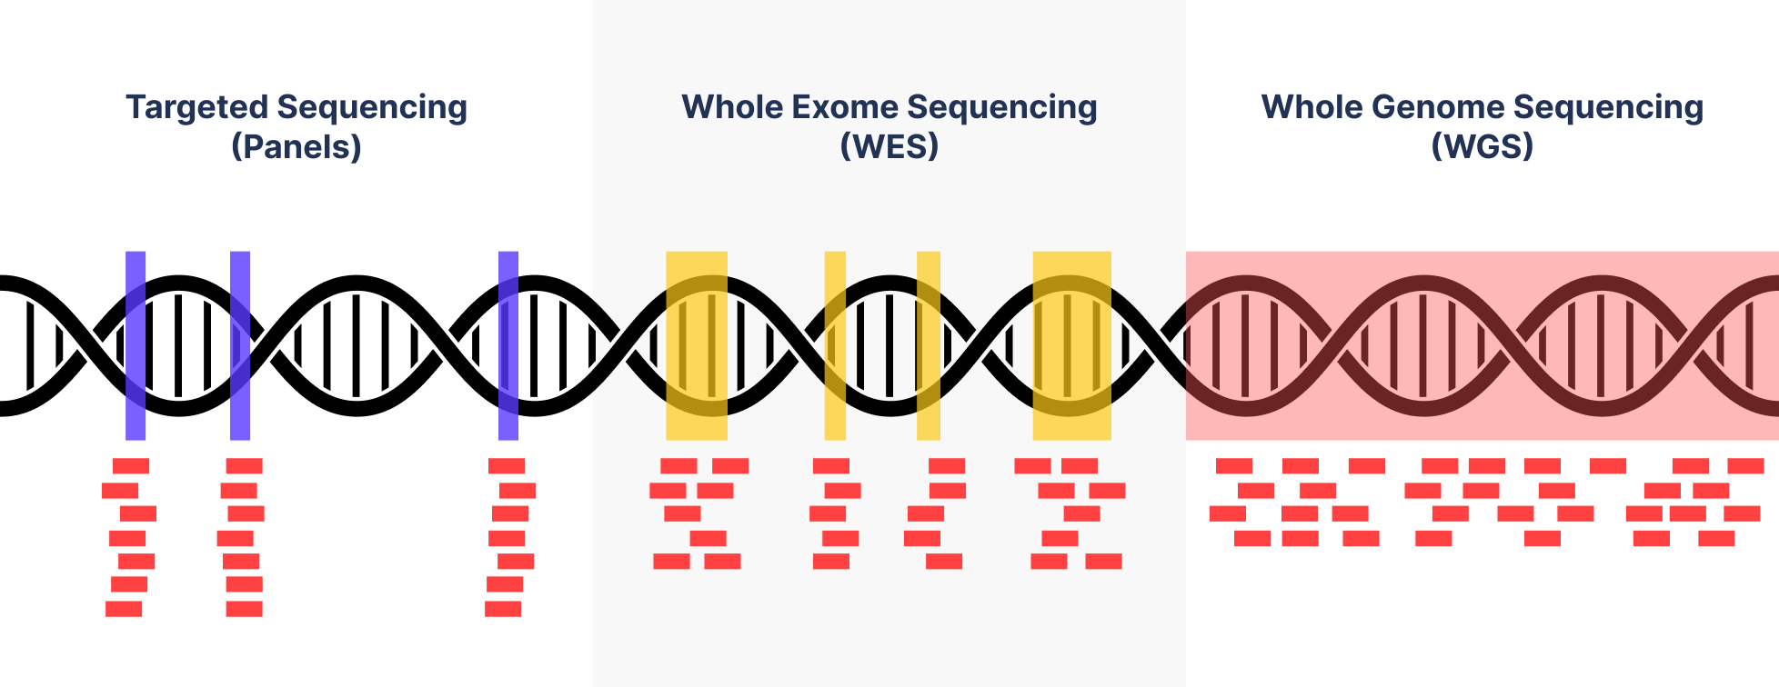
Commercial lab tumor tests meeting criteria
BostonGene (Tumor Portrait Test)
Caris Life Sciences (MI Tumor Seek Hybrid)
Exact Science, Inc. (OncoExTra)
Foundation Medicine (FoundationOne CDx)
Genomic Testing Cooperative (Solid Tumor Profile)
Intermountain Precision Genomics (TheraMap: Solid Tumor)
NeoGenomics Laboratories (Neo Comprehensive – Solid Tumor)
PathGroup (SmartGenomics Complete)
Quest Diagnostics Inc. (Solid Tumor Expanded Panel)
siParadigm Diagnostic Informatics (siPortfolio, Comprehensive NGS)
Strata Oncology (Strata Select)
Tempus (xT Solid Tumor)
The Jackson Laboratory (SOMASEQ)

Slide 61
Academic lab tumor tests
Augusta University
Brigham and Women’s Hospital/Dana-Farber Cancer Institute
Cedars-Sinai Medical Center
Children’s Hospital of Philadelphia
City of Hope National Medical Center
Columbia University
Frederick National Laboratory for Cancer Research
Johns Hopkins Genomics
Knight Diagnostic Laboratories at Oregon Health & Science University
Massachusetts General Hospital
Memorial Sloan Kettering Cancer Center
Moffitt Cancer Center
National Cancer Institute – Laboratory of Pathology
Providence Genomics
Stanford Heath Care
Texas Children’s Hospital
The University of Texas MD Anderson Cancer Center
University of California San Francisco
University of Chicago
University of Colorado
University of Illinois Chicago
University of Michigan
University of Washington
Weill Cornell Medicine
Yale University

Slide 62
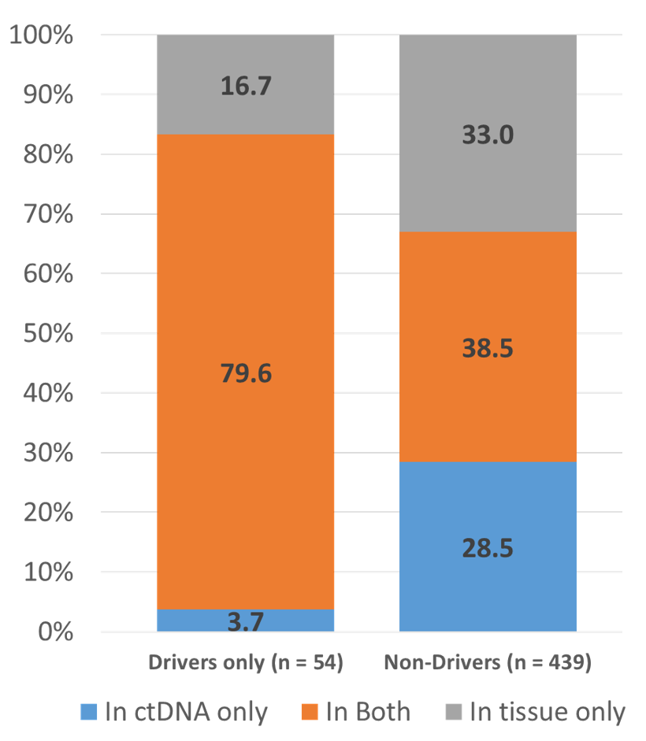
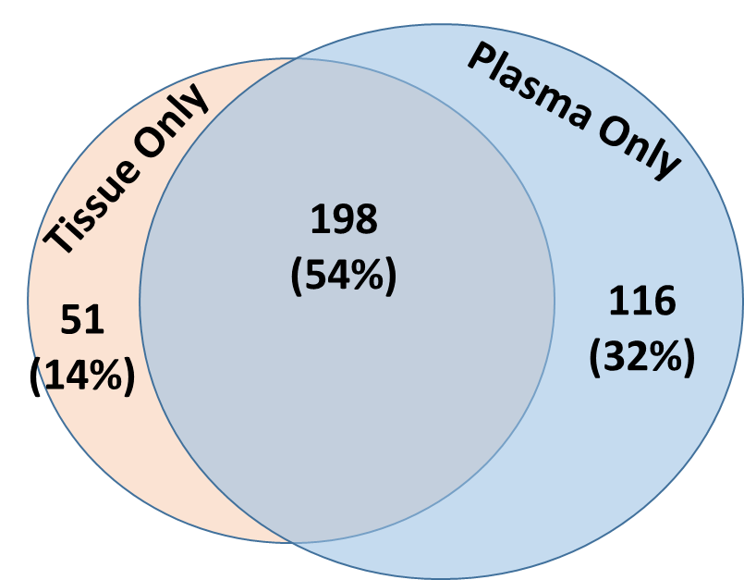
Circulating tumor (ctDNA) tests for enrollment onto matched sub-studies
Based on our work (e.g., Phil Mack et al.), there is sufficient positive percent agreement/predictive value for this
Negative predictive value depends on tumor fraction of cell free DNA
Patients with tumors positive for biomarkers for actively enrolling matched sub-studies should ideally not go on an unmatched study
Mack et al. WCLC 2020

Slide 63
Commercial lab ctDNA tests meeting criteria
Foundation Medicine (FoundationOne F1LCDx)
Guardant (Guardant 360)

Slide 64
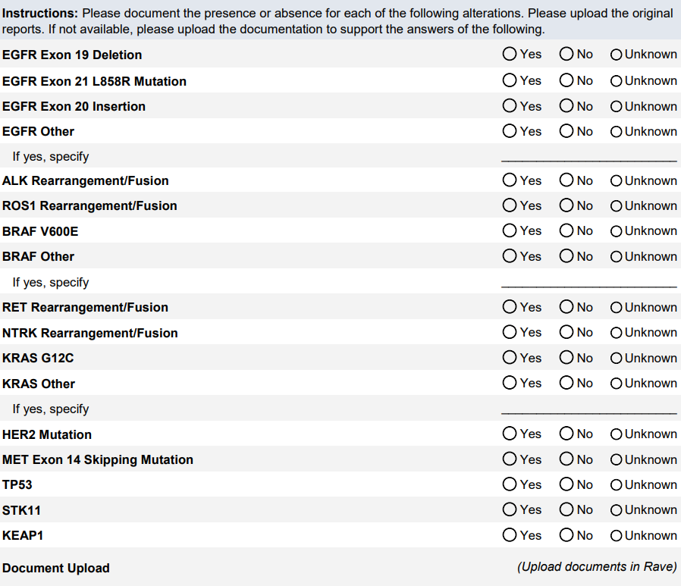
How to collect data:
Case Report Form per S2302 Pragmatica-Lung

Slide 65
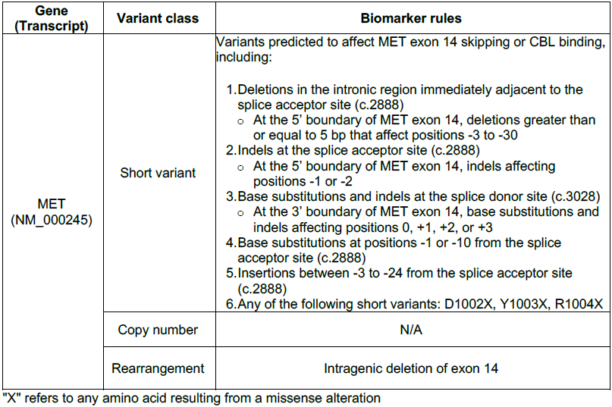
Complex biomarker definitions example: MET exon 14

Slide 66
Confirmatory testing of samples
For patients enrolled onto a biomarker matched sub-study
  May exclude patients with insufficient tissue for central testing depending on sub-study requirements (e.g., registrational intent)
  May choose not to require for signal-seeking studies of rare biomarkers
For patients with only ctDNA testing results
  Tissue NGS confirmation of presence or absence of biomarkers when tissue is available

Slide 67
Previous NGS Testing
No
Yes
Submit Tissue for F1CDx as part of LUNGMAP
Testing approach other than F1CDx
Yes
No
Sub-study Assignments will proceed as currently done
No
Tissue NGS shows lack of presence of any sub-study biomarker
Only Blood NGS shows lack of presence of any sub-study biomarker
Submit Request for Re-Analysis in LUNGMAP
Tissue or blood NGS shows presence of sub-study biomarker
Sub-study Assignments will proceed as currently done
Submit LUNGMAP Genomic Alterations Form in RAVE and upload source documentation
Assigned to Biomarker-Driven Sub-Study
Assigned to a Non-Match Sub-Study
Require Tissue submission for LUNGMAP F1CDx testing

Slide 68
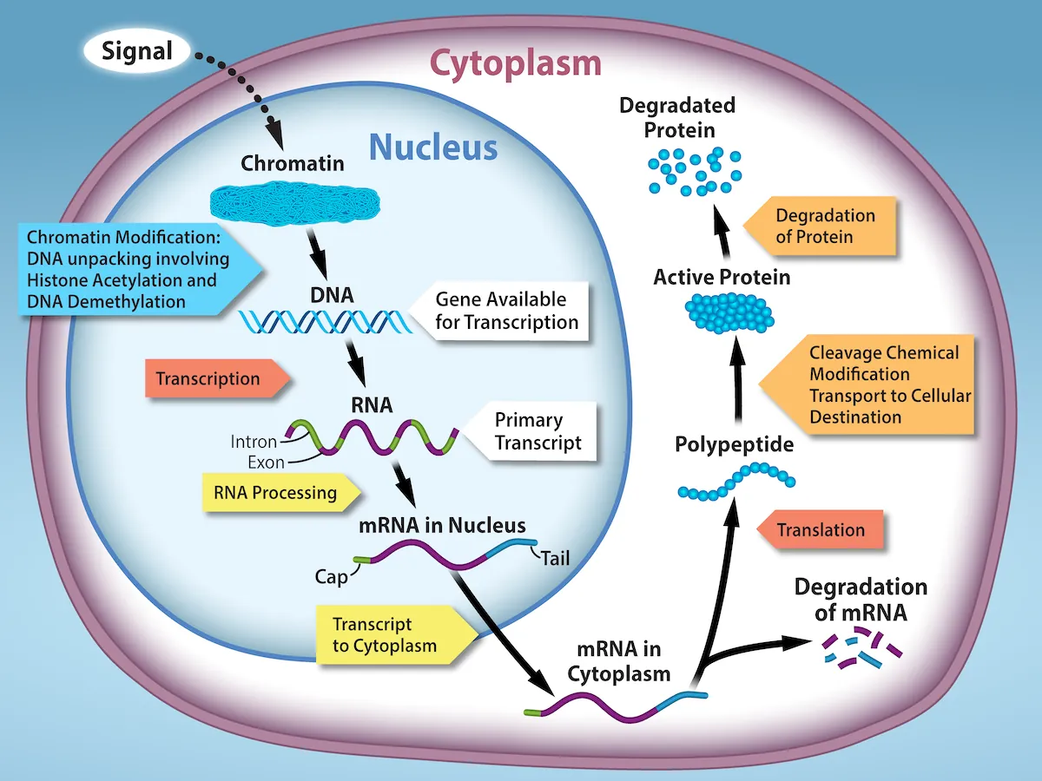
Protein expression biomarkers
NGS testing reveals DNA alterations that can impact protein function
Myriad additional ways to impact protein function, including regulation of protein expression levels
https://openstax.org

Slide 69
Where do we need expression biomarkers the most?
Antibody Drug Conjugates (ADCs)
  E.g., trastuzumab deruxtecan, sacituzumab govitecan
  Eligibility and/or stratification may depend on protein expression levels determined by immunohistochemistry
ADC | Target | Linker | Biomarker | Overall Response Rate | Clinical Trial
T-DM1 | HER2 | Non-cleavable | HER2 | 0/29 (0%) IHC 2+, 4/20 (20%) IHC 3+ | NCT02289833
Teliso-V | c-MET | Cleavable | Non-squamous EGFR WT, c-Met | 7/29 (24%) intermediate, 12/23 (52%) high | LUMINOSITY

Slide 70
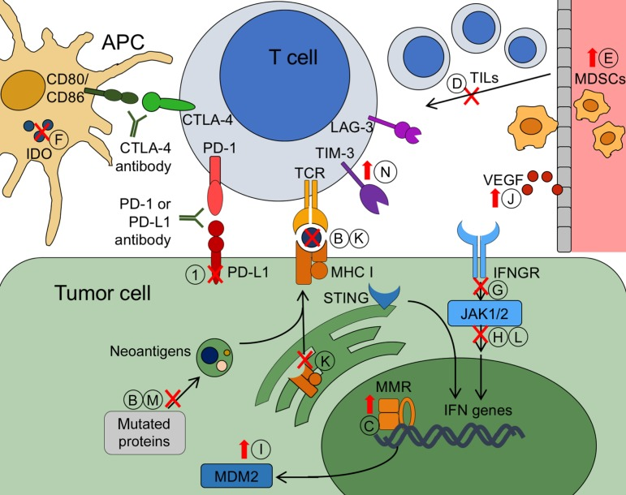
Where do we need expression biomarkers the most?
Immuno-oncology biomarkers
    Primary resistance may be related for example to low PD-L1 or IDO expression
    Acquired resistance may be related to upregulation of suppressors such as LAG-3 or TIM-3, loss of immunodominant neoantigens
Chae YK et al. Oncologist 2018

Slide 71
Expression biomarker considerations
Current standard is immunohistochemistry (IHC) for single proteins
  Availability of tumor tissues is often limited; it would not be feasible to screen for multiple protein biomarkers
  Multiplex immunofluorescence/IHC can assay several (up to ~3 dozen) proteins
Alternatives to immunoassays include mass spectroscopy-based techniques
Comprehensive proteomics include characterization of post-translational modifications including phosphorylation, ubiquitination, and glycosylation
RNA expression may correlate to protein expression, however, may not account for post-translational regulation, e.g., protein degradation

Slide 72
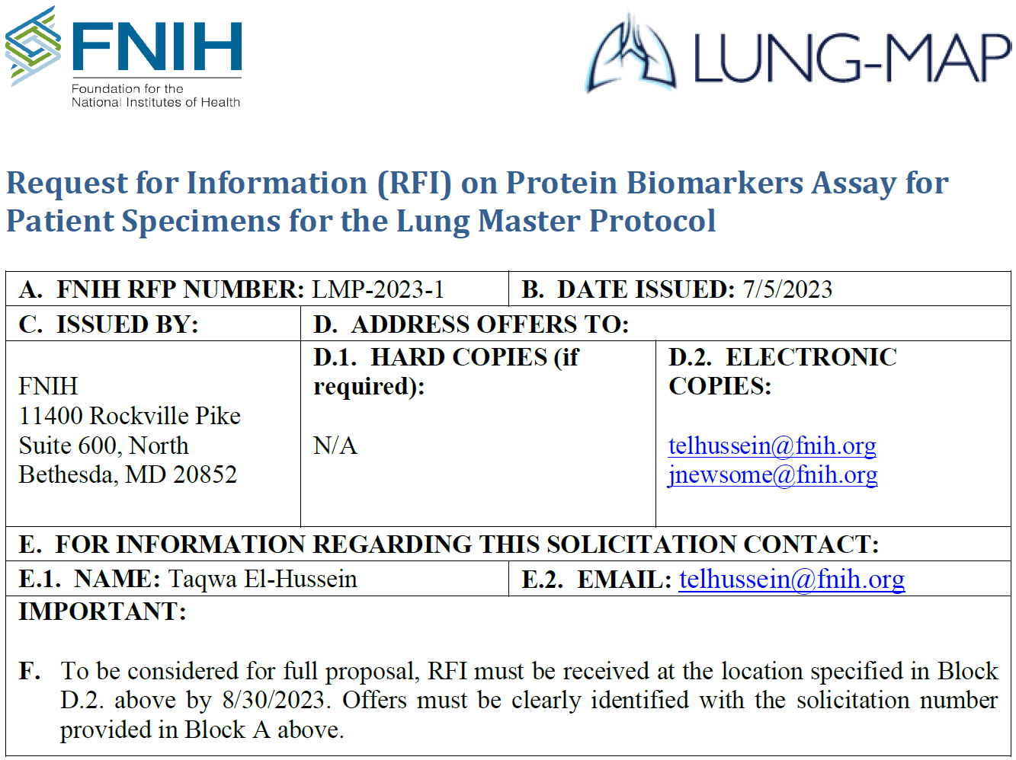
RFI for protein biomarker assays

Slide 73
How to utilize Lung-MAP Data
Biospecimens
Data

Slide 74
Tumor tissues
S1400 (squamous only, Jun 2014 – Jan 2019)
  Tissue block (preferred) or at least 12 unstained slides
LUNGMAP (all NSCLC, Jan 2019 –)
  Commercial FMI F1CDx testing results allowed since revision #4 on Mar 1, 2021
  Tissue block (preferred) or at least 12 unstained slides if submitting tissue for on-study biomarker profiling

Slide 75
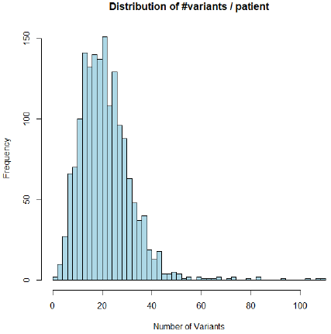
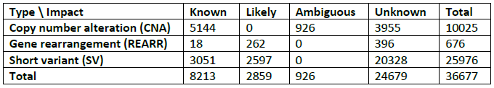
S1400 sequencing data
Enrolled 1864 patients with stage IV or recurrent squamous cell lung cancer Jun 16, 2014 – Jan 28, 2019
Next Generation Sequencing (NGS) data available for 1672 patients using the FoundationOne T5 research platform
T5 = exons and/or introns of 313 cancer-related genes
36,677 variants identified
Largest NGS dataset of advanced squamous cell lung cancers of previously treated patients

Slide 76
Lung-MAP blood samples
 |  |  |  |  | EDTA (0.5 ml froz plasma aliquots)/buffy coat |  |  |  |  | RNA samples |  |  | cfDNA samples (two 8.5 ml Roche tubes)
Study | Biomarker | Drug | Accrual | Goal | Baseline | Wk/Cycl | Wk/Cycl | Wk/Cycl | 1st progr | Baseline | Wk/Cycl | Wk/Cycl | Baseline | Pre-tx | Cycle | Cycle | Cycle | 1st progr
S1400 | Screening |  | 1864 | closed | X
S1400A | Non-match | durvalumab vs. docetaxel | 116 | closed |  | W3-4 | W7 | W9-10 | X | X | W13 | W25
S1400B | PI3K | taselisib | 39 | closed |  | W4 | W7 | W10 | X
S1400C | Cell cycle gene alterations | palbociclib vs. docetaxel | 53 | closed |  | W4-5 | W7 | W9-10 | X
S1400D | FGFR | AZD4547 | 43 | closed |  | W4 | W7 | W10 | X
S1400E | c-Met | erlotinib ± rilotumumab | 9 | closed |  | W4 | W7 | W10 | X
S1400F | Non-match | durvalumab + tremelimumab | 67 | closed |  | W5 | W9 | W13 | X
S1400G | HR repair deficiency | talazoparib | 51 | closed |  | W4 | W7 | W10 | X
S1400I | Non-match | nivolumab ± ipilimumab | 275 | closed |  | W3 | W7 | W9 | X
S1400K | c-Met | ABBV-399 | 28 | closed |  | W4 | W7 | W10 | X
LUNGMAP | Screening |  | 3169 | 6000 | X |  |  |  |  |  |  |  | n = 166
S1800A | previously IO treated | ramucirumab + pembrolizumab | 166 | closed |  | C2 | C3 | C4 | X |  |  |  |  | X |  |  |  | X
S1800D | previously IO treated | N-803 + pembrolizumab | 82 | closed | (30 ml) | C2 | C3 | C5 | X | X | C2 | 1st progr |  | X (Streck x1) | C2 | C3 | C5 | X
S1900A | gLOH high or BRCA1/2 | rucaparib | 64 | closed |  | C2 | C3 | C4 | X |  |  |  |  | X
S1900B | RET fusion | selpercatinib | 6 | closed |  | C2 | C3 | C4 | X |  |  |  |  | X |  |  |  | X
S1900C | STK11 | talazoparib + avelumab | 47 | closed |  | C2 | C3 | C4 | X |  |  |  |  | X |  | C3 |  | X
S1900E | KRAS G12C | sotorasib | 102 | 116 |  | C2 | C3 | C4 | X |  |  |  |  | X | C2 | C3 |  | X
S1900F | RET fusion, nonsquamous | carboplatin/pemetrexed ± selpercatinib | 0 | closed |  | C2 | C3 | C4 | X |  |  |  |  | X |  |  |  | X
S1900G | EGFR mut, MET amplified | capmatinib/osimertinib ± ramucirumab | 5 | 66 |  | C2 | C3 | C4 | X |  |  |  |  | X | C1D15 | C3 |  | X

Slide 77
Making the most of TM resources
Slides stained by FMI including most PD-L1 stained slides and some H&E-stained slides (if FMI did not receive an H&E slide from site and did the H&E staining themselves)
Digital images of H+E and PD-L1 slides
FMI-stained H&E and PD-L1 slides are stored on an Aperio imaging system
Residual extracted DNA from ctDNA submissions
1676 samples of residual extracted DNA from ctDNA submissions
1-2 slides per tissue submission
Currently 15-20 slide boxes which have ~800 slides

Slide 78
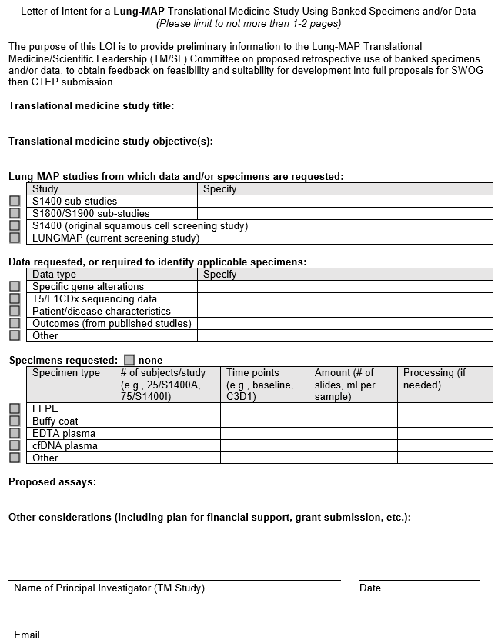
Letter of Intent
Goal: to promote TM research by simplifying initial inquiries
One to two pages
Preliminary information on proposed retrospective use of banked specimens and/or data
Send to TM committee chair for review and advice: lungmaptm@gmail.com

Slide 79
1. Pre-proposal discussion
Approval Process
1
Translational Medicine
Principal Investigator
3. Submit completed TM Proposal Form to
TM/SL Committee + Stats.
Present at TM/SL meeting.
Translational Medicine & Scientific Leadership Committee
5. Send updated proposal
cc
2. Provide TM Proposal Template Form
Statistician/
Stats PRC
SWOG Ops
Protocol Project Manager
approve
Review/Vote
approve
2
requires modification/
disapprove
Review
4. TM/SL voting outcome sent
&
Comments/Suggestions to PI from:
TM/SL scientific reviewers, statistician, Protocol PM
Review
forward
3
6. Approval
Final Vote
TM Approval Committee
4
Protocol Amendment
7. Protocol Amendment submitted to PIO
Contracts and funding are in place
TM analysis begins
SWOG Ops
Protocol Project Manager
CTEP & CIRB
Review
approval
Contracts & Budgets Team
Data transfer or
ship specimens to lab

Slide 80
Thank You
Email: dkozono@bwh.harvard.edu

Slide 81
Lung-MAP Drug Selection Committee
Saiama Waqar, MBBS, MSCI
Medical Oncology & Drug Selection Committee Chair
NRG

Slide 82
Disclosures
  Advisory Board
  Astra Zeneca
  Gilead
  Research Grant support
  SWOG-Clinical Trials Partnership
  Research Support to institution for clinical trials (site PI): AbbVie Inc, Ariad Pharmaceuticals, Genentech, Immunomedics, Inc., Millennium Pharmaceuticals Inc, Roche, Astellas Pharma Inc, Daiichi Sankyo, Cullinan Pearl, Verastem Inc, GlaxoSmithKline/GSK , Janssen Research & Development LLC ,Elevation Oncology, Genentech, Loxo Oncology, Takeda Pharmaceuticals

Slide 83
DSC Overview
Sub-study ideas
  Investigators/Drug Selection Committee Initiated
  Pharmaceutical company initiated
Initial Qualification
  Investigational drug/biomarker combination with preclinical & clinical data supporting safety & potential efficacy as a targeted therapy or “non-match” therapy
  Ready or near ready to enter the Lung-MAP phase 2 clinical protocol
Evaluated by the Lung-MAP Drug Selection Committee (DSC), comprised of:
  Key investigators & clinical researchers
  Biomarker & molecular target experts from academia, NCI & FDA
  Non-conflicted industry-based drug developers

Slide 84
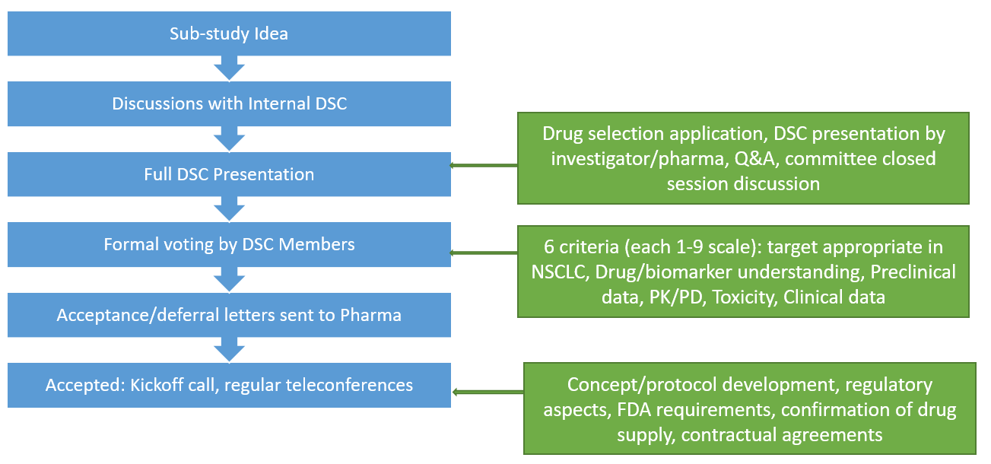
DSC Process

Slide 85
Current Lung-MAP Schema
Actively Accruing
Temporarily Closed
In Development
LUNGMAP Screening
Biomarker–Driven
Sub-Studies
Non-match
Sub-Studies
Targeted therapy-Naive
ICI Resistance
TKI-Treated/Resistant
ICI Acquired Resistance¹
Open
Q4 2023
Q4 2023
DSC Approved ²
Open
DSC Approved ²
S1900E
KRASG12C
S1900J
MET amplification
S1900K
MET Exon 14 skipping
S1900L
CEACAM5 expressing
S1900G
EGFR mutation
w/ acquired MET amplification at resistance
S1800E
Phase II/III
anti-PD1 + anti-VEGFR2 + Docetaxel vs. SoC
Sotorasib (AMG 510)
MET TKI Vs.
MET TKI + anti-VEGFR2
CEACAM5-targeting ADC + checkpoint inhibitor + anti-VEGFR2
vs.
Checkpoint inhibitor + anti-VEGFR2
EGFR-MET bispecific antibody
INC280 (Capmatinib) + Osimertinib + Ramucirumab
Vs.
INC280 (Capmatinib) + Osimertinib
¹ Acquired Resistance is defined as progression at least (≥) 84 days from initiation of the most recent line of anti-PD-1/PD-L1 and best response of stable disease, partial response, or complete response.
² Approved by the Lung-MAP Drug Selection Committee
TRIAL POINTS OF INTEREST:
Each of sub-study operates independently of the others
Prescreening can be performed while the patient is on any line of therapy for stage IV disease
Repeat or fresh biopsy necessary for tissue screening is paid by the trial
#Biomarker-driven sub-studies may progress to Phase III if study meets endpoint and Phase III is feasible, at which point the standard of care arm will be determined.

Slide 86
S1900J A Phase II of Amivantamab in Participants with Stage IV or Recurrent Non-Small Cell Lung Cancer Previously Treated with high MET amplification (Lung-MAP Sub-Study)
Registration to
Screening Study
Study chairs: Rolfo (chair), Gadgeel (co-chair)
Lead Group/Committee Chair: SWOG/Gray
Study Champion Lead: Gandara
Stats: Redman, Minichiello
DC: Highleyman
PM: Beeler
MET
Amplification
Primary Endpoint: Response by RECIST
Non-Squamous
Cohort
N=40 Eligible (44 total)
Squamous
Cohort
N=40 Eligible (44 total)
Protocol re-submitted to CTEP 8/25/2023 to address minor follow-up review comments, activation targeted for Q1 2024
Amivantamab
1050 or 1400 mg (if 80kg+)
^{Q weekly x 4 weeks}
^{Q 2W thereafter}

Slide 87
S1900K A Randomized Phase II Study of Tepotinib with or without Ramucirumab in Participants with MET Exon 14 Skipping Stage IV or Recurrent Non-Small Cell Lung Cancer (Lung-MAP Sub-Study)
Study Chairs: Paik (chair), Le (co-chair)
Lead Group/Committee Chair: SWOG/Gray
Study Champion Lead: J. Patel
Stats: Redman, Minichiello,
DC: Highleyman
PM: Beeler
CIRB approval 8/9/2023
CTEP approval on hold 8/15/2023
Contract underway
Activation targeted for Q3 2023
ARM A
Tepotinib + ramucirumab
Registration to
Screening Study
MET exon 14 skipping
positive
(local CLIA profiling allowed)
Randomization
1:1
ARM B
Tepotinib
N = 50
Primary Endpoint: Response (confirmed and unconfirmed, complete and partial) per RECIST 1.1.

Slide 88
S1900L A Randomized Phase II Trial of Pembrolizumab and Ramucirumab with or without Tusamitamab-ravtansine in CEACAM5 Expressing, Previously Treated, Stage IV or Recurrent NSCLC (Lung-MAP Sub-Study)
Study Chairs: Judd (chair), Petty (co-chair)
Lead Group/Committee Chair: ECOG/ Brahmer
Study Champion Lead: Leal
Stats: Redman, Minichiello,
DC: Highleyman
PMs: Laubach/Beeler
INCLUSION CRITERIA
Pts with aNSCLC, PDL1 all comers
Squamous and non squamous histology
Failure/PD after PD1/PDL1 inhibitor and platinum-doublet CT
  Acquired resistance to ICI (>84 days)
Pts with KRAS G12C mt must have received prior KRAS G12C inhibitor or must be ineligible or declined
CEACAM5 expression by IHC: ≥2+ in intensity ≥1% TPS (moderate + high)
  ARCHIVE OR FRESH BIOPSY
ECOG 0-1
All patients meet eligibility to receive Ramucirumab
Untreated asymptomatic brain metastasis
Previously treated stable brain metastasis
NO prior treatment with Docetaxel
CEACAM5
tumor assessment
Prevalence
IHC 3-5 slides, 5 day turn around
Randomization
1:1
ARM A: (n=42)
Pembrolizumab 200mg IV Q3W
Tusamitamab ravtansine 150 mg/m² IV Q3W
Ramucirumab 10 mg/kg IV Q3W
Treatment until disease progression, unacceptable toxicity
Stratification factors:
Histology
CEACAM5 expression
ARM B: (n=42)
Pembrolizumab 200mg IV Q3W
Ramucirumab 10 mg/kg IV Q3W
Single arm exploratory cohort (n=30)
Pembrolizumab 200mg IV Q3W
Tusamitamab ravtansine 150 mg/m² IV Q3W
Ramucirumab 10 mg/kg IV Q3W
EXPLORATORY POPULATION: Pts with driver mutations who have exhausted all lines of standard of care therapy (prior PD1/PDL1 inhibitor required)

Slide 89
Updated S1900L: A Randomized Phase II Trial of Pembrolizumab, Ramucirumab and Tusamitamab-ravtansine vs. SOC in CEACAM5 Expressing, Previously Treated, Stage IV or Recurrent NSCLC
Study Chairs: Judd (chair), Petty (co-chair)
Lead Group/Committee Chair: ECOG/ Brahmer
Study Champion Lead: Leal
Stats: Redman, Minichiello,
DC: Highleyman
PMs: Laubach/Beeler
INCLUSION CRITERIA
Pts with aNSCLC, PDL1 all comers
Squamous and non squamous histology
Failure/PD after PD1/PDL1 inhibitor and platinum-doublet CT
  Acquired resistance to ICI (>84 days)
Pts with KRAS G12C mt must have received prior KRAS G12C inhibitor or must be ineligible or declined
CEACAM5 expression by IHC: ≥2+ in intensity ≥1% TPS (moderate + high)
  ARCHIVE OR FRESH BIOPSY
ECOG 0-1
All patients meet eligibility to receive Ramucirumab
Untreated asymptomatic brain metastasis
Previously treated stable brain metastasis
NO prior treatment with Docetaxel
CEACAM5
tumor assessment
Prevalence
IHC 3-5 slides, 5 day turn around
Randomization
1:1
ARM A: (n=42)
Pembrolizumab 200mg IV Q3W
Tusamitamab ravtansine 150 mg/m² IV Q3W
Ramucirumab 10 mg/kg IV Q3W
Treatment until disease progression, unacceptable toxicity
10 patient safety run in
Stratification factors:
Histology
CEACAM5 expression
ARM B: (n=42)
Docetaxel plus ramucirumab (SOC)
Budget being looked at
Pending DSC voting on new design

Slide 90
S1800E A Randomized Phase III Study of Docetaxel and Ramucirumab with or without Cemiplimab for Participants Previously Treated with Platinum-based Chemotherapy and Immunotherapy for Stage IV or Recurrent Non-Small Cell Lung Cancer (Lung-MAP Non-Match Sub-Study)
Study Chairs: Waqar (chair), Li (co-chair)
Lead Group/Committee Chair: SWOG/Gray
Study Champion Lead: Gandara
Stats: Redman, Minichiello
DC: Highleyman
PM: Biddle
DSC approved 4/1/22, redesign to phase 3, submitted to CTEP 9/21/23
ARM A
Standard of Care
Docetaxel + Ramucirumab
Registration to
Screening Study
Screening Study to
determine sub-study
assignment
Randomization
1:1
ARM B
Cemiplimab
+
Docetaxel + Ramucirumab
N = max 378
For 340 Eligible Participants
Primary objective: OS
10 Participant Safety Run-In for Arm B

Slide 91
Closing Announcements & General Q & A Session
Virtual attendees–
Place your questions in the chat box and a team member will read it out loud for the study team to answer.
Hossein Borghaei, MS, DO, LunGMAP Chair
All Attendees

Slide 92

Contact Us
Site Coordinators Committee
  LUNGMAPSCC@crab.org
Protocol & Regulatory Questions
jbeeler@swog.org or
  lsmith@swog.org
  Eligibility & Data Submission Questions
  LUNGMAPQuestion@crab.org
  Funding Questions
  Funding@swog.org
  General Medical Questions
  LUNGMAP@swog.org
  S1900E Medical Questions
  S1900EMedicalQuery@swog.org
  S1900G Medical Questions
  S1900GMedicalQuery@swog.org
Accrual Enhancement Committee
lungmapAEC@swog.org

Slide 93
Acknowledgements
Thank you for supporting the Lung-MAP Trial!
Patients and Sites
Lung-MAP Site Coordinators Committee
Patient Advocate
Diversity, Equity, and Inclusion Champion
Accrual Enhancement Committee
Trial Oversight Committee
Study Chairs
Statistical Team
Pharmaceutical Collaborators
Data Coordinators & Protocol Project Managers
Applications Development Team
Quality Assurance Team
Funding & Contracts Team
NCI, CTEP, CIRB, CTSU
Foundation for the National Institutes of Health
Friends of Cancer Research
CCS Associates Inc.

Slide 94

Summary & Adjourn
Thank you joining us!
The slides will be available on the SWOG & CTSU websites

