Slide 1
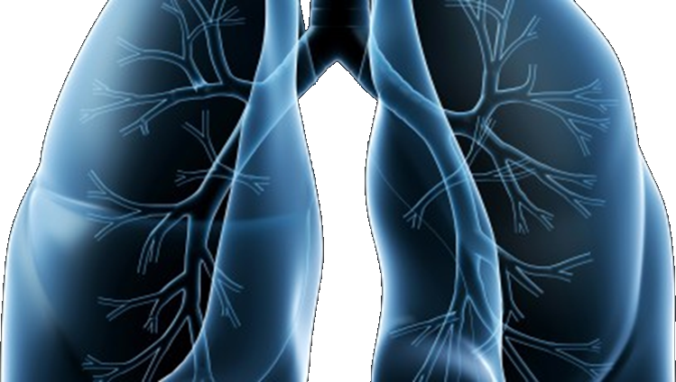
Audit Update
LUNG-MAP
Rose Ermete, Rn, bsn, ocn, ccrp
SWOG Quality Assurance Manager

Slide 2
QA/Monitoring Common Problems
Regulatory: For sites using the CIRB:
  Consent forms deviate from the approved boilerplate language
  Unable to determine when consent versions were implemented
Boilerplate Document
  Protocol Specific
  Annual Signatory
DTL – New requirement

Slide 3
QA/Monitoring Common Problems
Patient Case Review: Eligibility
  S1400: Failure to confirm ≥ 20% tumor cells by local pathologist
    Much better – we are seeing less of this
  S1400G: – Must have achieved stable disease, a partial response, or a complete response at their first disease assessment after initiating first-line platinum-based chemotherapy
  S1400I: Must not have received systemic treatment with corticosteroids (> 10 mg daily prednisone or equivalent) or other immunosuppressive medications within 14 days prior to sub-study registration.

Slide 4

QA/Monitoring Common Problems
Patient Case Review: Treatment
  Failure to dose reduce per protocol
  Failure to document compliance to oral drugs
Patient Case Review: Adverse Events
  Failure to report adverse events
  See CRF Guidelines page 27
  NEW: S1400 A & I - Collection of immune relationships of events (going forward & retrospective)

Slide 5
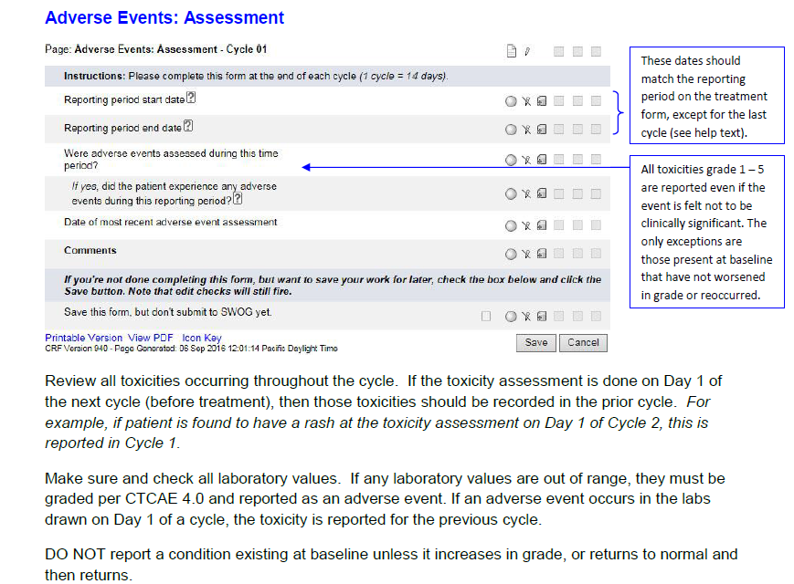

Slide 6
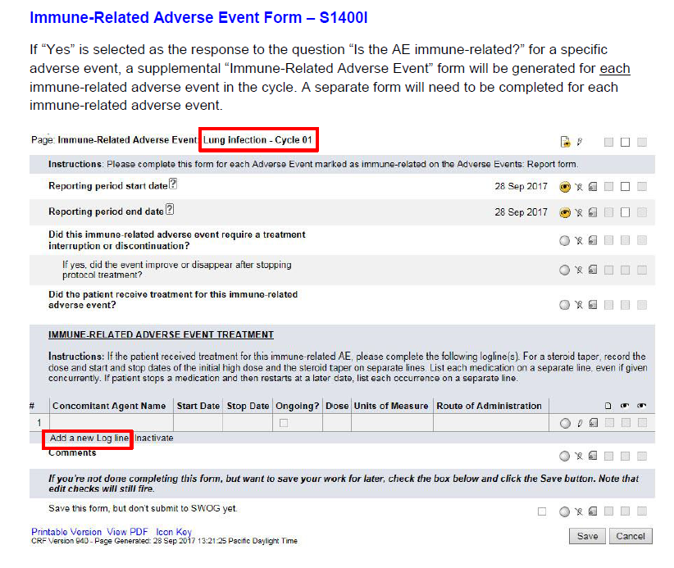

Slide 7
QA/Monitoring Common Problems
Patient Case Review: Data Quality
  Data entry errors (CRF Guidelines on Abstract page and CRA Workbench)
    Current date of staging (Pg 3)
    TNM staging (Pg 3)
    # of prior systemic treatments for Stage IV (Pg 4)
    Date on uploaded reports (Pg 5)
    Measured Creatinine Clearance (Pg 15)
    RECIST (Pg 21 & 22)

Slide 8
Disease Assessment
Target Lesions
  Choose up to 2 lesions per organ & 5 lesions total
  For lymph nodes, record the smallest (short axis) diameter (must be > 1.5 cm to be a measurable lesion).
  Nodules are generally not considered lymph nodes.

Slide 9
Disease Assessment
Non-Target Lesions
  Measurable lesions that were not selected as target lesions. Since only two lesions per organ and five lesions in total can be selected as target lesions, any additional lesions should be followed as non-target disease.
  Small lesions (longest diameter < 1.0 cm or pathologic lymph nodes with ≥ 1.0 cm to <1.5 cm short axis). Note: Lymph nodes that have a short axis < 1.0 cm (10 mm) are considered non-pathological and should not be recorded or followed.
  Bone lesions, leptomeningeal disease, ascites, pleural/pericardial effusions, lymphangitis cutis/pulmonitis, inflammatory breast disease, and abdominal masses (not followed by CT or MRI).
  Previously radiated lesions that have not progressed.

Slide 10
Data Delinquency & Failure to Collect Specimens
All data is submitted electronically:
Medidata Rave® | TRIAD application | SWOG Specimen Tracking System
All case report forms & specified source documentation | Radiology images | All specimens
Protocol Section 14 for submission schedule | Protocol Section 14 for schedule Protocol Section 15 for details | Protocol Section 15 for details and schedule
Baseline forms due within 7 days of registration | Scan images to be uploaded within 7 days of the disease assessment | Specimens can be batched, but enter the date drawn in Specimen tracking
For Baseline Forms: > 30 days late is a lesser > 90 days late is a major | For Baseline Forms: > 30 days late is a lesser > 90 days late is a major
Timely submission of data is critical to trial success!

Slide 11
Questions??
S1400question@crab.org

