Slide 1





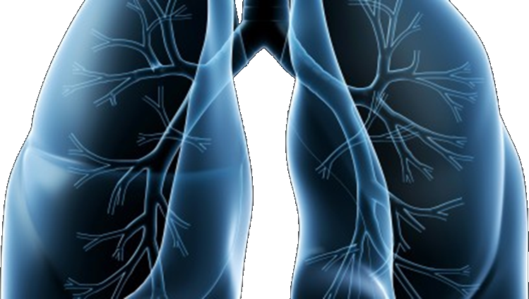
LUNG-MAP
Lung Master Protocol
(LUNGMAP)

Slide 2
Agenda
Welcome / Agenda | Roy Herbst
Future of Lung-MAP | Jyoti Patel
LUNGMAP & commercial FoundationOneCDx Overview: Joel Neal Consent: Jessica O’Donovan forms/STS: Louis Highleyman | Joel Neal Jessica O’Donovan Louise Highleyman
Summary of S1900E | Suki Padda
Summary of S1800D | Mary Redman
S1400G, K, I, F, GEN Publications | Mary Redman
TM Committee Update & Analyses Presented at World Lung | David Kozono
Drug Selection Committee Overview/Process | Hossein Borghaei
Concept/Protocol timelines and CTEP review | Mariah Norman
Closing Announcements & Q & A | David Gandara

Slide 3
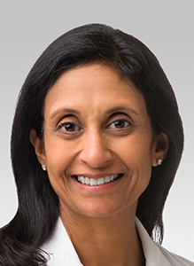
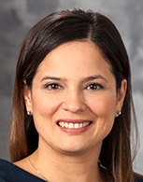
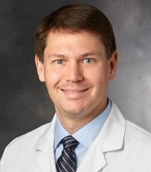

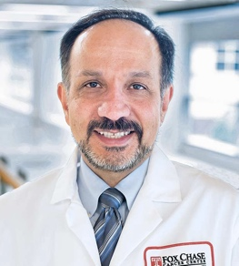


Who are we?
Study Chairs
Medical Oncology Chairs
Roy Herbst, MD PhD
Jyoti Patel, MD
David Gandara, MD
Konstantin
Dragnev, MD
Ticiana Leal, MD
Joel Neal, MD, PhD
Martin Edelman, MD
Saiama Waqar, MD
Committee Chairs
Translational Medicine
Biostatisticians
Katherine Minichiello, MS
Jieling Miao, MS
James Moon, MS
Hossein Borghaei, DO
David Kozono, MD PhD
Fred Hirsch, MD
Philip Mack, PhD
Mary Redman, PhD
Drug Selection
Translational Medicine

Slide 4
Current Lung-MAP Schema
Actively Accruing
Temporarily Closed
Screening Protocols*
In Development
S1400
LUNGMAP
Completed/Closed
Biomarker–Driven
Sub-Studies
Non-match
Sub-Studies
Closed/Completed
Open
Open
Closed/Completed
Q3 2021
S1400B : Pi3K+ Taselisib
S1400C : CCGA+ Palbociclib
S1400D: FGFR+ AZD4547
S1400E: c-MET+ Rilotumumab+Erlotinib
S1400G: HRRD+ Talazoparib
S1400K: c-MET+ Teliso-V (ABBV-399)
S1900A: LOH/BRCA+ Rucaparib
S1900C: STK11+ Talazoparib+Avelumab
S1900B#
RET fus +
S1900E
KRASG12C
ICI Naïve:
S1400A : Durvalumab
S1400I : Nivo+Ipi V. Nivo
ICI Refractory:
S1400F: Durvalumab + Tremelimumab (both cohorts)
S1800A: Pembrolizumab + Ramucirumab vs. SoC
S1800D
Checkpoint
Refractory
Selpercatinib
(LOXO-292)
AMG 510
N-803 +
Pembrolizumab vs. SoC
*LUNGMAP screening protocol (activated 1/28/19) allows all histologic types of NSCLC. S1400, the original screening/umbrella protocol included only squamous lung cancer. S1400 accrued patients between 6/16/2014 and 1/28/2019. While S1400 is closed to accrual, patients enrolled to S1400 may participate in sub-studies they are eligible for.
TRIAL POINTS OF INTEREST:
Each of sub-study operates independently of the others
Prescreening can be performed while the patient is on any line of therapy for stage IV disease
Repeat or fresh biopsy necessary for tissue screening is paid by the trial
#Biomarker-driven sub-studies may progress to Phase III if study meets endpoint and Phase III is feasible, at which point the standard of care arm will be determined.

Slide 5
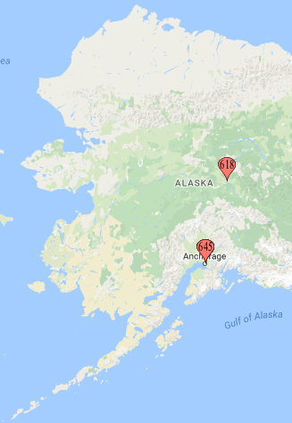
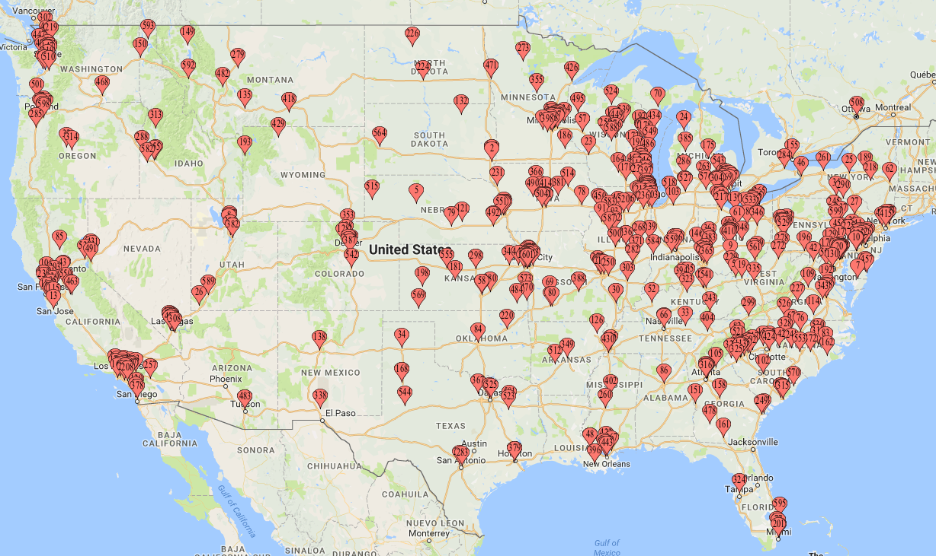
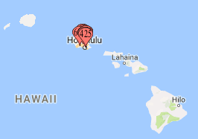
Where are we now?
As of 4/9/21 | Total | S1400 | LUNGMAP
Screening Registrations | 3787 | 1864 | 1923
Screened at PD | 1898 | 1127 | 771
Pre-screened* | 1889 | 737 | 1152
Sub-study Assignments | 2413 | 1475 | 938
Among Screened at PD | 1607 | 996 | 611
Among Pre-screened | 713 | 410 | 303
Additional Assignments after PD on a Sub-study | 95 | 69 | 26
Sub-study Registrations | 964 | 690 | 273

Slide 6
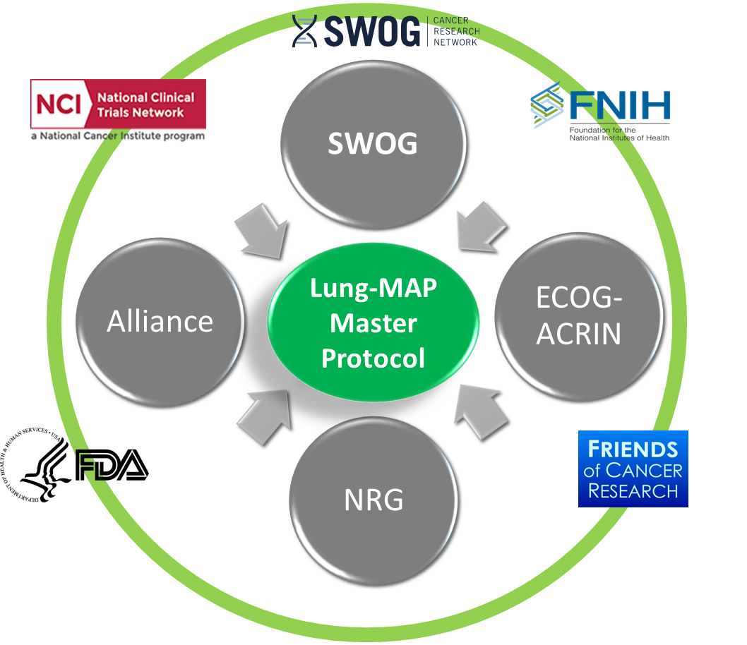













Lung-MAP Partners and Collaborators
Coming Soon:
ImmunityBio

Slide 7
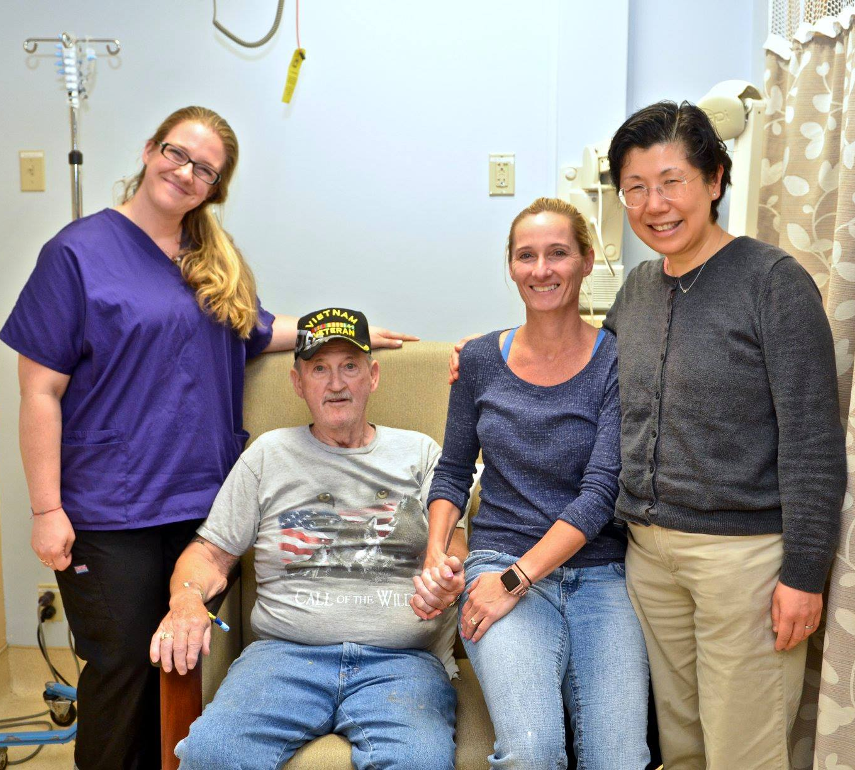



Lung-MAP Impact
Most importantly, we are grateful Lung-MAP has helped many patients!
I continue to be so grateful for everyone involved. Even after 48 visits for my opdivo infusion!
~ Annie B.
Living!
  I am more confident than I have been in a long time. Lung-MAP gave me my life back. ~ Clifford C.

Slide 8
The Future of Lung-MAP
The Next Generation
Jyoti D. Patel, MD FASCO
Lurie Cancer Center
Northwestern University

Slide 9
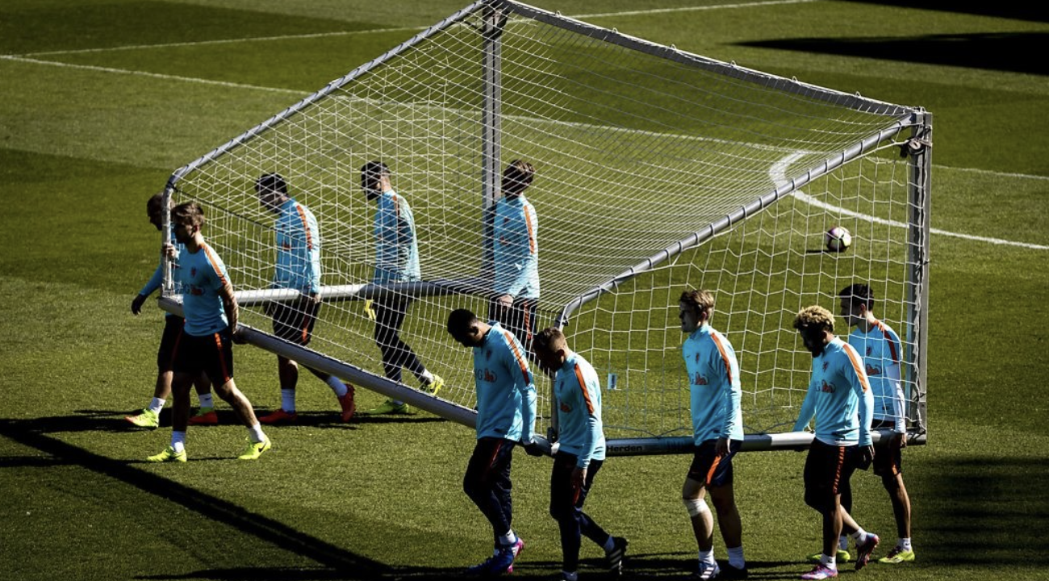
The Future of Lung-MAP
The Next Generation
Wide adoption of NGS in NS-NSCLC
Immunotherapy as standard of care in WT NSCLC patients
Evolution of blood based testing
Ambiguous historical controls

Slide 10
Lung-MAP
The Next Generation
Identifying and overcoming mechanisms of immune resistance
  Primary vs acquired
Identifying rational strategies to treat patients who have developed resistance to targeted therapies
  Small patient populations, acquired mutations
Comprehensive biomarker analysis from tissue and blood

Slide 11
The Future: Lung-MAP Schema
Screening Protocols*
Can enroll with FoundationOneCDx
S1400
LUNGMAP
Biomarker–Driven
Sub-Studies
Non-match
Sub-Studies
cfDNA pre- and during study
Open
Open
Closed/Completed
Q3 2021
S1400B : Pi3K+ Taselisib
S1400C : CCGA+ Palbociclib
S1400D: FGFR+ AZD4547
S1400E: c-MET+ Rilotumumab+Erlotinib
S1400G: HRRD+ Talazoparib
S1400K: c-MET+ Teliso-V (ABBV-399)
S1900A: LOH/BRCA+ Rucaparib
S1900C: STK11+ Talazoparib+Avelumab
S1900B#
RET fus +
S1900E
KRASG12C
ICI Naïve:
S1400A : Durvalumab
S1400I : Nivo+Ipi V. Nivo
ICI Refractory:
S1400F: Durvalumab + Tremelimumab (both cohorts)
S1800A: Pembrolizumab + Ramucirumab vs. SoC
S1800D
Checkpoint
Refractory
Selpercatinib
(LOXO-292)
AMG 510
N-803 +
Pembrolizumab vs. SoC
Closing*
Anticipate refractory population trial
+ Trials in TKI-refractory patients: anti-VEGF, chemo
Novel immunotherapy trials

Slide 12
Lung-MAP
Collaboration: cooperative groups, NCI, industry
Next generation of researchers
Patient focused and centric
The Next Generation

Slide 13


Using FoundationOne CDx testing for LUNGMAP
Joel Neal MD PhD
LUNGMAP Study Co-Chair + FMI Liaison
LUNGMAP meeting, April 21, 2021

Slide 14
Using FoundationOne CDx testing for LUNGMAP
Background: For LUNGMAP screening eligibility, tissue submission for research testing is required.
We would like to expand to allow sub-study assignment for patients with known NGS testing
Prior known Foundation CDx (Tissue based DNA NGS) will be allowed to satisfy LUNGMAP screening in an upcoming amendment

Slide 15
Using FoundationOne CDx testing for LUNGMAP
Protocol version 3/1/21 (anticipated release to sites Q2 2021) update to eligibility criteria:
Patients may either submit tissue for biomarker profiling (current state) OR submit previous commercial FoundationOne CDx test results.
If submitting commercial results:
    Patients must have a FoundationOne CDx report available with the following information:
      Results done on solid tumor tissue (liquid test not allowed)
      Original report date on or after September 1,2019
      FMI Test Order # (e.g. ORD-1234567)
    Patients must consent to have their commercial FoundationOne CDx test results disclosed to SWOG
Note: PD-L1 testing will no longer be performed centrally
Commercial test results will be reanalyzed to use on LUNGMAP – turnaround still 16 days but probably less

Slide 16
Using FoundationOne CDx testing for LUNGMAP
For patients submitting commercial FoundationOne CDx results:
The request to reanalyze commercial FoundationOne CDx results must be submitted through STS (including generating a Packing List, which will be used as the request form by FMI) and source documentation must be uploaded in RAVE
When submitting the request through STS, be prepared to provide answers to the following questions.
      Original collection date of the tissue used for commercial testing
      Patient’s date of birth (mm/dd/yyyy)
      Patient’s sex (Male, Female)
      Has the patient had any type of transplant? (Yes, No)
      Patient’s diagnosis (NSCLC)
      Primary tumor site (Lung)
      Specimen tumor site
      ORD number from commercial FoundationOne CDx report (e.g. ORD-1234567)

Slide 17
Known Foundation CDx testing for LUNGMAP
Summary: Upcoming protocol amendment will allow prior Foundation CDx tumor (not liquid) results from Sept 1, 2019 or after to satisfy tissue requirement
The study chairs will continue to seek opportunities to expand to other testing platforms in the future.
Questions?

Slide 18
Consent Form Changes and Implementation
Jessica O’Donovan
Chair, LungMAP Site Coordinators Committee
VA Connecticut Healthcare System

Slide 19

Best Practices for Implementation/ Training
Review protocol changes
  Specific Consent changes
  Team Meetings
    Might have to go over a couple of times
    Prior to consenting reminders that there are changes
      Flag everything that needs to be signed, especially areas that have been added
      Remind the person if there have been items removed

Slide 20
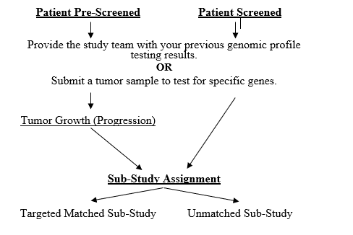
Major Changes
Previous commercial FoundationOne CDx results for sub-study assignment
Patient will have to consent to:
  Release tissue for testing through the study
  OR
  Release previous results from FoundationOne CDx testing
  When consenting make it clear which group the patient fits into:
    Pre-Screening VS. Screening
    Previous Results VS. Tissue Release

Slide 21

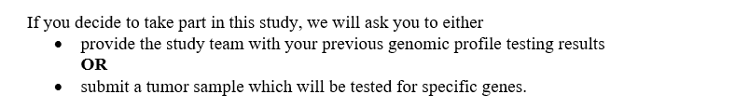
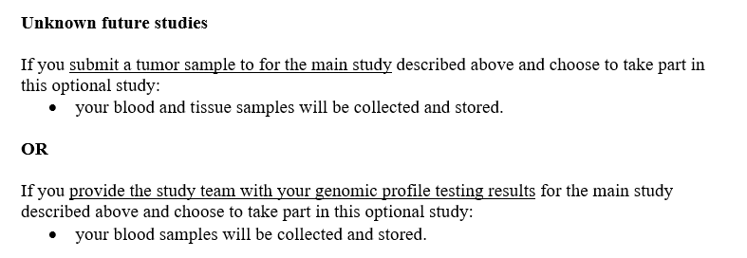
“OR” Statements

Slide 22
New Section under “What Exams, tests, and procedures are involved in this study?”
If you provide the study team with your previous genomic profile testing results, the information below applies to you.
Provide the study team with your genomic profile testing results from the FoundationOne CDx next generation sequencing test obtained commercially through your doctor.
If you had genomic profile testing, which was done as part of your cancer care, you will need to provide the results to SWOG Cancer Research Network. This is a test that you had done prior to consenting to this study. The genomic profile test results are required in order for you to take part in this study. The results of that test will determine which sub-study you will be offered.
If you submit a tumor sample to the study team, the information below applies to you.
Tumor Sample
Before you begin the study, a small piece of tumor sample, which was already removed by surgery or biopsy, will be sent to special laboratories for the study. This tumor sample is required in order for you to take part in this study because the research on the sample is an important part of the study. The result of this testing will determine which sub-study you will be offered.

Slide 23
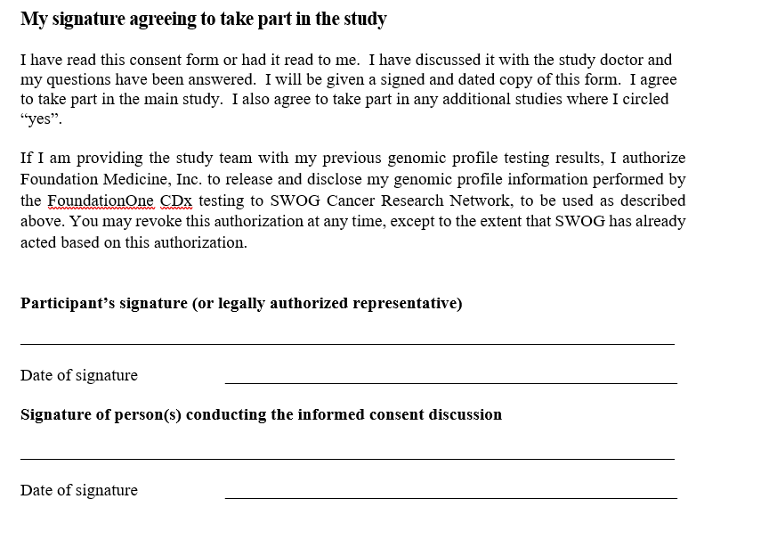
Major Change to Signature Page

Slide 24
Take Home
Know which group your patient falls into prior to consent
  Prescreening VS Screening
  Previous testing VS Tissue Sample being sent
Make sure you read the statements that correspond with the situation
MAKE SURE the patient knows that they are agreeing to either sending previous results OR the tissue NOT both
Review the new consent with all members of the team
Make sure all members are aware that we can send out previous results as of this update

Slide 25
How To: Request Re-analysis of Commercial FoundationOne CDx Results for Lung-MAP biomarker analysis and sub-study assignment
LUNGMAP Screening Protocol Revision #4
LOUISE HIGHLEYMAN, Lung-MAP Data Coordinator
SWOG Statistics and Data Management Center

Slide 26
Overview
Site follows steps in SWOG Specimen Tracking (STS) to request re-analysis of commercial FoundationOne CDx results
Site consents patient, confirms eligibility, and registers patient to LUNGMAP Step 1
SWOG SDMC receives file and alerts site of sub-study assignment (at progression)
FMI re-analyzes commercial data and sends data file to SWOG SDMC
SWOG SDMC alerts FMI to request
Site completes Rave form, uploading commercial report as documentation

Slide 27
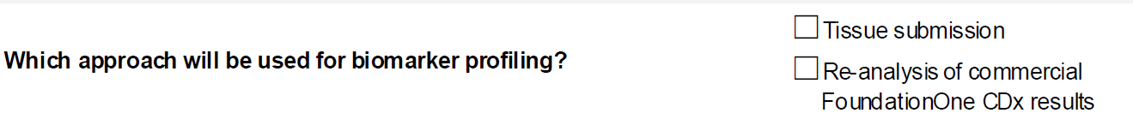

OPEN Registration
Site consents patient, confirms eligibility, and registers patient to LUNGMAP Step 1
As part of eligibility, confirm commercial FoundationOne CDx report meets requirements
During LUNGMAP Step 1 Registration:
  Answer auxiliary registration question regarding which approach will be used for biomarker profiling

Slide 28
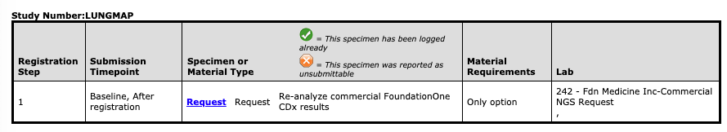
SWOG Specimen Tracking System
Site follows steps in SWOG Specimen Tracking (STS) to request re-analysis of commercial FoundationOne CDx results
Complete STS steps exactly like you would for a specimen (log and “ship”), selecting “Request” for the specimen type

Slide 29
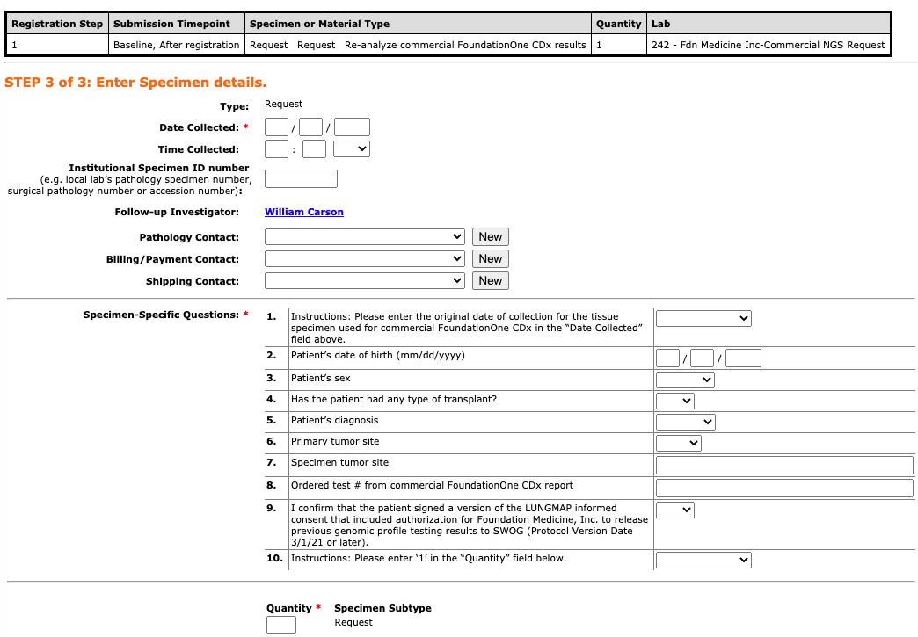
SWOG Specimen Tracking System
Site follows steps in SWOG Specimen Tracking (STS) to request re-analysis of commercial FoundationOne CDx results
Answer important questions that FMI will use to link the request to existing commercial results

Slide 30
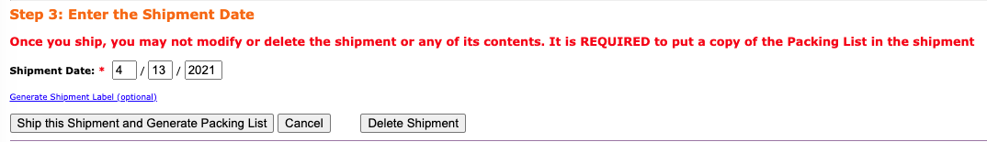

SWOG Specimen Tracking System
Site follows steps in SWOG Specimen Tracking (STS) to request re-analysis of commercial FoundationOne CDx results
Once “Ship this Shipment and Generate Packing List” is selected, the request has been completed and sent to FMI
  No need to physically mail or email anything

Slide 31
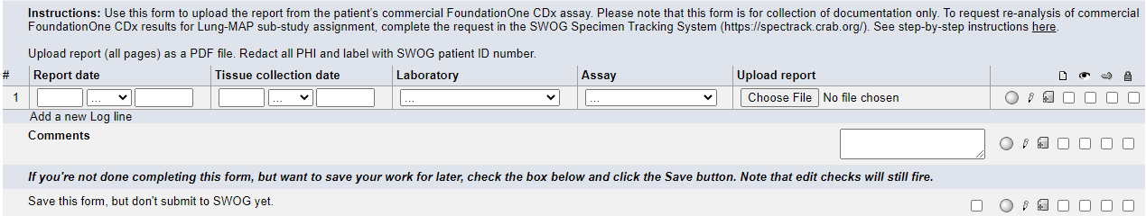
Commercial NGS Testing Form (Rave)
Site completes Rave form, uploading commercial report as documentation
Commercial NGS Testing folder will rollout in Rave based on registration question
Upload commercial FoundationOne CDx report to form
Source documentation only; upload does NOT request use of results for re-analysis and sub-study assignment

Slide 32
Receipt of Sub-study Assignment
SWOG SDMC receives file and alerts site of sub-study assignment (at progression)
Same process as tissue submissions
  Email to site contacts
  Added to Sub-study Assignment form in Rave
  No PDF reports will be attached as these are shared via commercial process
    Including any updates if they occur during re-analysis
Same timing as tissue submissions
  Patients screened at progression: Sub-study assignment expected within 16 days after submission of request
  Patients pre-screened prior to progression:
    Confirmation email sent when results successfully transferred to SWOG
    Sub-study assignment sent the next day after submission of Notice of Progression in Rave

Slide 33
Contact us!
Your friendly Lung-MAP Data Coordinators (Louise, Leah, and Amy) are here to help!
We would be happy to be on the phone with you while you go through this process for the first time
Better to ask questions ahead of time, rather than have to fix things after the fact (although we can usually help with that too)
Email: LungMAPquestion@crab.org
Phone: 206-652-2267

Slide 34





S1900E, A PHASE II STUDY OF AMG 510 IN PARTICIPANTS WITH PREVIOUSLY TREATED STAGE IV OR RECURRENT KRAS G12C MUTATED NON-SQUAMOUS NON-SMALL CELL LUNG CANCER
Sukhmani K. Padda MD, Cedars-Sinai Medical Center- Chair
David E. Gerber MD, UT Southwestern- Co-Chair
Notes:
SOTORASIB

Slide 35
Objectives
The drug- AMG 510 (Sotorasib)
The disease- KRAS G12C mutated non-squamous non-small cell lung cancer, focus on TP53 and STK11 co-mutated subsets
The study- S1900E substudy

Slide 36
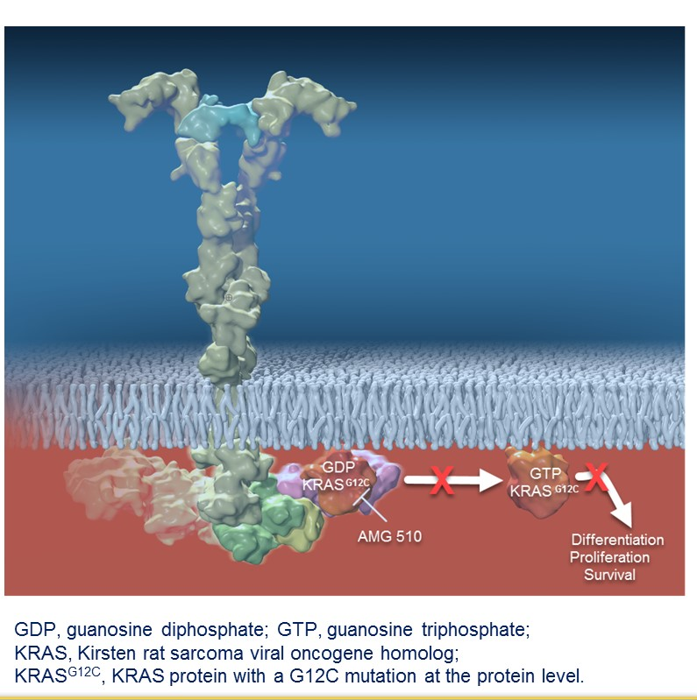
AMG 510 (Sotorasib) is a First in Class KRAS G12C Inhibitor
KRAS G12C mutation found in ~13% of lung cancer; 3% of colorectal cancer and appendix cancer; 1-3% of other solid tumors
AMG 510 is a novel, first in class, small molecule that specifically and irreversibly inhibits KRAS G12C by locking it in an inactive GDP-bound state
Fakih M et al. ASCO Annual Meeting 2019. Biernacka A et al. Cancer Genetic. 2016;209:195-198. Neumann J et al. Pathol Res Pract. 2009, 205:858-862. Zhou L et al. Med Oncol 2016;33:32.
Notes:
irreversibly binds to the cysteine amino acid that replaces glycine in mutant KRAS, keeping the protein locked in an inactive GDP-bound state. KRAS^{G12C} occurs in approximately 13% of patients with NSCLC

Slide 37
Sotorasib Phase 1 Clinical Trial Schema (CodeBreaK100)
Hong DS et al. N Engl J Med. 2020 Sep 24;383(13):1207-1217.

Slide 38
Sotorasib Phase 1 Safety Data in NSCLC
Recommended Dose: 960 mg daily
Hong DS et al. N Engl J Med. 2020 Sep 24;383(13):1207-1217.

Slide 39
Sotorasib Phase 1 Efficacy Data in NSCLC
Median DOR 10.9 mo (1.1+-13.6)
Median PFS 6.3 mo (0.0+-14.9)
Efficacy All / 960 mg dose
ORR 32.2% / 35.3%
DCR 88.1% / 91.2%
Hong DS et al. N Engl J Med. 2020 Sep 24;383(13):1207-1217.
Notes:
Almost 90% former smokers
All patients received prior platinum-doublet chemotherapy
90% patients received prior PD1/PD-L1 therapy
Median prior lines of therapy 3
1/3 brain metastases

Slide 40
Sotorasib Phase 2 Clinical Trial in NSCLC
Li B et al. IASLC WCLC 2020. Singapore Virtual
Notes:
80% of patients received 1 or 2 prior lines of therapy
81% prior chemo/PD-1
Data cutoff was December 1, 2020; median follow up time was 12.2 months

Slide 41
Sotorasib Phase 2 Efficacy Data in NSCLC
Median f/u 12.2 mo
Confirmed ORR 37.1% (95% CI 28.6, 46.2)
DCR 80.6% (95% CI 72.6, 87.2)
Median % best tumor shrinkage 60% (among responders)
Li B et al. IASLC WCLC 2020. Singapore Virtual
Notes:
126 patients enrolled

Slide 42
Sotorasib Phase 2 Efficacy Data in NSCLC
Median time to objective response 1.4 mo
Median DOR 10.0 mo (95% Cl 6.9, 11.1)
43% remain on treatment w/o progression
Median PFS 6.8 mo (95% CI 5.1, 8.2)
Li B et al. IASLC WCLC 2020. Singapore Virtual

Slide 43
Sotorasib Phase 2 Safety Data in NSCLC
Li B et al. IASLC WCLC 2020. Singapore Virtual

Slide 44
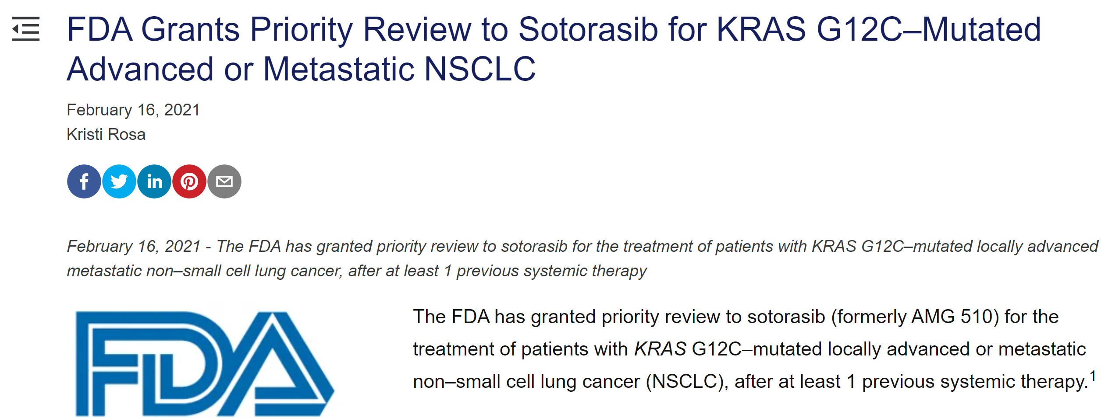
FDA grants priority review to sotorasib
Onclive https://www.onclive.com/view/fda-grants-priority-review-to-sotorasib-for-kras-g12c-mutated-advanced-or-metastatic-nsclc
Notes:
The decision was based on data from the phase 2 CodeBreaK 100 trial (NCT03600883), which showed that treatment with KRAS G12C inhibitor elicited a 6.8-month median progression-free survival (PFS) in patients with KRAS G12C–mutated NSCLC.²
Moreover, at a median follow-up of 12.2 months, sotorasib induced an objective response rate (ORR) of 37.1% (95% CI, 28.6%-46.2%) and a disease control rate (DCR) of 80.6% (95% CI, 72.6%-87.2%). The median duration of response (DOR) was 10 months.
The FDA is slated to make a decision on the agent by August 16, 2021 per the Prescription Drug User Fee Act; this is 4 months earlier than the standard review cycle, according to Amgen, the drug developer.
Confirmatory phase 3 CodeBreaK200 trial is currently enrolling (clincaltrials.gov identifier: NCT04303780)

Slide 45
Co-mutations are arising as potentially predictive markers in KRAS mutated NSCLC
Most common TP53, STK11, KEAP1
  Arbour et al (n=330): TP53 (42%), STK11 (29%), KEAP1 (24%)
  Scheffler et al (n=1078): TP53 (39%); (n=101 subset): STK11 (20%), KEAP1 (13%)
  Aredo et al (Stanford; KRAS^{G12C} mutation subtype): TP53 31% and STK11 27%
Preclinical– differences in signaling, immune features, metabolic programming
Prognostic
Potentially predictive with treatment (e.g. immunotherapy)
Clustering analysis of 776 cases of KRAS mutated NSCLC
Figure from Padda SK et al. JCO Precision Oncology 2021:5, 153-162
Arbour KC et al. Clin Cancer Res, 2018. 24(2): p. 334-340. Scheffler M et al. J Thorac Oncol, 2019. 14(4): p. 606-616. Aredo JV et al Lung Cancer, 2019. 133: p. 144-150. Chen Z et al. Nature. 2012 Mar 18;483(7391):613-7. Skoulidis F et al. Cancer Discovery. 2015 Aug 1;5(8):860-77.; Galan-Cobo et al. Cancer Res. 2019 Jul 1;79(13):3251-3267; Skoulidis F et al. Cancer Discov 2018
Notes:
The rates of co-mutations in KRAS mutant NSCLC have been described in several series. Arbour et al (n=330) reported co-mutations in TP53 (42%), STK11 (29%), KEAP1 (24%), RBM10 (16%), and PTPRD (15%). () Scheffler et al (n=1078) noted co-mutations in TP53 (39%), and in an additional subset analysis (n=101), identified co-mutations in STK11 (20%), KEAP1 (13%), and ATM (12%). () Aredo et al (Stanford cohort, n=186) reported co-mutations in TP53 (39%), STK11 (12%), KEAP1 (8%), NKX2.1 (8%) and ARID1A (7%). () Among patients harboring the KRAS^{G12C} mutation subtype, TP53 and STK11 co-mutations have been observed at frequencies of 31% and 27%, respectively (Stanford University data, n=189 participants, data not published).

Slide 46
KRAS G12C allosteric inhibitors efficacy across co-mutation subsets (sotorasib)
Li B et al. IASLC WCLC 2020. Singapore Virtual

Slide 47
KRAS G12C allosteric inhibitors efficacy across co-mutation subsets (adagrasib)
Riley G et al. ELCC 2021.

Slide 48
S1900E Schema
KRAS^{G12C}/TP53^{MUT}
Target N=40
AMG 510
960 mg QD
S1900E Substudy
Recurrent or metastatic KRAS^{G12C} mutated non-squamous NSCLC
Received at least one prior systemic therapy
No uncontrolled brain metastasis
KRAS^{G12C}/STK11^{MUT}
Target N=25
AMG 510
960 mg QD
End of Treatment
Enrollment
KRAS^{G12C}/Other ª
Target N=40
AMG 510
960 mg QD
Primary Endpoint
Objective response rate
Secondary Endpoints
Duration of response
Progression free survival
Overall survival
Safety
Treatment Period
until disease progression, intolerance, or consent withdrawal
Clinic visits/labs every 3 weeks
Imaging every 6 weeks
If Progression
Liquid biopsy to determine resistance mechanism
ªother co-mutations (e.g., KEAP1, NFE2L2, CUL3), double or triple co-mutations (e.g., STK11/TP53, STK11/TP53/KEAP1), or no co-mutations
Notes:
Cohort 1 (co-mutation with TP53): Presence of TP53 mutations AND Wild Type STK11, Wild Type KEAP1, Wild Type NFE2L2, AND Wild Type CUL3.
Cohort 2 (co-mutation with STK11): Presence of STK11 co-mutations AND Wild Type TP53, Wild Type KEAP1, Wild Type NFE2L2, AND Wild Type CUL3.
Cohort 3 (all others): All participants not eligible for Cohorts 1 and 2 will be included in Cohort 3. Note that this includes participants with dual co-mutations in STK11 and TP53; co-mutations in KEAP1, NFE2L2, CUL3, or others; or lack of any co-mutations.

Slide 49
Statistics/Primary endpoint: Objective response rate
 | Estimated percentage of study population | Stage 1 | Stage 2 | Accrual Time
Cohort 1 (TP53) | 42% | 20 3 responses* | 40 10 responses† | 1-2 years
Cohort 2 (STK11) | 18% | 15 2 responses* | 25 7 responses‡ | 1.5-3 years
Cohort 3 (all others) | 40% | 20 3 responses* | 40 10 responses† | 1-2 years
*Responses required to proceed to stage 2.
†Cohort 1/3: 90% power to rule out 14% response rate at 5% 1 sided type 1 error if true response rate at least 34%
‡Cohort 2: 90% power to rule out 14% response rate at 5% 1-sided type 1 error if true response rate at least 40%.
Biostatistics:
Mary Redman, Ph.D.
SWOG Statistic & Data Management Center
Notes:
Cohort 1/3: If accrual were to proceed to the full 40 eligible participants, then the observation that at least 10 participants had a response to AMG 510 would be considered evidence to rule out a response rate of 14% or smaller. This is based on a 2-stage design with 90% power to rule out a 14% response rate at the 5% 1-sided type I error if the true rate were at least 34%.
Cohort 2: If accrual were to proceed to the full 25 eligible participants, then the observation that at least 7 participants with a response to AMG 510 would be considered evidence to rule out a response rate of 14% or smaller. This is based on a 2-stage design with 90% power to rule out a 14% response rate at the 5% 1-sided type I error if the true rate were at least 40%.
Accrual will be placed on a temporary hold if the following occurs:
The 20 interim analysis participants have had data submitted for their second scheduled disease assessment or 25 eligible participants have been registered (whichever occurs first), and elss than 3 responses have been reported.
Docetaxel 2L studies → Docetaxel/ramucirumab but majority around 10%
Using the FoundationOne CDx data from participants screened on LUNGMAP starting in January 2019, of participants with non-squamous NSCLC with full biomarker results reported to SWOG (n=*** _), 40.4% had KRAS mutation detected in their tumor and of them, 42.9% (n=85) had the G12C alteration for a biomarker eligibility rate to the study of 17.4% (among non-squamous). The frequency of G12C alteration is in line with previously published results. (, , ) It is further estimated that of these participants, 42% will be assigned to the TP53 cohort (Cohort 1), 18% to the STK11 cohort (Cohort 2), and the remaining 40% to Cohort 3 (other). The frequencies of TP53 and STK11 co-mutations noted in LUNGMAP screening are lower than previously published results. (, ) Given the current sub-study accrual to Lung-MAP, the study team estimates the average monthly accrual rate to the study (all cohorts combined) would be 3-5 participants per month (36-60/year).
As previously mentioned in Section 2.1, KRAS mutations are the most common driver mutation (25%) observed in non-squamous non-small cell lung cancer. In addition, KRAS^{G12C} are the most common subtype (35-45%; TP53 39-42% and STK11 19-29%). The aforementioned Lung-MAP screening rates of KRAS^{G12C} co-mutated with STK11, TP53, and other are also noted in Section 2.1. Janne, P.A., et al., Impact of KRAS codon subtypes from a randomised phase II trial of selumetinib plus docetaxel in KRAS mutant advanced non-small-cell lung cancer. Br J Cancer, 2015. 113(2): p. 199-203.
Arbour, K.C., et al., Effects of Co-occurring Genomic Alterations on Outcomes in Participants with KRAS-Mutant Non-Small Cell Lung Cancer. Clin Cancer Res, 2018. 24(2): p. 334-340.
Aredo, J.V., et al., Impact of KRAS mutation subtype and concurrent pathogenic mutations on non-small cell lung cancer outcomes. Lung Cancer, 2019. 133: p. 144-150.
Sholl, L.M., et al., Multi-institutional Oncogenic Driver Mutation Analysis in Lung Adenocarcinoma: The Lung Cancer Mutation Consortium Experience. J Thorac Oncol, 2015. 10(5): p. 768-777.
Comprehensive molecular profiling of lung adenocarcinoma. Nature, 2014. 511(7511): p. 543-50.

Slide 50
LungMAP Team
Suresh Ramalingam, ECOG-ACRIN Lung Committee Chair
Mary Redman, Lead Biostatistician
Katie Minichiello, Biostatistician
Judy Johnson, Patient Advocate
Louise Highleyman, Data Coordinator
Leah Everhart, Data Coordinator
Arthur Lee, Clinical Research Project Manager (CRAB)
Mariah Norman, Project Manager & Protocol Coordinator (SWOG)
Laura Gildner, Project Manager & Protocol Coordinator (SWOG)
Stacey Adam, Scientific Program Manager (FNIH)
Amrin Chowdhury, Project Manager (FNIH)
Chris Pustulka, Budget Analyst
Amgen Inc.
Foundation Medicine Inc.

Slide 51
S1900E OPEN & AVAILABLE TO YOUR PATIENTS!

Slide 52
S1800D, A Phase II/III Study of N-803 plus Pembrolizumab versus Standard of Care in Participants with Stage IV or Recurrent Non-Small Cell Lung Cancer Previously Treated with Anti-PD-1 or Anti-PD-L1 Therapy (Lung-MAP Non-Match Sub-Study)
Study Chairs: John Wrangle, MD and Hatim Husain, MD

Slide 53
S1800D
Evaluate if N-803 combined with Pembrolizumab can overcome resistance to prior anti-PD-(L)1 therapy
Enrollment into 2 cohorts: Primary versus acquired resistance
Primary Endpoint (both cohorts): Overall Survival
Design:
  Primary Resistance: Stand-alone randomized Phase II
  Acquired Resistance: Phase II/III

Slide 54

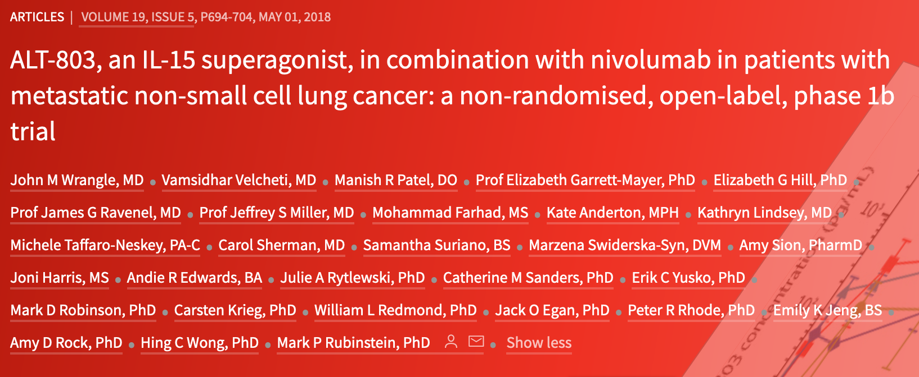

Slide 55

IL-15 Cytokine Super-agonist Structure
N-803
IL-15N72D
IL-15 N72D mutation enhances binding to IL-2Rb
IL-15Rα
Allows transpresentation selectively to only IL-2Rβγ chain and dramatically increases activity over native IL-15
IgG1 Fc
Increases half-life and lymphoid recycling and distribution
CD8⁺ and NK Cell expansion with CD4⁺ Sparing

Slide 56
Example of Durable Response after Chemoimmunotherapy Failure
65 year old female former smoker
PD-L1 70%, KRAS G12C
1st line Carboplatin + Pemetrexed + Pembrolizumab yielding ~40% response, ~5 month before progression
N-803 Started
3/14/18
-71%, ongoing response @ >30 months

Slide 57
Best response among CPI Relapsed and Refractory Patients Going on to Receive N-803 + PD1 mAb
- Refractory to PD-1 CPI
- Relapsed on PD-1 CPI

Slide 58
Safety of N-803 + anti-PD1 mAb
Common Adverse Events
AE Name (Grade) | 1 | 2 | 3 | 4 | Total (%)
Injection site reaction | 18 | 21 | 0 | 0 | 39 (70%)
Fatigue | 19 | 8 | 4 | 0 | 31 (55%)
Flu like symptoms | 22 | 2 | 0 | 0 | 24 (43%)
Fever | 11 | 9 | 1 | 0 | 21 (38%)
Nausea | 11 | 2 | 0 | 0 | 13 (23%)
Anorexia | 9 | 4 | 0 | 0 | 13 (23%)
Chills | 12 | 0 | 0 | 0 | 12 (21%)
Serious Possible or Definitely Related Adverse Events
AE Name (Grade) | 1 | 2 | 3 | 4 | TOTAL (%)
Fatigue | 0 | 0 | 4 | 0 | 4 (7%)
Other Lymphocyte Count Decreased | 0 | 0 | 2 | 0 | 2 (4%)
Anemia | 0 | 0 | 1 | 0 | 1 (2%)
Other Anemia | 0 | 0 | 1 | 0 | 1 (2%)
Myocardial infarction | 0 | 0 | 1 | 0 | 1 (2%)
Abdominal pain | 0 | 0 | 1 | 0 | 1 (2%)
Fever | 0 | 0 | 1 | 0 | 1 (2%)
Other Lymphocyte Count Decreased | 0 | 0 | 1 | 0 | 1 (2%)
Lung infection | 0 | 0 | 1 | 0 | 1 (2%)
Other Sepsis | 0 | 0 | 0 | 1 | 1 (2%)
Alkaline phosphatase increased | 0 | 0 | 1 | 0 | 1 (2%)
Ast increased | 0 | 0 | 1 | 0 | 1 (2%)
Lipase increased | 0 | 0 | 1 | 0 | 1 (2%)
Other Back Pain | 0 | 0 | 1 | 0 | 1 (2%)
Dizziness | 0 | 0 | 1 | 0 | 1 (2%)
Other Encephalopathy | 0 | 0 | 1 | 0 | 1 (2%)
Confusion | 1 | 0 | 0 | 0 | 1 (2%)
Depression | 0 | 0 | 1 | 0 | 1 (2%)
Other Actue Hypoxic Respiratory Failure | 0 | 0 | 0 | 1 | 1 (2%)
Other Cough | 0 | 0 | 1 | 0 | 1 (2%)

Slide 59
Study Design
Prior Anti-PD-(L)1 and
disease progression
PD on prior treatment
≤ 12 weeks
PD on prior treatment > 12 weeks
Primary Resistance
Cohort
Acquired Resistance
Cohort
Stand-alone Phase II
Phase II/III
N = 130
N = 300
N-803+Pembrolizumab
Standard of Care
N-803+Pembrolizumab
Standard of Care
Primary Endpoint: Overall Survival
Comparison: Weighted Log-rank test
Minimum Follow-up requirements for all analyses (interim and final)
Primary Endpoint: Overall Survival
Comparison: Standard Log-rank test
Minimum Follow-up requirements for all analyses (interim and final)
Standard of Care: Docetaxel/Ramuciramab, Docetaxel, Gemcitabine, Pemetrexed

Slide 60
Publications Fall 2020 – Spring 2021
S1400G:
  A Phase II Study of BMN673 (talazoparib) for Previously-Treated Patients with Homologous Recombinant Repair Deficiency Positive STAGE IV Squamous Cell Lung Cancer
  SCs: Taofeek Owonikoko (ECOG), Lauren Byers (SWOG); Stats: Miao, Minichiello, Redman; DCs: Highleyman
  PCs: Norman, Gildner;
  Published: Clin Lung Cancer. January 10, 2021
S1400K
  A Phase II Study of ABBV-399 in Patients with c-MET positive STAGE IV Squamous Cell Lung Cancer (LUNG-MAP SUB-STUDY)
  SCs: Saiama Waqar (NRG), Susanne Arnold (SWOG); Stats: Minichiello, Miao, Redman; DC: Highleyman; PC: Norman, Gildner
  Published: Clin Lung Cancer. October 14, 2020
S1400F
  A Phase II Study of Durvalumab Plus Tremelimumab as Therapy for Patients with Previously-Treated Anti-PD-1/PD-L1 Resistant Stage IV Squamous Cell Lung Cancer
  SCs: Natasha Leighl (CCTG), Naiyer Rizvi (SWOG); Stats: Minichiello, Redman; DC: Highleyman; PC: Norman, Gildner
  Submitted to JTO 04/14/21
S1400I
  A Phase III Study of Nivolumab and Ipilimumab VERSUS Nivolumab for Previously-Treated Checkpoint-inhibitor-naive Patients with STAGE IV Squamous Cell Lung Cancer
  SCs: Scott Gettinger (SWOG), Lyudmila A. Bazhenova (Alliance); Stats: Redman, Miao, Minichiello; DC: Highleyman; PC: Norman, Gildner
  Resubmitted to JAMA Oncology 04/15/21
S1400GEN
  Attitudes, Knowledge, and Expectations Related to Return of Genomic Results (LUNG-MAP ANCILLARY STUDY)
  SCs: Josh Roth, Scott Ramsey; Stats: Unger, Minichiello, Miao
  Published: JCO Oncology Practice 04/02/21
S1400
  Biomarker-driven therapies for previously treated squamous non-small-cell lung cancer (Lung-MAP SWOG S1400): a biomarker-driven master protocol.
  Redman MW, Papadimitrakopoulou VA, Minichiello K, Hirsch FR, Mack PC, Schwartz LH, Vokes E, Ramalingam S, Leighl N, Bradley J, Miao J, Moon J, Highleyman L, Miwa C, LeBlanc ML, Malik S, Miller VA, Sigal EV, Adam S, Wholley D, Sigman C, Smolich B, Blanke CD, Kelly K, Gandara DR, Herbst RS.
  Published: Lancet Oncol. October 27, 2020.

Slide 61
Translational Medicine/Scientific Leadership Committee
David Kozono
April 21, 2021

Slide 62
Purpose
Bring together expertise in translational medicine
Assist in biomarker selection and definitions and sample collection decisions for sub-studies under development
Review proposals for prospective and retrospective translational research
Assist in analysis and publication of sequencing and other correlative science data

Slide 63
Members/attendees
Lung-MAP
  Hoss Borghaei, Jeff Bradley, Afshin Dowlati, Konstantin Dragnev, Marty Edelman, David Gandara, Roy Herbst, Fred Hirsch, Leora Horn, Karen Kelly, Phil Mack, Joel Neal, Jyoti Patel, James Rae, Suresh Ramalingam, Tom Stinchcombe, Saiama Waqar, Ignacio Wistuba
  Xing Hua, Katie Minichiello, Mary Redman, Mike Wu (Stats)
  Stacey Adam, Amrin Chowdhury (FNIH), Mariah Norman (SWOG)
  David Kozono (Chair, 2020-)
FMI: Lindsay Chan, Jennifer Mills, Lynn Sullivan, Khaled Tolba, Jeff Venstrom
Nationwide/Biobank: Erin Grundy, Yvonne Moyer, Nilsa Ramirez, Kae Tegtmeier

Slide 64
Areas of expertise
Therapeutics
  Immuno-Oncology
  Targeted therapies
  DNA repair
  Anti-angiogenic therapy
Biospecimen banking and processing
Pathology
Clinical genomics

Slide 65
Making the most of TM resources
Slides stained by FMI including most PD-L1 stained slides and some H&E-stained slides (if FMI did not receive an H&E slide from site and did the H&E staining themselves)
  1-2 slides per tissue submission
  Currently 15-20 slide boxes which have ~800 slides
Residual extracted DNA from ctDNA submissions
  ~500 samples of residual extracted DNA from ctDNA submissions
Digital images of H+E and PD-L1 slides
  FMI-stained H&E and PD-L1 slides are stored on an Aperio imaging system

Slide 66
TM proposals
To utilize patient specimens gathered on Lung-MAP clinical trials to improve outcomes based on specified laboratory criteria
TM ideas may be proposed by companies, study chairs, or Lung-MAP collaborators (i.e., Foundation Medicine)

Slide 67
TM review checklist
How will this lead to new important scientific information that will directly impact patients, or indirectly by leading to future clinical trials?
Does this TM fit appropriately within the Lung-MAP platform and the priority of other Lung-MAP TMs?
Is there sufficient background data and justification for this TM?
Specimen Availability
  Is there a sufficient quantity of samples for the science to be conducted?
  If serial samples, will a patient be excluded if they are missing any samples?
  If retrospective analysis linked to outcome data, is the primary manuscript published or soon to be published in order to access samples?
If adding post-activation, will retrospective submissions be requested?
Will results be provided to treating investigator and patient?
  If yes, how and when?

Slide 68
TMB by NGS in S1400I and A (lead: Hirsch)
Oral presentation at WCLC
Higher TMB associated significantly with OS and PFS across two IO studies and was independent of PD-L1 status
Continuous TMB variable analyses was more informative than cutoff categories
Combination of TMB and PD-L1 expression impacted outcomes in S1400I
How genetic alterations associated with high TMB contribute to clinical outcomes warrants further considerations

Slide 69
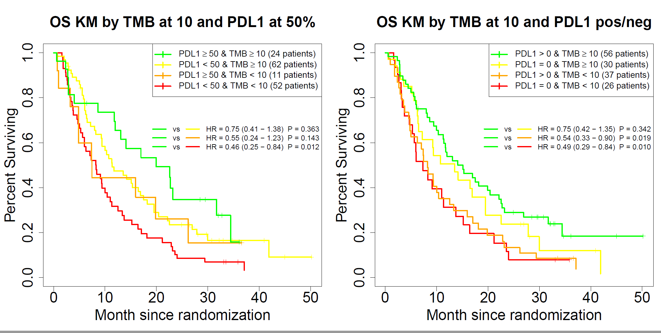
Combining PD-L1 and TMB analysis: patients high in both outperformed all other groups

Slide 70
S1400 NGS analysis (lead: Kozono)
Mini-oral presentation at WCLC
Largest NGS dataset of advanced squamous cell lung cancers of previously treated patients, although limited to genes sequenced on FoundationOne T5
Mutual exclusivity of PARP4 and NFE2L2 or KEAP1 alterations suggests that PARP4 may have a role in a pathway known to impact responses to oxidative stress and treatment resistance

Slide 71
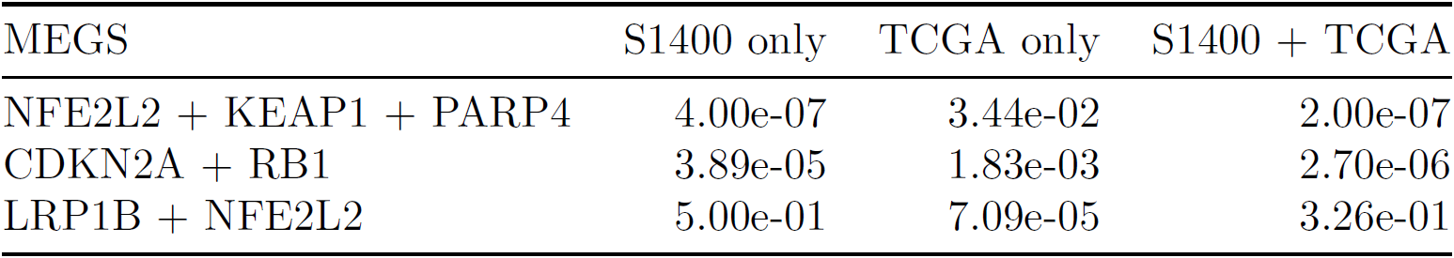
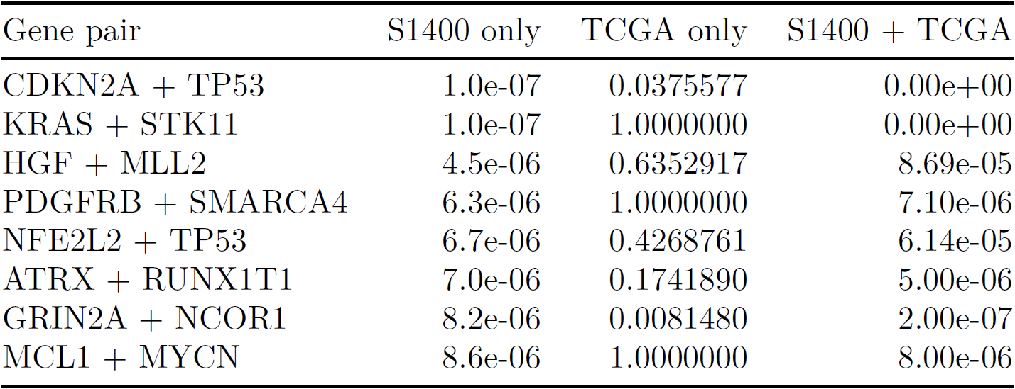
Mutual exclusivity and co-occurrence
P values
S1400 showed novel mutual exclusivity of PARP4, KEAP1 and NFE2L2 alterations
KEAP1
NFE2L2
PARP4
S1400
(n=1672)
TCGA
(n=495)
S1400 showed several novel pairs of co-occurring gene alterations
TP53
CDKN2A
S1400
(n=1672)
TCGA
(n=495)

Slide 72
ctDNA vs. tissue NGS (lead: Mack)
Mini-oral presentation at WCLC
Driver mutations, expected to be present in all cell lineages, had high fidelity between plasma and tissue
  Sensitivity of 83% consistent with ctDNA detection rates
For non-driver alterations, additional variants were detected exclusively in plasma or tissue
  Reflective of tissue heterogeneity
Findings support the planned use of ctDNA for enrollment onto LUNGMAP sub-studies, with a positive finding meriting inclusion in study but a negative finding, considered inconclusive

Slide 73
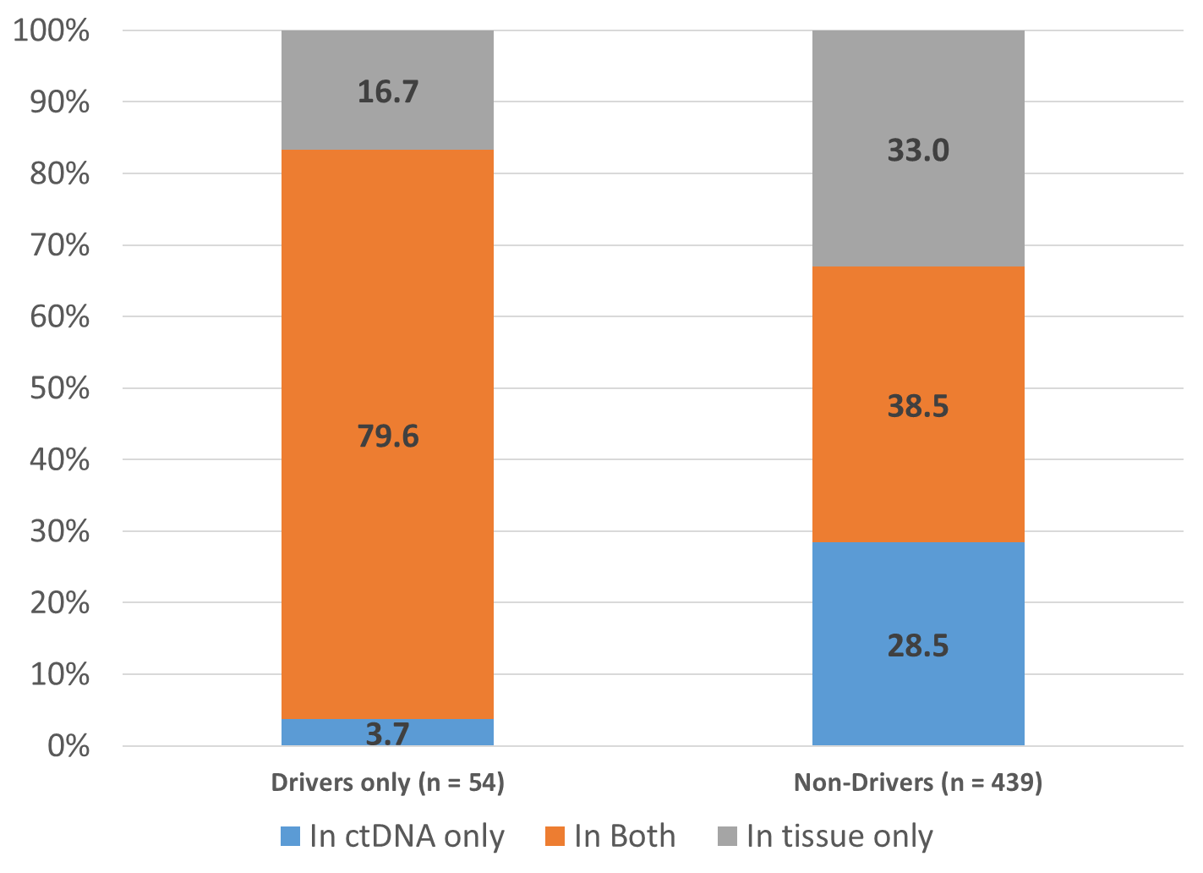
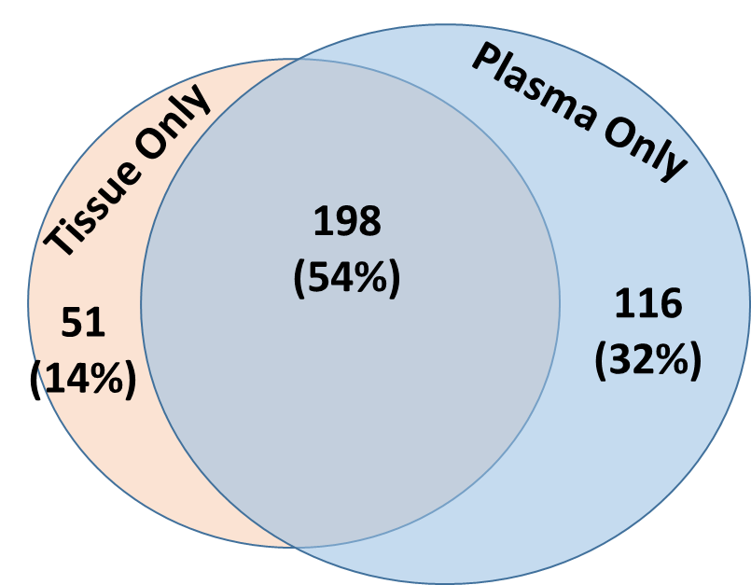
LungMAP tissue-ctDNA concordance studies
All short variants
Short variants (mostly point mutations) showed the most fidelity, with over twice as many unique to plasma compared to tissue

Slide 74
Drug Selection Committee
Contacts
Purpose
Hossein Borghaei (hossein.borghaei@fccc.edu)
Beverly Smolich (bsmolich@ccsainc.com)
Amrin Chowdhury (achowdhury@fnih.org)
Stacey Adam (sadam@fnih.org)
Introduction of new sub-study ideas
Facilitating discussion regarding proposals
Review and approval of formal sub-study applications
Members:
Senior Leadership of Lung-MAP, Investigators, Industry Consultants, NCI

Slide 75
Key Aspects of Drug Selection
Sources
  Investigators/Drug Selection Committee Initiated
  Pharmaceutical company initiated
Initial Qualification
  Investigational drug/biomarker combination with preclinical & clinical data supporting safety & potential efficacy as a targeted therapy or “non-match” therapy in advanced/metastatic non small cell lung cancer regardless of histology.
  Ready or near ready to enter the Lung-MAP phase 2 clinical protocol
Candidates are evaluated by the Lung-MAP Drug Selection Committee (DSC), comprised of:
  Key investigators & clinical researchers
  Biomarker & molecular target experts from academia, NCI & FDA
  Non-conflicted industry-based drug developers
Candidates are scored based on:
  Target appropriateness for Lung-MAP
  Drug/Biomarker preclinical & clinical data
  PK/PD data

Slide 76
Lung-MAP Drug Selection Process
Suggestions for sub-studies can come from Lung-MAP PIs, outside investigators, or pharma
Initial discussions are internal with a small group of PIs, followed by informal presentation from investigator/pharma to internal drug selection committee
Next step is decision to proceed to full Drug Selection Committee (DSC)
  Completion of Drug Selection application, summarizing preclinical and PK/PD data, prior human experience and safety profile, especially in lung cancer, and status of assay if proposed sub-study includes biomarker selection
  DSC presentation by investigator/pharma, Q&A, and committee closed session discussion
Formal voting process by DSC members; 6 criteria for evaluation, each scored on 1-9 scale
  Target/target appropriateness to NSCLC; Drug/biomarker understanding; Preclinical data; PK/PD; Toxicity; Clinical data
PIs have final decision if vote is close or issues are brought up
Acceptance/deferral letters sent to pharma
Upon acceptance, kick-off call and regular teleconferences are set up with FNIH and SWOG Operations, for concept/protocol development, including regulatory aspects and FDA requirements, confirmation of drug supply, and contractual agreements

Slide 77
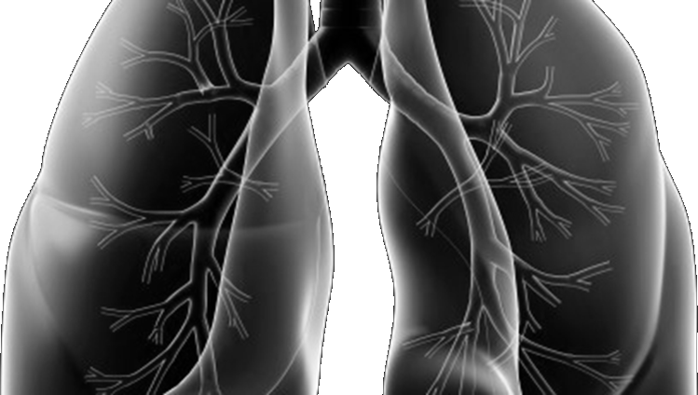

Lung-MAP
Protocol Development Process
Mariah Norman
Lung-MAP Project Manager & Protocol Coordinator
SWOG Operations Office
April 21, 2021

Slide 78
Steps for Adding a New Sub-study
Selection by Drug Selection Committee (DSC)
Concept development
    Biomarker selection & definition
    CTEP concept review
Protocol development
    Drafts reviewed by study team, company, Site Coordinators Committee, & Patient Advocate
    Budgets and contracts development & review
CTEP/CIRB protocol review
    CTEP protocol review
    FDA review (in parallel w/ CTEP review)
    CIRB protocol review
    Final CTEP approval of the study
Study Activation for Patient Enrollment

Slide 79
Accomplishments Along the Way
Since June 2014
20 concepts developed
15 studies activated
13 studies completed
Worked with over 12 companies

Slide 80
High-Level Overview of Sub-Study Development
Drug selection
Concept development
Biomarker selection & definition
CTEP reviews concept
Protocol development
CTEP
CIRB
CTEP approval
Activation
NCI OEWG CLOCK STARTS
on date of concept review
FDA review
Drug at PMB
Prelim talks on TM
Draft TM
Leadership review
Incorporate TM into study
Draft budget
Collect budget items & scope of work
Leadership review
Contract/budgets executed
Draft contract
Redline discussions
Final sign off
Contract execution
Biomarker kick-off call
Reporting prospective & retrospective biomarkers
Programming
Electronic Data Collection (Forms) Design and Development (Draft)
User Acceptance testing
Finalize EDC Forms

Slide 81

Contact Us
Site Coordinators Committee
  LUNGMAPSCC@crab.org
General Protocol & Regulatory Questions
  mnorman@swog.org
  lgildner@swog.org
  Eligibility/Specimen/Data Submission Questions
  LUNGMAPQuestion@crab.org
  General Medical Questions
  LUNGMAP@swog.org
  Funding Questions
  Funding@swog.org
  Patient Advocate, Judy Johnson
  judyjohnson.519@gmail.com
  Sub-Study Medical Questions
  S1800AMedicalQuery@swog.org
  S1900CMedicalQuery@swog.org
  S1900BMedicalQuery@swog.org
  S1900EMedicalQuery@swog.org
  Central Monitoring Questions
  centralmonitorquestion@crab.org
  QA Auditing Questions
  qamail@swog.org

Slide 82
Closing Announcements & General Q & A Session
Please place your questions in the chat box and a team member will read it out loud for the study team to answer
David Gandara, MD, LunGMAP Co-CHair
All Attendees

